Slide 1
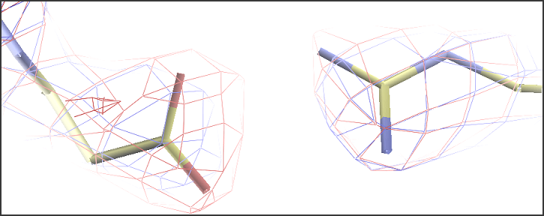
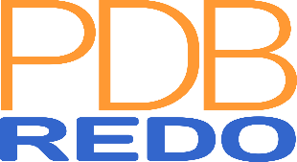
How good is my model?
And can it be improved?
Robbie P. Joosten
Netherlands Cancer Institute
CCP4-Diamond school 2018

Slide 2
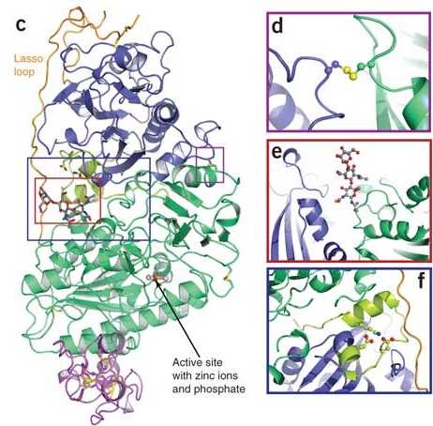
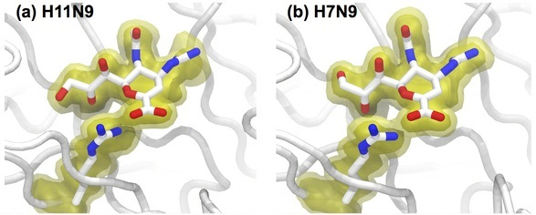
We want to know...
What are a protein’s function and mechanism?
How can we manipulate them?
We need the best possible model to answer these questions

Slide 3
Is my model as good as it can be?
Use validation when making the model
  Check model vs. data and vs. prior knowledge
  Focus on outliers (fix or explain them)
  Know the things that can go wrong
Optimise the model
  Focus on what can be improved
  Choose best refinement parameters and restraints
  Rebuild parts of the model
  PDB-REDO automates this

Slide 4
Validation

Slide 5




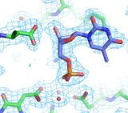
Need to know
Check the validity and value of a model
  Accuracy and precision
Many different software tools
  General: WHAT_CHECK, MolProbity, PDB validation server
  Special purpose: PDB-care, CheckMyMetal, Privateer etc.
  Tools may check the same things differently
Not a substitute for common sense
  False positives do occur
  Conflicting results
  Not all problems are detected (explicitly)

Slide 6
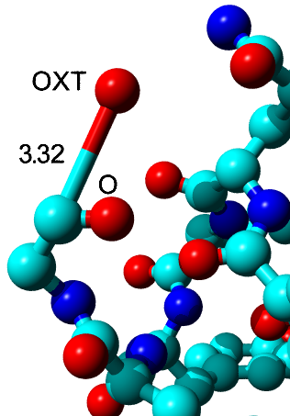
Bonds and angles
Individual outliers
  Usually fitting errors
  Express deviation in terms of SD (Z-scores)
  Example: Z = 105
Large overall deviations from ideal values
  Express as rmsZ, not rmsd
    Should be < 1.000
  Use tighter restraints

Slide 7
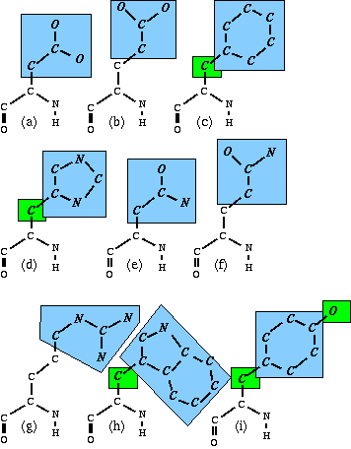
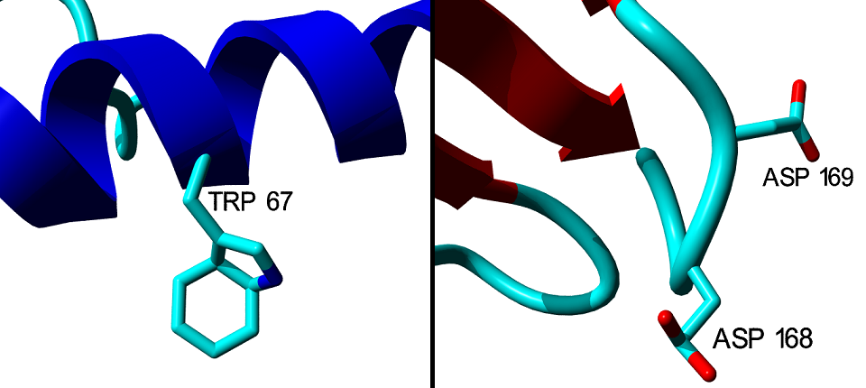
Planar groups
9 side chains have planar groups
Outliers indicate fitting errors or too loose restraints
37σ deviation
64σ deviation

Slide 8
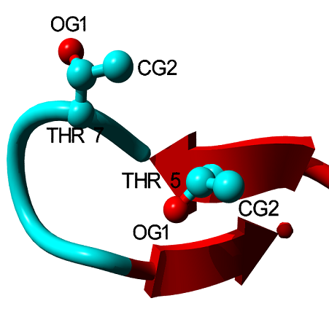
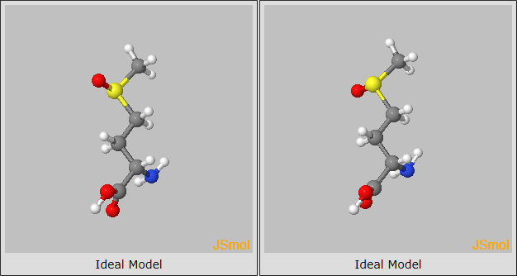
Chirality
Different chirality, different compounds
  Know what to expect

Slide 9
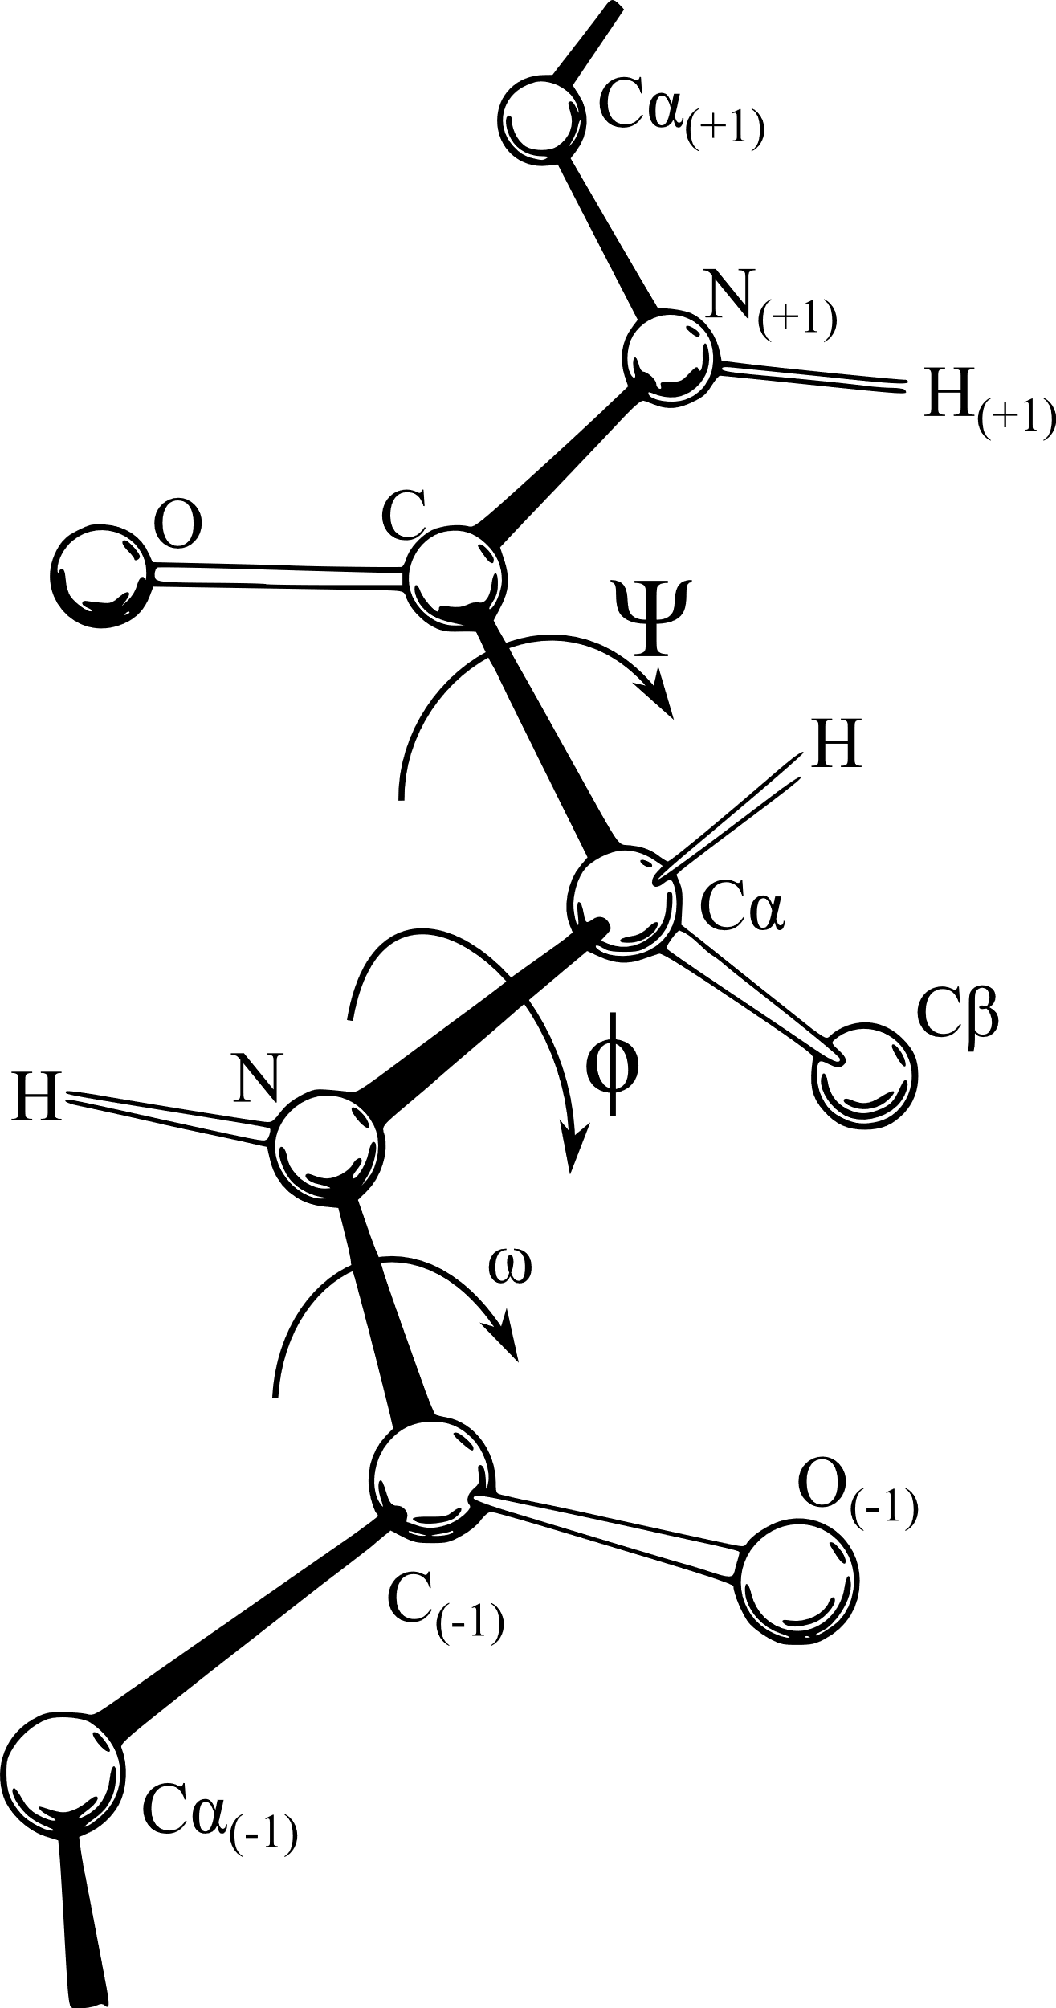
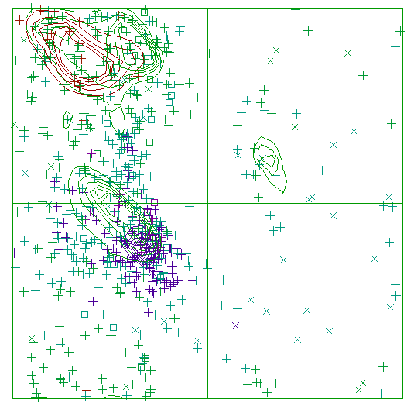
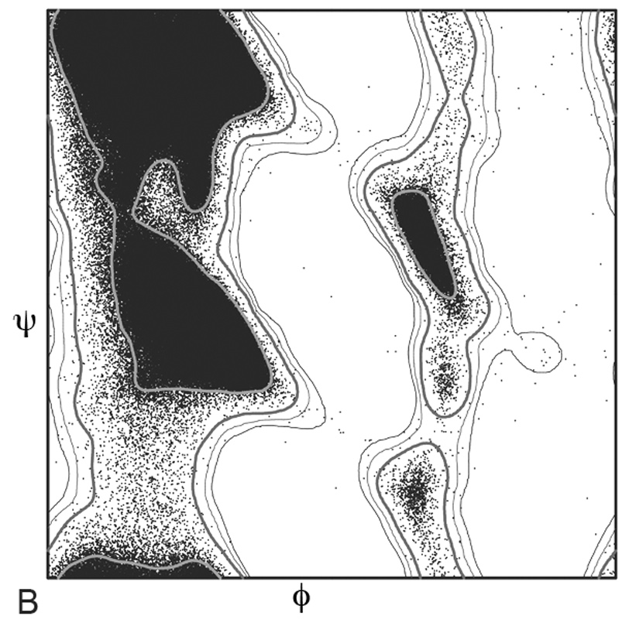
Backbone torsion angles
Ramachandran plot
  φ and ψ angles
  Compare to the whole PDB or a subset
Different implementations
  MolProbity and COOT: preferred, okay, outlier
    Good for finding specific problems
  WHAT_CHECK: overall Z-score
    Good for checking building and refinement progress

Slide 10
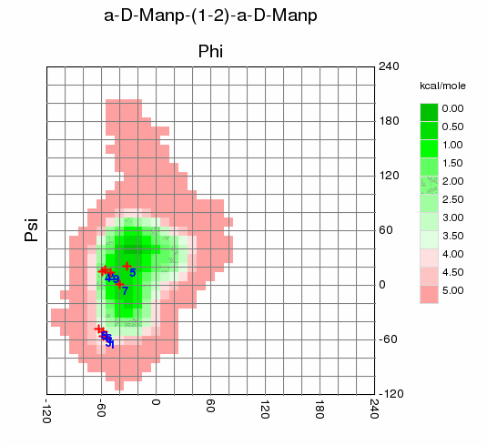
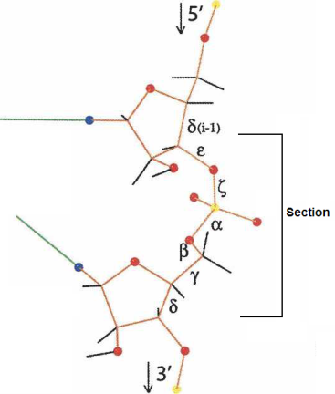
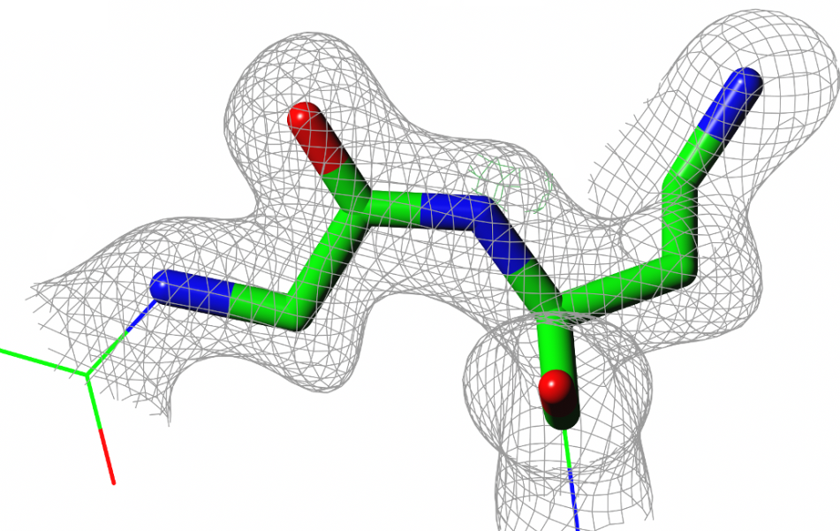
Backbone torsion angles
Peptides are flat
  ω angle is ~180° (trans) or ~0° (cis)
  Fitting errors or the wrong restraints cause outliers
Ramachandran-like validation for non-proteins
  RNA in MolProbity
    46+7 backbone conformers
  Sugars in CARP
    sugar-sugar bond specific

Slide 11
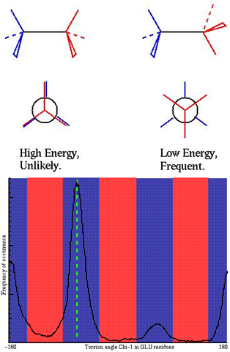
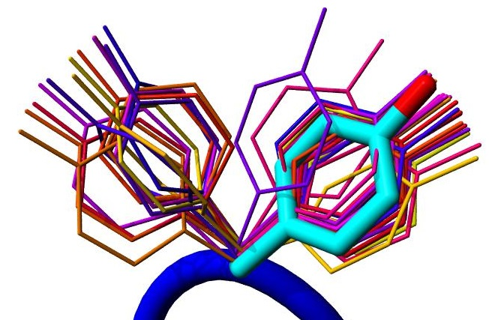
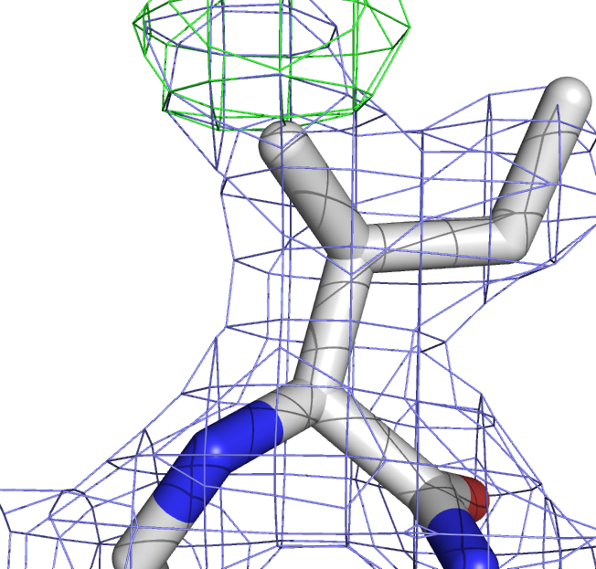
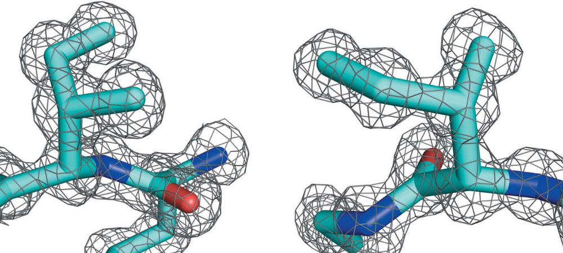
Side chain torsion angles
Steric hindrance causes discrete rotamers
Check against (backbone specific) distributions from the PDB
Outliers are fitting errors or false positives

Slide 12
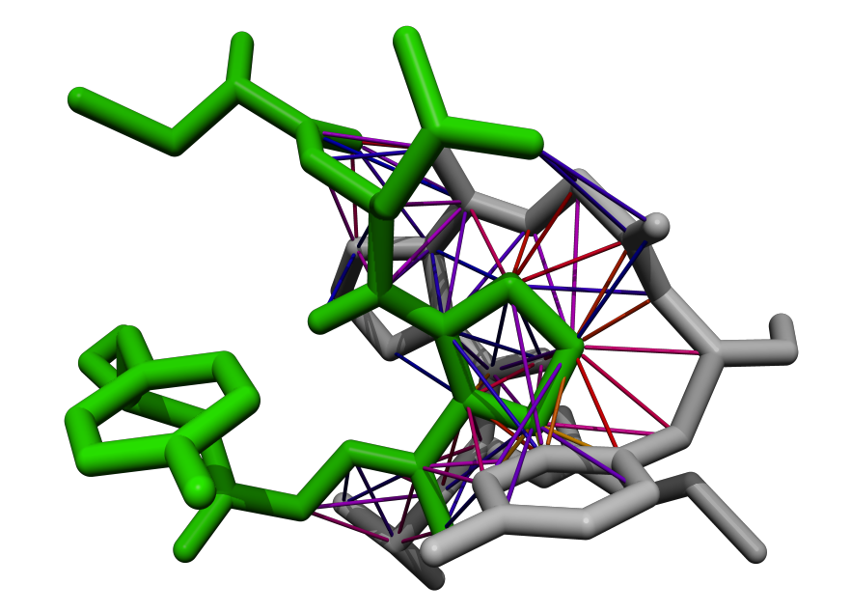
Bumps
Two atoms cannot occupy the same space
Average PDB file > 100 bumps
Bumps vary in severity
  Mild bumps can be fixed by refinement
  Severe bumps typically require rebuilding
Don’t forget about symmetry
Normal contact Mild bump Severe bump

Slide 13
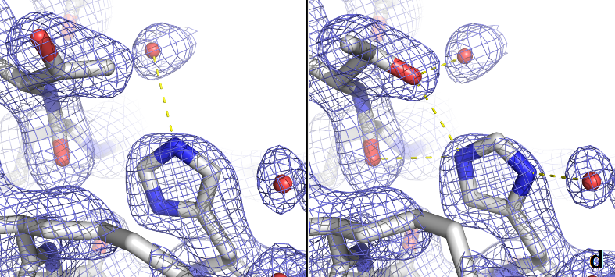
Hydrogen bonds
Asn, Gln, and His flips
  Detected by WHAT_CHECK, MolProbity & COOT
  Also use common sense
Buried unsatisfied H-bond donors and acceptors mark (subtle) errors
Waters should also make H-bonds
  3b3q has > 250 waters without H-bonds

Slide 14
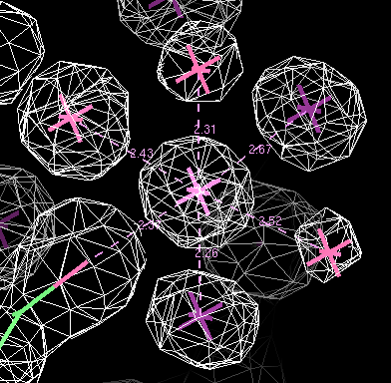
Metal ions
Metal ions are easily overlooked
  Water, Na+, and Mg++ have same number of electrons
Detect with COOT, Phenix, CheckMyMetal, and WHAT_CHECK
  All use the Bond Valence method
  Depends on coordination distances
  Very different results
  Remember your crystallisation conditions
  Anomalous signal may help as well

Slide 15
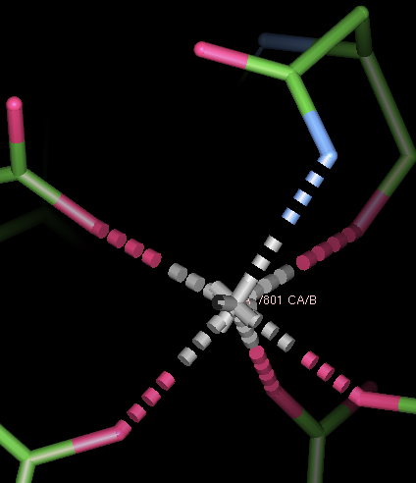
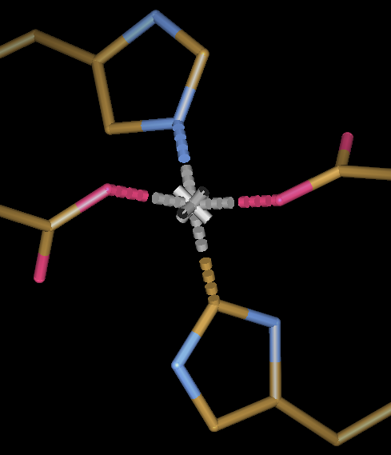
Metal ions
Na, Mg, K, Ca prefer being coordinated by oxygen atoms
  Flip Asn or Gln side chains if needed
Carbons usually do not coordinate metals
  Flip His side chains id needed
  Cyanide and carbon-monoxide are exceptions
Notes:
pdb1hfe.ent:LINK CE1 HIS S 82 ZN ZN S 500

Slide 16
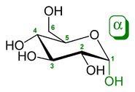
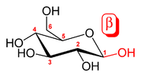
Sugars are complicated
Small differences matter for biology/biochemistry
Maps are often difficult to interpret
Coordinates and residue name must match sugar identity
  Or your refinement will go wrong
Bonds between sugars are common
  ‘Always’ from C1 to an oxygen (O1 is lost)
  Original position of the O1 describes the linkage type (α or β)

Slide 17
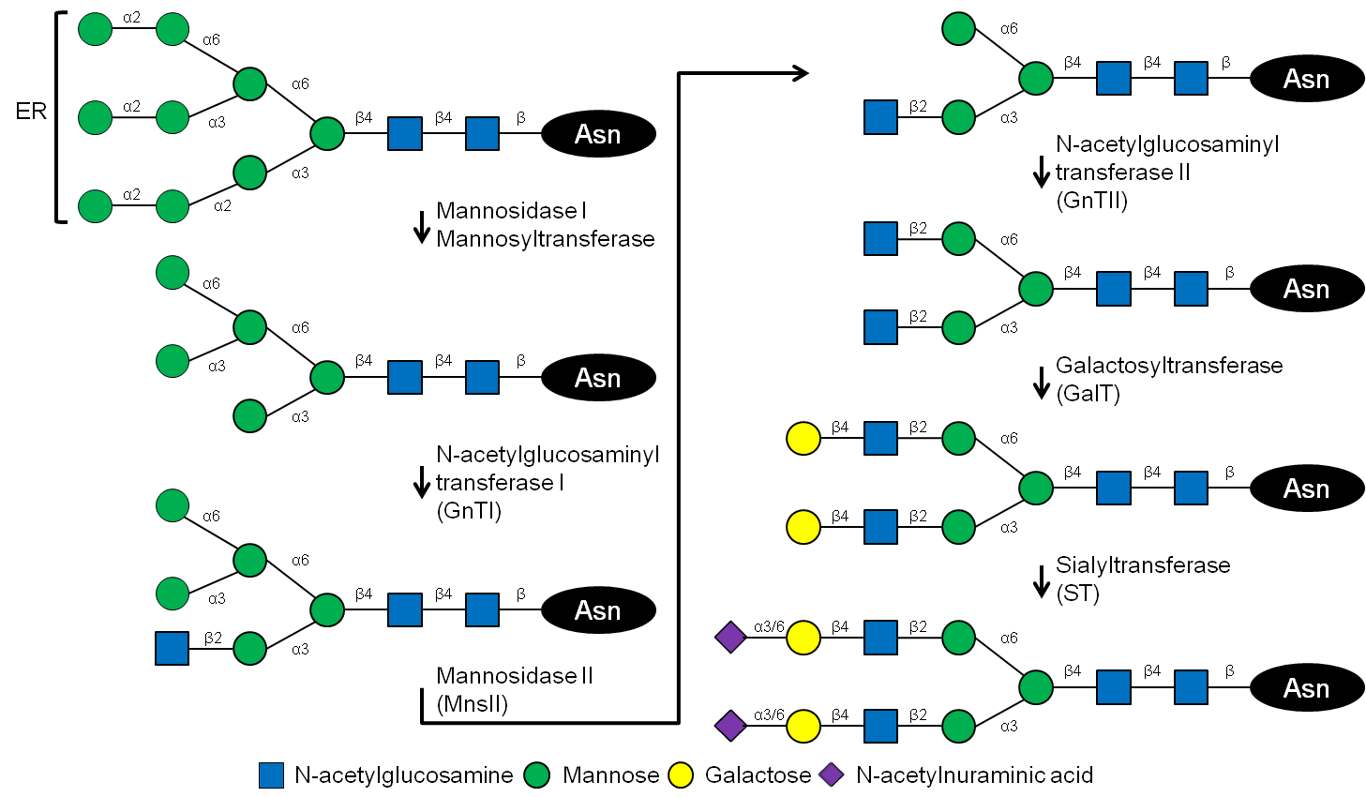
Sugar validation
PDB-care validates nomenclature and connectivity based on atom coordinates and biological pathway
Privateer-validate checks conformations

Slide 18
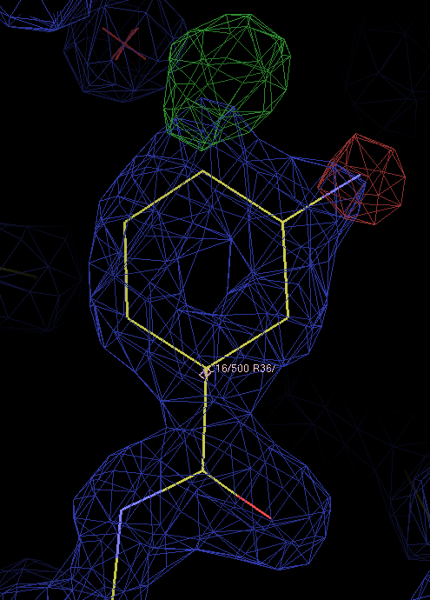
Ligands
Building and validation steps:
Is something there?
  Check the (difference) density
Is it my ligand?
  Check contacts
  Remember crystallisation conditions
  Check the density in detail
Is the geometry sensible?
  Check against restraints
  Check against small molecules
  Check the restraints themselves

Slide 19
Validation is a lot of work, but it helps you make better models

Slide 20
Model optimisation
Refinement settings
  Restraints and weights (geometry, B-factors, homology, jelly body)
  Solvent model
  High resolution cut-off
  Special cases (NCS, twinning, occupancies)
Number of model parameters
  B-factor model
  Number of TLS models
Structure model
  Main chain
  Side chains
  Hetero compounds
Automation speeds up optimisation

Slide 21
PDB-REDO
Pipeline for X-ray & electron crystallography
  Fully automated expert system
  Refines, rebuilds, and validates your model
Well-tested and high-throughput
  Run on the entire PDB
  Databank with weekly updates (pdb-redo.eu)
Available as webserver & installable software
  1800 registered users
Model, X-ray data, sequence
Parametrisation
REFMAC refinement
Rebuilding
REFMAC refinement
Model validation
PDB-REDO model and data

Slide 22
Features and algorithms
Methods
Handling of (too) small R-free sets:
  If test set < 1000 reflections: new set to up to 10% of all data
  If test set still < 500 reflections: k-fold cross validation
    Gives R-free average plus SD, also gives R-complete
Restraints:
  Basic from user, from dictionary, or made on-the-fly
  Local NCS restraints and/or strict NCS
  Jelly-body restraints (low resolution)
  Harmonic position restraints (small datasets)
Twin refinement:
  Only if SFCHECK and PHASER and REFMAC detect twinning
  Warns if previous false positives or space group problems are detected

Slide 23
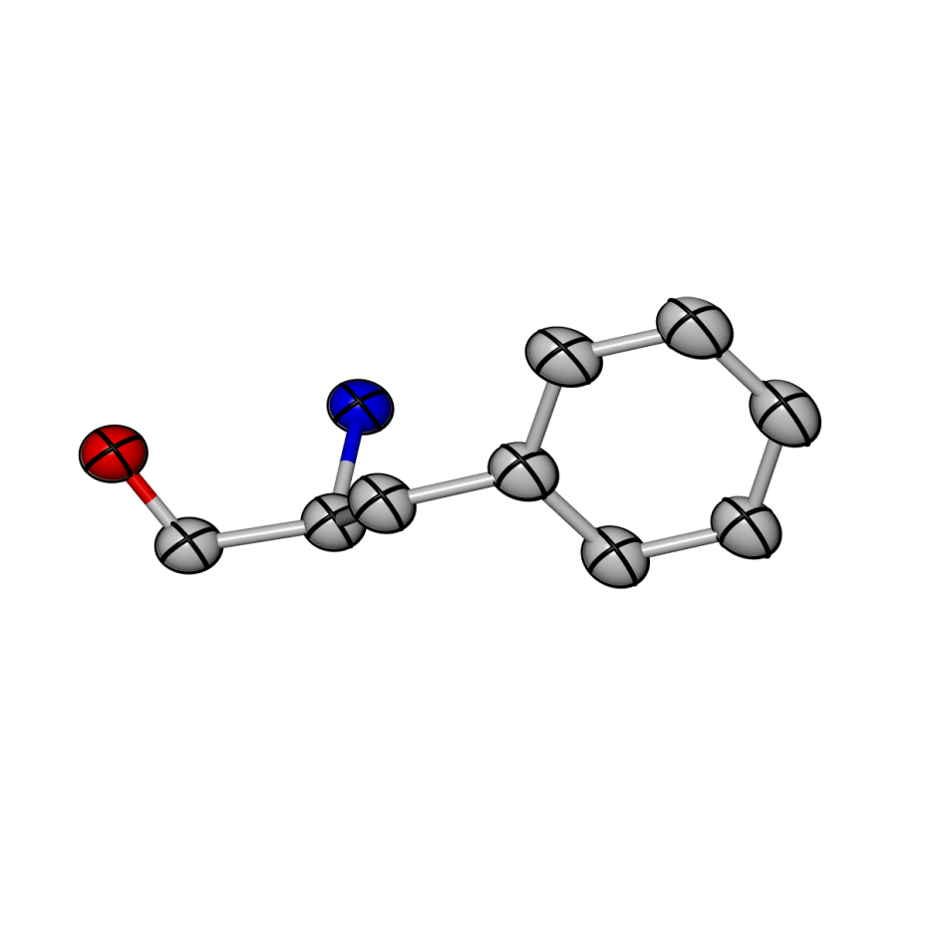
Features and algorithms
Methods
Establish high resolution cut-off through paired refinement
  Can be forced to run
Hamilton test:
  See whether R-factor drop comes from better model or adding parameters
  Refine alternative models and select best one
    Isotropic, anisotropic, or flat B-factors
    One TLS group per chains or user-provided model
Grid searches:
  Optimise solvent mask parameters
  Select weights for geometric and B-factor restraints

Slide 24
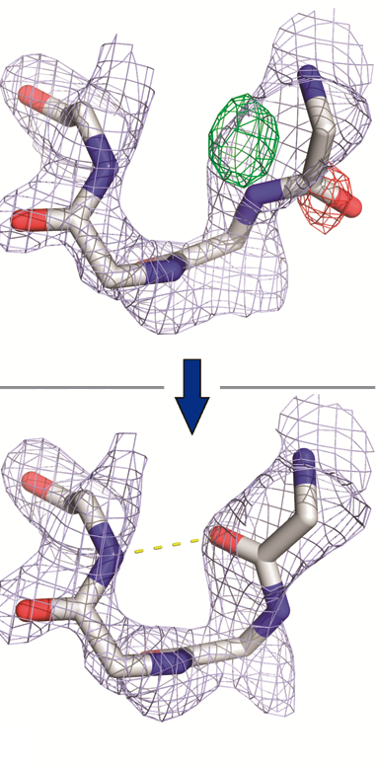
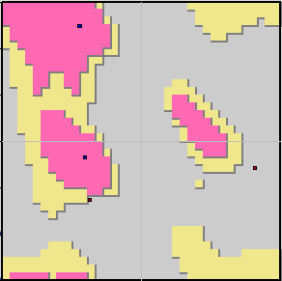
Features and algorithms
Methods
Peptide flips:
  If a flip improves density fit and Ramachandran plot: accept flip

Slide 25
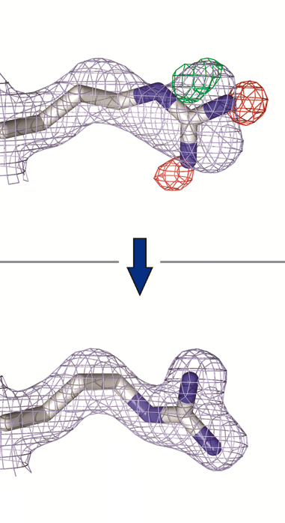
Features and algorithms
Methods
Side chain (re)building:
  If side-chain missing: add sidechains
  If a rotameric conformation improves density fit: keep new conformation
  If flipping His/Asn/Gln side chain improves H-bonding: flip

Slide 26
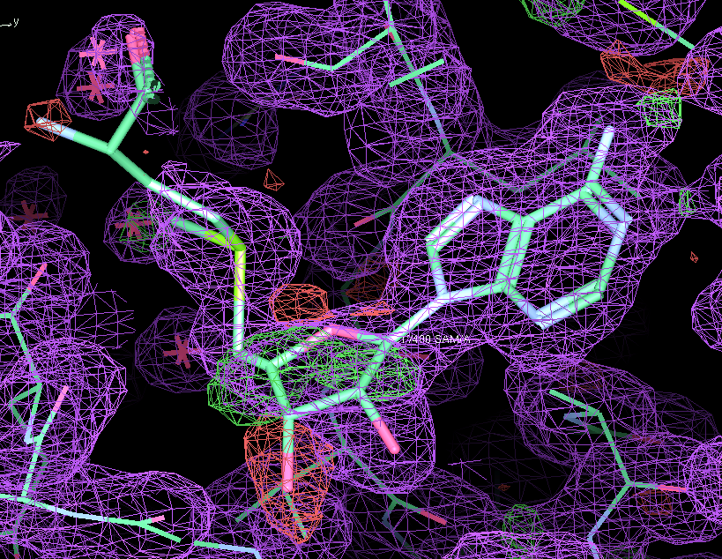
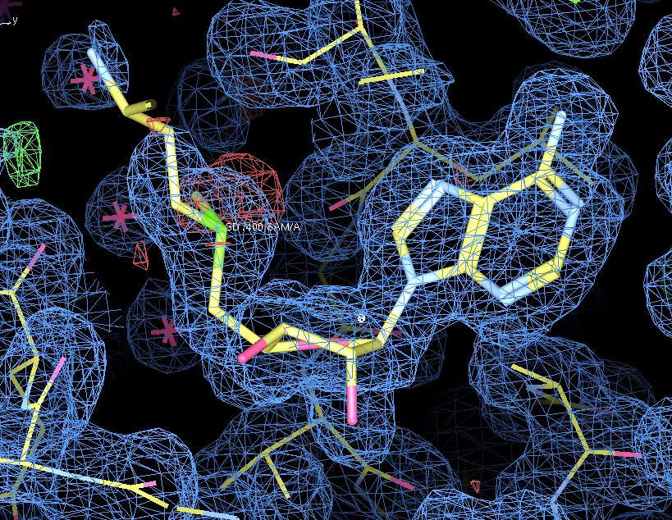
Features and algorithms
Methods
Validation:
  Geometry: packing, rotamers, Ramachandran plot, H-bonds, bumps
  Density fit: per-residue RSR, RSCC, EDIAm and OPIA
  Ligands: compare scores for density fit, interactions and Heat-of-Formation
 | PDB | REDO
RSCC | 0.91 | 0.96
Bumps | 22 | 5
H-bonds (kJ/mol) | -70 | -95
HoF (kJ/mol) | 11817 | 322

Slide 27
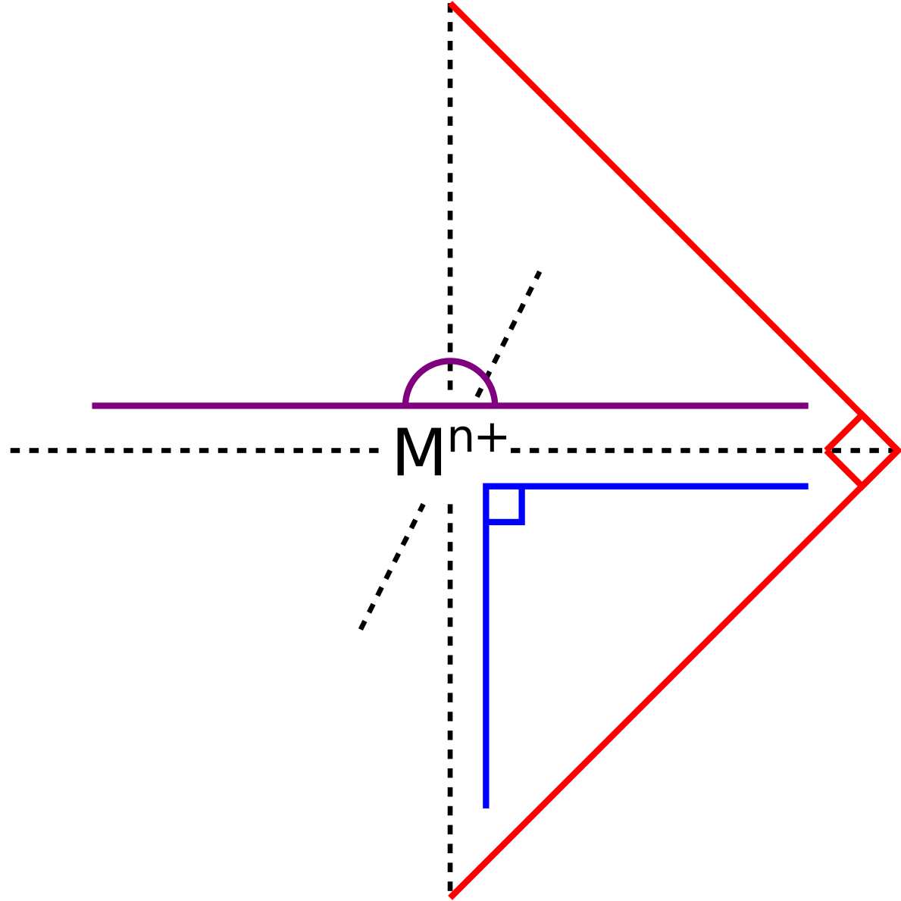
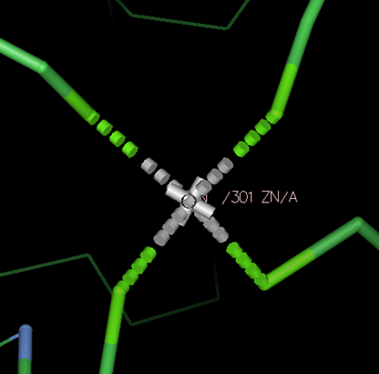
Features and algorithms
Methods
Metal site treatment
  Na⁺, Mg²⁺, K⁺, Ca²⁺ sites
    Asn and Gln flips
  Octahedral Na and Mg sites (experimental)
    Octahedral angle restraints, no distance restraints
    Try to unbias coordination distances to allow atom identification
  Tetrahedral, structural zinc sites
    Break SS-bonds, His flips, Distance and angle restraints

Slide 28
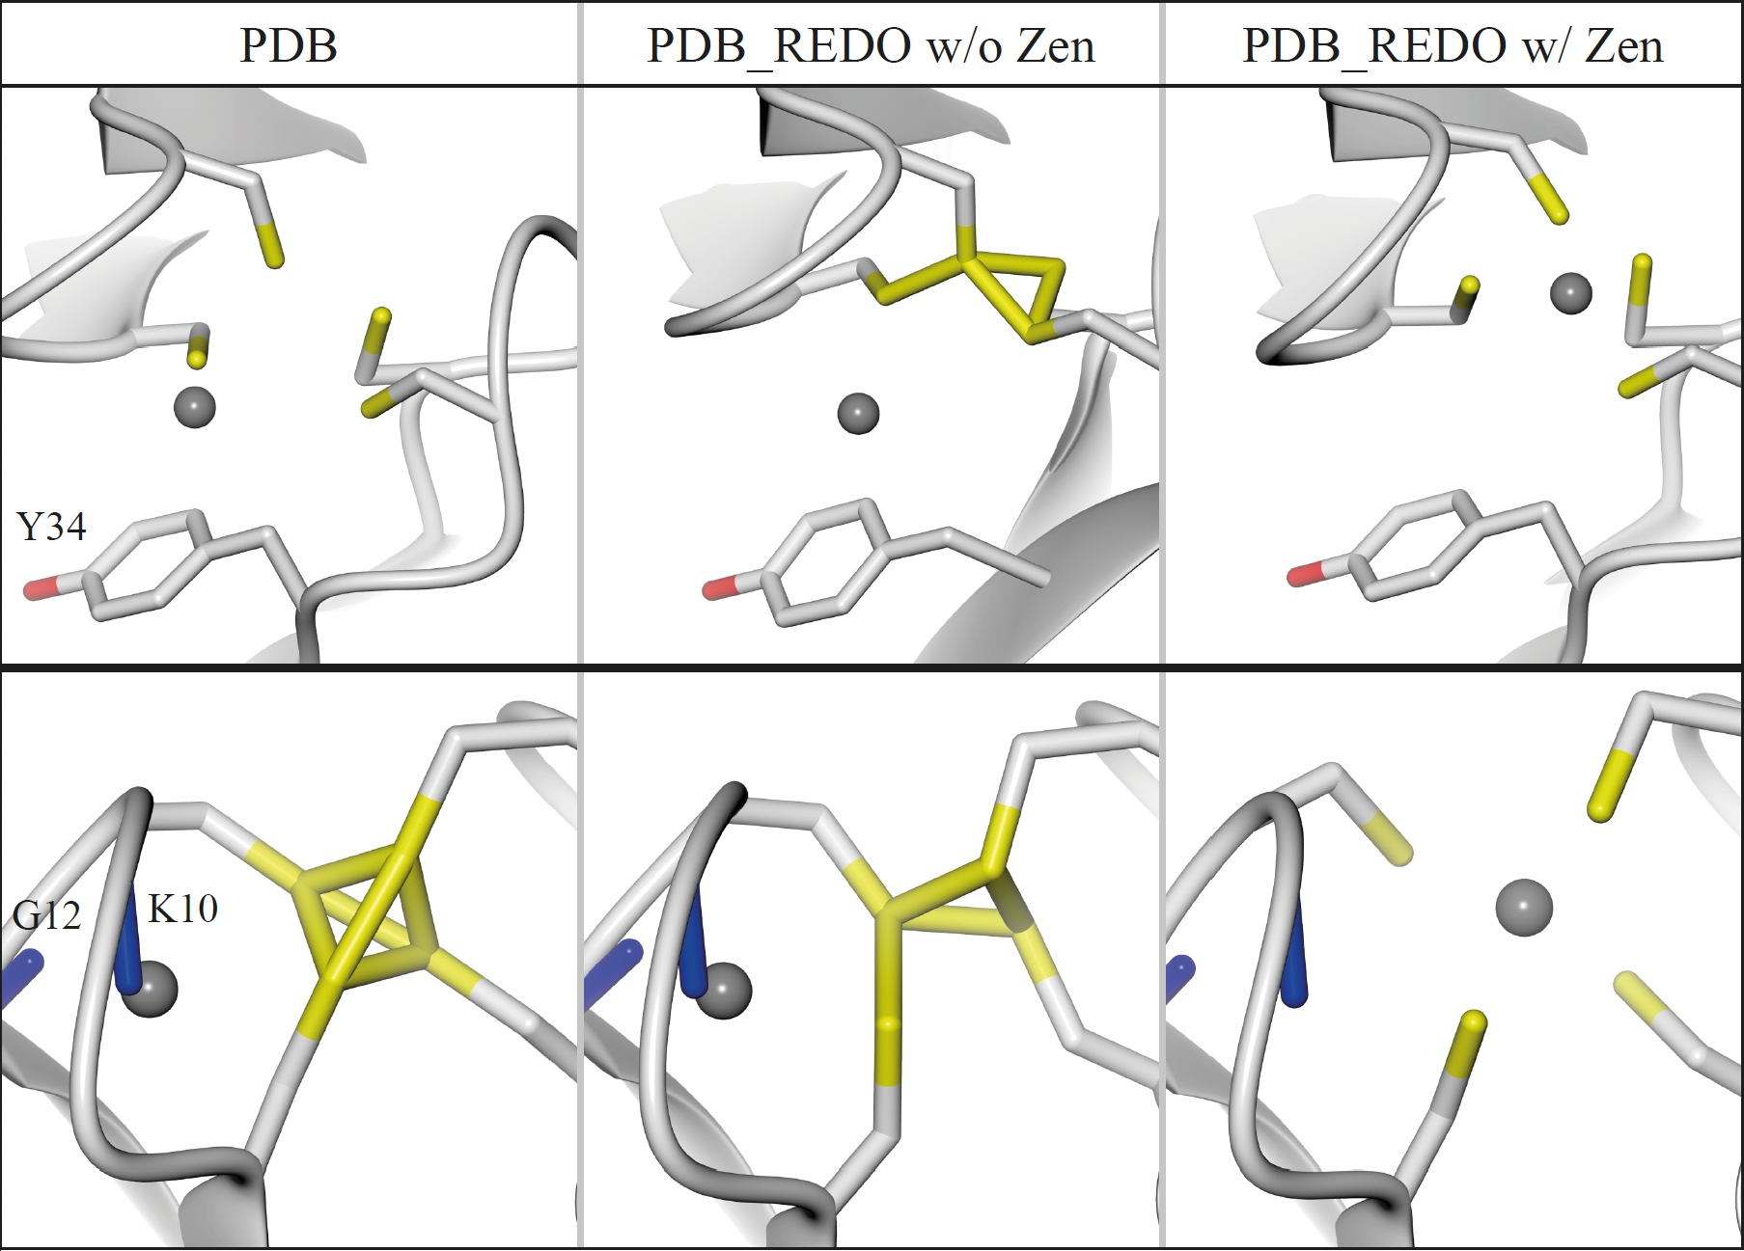
Added value of Zinc restraints
Theory
Notes:
Resolution indirect measure of amount of data

Slide 29
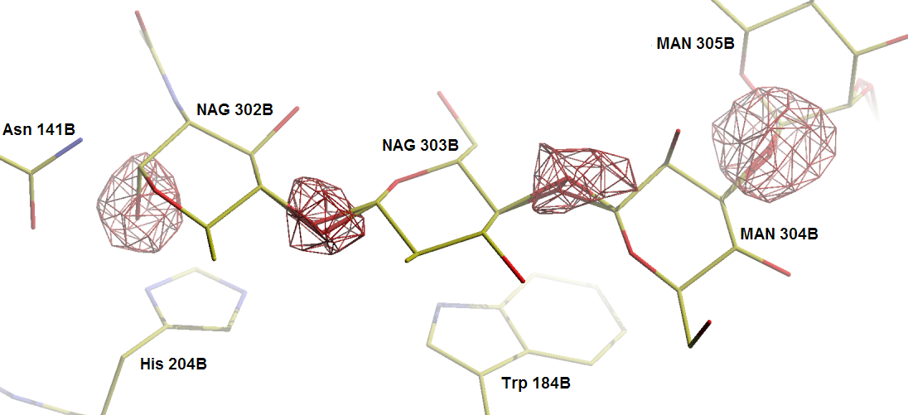
Features and algorithms
Methods
Carbohydrate handling:
  Rename residues to match expected type
  Add and annotate glycosidic linkages
  Delete superfluous oxygens

Slide 30
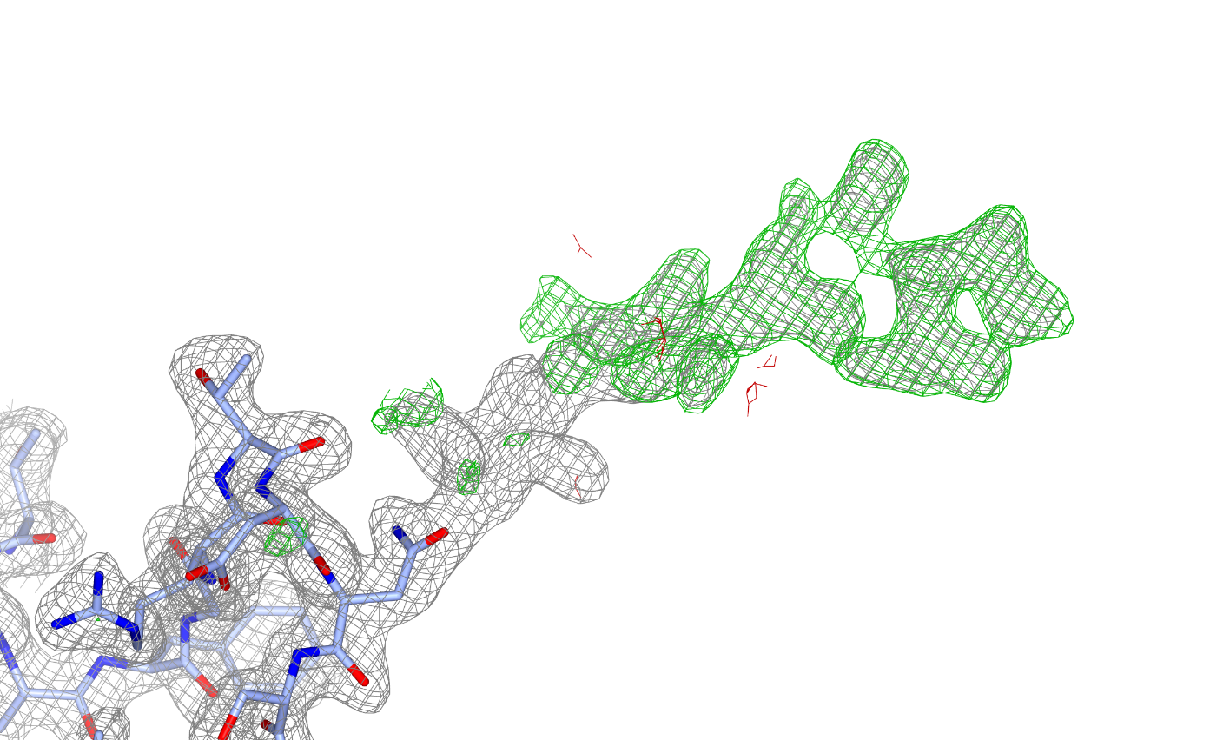
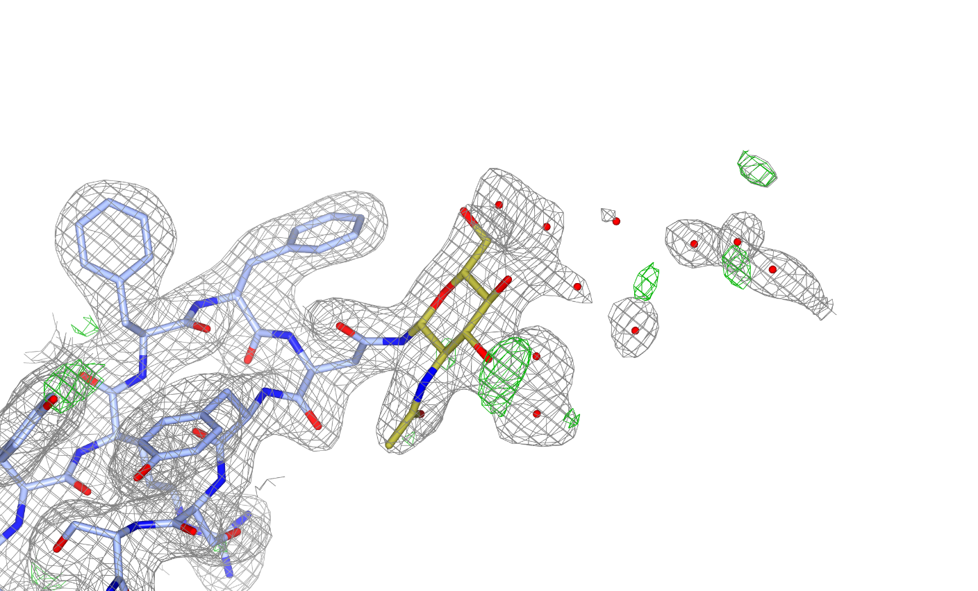
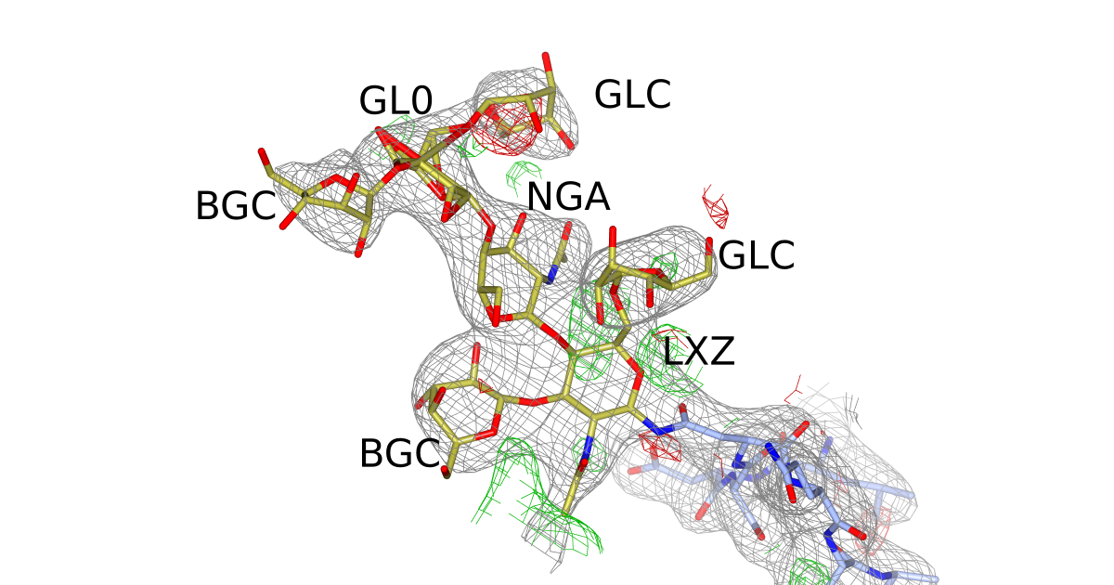
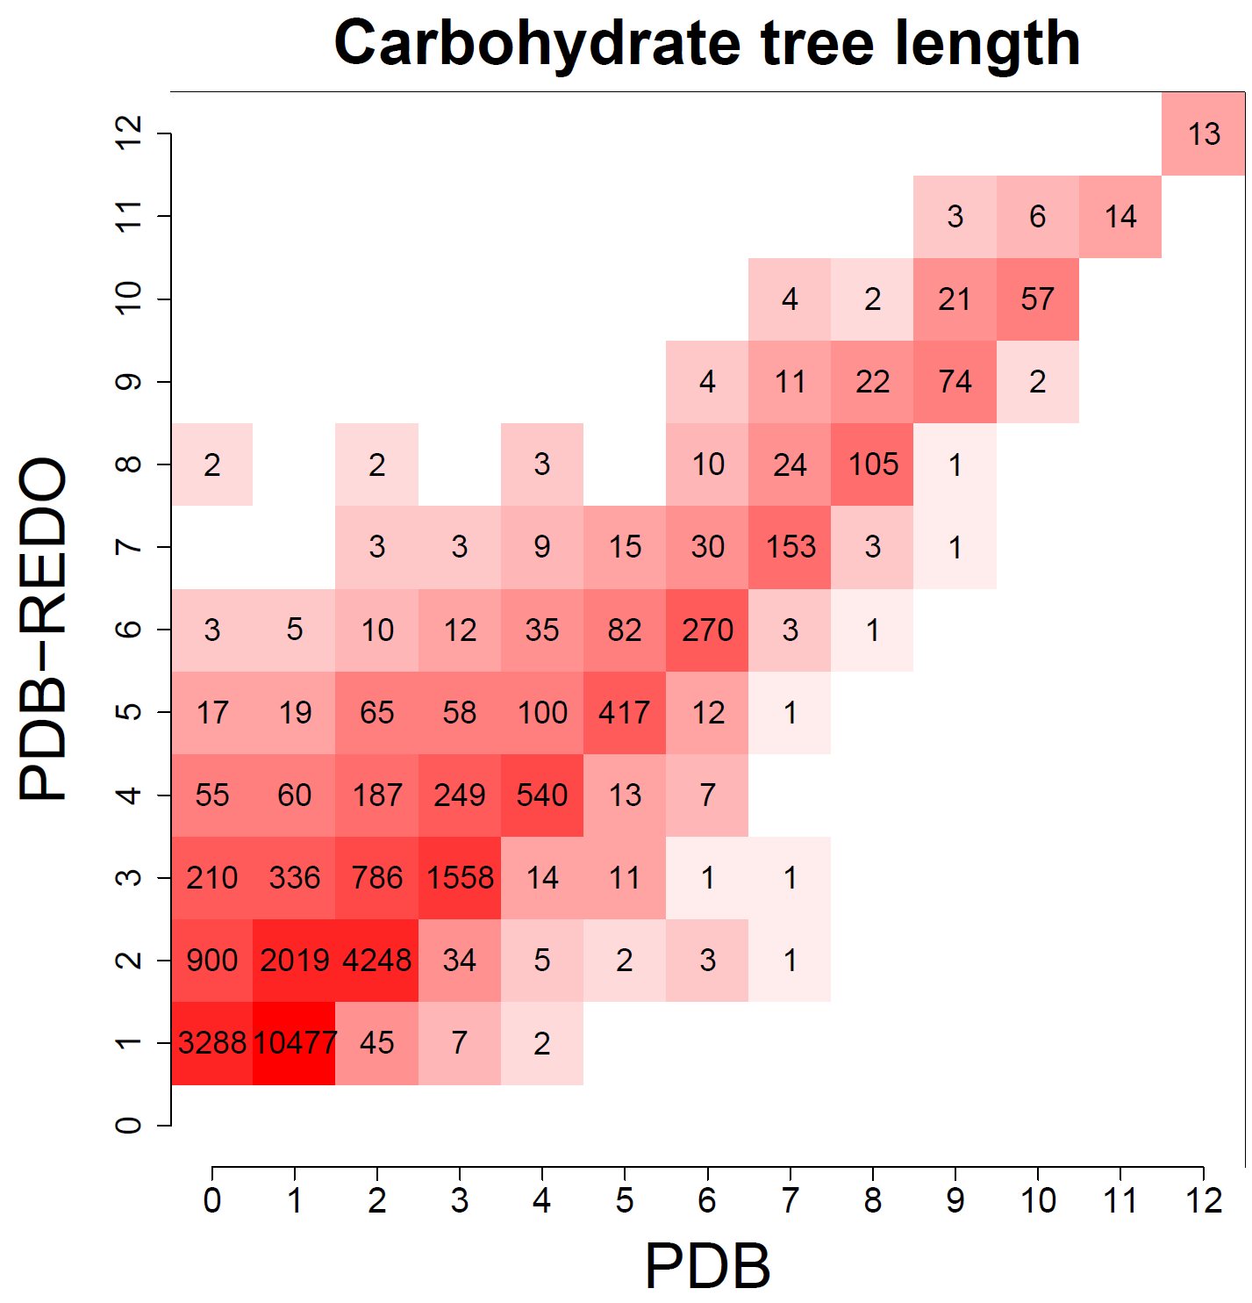
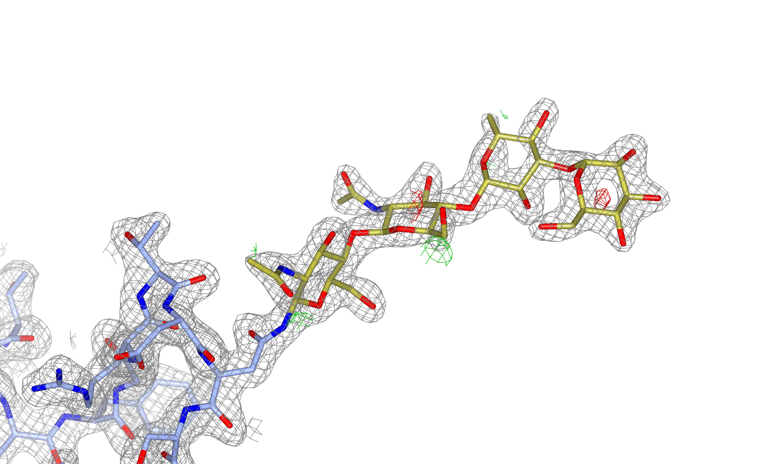
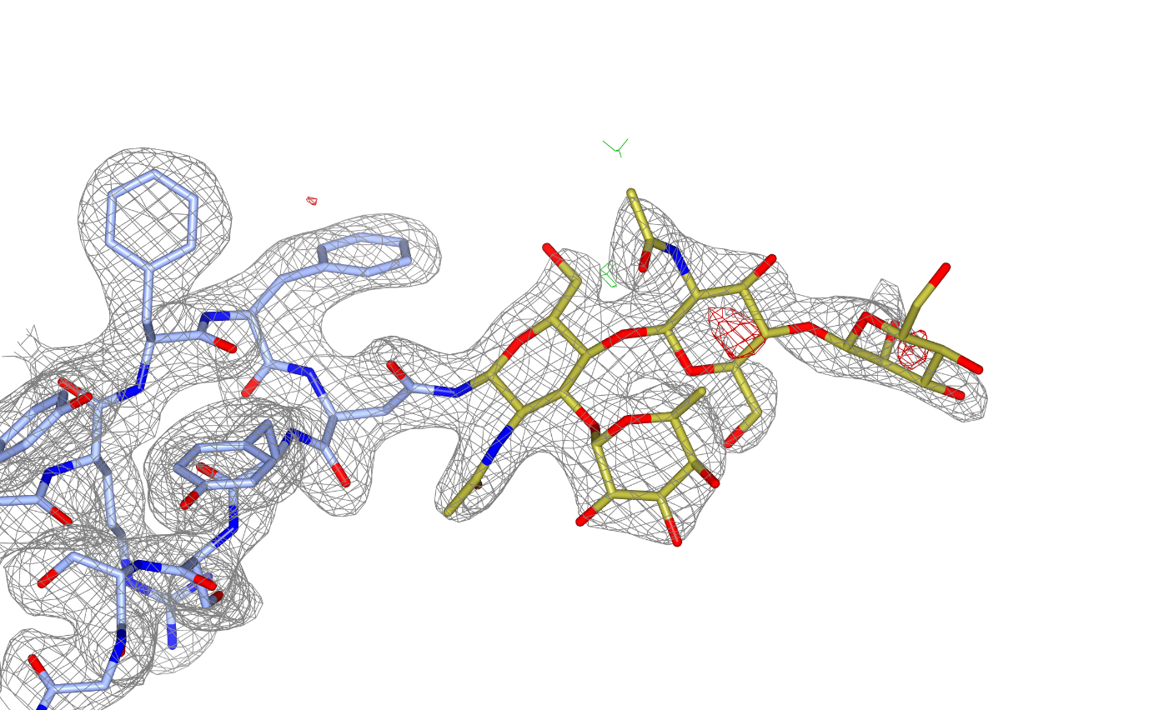
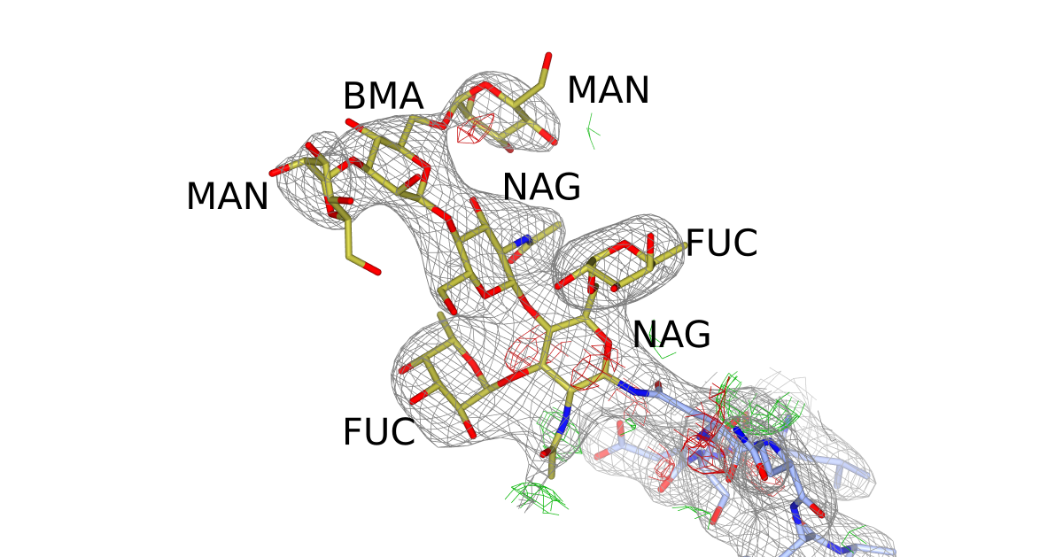
Features and algorithms
Methods
Carbivore and COOT N-glycan building
Rebuild glycan trees with poor geometry
  Either biologically wrong sugars or residues marked by Privateer
Extend existing trees
  Delete waters that are in the way
Build trees from scratch
  Detect possible glycosylation sites from sequence (N-x-[TS])
Validate on density and geometry

Slide 31
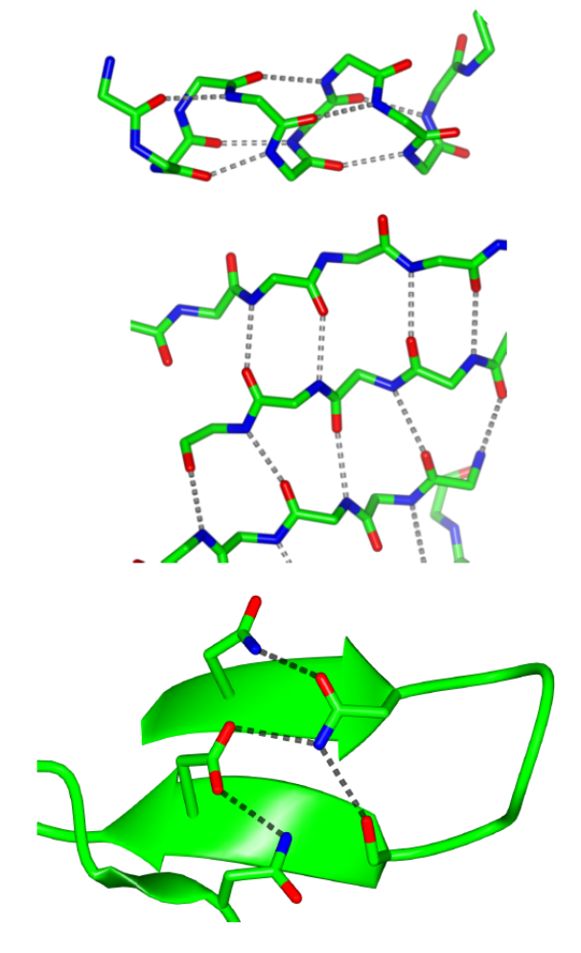
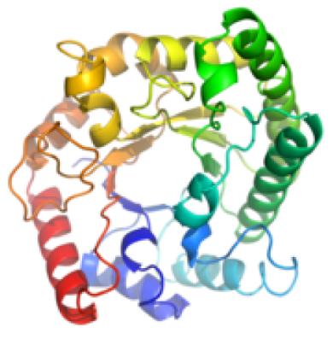
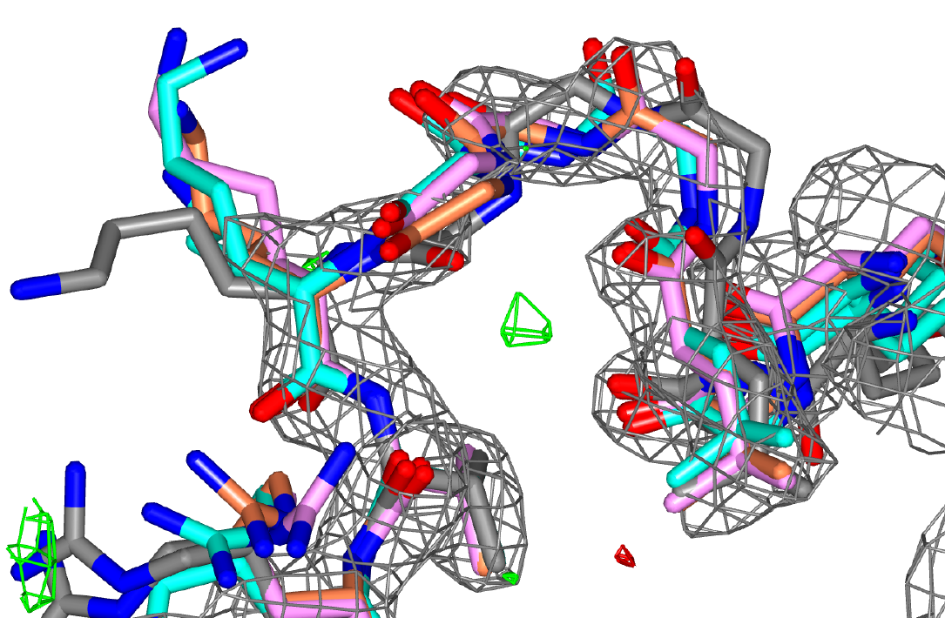
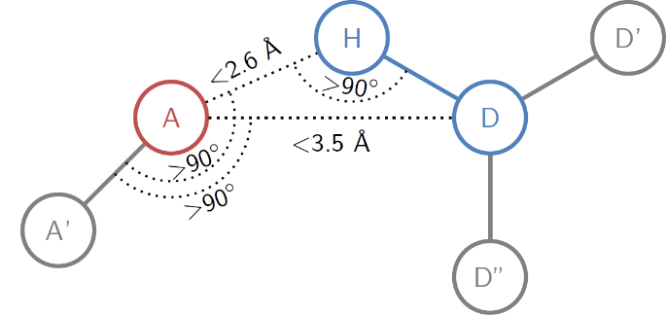
Homology in PDB-REDO
Theory
Homology: extra knowledge for model improvement
  Average PDB entry has > 10 homologs
Combine knowledge from all homologs
  Alternative to using single ‘reference structure’
  Highlights true structural differences in models
    Important for drug development
Hydrogen bond restraints in refinement
  Many restraints that can be filtered reliably
  Use local structural variability for weighting
Homology-based loop fitting
  Protein-specific structure templates

Slide 32



HODER: HOmology-DErived Restraints
Get homologs from PDB-REDO db
  Sequence identity > 70%
  Resolution ≤ model
Find equivalent H-bonds in homologs
  Filter: same secondary structure
  Filter: same side-chain rotamer
If: #distances > 5 , fit target and SD
  Higher SD, lower relative restraint weight
Else: fallback to atom and secondary structure specific H-bond restraints
  97 types available
    3.7 million observations

Slide 33



Added effect of homology restraints
Theory
E. Coli maltose transporter (3fh6, 4.5Å)
PDB
PDB-REDO
PDB-REDO new
Notes:
36.3% to 33.9%

Slide 34






Homology-based loop building
Loopwhole adds missing loops by homology
Find missing loop based on sequence
Find homologous structures with the loop present
Prepare for loop transfer
For all homologous loops:
  Align loop borders using quaternions
  Copy over loop
  Refine with coot-mini-rsr
Keep the best loop if it is good enough
  Filter on geometry and map fit

Slide 35


Loop building
When is a loop ‘good enough’?
It has good geometry
  Bonds, angles, clashes and Ramachandran plot
It has good density
  Uses density ratio between loop and rest of model
25k loops built in PDB

Slide 36



PDB-REDO redone (n=100k)

Slide 37



How to use PDB-REDO
Web server: pdb-redo.eu
Create password protected account
  Or use ARIA or West-Life SSO login
  1800 existing accounts
Submit PDB, MTZ, sequence
  Restraints are optional
  5500 jobs submitted in 2017
Wait ~1 hour
Check results

Slide 38
PDB-REDO output
Output
New model + new map coefficients
Tools to continue working on the structure model
  Optimised settings for refinement in REFMAC
  Already refined TLS model
  Ready-made extra restraints
Description of model changes
  At the local and the global level
  Visually oriented: colour coding, plots, visualisation script for COOT

Slide 39




Output

Slide 40

Herceptin – HER2 interface
After PDB-REDO:
R-free from 31.6% to 26.7%
  7σ improvement
Moved from 34th to the 99th quality percentile in MolProbity
Notes:
7 sigma improvement
Changes a30 A31 (herceptin) C602 C596 (HER2)
34th %-ile to
1n8z

Slide 41


Herceptin – HER2 interface
PDB
PDB-REDO
Notes:
7 sigma improvement
Changes a30 A31 (herceptin) C602 C596 (HER2)

Slide 42
Using PDB-REDO is little work, but it helps you make better models

Slide 43








Acknowledgements
Bart van Beusekom
Maarten Hekkelman
Natasja Wezel
Krista Joosten
Thomas Lütteke
Anastassis Perrakis
Gert Vriend
Coos Baakman
CCP4 developers
Garib Murshudov
Paul Emsley
Fei Long

