Slide 2
Solving THE PHASE PROBLEM – A very brief (but not very rigorous) introduction
Gordon Leonard
ESRF Structural Biology Group

Slide 3
Contents
The Phase Problem
Molecular Replacement
Isomorphous Replacement
        SIR/MIR
Anomalous Scattering
      What is it?
      How can we exploit it?
        SIRAS
        MAD
        SAD

Slide 4
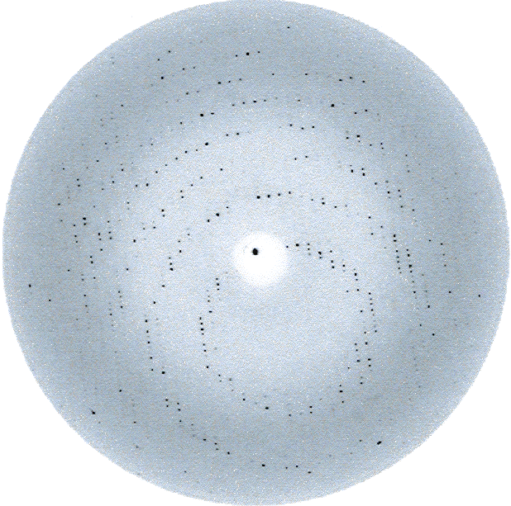
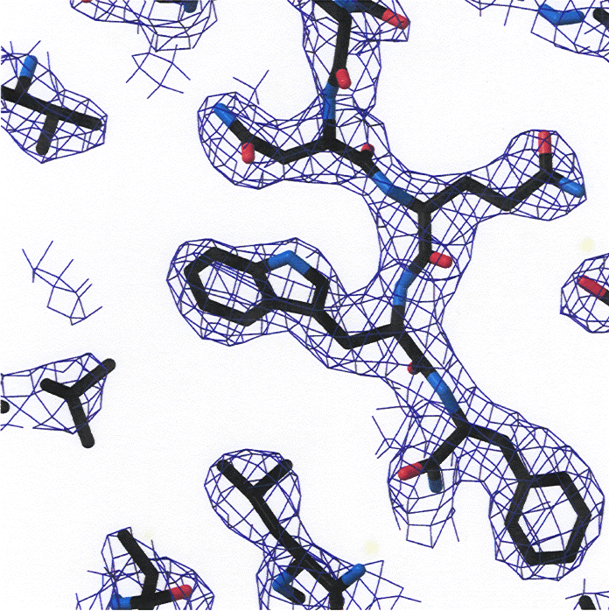
Structure Determination: from intensities to electron density
Integrated Intensities
Electron density
(= protein structure)

Slide 5
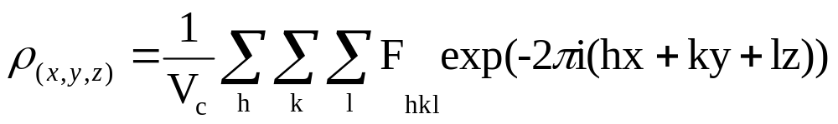
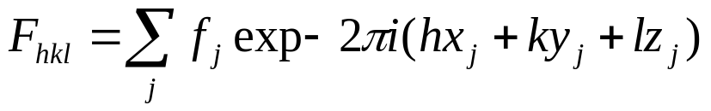
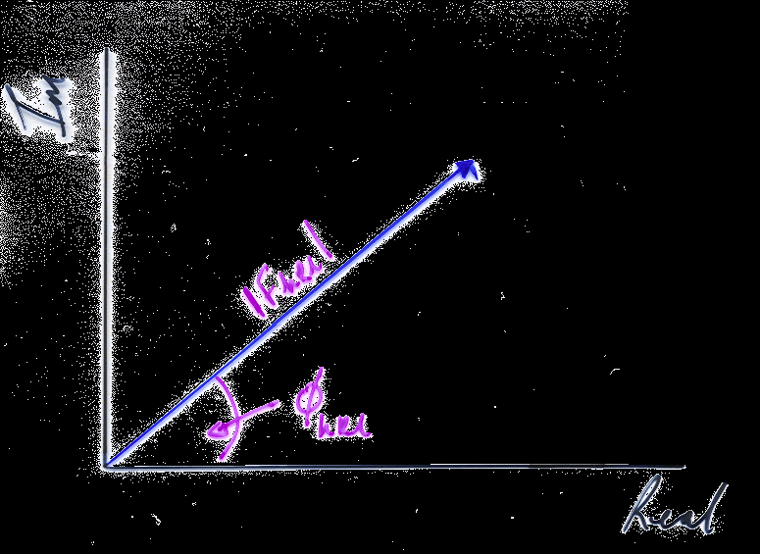
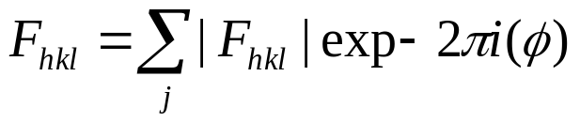

The Electron Density Equation
Amplitude
Phase
From an x-ray diffraction experiment we can ‘measure’ the amplitude ( ) but get no information about the phase. Deriving the phase is known as ‘the phase problem’

Slide 6

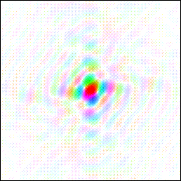
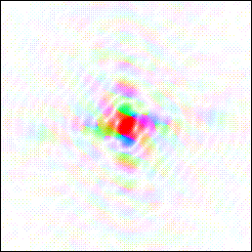
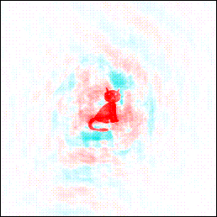

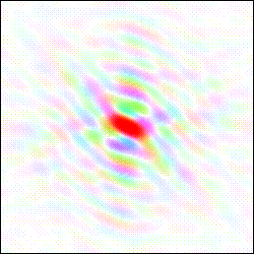
‘Good’ phases are more important than ‘good’ amplitudes
Amplitudes (colours) from duck transform
Phases (brightness) from cat transform
http://www.ysbl.york.ac.uk/~cowtan/fourier/magic.html

Slide 7
Methods for Resolving the Phase Problem in MX
Direct Methods
  requires high (near atomic; d_{min} ~1.2 Å) resolution data, still quite rare
Molecular Replacement
  requires some prior knowledge of the crystal structure you want to solve (homologous protein, etc.)
Experimental Phasing
      Isomorphous Replacement
      Anomalous Dispersion Methods

Slide 8
Molecular Replacement

Slide 9
What is molecular replacement?
‘The term ‘molecular replacement’ (MR) is generally used to describe the use of a known molecular model to solve the unknown crystal structure of a related molecule. MR enables the solution of the crystallographic phase problem by providing initial estimates of the phases of the new structure from a previously known structure, as opposed to the other two main methods for solving the phase problem, i.e. experimental methods (which measure the phase from isomorphous or anomalous differences) or direct methods….’
‘….The use of MR has naturally become more common as the database of known structures expands. MR is currently used to solve up to [80%] of deposited macromolecular structures….’
Philip Evans and Airlie McCoy (2008). An introduction to molecular replacement. Acta Crystallogr D64, 1–10.

Slide 10
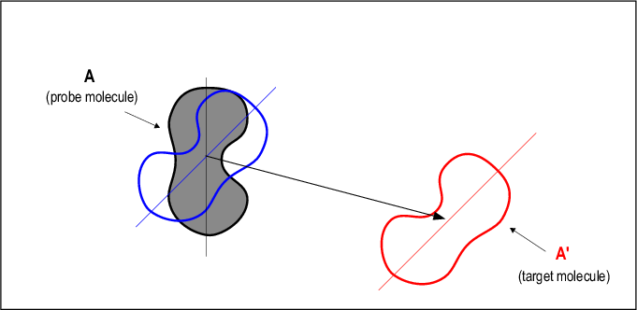
molecular replacement (MR)
http://www.xray.bioc.cam.ac.uk/xray_resources/whitepapers/mr-in-action/
Known crystal form
Rotation
New (unknown) crystal form
Rotation + Translation
Translation
How can we do this?

Slide 11
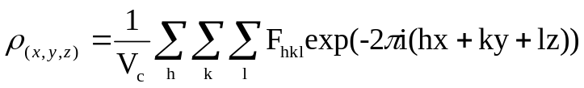
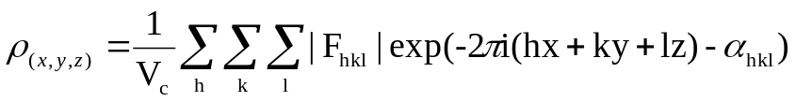
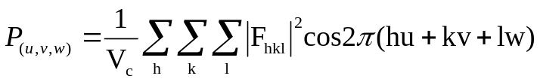
The PATTERSON FUNCTION is IMPORTANT in MR
1. The electron density equation
=
Real space positions of atoms in unit cell. Electron density α to atomic number (Z).
Need to know both amplitude (|F_{hkl}|) and phase (α_{hkl}) of reflections.
2. The Patterson Function
Map of position vectors between each pair of atoms in the unit cell. The value of the function at maxima α Z_{i}Z_{j} (i.e. product of atomic numbers of the two atoms involved in the position vector).
Patterson space (defined by a unit cell identical to the crystal unit cell) is defined by generic coordinates u, v, w, in such a way that a vector between a pair of atoms in the unit cell, located at (x₁, y₁, z₁) and (x₂, y₂, z₂), will be shown in the Patterson map by a maximum with coordinates:
u = x₁ - x₂ ; v= y₁ - y₂ ; w = z₁ - z₂
Only need to know structure factor amplitudes |F_{hkl}| (or intensities, I_{hkl}) to calculate it.

Slide 12
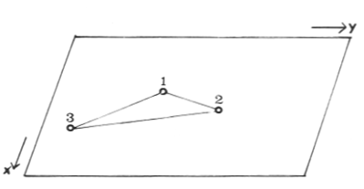
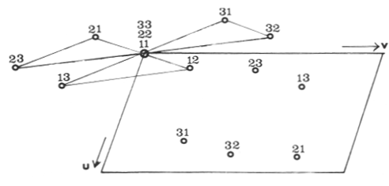
A Simple Patterson Map (P1)
Atomic Structure
Patterson Function
The Patterson function is centrosymmetric even if original structure is not.
For a structure with N atoms in the unit cell the Patterson map contains N² peaks.
N fall at the origin (get a (very) large peak at u,v,w = 0,0,0)
N(N-1) do not
For crystals containing large molecules, Patterson Function is very crowded leading to lots of overlap.
For crystals of macromolecules intramolecular vectors are found ‘close’ to the origin
Individual molecules of similar 3-D structure will have produce similar Patterson functions (intramolecular vectors)

Slide 13
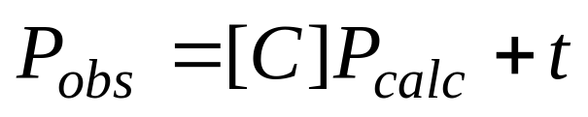
How does Patterson-based MR work?
For MR calculations need two Patterson functions:
Calculated (from atomic positions of known structure)
Observed (|F|² from diffraction data from crystals of unknown structure)
P_{obs}
P_{calc}
[C] = Rotation Matrix
t = Translation Vector

Slide 14
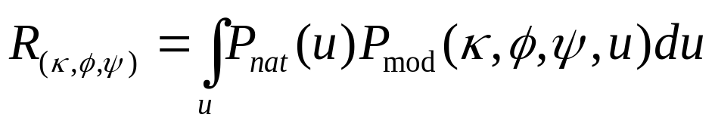
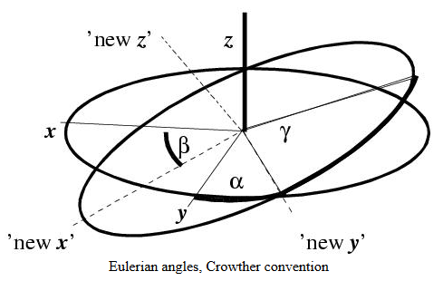
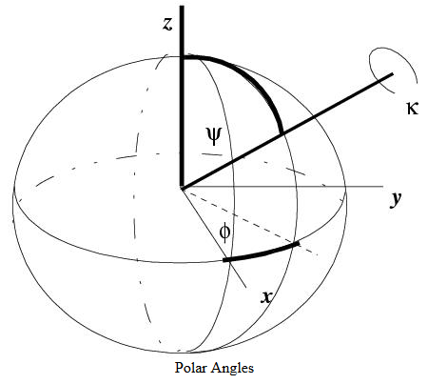
The Rotation Function
Rotation Function: finds rotation which gives best superposition (intramolecular vectors only)
Once the best rotation has been found, then need to find best translational component

Slide 15
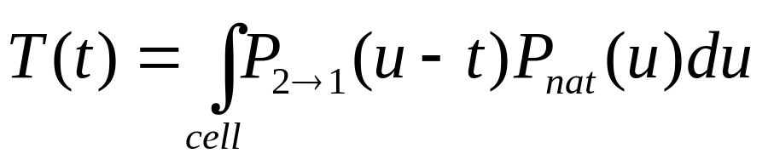
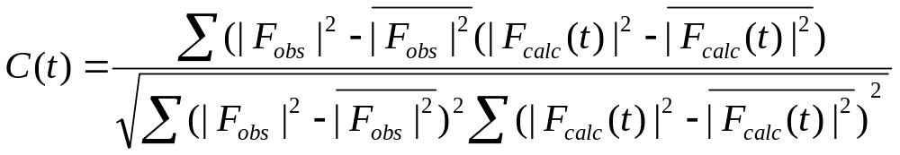
The TRANSLATION Function
Place the correctly oriented model (see previous slide) in the unit cell of the unknown structure. For one molecule in P1 only correct orientation is needed.
When there is more than one molecule in unit cell then we translate rotated model, calculate intermolecular vectors and compare these to those in the observed Patterson map and compute a translation function:
Can also calculate a Translation Correlation Function (better signal to noise than the product function.)

Slide 16
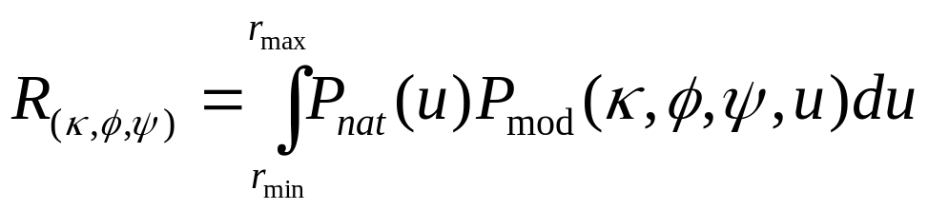
MR Appears straightforward, But not always easy
MR works best when there is a high similarity (minimum of ~30% sequence identity) between target & probe
MR works best when one is searching for only one molecule of the a.u. of the target crystal.
As with all MX experiments and phasing protocols important that the experimental data from the target crystal are very complete (ideally 100%). Systematically missing regions (ice rings, detector overloads, blind regions) can cause problems.
The calculation of the rotation function should be based only on intra-molecular vectors in the experimental Patterson function so a correct choice of integration radius is crucial.
  Don’t include origin region
  For a spherical molecule, a value of ~75% of the minimum diameter should be used
  For elongated molecules, the average of the three semi-axes of the corresponding ellipsoid would be the value of choice.
  Should try several values to see which gives best S/N ratio.

Slide 17
Which search model should I use?
Don’t use search models blindly:
The higher the sequence identity the easier MR (inverse correlation between the r.m.s. deviation of probe/target atomic positions and the % sequence identity).
If there are particular regions of low sequence identity trim side-chains to Ala/Gly.
If a domain in the probe does not exist in the target, delete this from the search model.
If a domain in the probe is flexible, delete this from the search model or (better) use the two domains as separate search models in the same MR protocol.
If several models are available, combine them for use in MR using ‘ensembling’ (Phaser).

Slide 18
Likelihood in MR (phaser)
Patterson-based MR methods assume there are no errors in the data (clearly not true). Likelihood-based methods explicitly model errors, both experimental (σ(F)) and of the model (r.m.s. coordinate error).
Maximum likelihood:
The best model is the one that is most consistent with the data.
Consistency of a model with the data can be measured by the probability that the data would be measured given the model that is being tested.
Use of likelihood in MR is straightforward for translation search using a model in a ‘correct’ orientation. Each possible translation generates an atomic model with, for the correct translation, all the atoms in about the right place. So, easy to test whether possible translations are consistent with/predict the ‘observed’ data.
More difficult for a rotation search. For each orientation tried we still do not position in the unit cell. This introduces new errors into the prediction of the data. But,
Likelihood methods are more robust and generally give clearer solutions in difficult cases than do Patterson-based MR methods.

Slide 19
For a lot more about MR, make sure you are here on Monday (and Tuesday)

Slide 20
When mr doesn’t work
Experimental Phasing

Slide 21
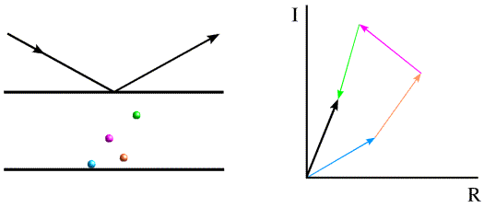
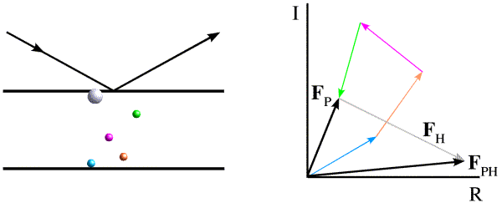
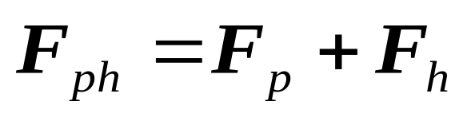
introducing a new (heavy) atom into a crystal
(protein) Crystal
Fp
(protein) Crystal
+
(heavy) atom
Get a different structure factor, F_{PH}

Slide 22
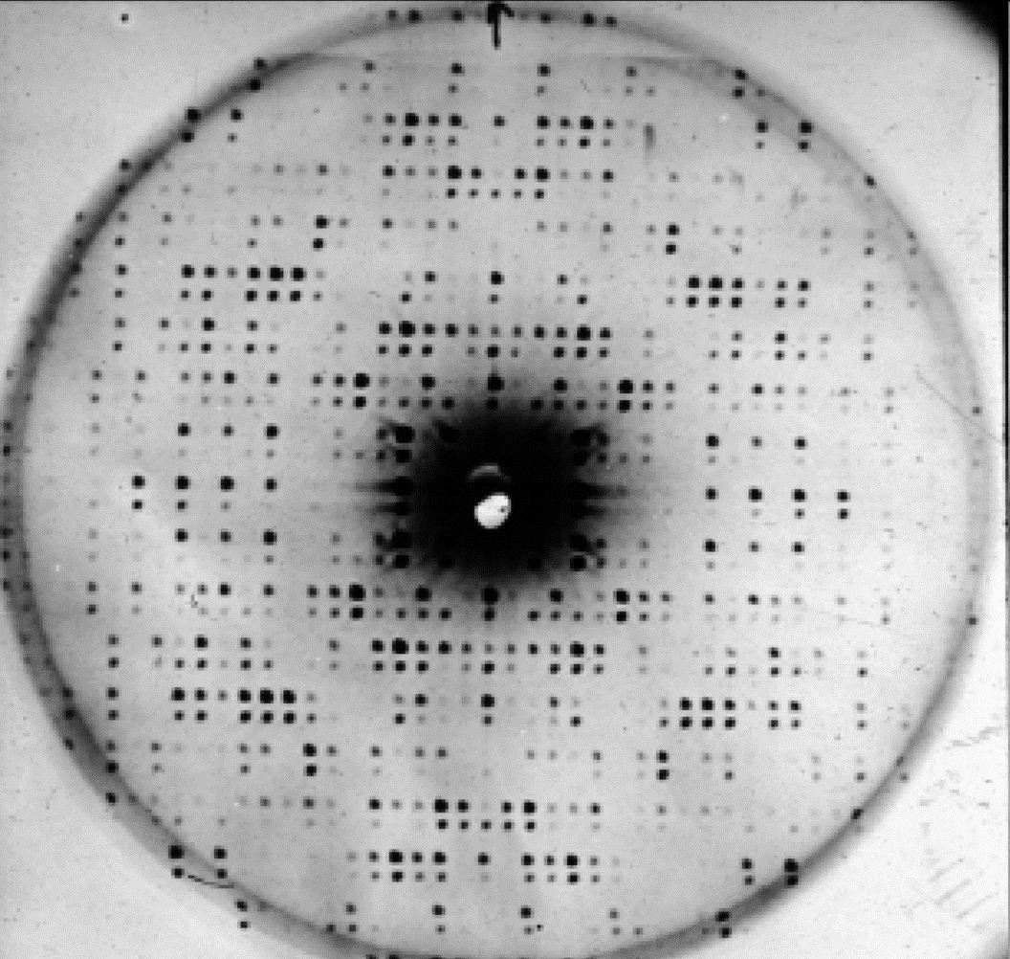
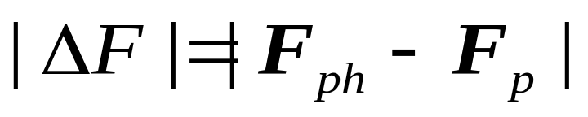
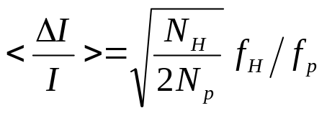
introducing a new (heavy) atom into a crystal: isomorphous differences
Two protein diffraction patterns shifted vertically relative to one another. One is from native bovine β-lactoglobulin, the other from a crystal soaked in a mercury-salt solution. Note: 1) intensity changes for reflections in the latter; 2) identical unit cells suggesting isomorphism.
Addition of 1 Hg atom to a protein of 1000 atoms will produce an average fractional change of intensity of ~25% so differences should be easy to measure
Taylor, G. L. (2010). Introduction to phasing. Acta Cryst. D66, 325-338.
We can use isomorphous differences to derive phase information via isomorphous replacement

Slide 23
How is Isomorphous Replacement DonE?
Collect data set from native crystal (structure factors, F_{p})
Introduce a small number of heavy atoms (Pt, Hg, Br, I) into another crystal of the same protein
Collect data set from derivative crystal (structure factors, F_{ph})
Use differences (isomorphous differences) to find heavy atom positions in unit cells
Use these positions to initiate phase calculations

Slide 24
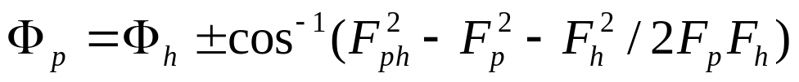
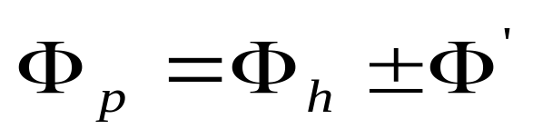
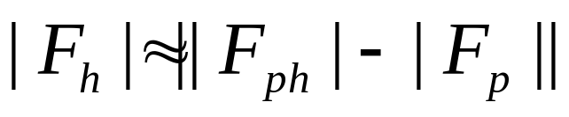
Single Isomorphous Replacement
Want to calculate φ_{p}:
Imaginary
|F_{h}|
|F_{ph}|
φ_{h}
|F_{p}|
φ_{p}
Phase Ambiguity
Real
Measure |F_{p}|, |F_{ph}|; Calculate |F_{h}|, φ_{h} from heavy atom positions

Slide 25
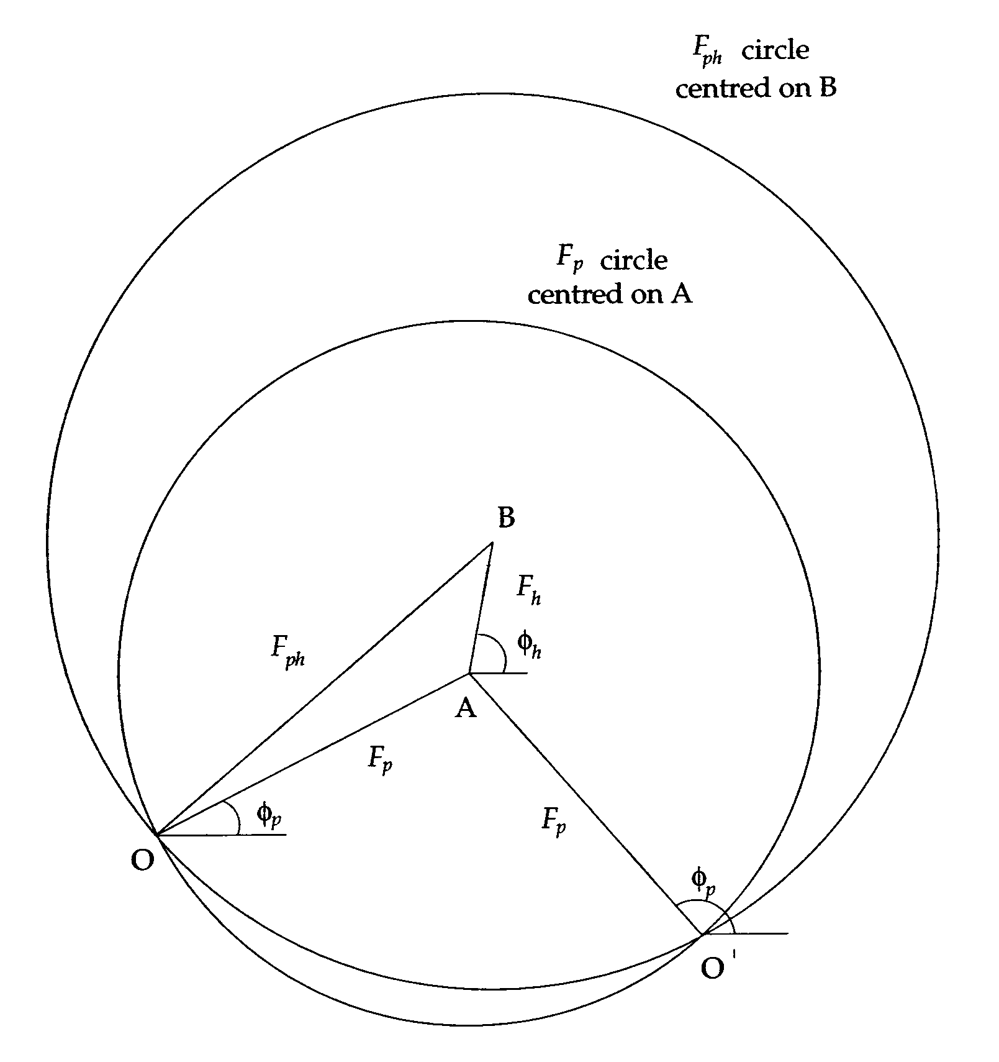
Graphical Illustration of phase Ambiguity
No errors shown here. What we actually get are phase probability distributions

Slide 26
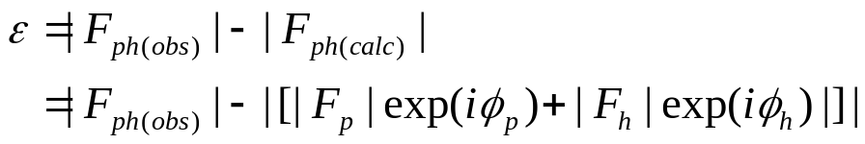
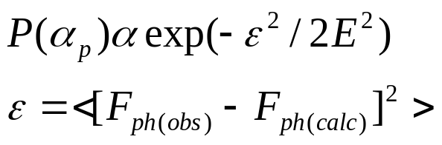
lack of closure (ɛ) and phase probabilities
Measurement errors in |F_{P}|, |F_{PH}|
Model of heavy atom substructure is incorrect (minor sites not included)
Native and heavy atom derivative crystal are not isomorphous
ε
Imaginary
F_{h}
F_{ph}
F_{p}
Real
Blow, D. M. & Crick, F. H. C. (1959). Acta Cryst. 12, 794-802.

Slide 27
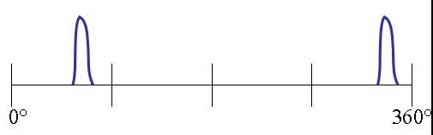

SIR Phase Probability Distribution

Slide 28
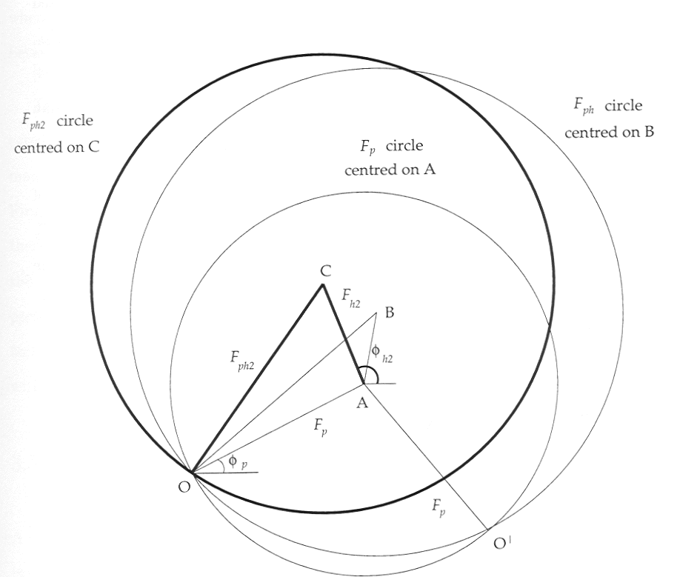
A Second Derivative Resolves the SIR Phase Ambiguity
0°
360°
0°
360°
JPDF
0°
360°

Slide 29
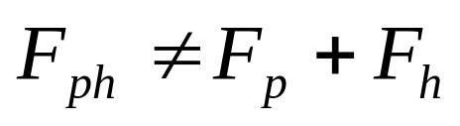
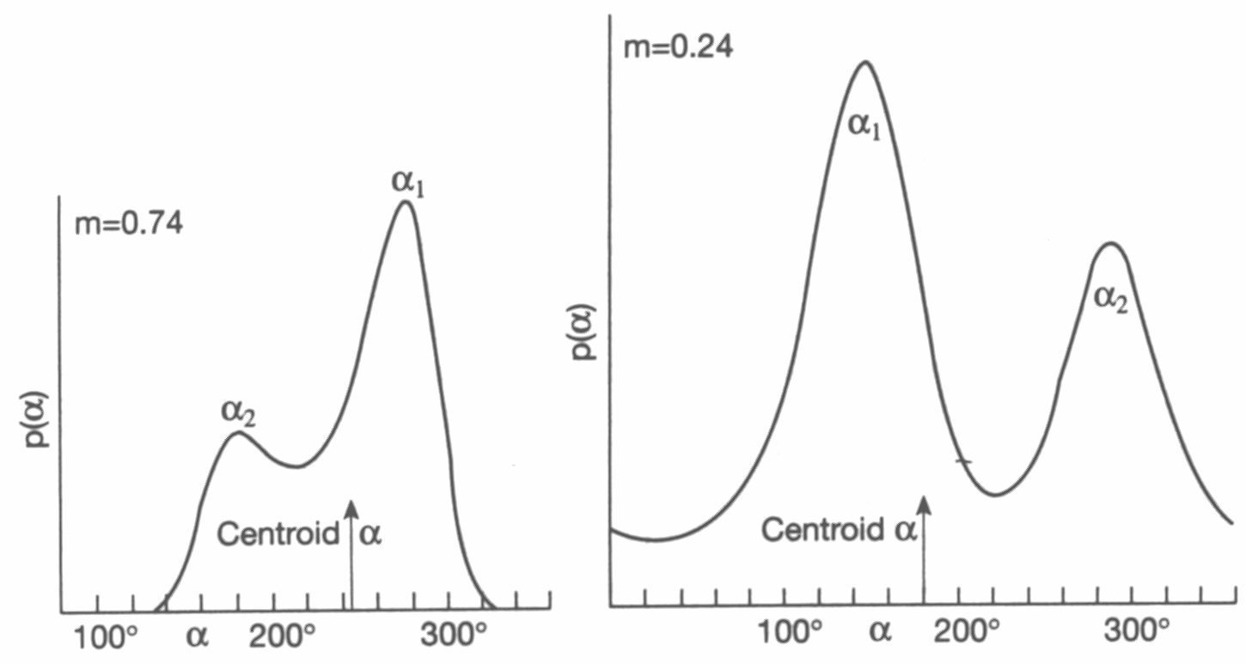
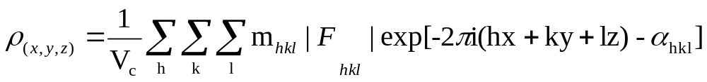
phase probability Distributions
Measurement errors in |F_{P}|, |F_{PH}|
Model of heavy atom substructure is incorrect (minor sites not included)
Native and heavy atom derivative crystal are not isomorphous
The most probable phase is not be the best phase to use in map calculations. The centroid phase (best phase) gives the least error in the Fourier map.

Slide 30
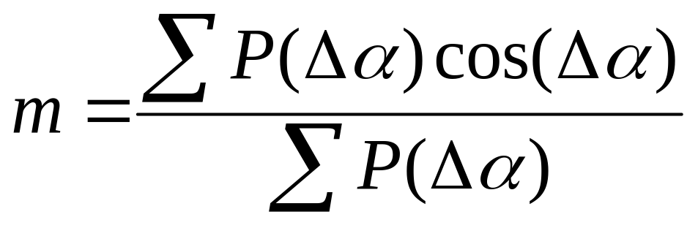
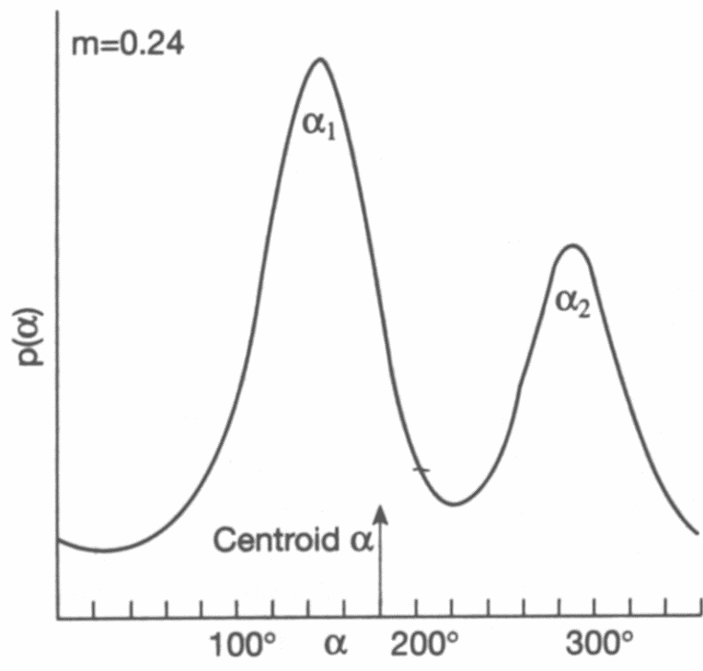
The Figure of Merit
m = probability that centroid phase is correct
Δα = phase angle measured from the centroid phase.
P(Δα) = probability that Δα is the true phase.
m = 0.866 => phase error = 30°
m = 1.0 => phase error = 0°
m = 0.0 => phase error = 90°
m = 0.5 => phase error = 60°

Slide 31
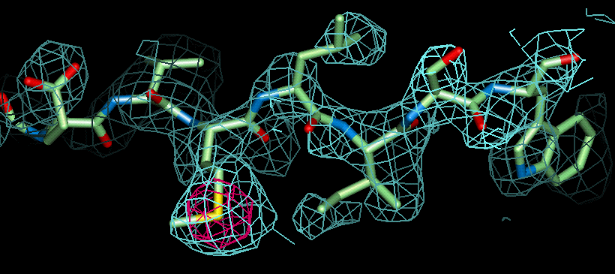
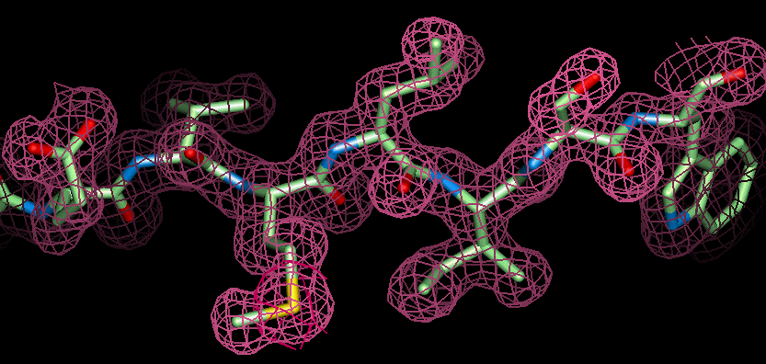
improving experimental phases
Mean phase error = 53º
Phase Improvement
Mean phase error = 41º

Slide 32
What can happen in heavy atom soaking experiments?
Good
Not Good
Not Good
+ Heavy atom
or
or
If heavy atoms don’t bind to protein - or are not ordered in the crystal – then there will be no intensity differences
Binding of heavy atom to protein in crystal can cause protein to rotate and/or translate in unit cell and/or unit cell dimensions to change
Non-isomorphism: For a 100 Å cubic unit cell a 0.5% change in unit-cell dimensions or a 0.5° rotation of the molecule within the unit cell would produce an average 15% change in intensity.

Slide 33
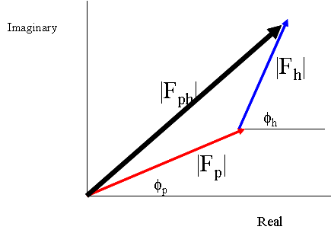
Non isomorphism (again)
Adding heavy atoms to protein crystals can cause the protein molecules to rotate and/or translate inside the unit cell. This induces non-isomorphism between native and derivative crystals
To help get around this take advantage of anomalous scattering

Slide 34
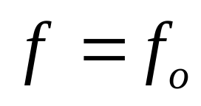
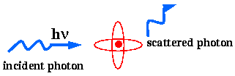
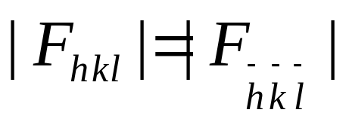
Normal Scattering
X-ray photon interacts with the electrons in the atoms of the sample. Atomic scattering factor f proportional to atomic number, Z, of atoms
All atoms scatter X-rays in the same way. Friedel’s Law is obeyed.

Slide 35
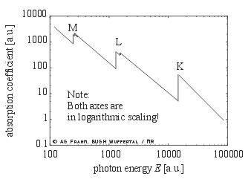
But, electron shells in atoms have X-ray absorption edges
At incident X-ray energies close to absorption edges scattering from atoms is no longer normal

Slide 36
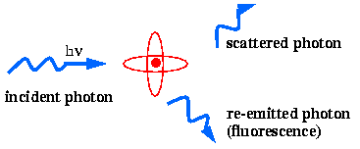

Normal scattering is modified close to absorption edge
Photons interact with the electrons in the atoms of the sample.
Depending on the photon energy the probability of absorption changes.
At photon energies close to absorption edges of a given atom, some photons are absorbed by the atom and electrons are ejected from its inner shell.
Electrons from higher energy shells decay to lower energy shells emitting fluorescence as they do so
http://www.bmsc.washington.edu/scatter/AS_tutorial.html

Slide 37



scattering factors AT X-ray energiEs close to AN absorption edge
Treat electron shells as harmonic oscillators with resonance frequencies close to energy of shell absorption edge. Scattering factor modified so that:
Scattering factor modified in such a way that it has additional, wavelength(energy)-dependent dispersive (f’) (real) and absorptive (f’’) (imaginary) terms

Slide 38





Deriving anomalous scattering factors
Experimental fluorescence scan
Experimentally determined anomalous scattering factors

Slide 39




Under ANOMALOUS SCATTERing FriEdel’s Law is no longer obeyed
We can use the anomalous difference to (help) solve the phase problem.
The larger f”, the bigger anomalous difference and the easier (in principle) it will be to solve the phase problem

Slide 40

Using Anomalous Scattering - SIRAS PHASING
If in an SIR experiment we measure F_{p} (native crystal) and both F_{ph}⁺ and F_{ph}⁻ for the derivative crystal we get three phasing circles. Hence no phase ambiguity
So, need only one derivative thus less chance of non-isomorphism

Slide 41

PHASING without a native crystal USING SAD
SAD results (like SIR) in phase ambiguity. But can use this technique to solve the phase problem.
Also allows the solution of the phase problem by collecting data from native crystals of macromolecules (i.e. no derivative). Exploits small f” available from S or P at the wavelengths we can routinely access.

Slide 42


Why do we care about f”?
If we at collect data at different wavelengths about absorption edge then F_{hkl} at different wavelengths changes
^{λ1}F ≠ ^{λ2}F
DISPERSIVE difference:
By combining measurement of anomalous and dispersive differences we can solve the phase problem using HA derivatives in MX without measuring data from a native crystal. How?
^{λ1}F
λ1
λ2
^{λ2}F

Slide 43


MAD as Quasi-(M)IR
f’ moderate, f” moderate
f’at minimum, moderate value of f”
f’ moderate, f” large

Slide 44


MAD - WHICH WAVELENGTHS? - I
Δf’
“From a practical point of view a larger f” will give more accurate values for the possible solutions [of the phase]….” Woolfson & Fan, “Solving Crystal Structures” (1995) Cambridge University Press
“….while a larger difference in f’ will provide better discrimination in resolving the [phase] ambiguity” Woolfson & Fan, “Solving Crystal Structures” (1995) Cambridge University Press
To maximise f’ need to collect two data sets: (1) at inflection point. (2) (preferably) high energy remote. So, a typical MAD experiment uses three wavelengths (peak, inflection point, remote)

Slide 45



Maximum SiGNAL: Experiment differs from theory. Don’t rely on tables
JM Guss, EA Merritt, RP Phizackerley, B Hedman, M Murata, KO Hodgson, & HC Freeman (1989). "Phase determination by multiple-wavelength X-ray diffraction: crystal structure of a basic blue copper protein from cucumbers". Science 241, 806-811.
We’re not dealing with free atoms. Interaction of anomalous scatterer with other atoms causes deviation from ideality, as do changes in oxidation state. So, we MUST measure absorption edge experimentally if we want to be sure to obtain maximum ‘signal’

Slide 46

Energy of absorption edges commonly used in experimental phasing procedures
λ~2.1Å
λ~0.62Å

Slide 47
Phasing exploiting anomalous scattering
Introduce a small number of anomalously scattering atoms into crystals
Collect both F⁺ and F⁻ at one (or more) wavelength(s). If more than one wavelength make sure these are chosen using absorption edge scan.
Derive anomalous and (if more than one wavelength) dispersive differences.
Use anomalous and/or dispersive differences to locate anomalously scattering atoms
Use these positions to initiate phase calculations

Slide 48

Collecting both F(+) and F(-) (after Dauter, Z. Methods in Enzymology, 276)

Slide 49
(S)MAD: Good & Bad
No ‘native’ crystal – no problems with isomorphism when using heavy atom derivatives
Selenomethionine can be introduced into many protein sequences and can be used as a “magic bullet”
The ‘method of choice’ for de novo structure solution in macromolecular crystallography
Signals are small in comparison to those from isomorphous replacement – data have to be good!
In MAD have to collect a lot of data from one crystal – radiation damage is a problem

Slide 50




Finding heavy atom sites
Use of direct methods much more common

Slide 51

(S)MAD intensity differences are much smaller than for IR
K absorption edges: f” ~ 4e⁻ ; can rise to 6-7e⁻ with ‘white line’. Δf’ usually has a maximum around 7e⁻ ; can rise to ~10e⁻ if far from edge.
L absorption edges: f” usually has a maximum around 12e⁻; can rise to ~30e⁻ with ‘white line’. Δf’ usually has a maximum around 13e⁻; can rise to > 20e⁻ if far from edge
For comparison, Hg has Z = 78 e⁻.
(J. Smith, Curr. Opin. Struct. Biol. 1, 1991)
In comparison to signals available in IR, AD signals are small
This knowledge must inform all decisions when collecting data for AD experiments
Need to: MAXIMISE SIGNAL and/or REDUCE ERRORS

Slide 52



Expected anomalous signal
(J. Smith, Curr. Opin. Struct. Biol. 1, 1991)
http://www.ruppweb.org/new_comp/anomalous_scattering.htm

Slide 53
Methods for S/MAD Data Collection - I
The Random Orientation ‘Technique’ – Here the crystal is mounted in a random orientation with respect to the X-ray beam and goniometer axes. Data are then collected in one contiguous oscillation range such that complete and redundant anomalous data are obtained.
  The rotation range required can be obtained using various data collection strategy programs (i.e. BEST).
    Takes no real account of factors that can adversely affect intensities (absorption, different detector position for diffraction spots)

Slide 54






Data collection strategies and data quality predictions
Bourenkov, G.P. & Popov, A.N. (2010). Optimization of data collection taking radiation damage into account. Acta Cryst. D66, 409-419.

Slide 55
Methods for S/MAD Data Collection - II
The Inverse-beam Method – Crystal mounted in a random orientation. Data are collected in one contiguous oscillation range (from φ = Xº to φ = Yº) such that data is as complete as possible for a ‘standard’ data collection. The Freidel mates of these reflections are then collected by inverting the orientation of the crystal and collecting the equivalent data (i.e. by collecting from φ=180+Xº to φ=180+Yº). Can also collect in smaller wedges.
  Freidel pairs are measured with the same path-length through crystal (absorption).
  Freidel pairs are collected close together in time (if we use small wedges).
  Freidel pairs measured with the same multiplicity
  Best to interleave collection of wedges.

Slide 56
Methods for S/MAD Data Collection - III
The ‘Set-Crystal’ Method – Here the crystal is mounted such that the principle rotation axis of the crystal point group is parallel to the spindle axis of the goniometer. If this rotation axis is even-fold (i.e. 2, 4, 6) then:
  Bijvoet mates are collected on the same oscillation image.
  Bijvoet mates are collected after same total exposure time.
  Bijvoet mates suffer from ‘same’ absorption and radiation damage.
  (Mini-)Kappas make this straightforward

Slide 57


Using Kappa Goniometers

Slide 58


A ‘Problem’ with Set Crystal Method
Ewald Sphere
The ‘Blind’ Region:
Shaded region will never pass through Ewald Sphere. Need to collect data in a second orientation to ensure data is properly complete.
Size of blind region:

Slide 59






data processing, substructure determination, phase calculations and electron density maps

Slide 60
Some reading…..
Evans, P. & McCoy, A. (2008). An introduction to molecular replacement, Acta Cryst. D66, 1–10.
Taylor, G.L. (2010). Introduction to phasing. Acta Cryst. D66, 325-338.
Dauter, Z., Dauter, M. & Dodson, E.J. (2002). Jolly SAD. Acta Cryst. D58, 494-506.
Hendrickson W.A. (1991) Determination of macromolecular structures from anomalous diffraction of synchrotron radiation. Science. 254, 51-8.
Sheldrick, G. M. (2008). A short history of SHELX. Acta Cryst. A64, 112-122.
Bourenkov, G.P. & Popov, A.N. (2010). Optimization of data collection taking radiation damage into account. Acta Cryst. D66, 409-419.

