Slide 1


Refinement
DLS-CCP4 Data Collection and Structure Solution Workshop
December 13-20 2016
Diamond Light Source, Oxfordshire, UK
Oleg Kovalevskiy Rob Nicholls okovalev@mrc-lmb.cam.ac.uk nicholls@mrc-lmb.cam.ac.uk

Slide 2
Low Resolution Refinement
~3Å or lower (tools are sometimes useful at slightly higher resolutions)
Reflection intensities often noisy
Limited data - poor observation:parameter ratio
At low resolution, refinement often becomes unstable
Overfitting – R-factors diverge
Notes:
weak signal, noisy data
Model incompleteness
Limited data - Poor observation-to-parameter ratio
Higher risk of overfitting – often characterised by large difference in R and Rfree
Unstable refinement
Unreliable/suboptimal model
One Solution: Regularisation

Slide 3
Low Resolution Refinement
~3Å or lower (tools are sometimes useful at slightly higher resolutions)
Reflection intensities often noisy
Limited data - poor observation:parameter ratio
At low resolution, refinement often becomes unstable
Overfitting – R-factors diverge
To improve models, we need to:
  Ease manual model building
  Use of prior knowledge to stabilize refinement – Regularisers
Notes:
weak signal, noisy data
Model incompleteness
Limited data - Poor observation-to-parameter ratio
Higher risk of overfitting – often characterised by large difference in R and Rfree
Unstable refinement
Unreliable/suboptimal model
One Solution: Regularisation

Slide 4
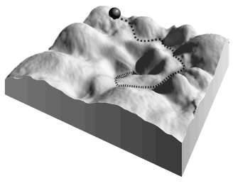
Regularisation
Notes:
Energy potential

Slide 5

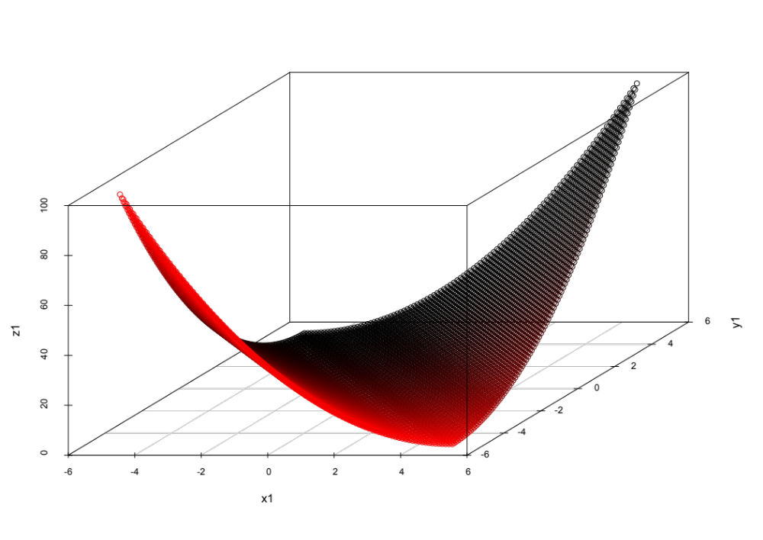
Regularisation
Example:
Notes:
Energy potential
Suppose we start with a particular set of parameter values.
We want to travel through space in order to minimise the function, hopefully resulting in a good model.
We want to estimate the direction of travel, and how far to travel. For that, we need the gradient and curvature.
In the presence of noise, the direction and distance to travel in a given optimisation cycle may be unstable.

Slide 6

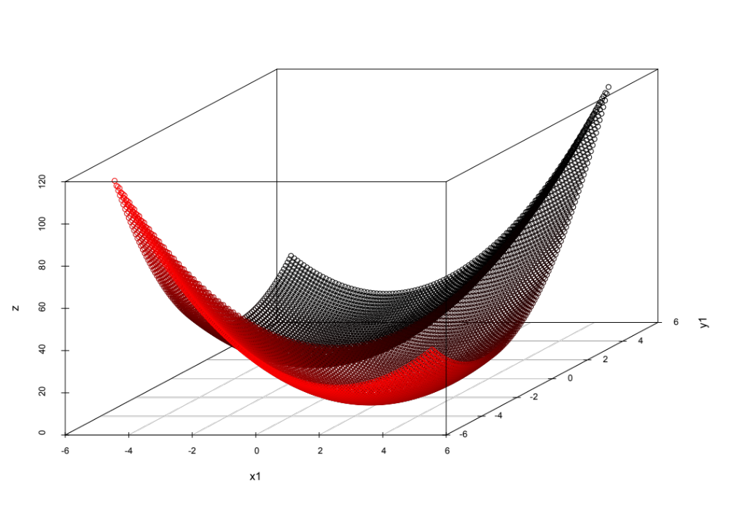

Regularisation
Example:
Regularise using prior information:
Notes:
Using regularisers can help to improve stability of refinement by altering the shape of the likelihood function.

Slide 7
Regularisation
Use of available knowledge (prior information):
High-low resolution:
Geometry restraints (chemical information)
Medium-low resolution:
Local NCS restraints
B-value restraints
Jelly body restraints
Low resolution (and medium-low resolution model building):
External restraints

Slide 8
Regularisation
Use of available knowledge (prior information):
High-low resolution:
Geometry restraints (chemical information)
Medium-low resolution:
Local NCS restraints
B-value restraints
Jelly body restraints
Low resolution (and medium-low resolution model building):
External restraints
Regularisers with a target value

Slide 9
Regularisation
Use of available knowledge (prior information):
High-low resolution:
Geometry restraints (chemical information)
Medium-low resolution:
Local NCS restraints
B-value restraints
Jelly body restraints
Low resolution (and medium-low resolution model building):
External restraints
Regularisers without an external target value

Slide 10
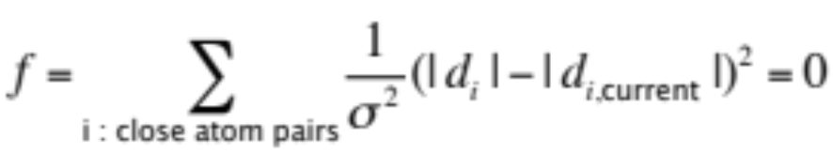
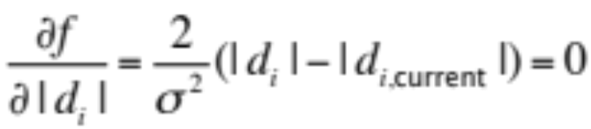
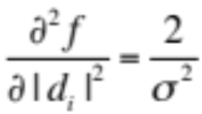
Jelly Body Restraints
Regularisers without a target:
|d_{i}| : interatomic distance
|d_{i,current}| : current interatomic distance
σ : restraint standard deviation
Does not change likelihood function.
Does not change derivative.
Does change 2nd derivative - curvature.
Model should be less prone to fitting into noise
Should only work if parameters are near the minima (model is good)
Typical: σ = 0.01–0.02
Distance threshold: 4.2Å

Slide 11
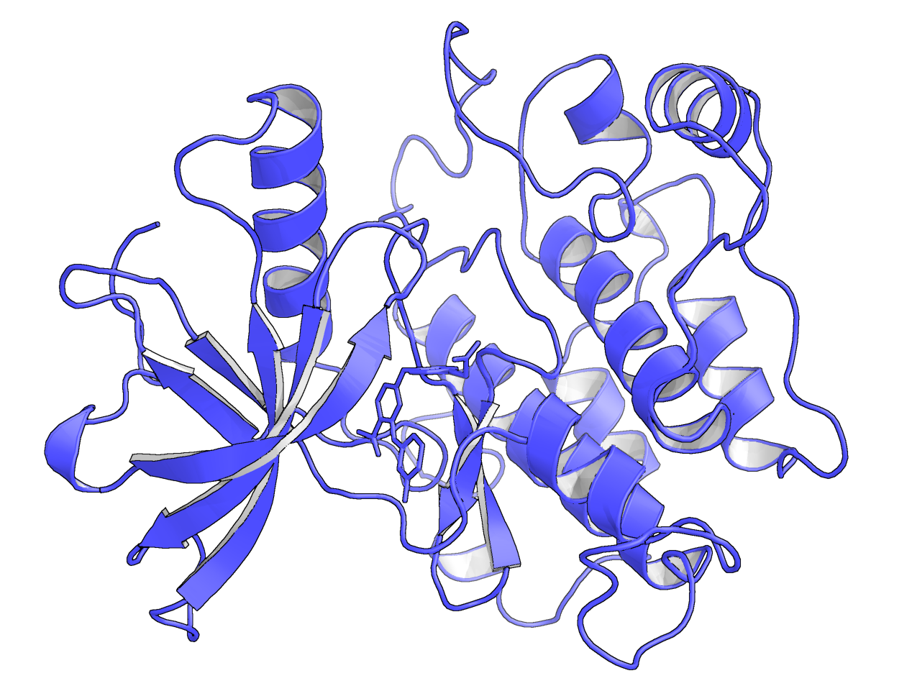
Jelly Body Restraints
Tyrosine Kinase
2z8c (2007) – 3.25Å
R_{work}/R_{free} : 21.7/29.2 %

Slide 12
Jelly Body Restraints
Tyrosine Kinase
2z8c (2007) – 3.25Å
R_{work}/R_{free} : 21.7/29.2 %
R_{work}/R_{free} : 19.7/27.3 %
Jelly-body:

Slide 13
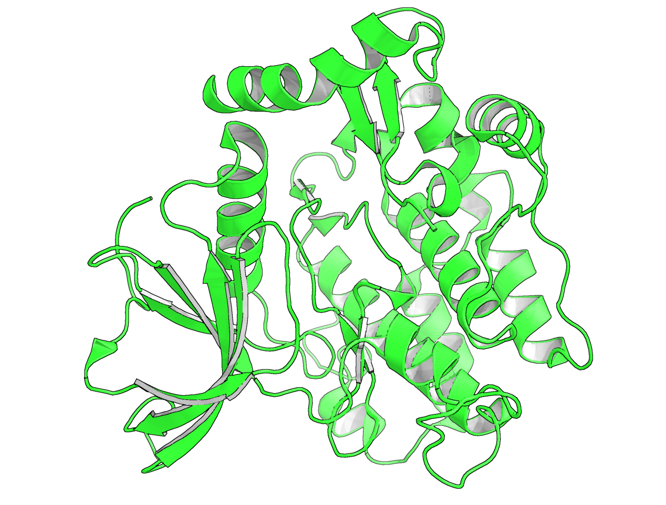
Jelly Body Restraints
Tyrosine Kinase
2z8c (2007) – 3.25Å 2auh (2005) – 3.2Å
R_{work}/R_{free} : 21.7/29.2 % R_{work}/R_{free} : 22.3/25.4 %
R_{work}/R_{free} : 19.7/27.3 %
Jelly-body:

Slide 14
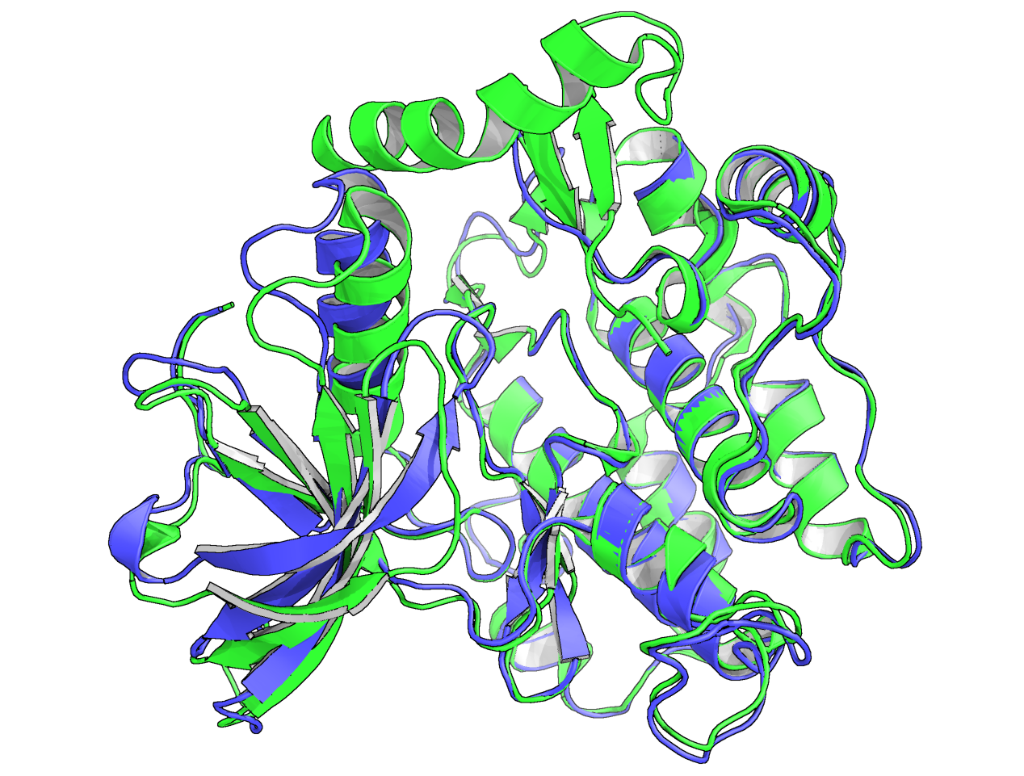
Jelly Body Restraints
Tyrosine Kinase
Positional shift up to 4.5 Å
Molecular replacement
(Molrep, 10s)
2z8c (2007) – 3.25Å 2auh (2005) – 3.2Å
R_{work}/R_{free} : 21.7/29.2 % R_{work}/R_{free} : 22.3/25.4 %
R_{work}/R_{free} : 19.7/27.3 %
Jelly-body:
Notes:
2auh (the earlier model) has no ligands (apart from 2 Ca++ ions).
2z8c is a ligand-bound version. The ligand causes domain movement, resulting in positional shift.
For an experiment:
Used 2auh as MR search model (without any modifications) to solve 2z8c using molrep with default parameters - solved in 10 seconds.

Slide 15
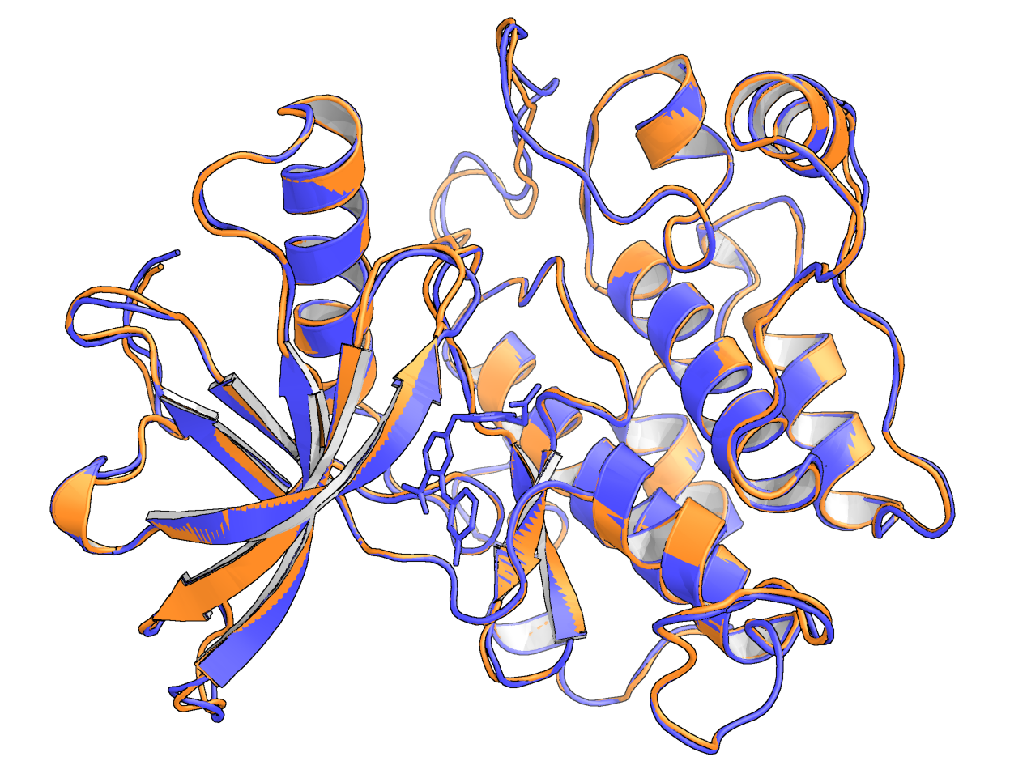
Jelly Body Restraints
Tyrosine Kinase
Molecular replacement
(Molrep, 10s)
2z8c (2007) – 3.25Å 2z8c solved using 2auh,
re-refined using jelly-body
R_{work}/R_{free} : 21.7/29.2 % R_{work}/R_{free} : 20.2/25.8 %
R_{work}/R_{free} : 19.7/27.3 %
Jelly-body:
Notes:
For an experiment:
Used 2auh as MR search model (without any modifications) to solve 2z8c using molrep with default parameters - solved in 10 seconds.
Ran 3 rounds of jelly-body refinement (40 cycles), after which the model adopted a conformation very close to the deposited 2z8c – the model was able to change conformation during refinement.

Slide 16
Jelly Body Restraints
Tyrosine Kinase
Molecular replacement
(Molrep, 10s)
2z8c (2007) – 3.25Å 2z8c solved using 2auh,
re-refined using jelly-body
R_{work}/R_{free} : 21.7/29.2 % R_{work}/R_{free} : 20.2/25.8 %
R_{work}/R_{free} : 19.7/27.3 %
Jelly-body:
Molprobity clashscore : 28.3 Molprobity clashscore : 16.9

Slide 17
Jelly Body Restraints
Tyrosine Kinase
Molecular replacement
(Molrep, 10s)
2z8c (2007) – 3.25Å 2z8c solved using 2auh,
re-refined using jelly-body
R_{work}/R_{free} : 21.7/29.2 % R_{work}/R_{free} : 20.2/25.8 %
R_{work}/R_{free} : 19.7/27.3 %
Jelly-body:
Molprobity clashscore : 28.3 Molprobity clashscore : 16.9

Slide 18
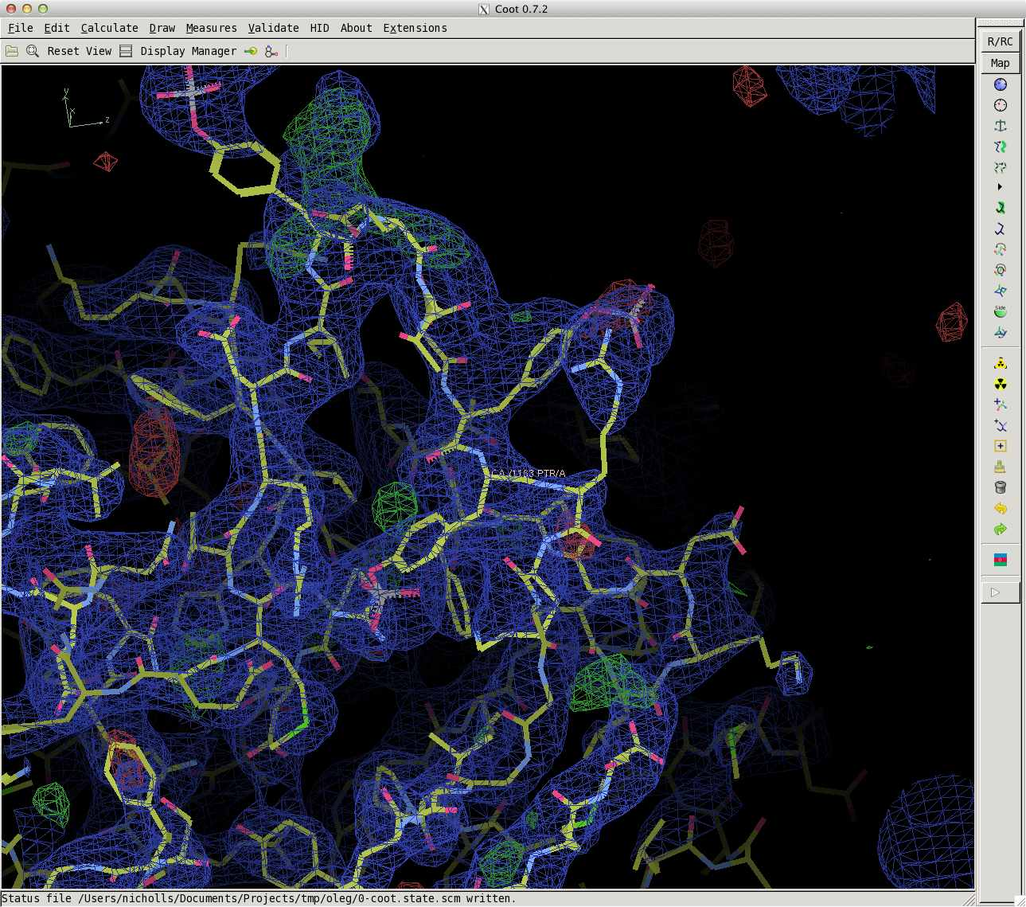
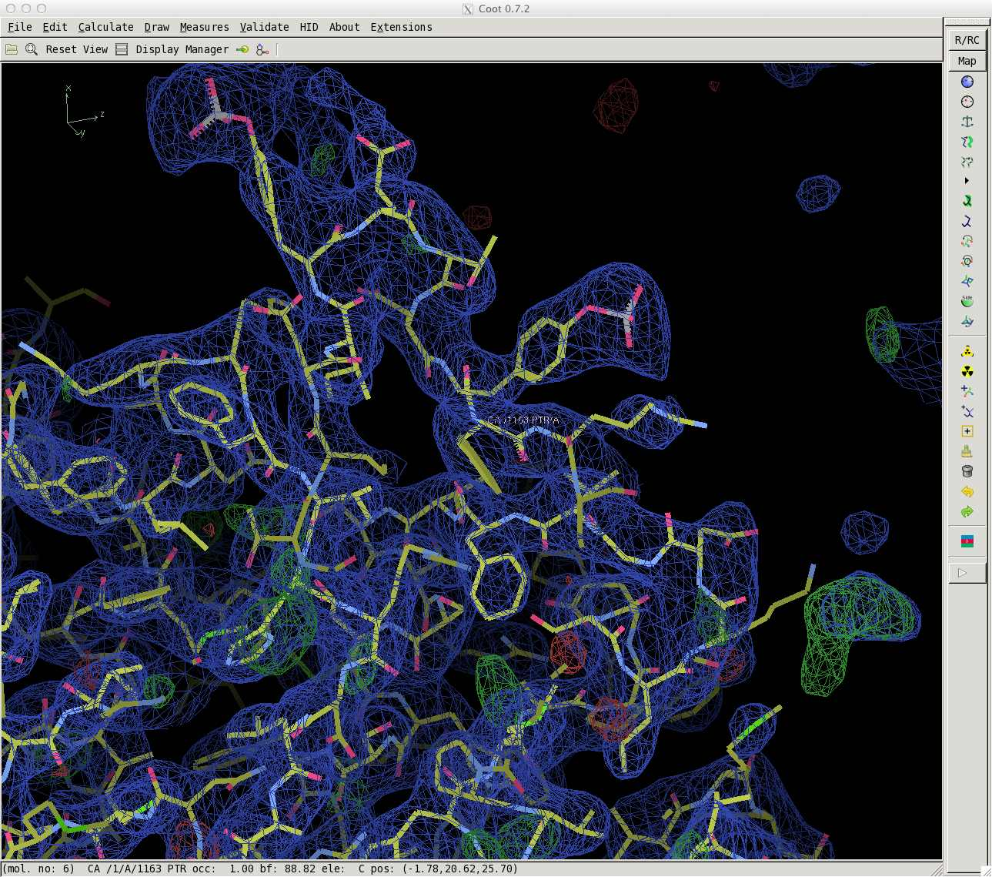
Jelly Body Restraints
Tyrosine Kinase
2z8c – 3.25Å 2z8c solved using 2auh,
re-refined using jelly-body
R_{work}/R_{free} : 21.7/29.2 % R_{work}/R_{free} : 20.2/25.8 %
R_{work}/R_{free} : 19.7/27.3 %
Jelly-body:
Molprobity clashscore : 28.3 Molprobity clashscore : 16.9
Notes:
Just one loop was out of the density (left).
However, the density was clear enough to indicate how the model should be rebuilt (right).
After quick rebuilding, and re-running jelly-body refinement, the model was substantially improved.

Slide 19
Jelly Body Restraints
Conclusions:
Jelly-body restraints are great at stabilising refinement,
and can have quite a wide radius of convergence…
but can’t alone improve a model dramatically
We can’t rely on the reliability of models deposited in the PDB
(applies for more moderate-resolution models also)
Structural information in the PDB can be useful in the determination of new structures

Slide 20
ProSMART in MX Refinement
External restraint generation:
Injection of prior knowledge to aid new structure determination:
  External Restraints from homologous structures
  Hydrogen bond restraints
Restraints utilised by: REFMAC5, Coot
Executed from: CCP4i, CCP4i2, CCP4mg, Coot, command line
Independent of global conformation
Notes:
Produces a structure-based alignment. It’s able to align structures even in the presence of conformational changes such as domain motion. So if you want to compare two structures, ProSMART doesn’t care whether or not they are in different global conformations. Rather, ProSMART is only interested in the conservation of local structure.
This is really useful, particularly in the context of external restraint generation, where a high-resolution structure may have been solved in a different conformational state.
Covered in tutorial

Slide 21
External Restraint Generation
structure to be refined known similar structure (prior)
(abstract representation of an atomic model; circles = atoms)

Slide 22
External Restraint Generation
structure to be refined known similar structure (prior)
d
r
(abstract representation of an atomic model; circles = atoms)

Slide 23
External Restraint Generation
structure to be refined
d
r
d Ν(r,σ²)
~
(abstract representation of an atomic model; circles = atoms)
Notes:
Prior information used in refinement is that d is normally distributed with mean equal to the corresponding distance in the reference structure, and variance sigma^2.

Slide 24
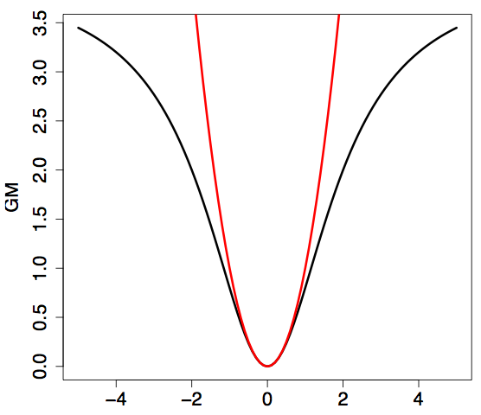

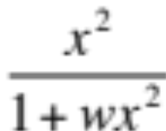
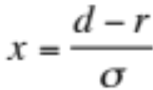
External Restraints
Least squares:
Geman-McClure:

Slide 25
External Restraints
Least squares:
Geman-McClure:

Slide 26
External Restraints
Least squares:
Geman-McClure:

Slide 27
External Restraints
Least squares:
Geman-McClure:

Slide 28
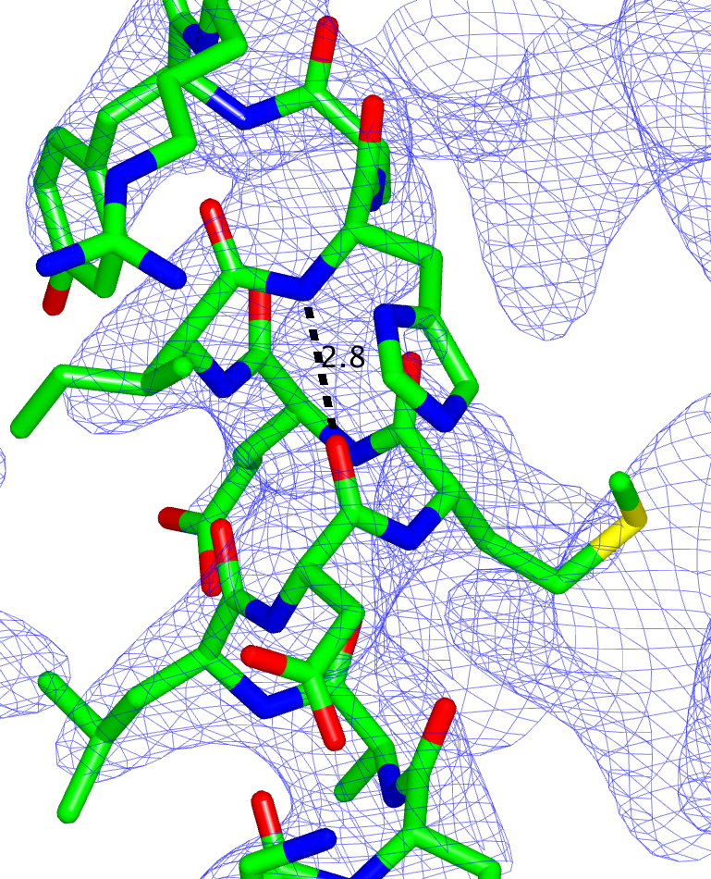
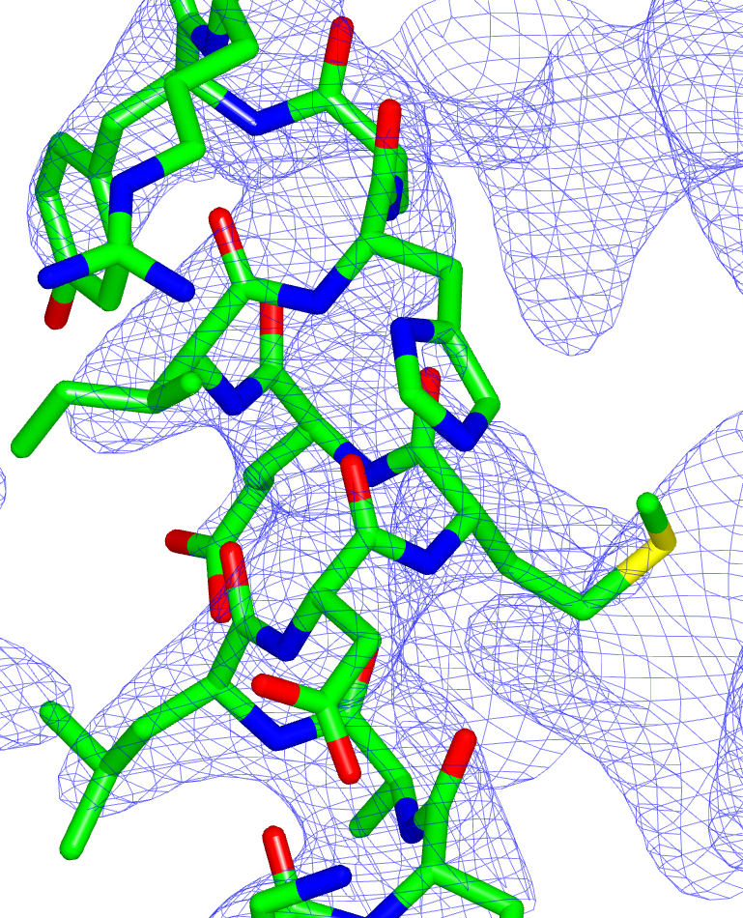





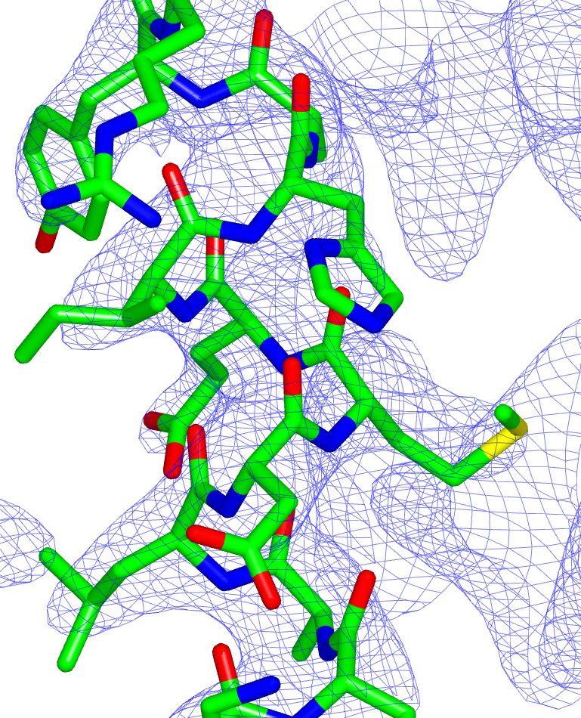
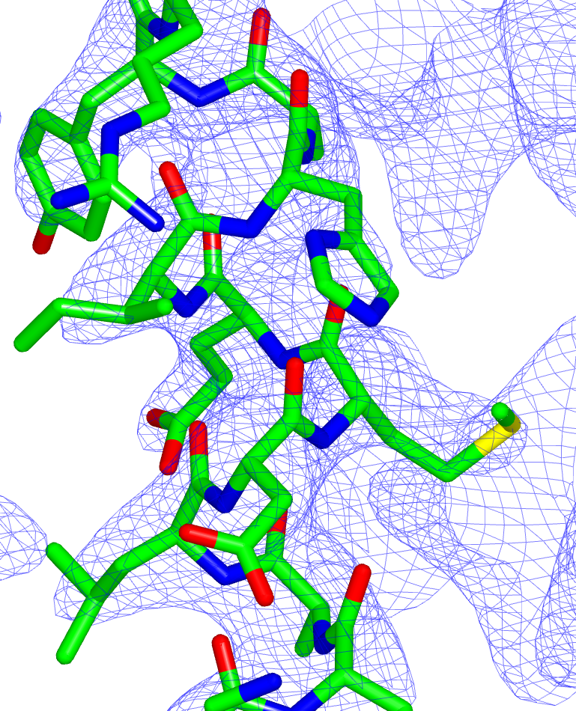
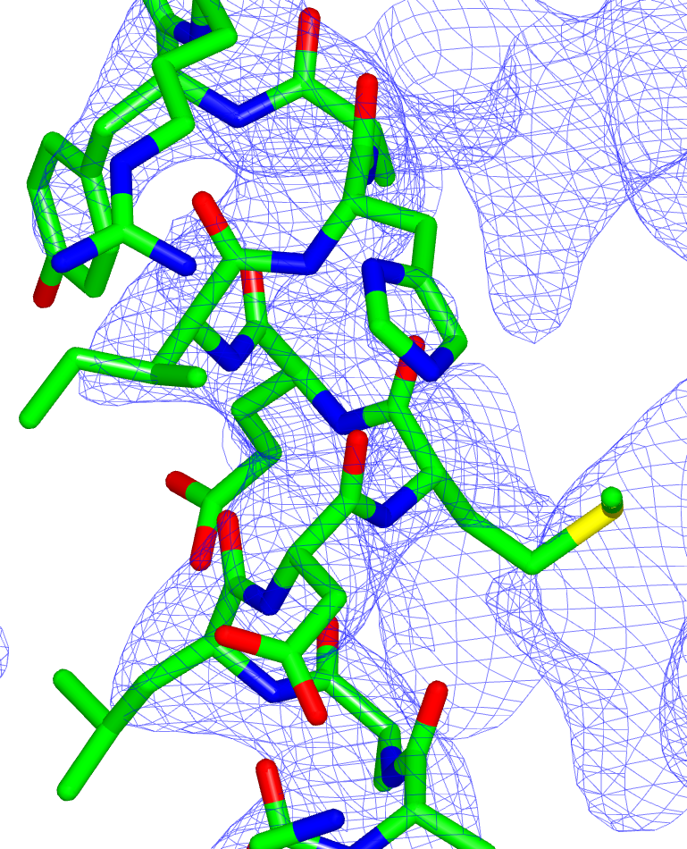
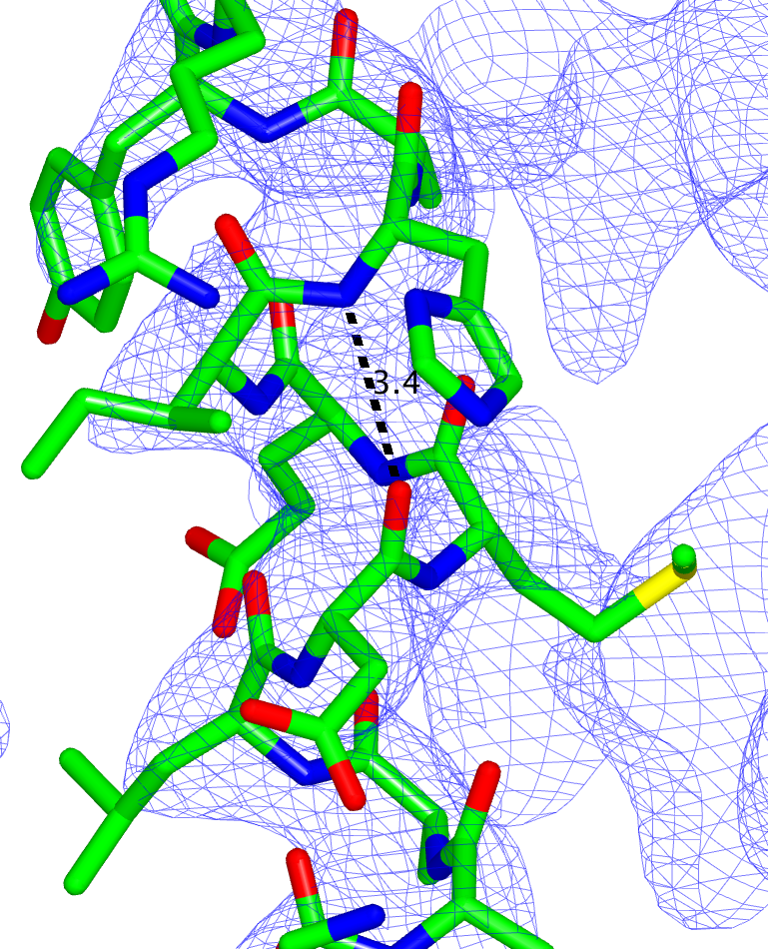
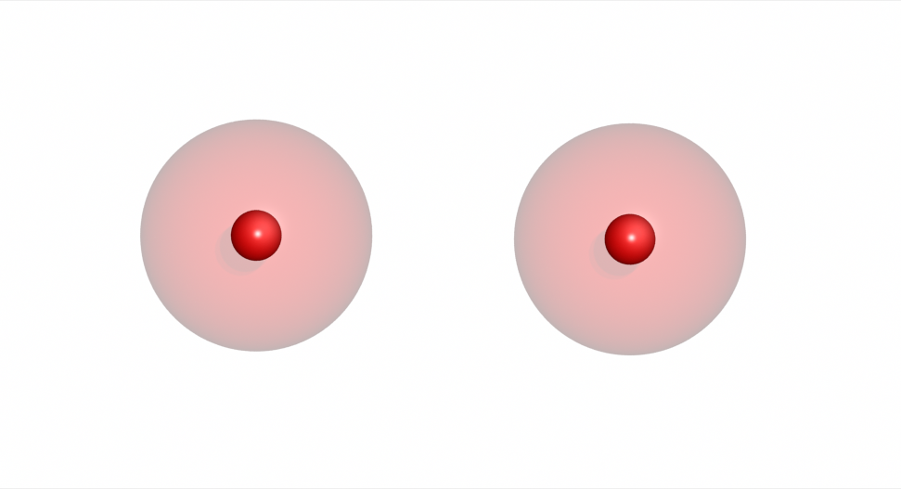
External Restraints
Prior information:
2.8Å
Stabilises structural features
3g4w – 3.7Å
Notes:
Example of the distance between Hydrogen bonded atoms being restrained to an ideal value.

Slide 29
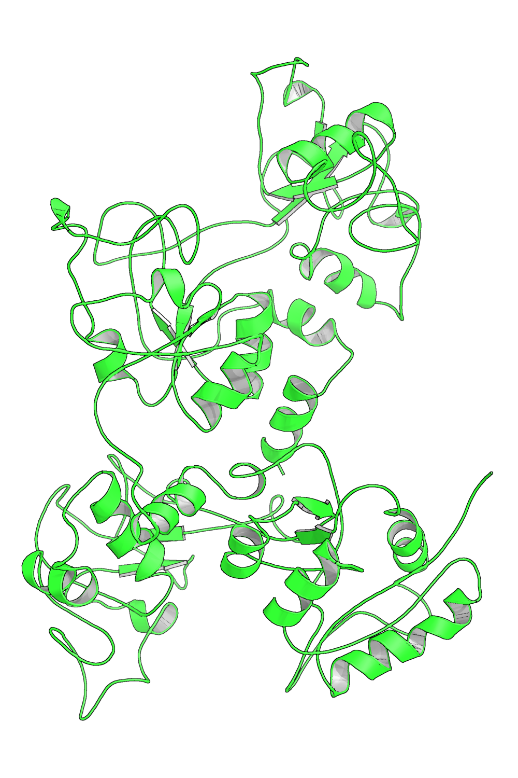
Motivational Example
Ovotransferrin
Low-resolution refinement:
Weak signal
Noisy data
Unstable refinement
Result:
Poor quality model
1ryx – 3.5Å
Notes:
Data poor -> model poor.
Data are limited and incomplete
Difficult to interpret density -> difficult to build model
Little secondary structure well defined – scruffy looking
Can’t improve R factors; R-factors diverge when you try to refine.

Slide 30
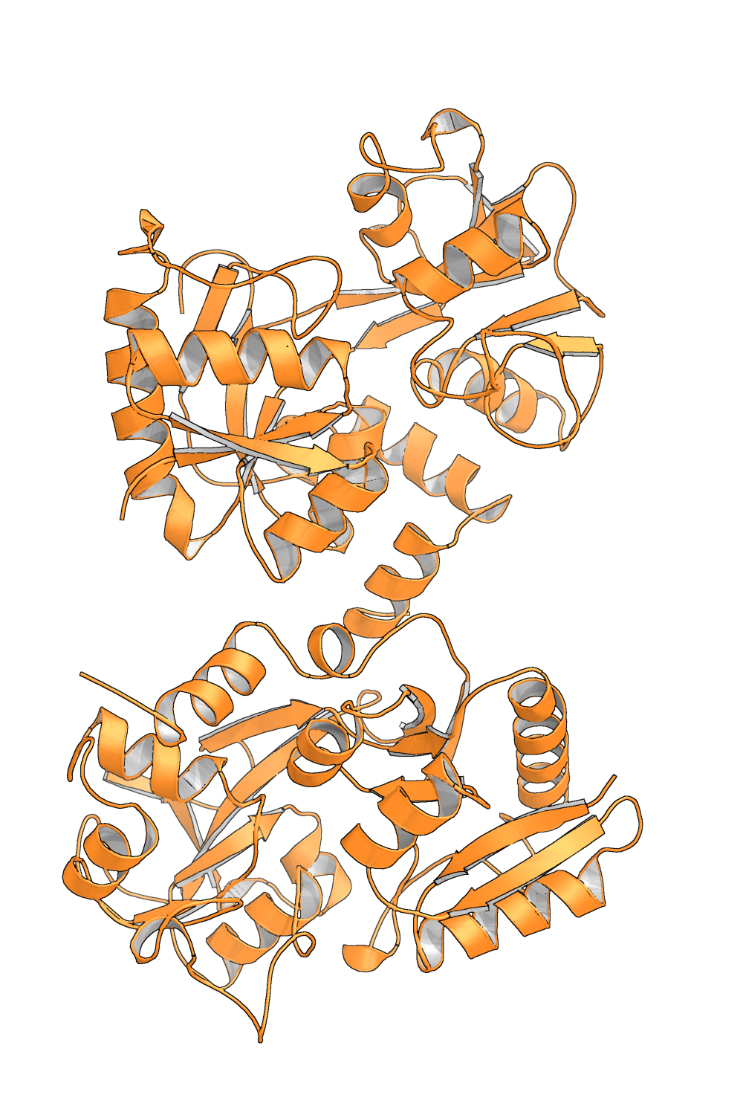
Motivational Example
Ovotransferrin High-resolution homologue
1ryx – 3.5Å 2d3i – 2.15Å
Notes:
High resolution homologous model is available
Want to use this info to improve quality of the low-res model

Slide 31
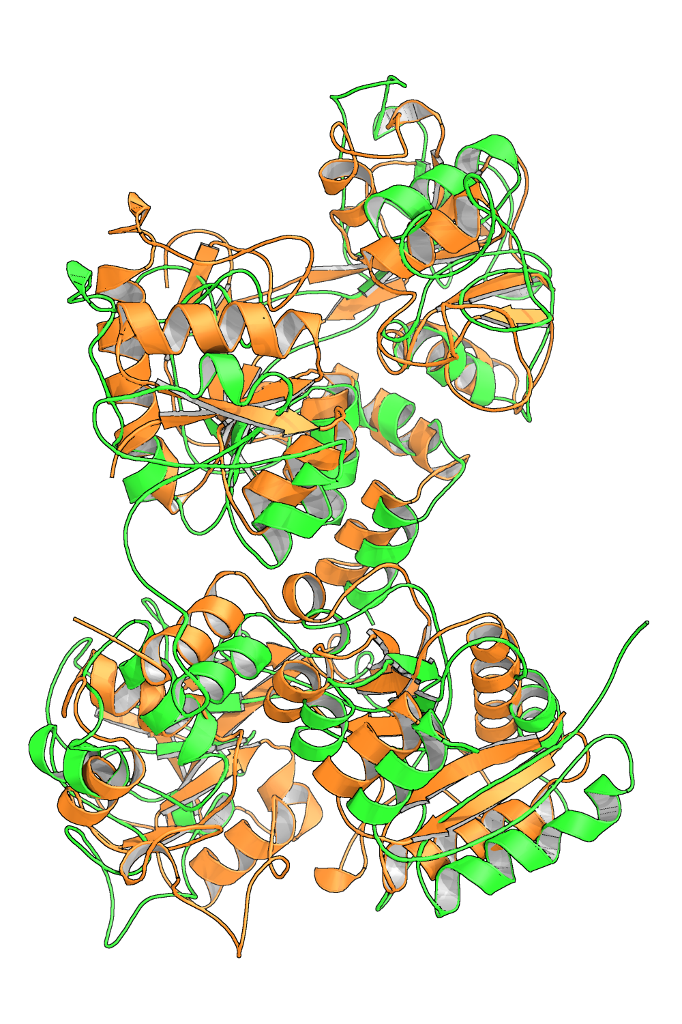
Motivational Example
Ovotransferrin
Models don’t superpose well
Notes:
The higher resolution model may be in a different global conformation to the low-res model, thus they don’t superpose well.
Want to inject information about local structural similarity into the low-res structure.

Slide 32
External Restraints
Ovotransferrin High-resolution homologue
1ryx – 3.5Å 2d3i – 2.15Å
Notes:
High resolution homologous model is available
Want to use this info to improve quality of the low-res model
Now we have the tools to generate restraints, we can attempt to address this problem.

Slide 33
External Restraints
Ovotransferrin
Models don’t superpose well
Notes:
The higher resolution model may be in a different global conformation to the low-res model, thus they don’t superpose well.
Want to inject information about local structural similarity into the low-res structure.

Slide 34
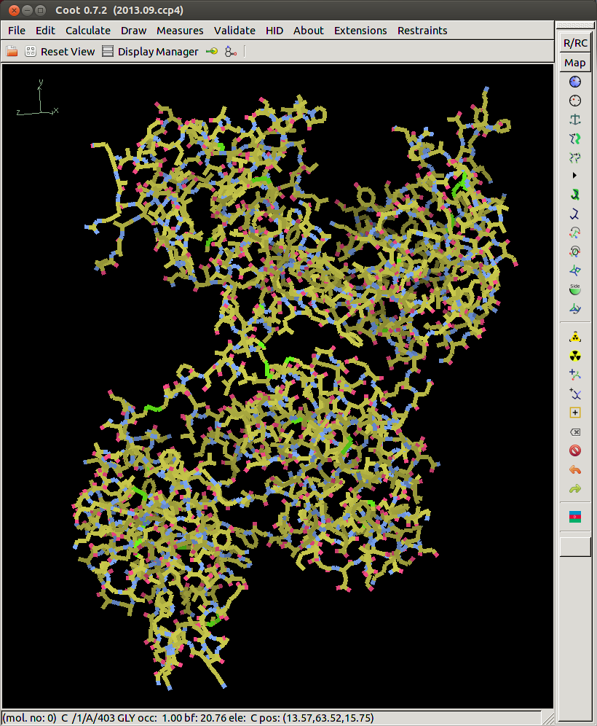
ProSMART Restraint Visualisation in Coot
Ovotransferrin
1ryx (3.5Å)
Thanks to Paul Emsley

Slide 35
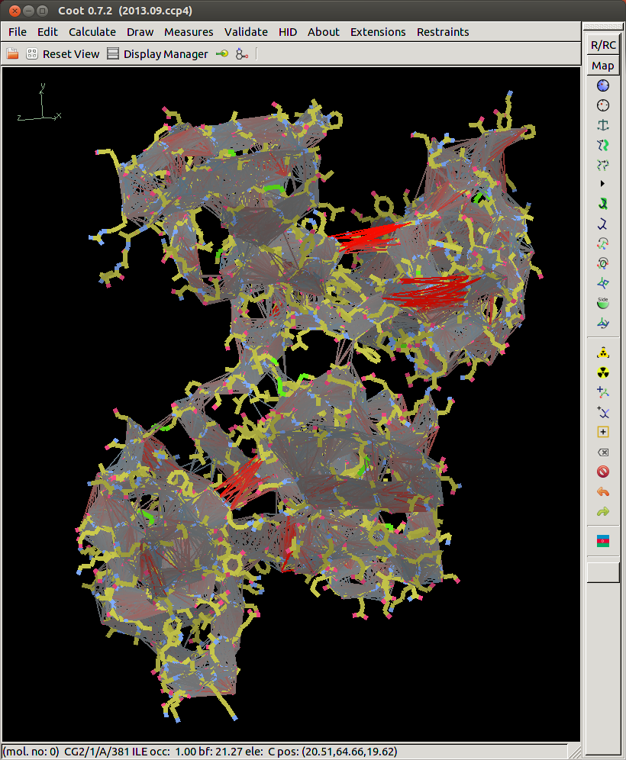
ProSMART Restraint Visualisation in Coot
Backbone
Restraints
Ovotransferrin
1ryx (3.5Å)
restrained to
2d3i (2.15Å)
Thanks to Paul Emsley

Slide 36
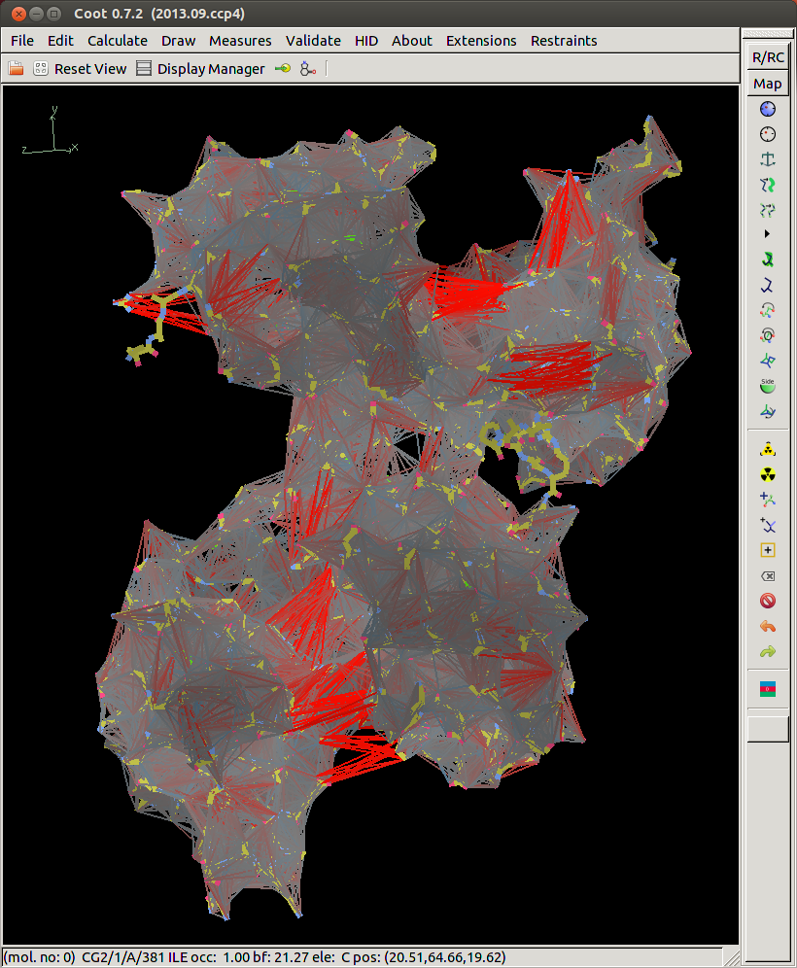
ProSMART Restraint Visualisation in Coot
Backbone
& Side Chain
Restraints
Ovotransferrin
1ryx (3.5Å)
restrained to
2d3i (2.15Å)
Thanks to Paul Emsley

Slide 37
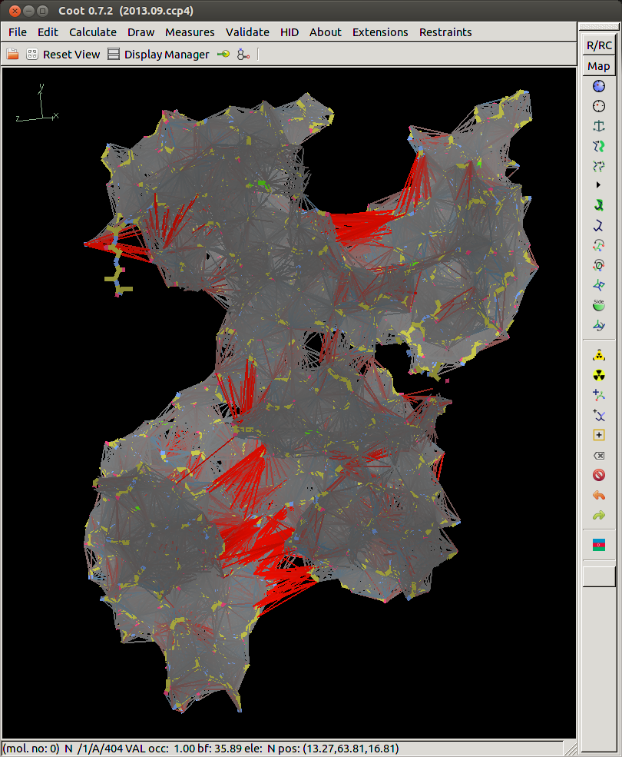
ProSMART Restraint Visualisation in Coot
Backbone
& Side Chain
Restraints
Regenerated after re-refinement
Ovotransferrin
1ryx re-refined
restrained to
2d3i (2.15Å)
Thanks to Paul Emsley

Slide 38
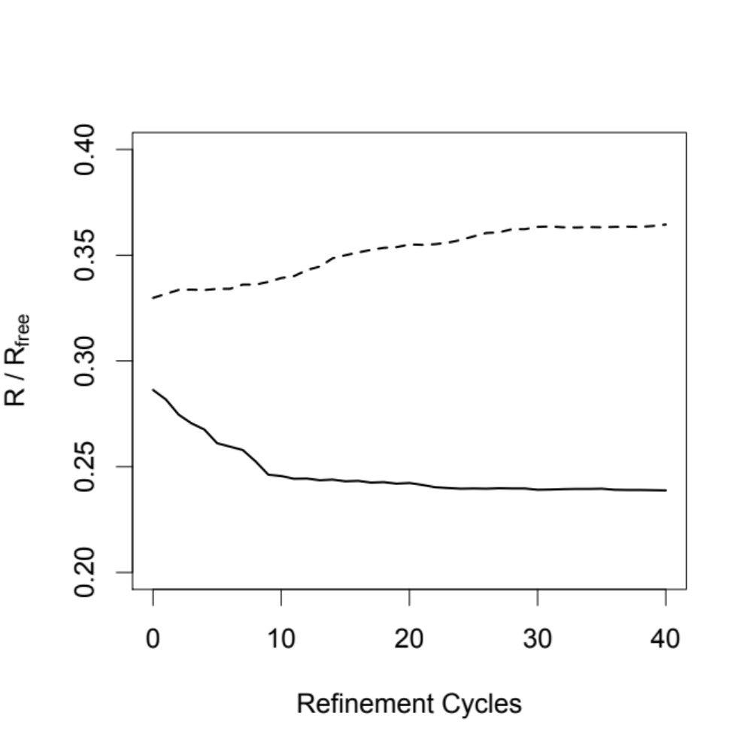
External Restraints
Ovotransferrin
36.5 %
23.9 %
R_{free}
R-factor

Slide 39
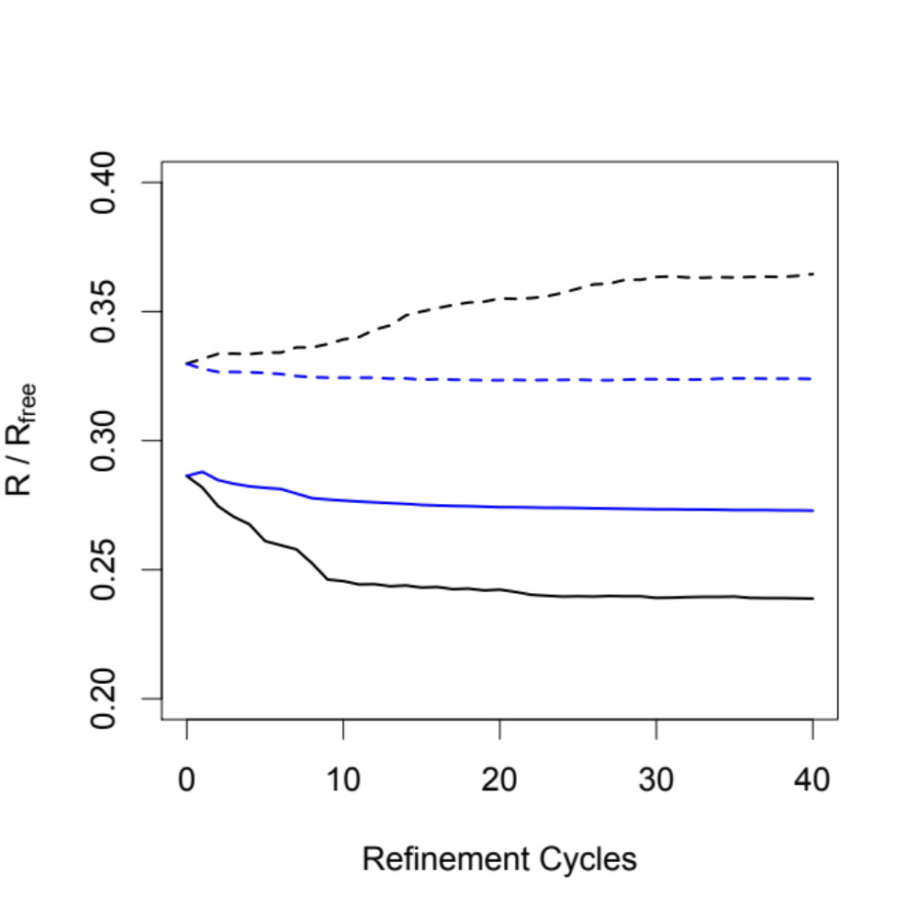
External Restraints
Ovotransferrin
36.5 %
32.4%
27.3 %
23.9 %
R_{free}
R-factor
Jelly-body restraints

Slide 40
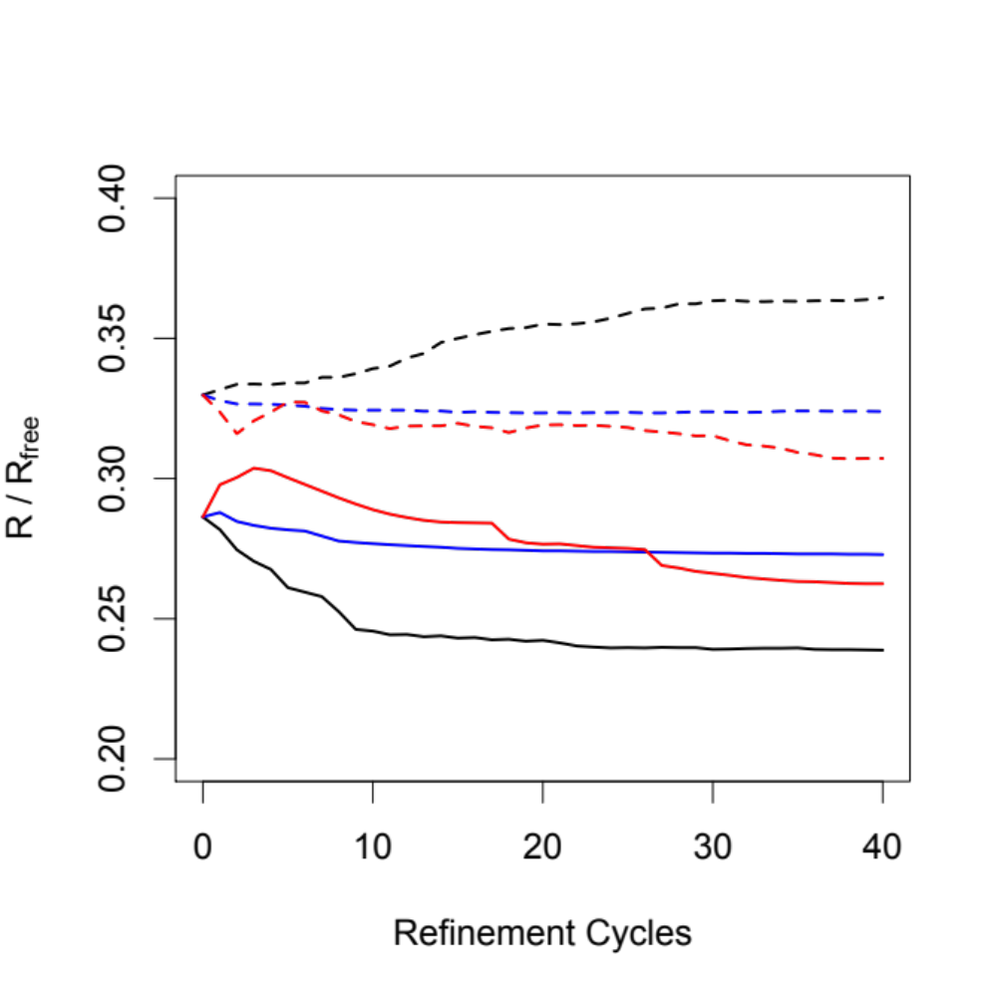
External Restraints
Ovotransferrin
36.5 %
32.4%
30.7 %
27.3 %
26.3 %
23.9 %
R_{free}
R-factor
Jelly-body restraints
External restraints
Notes:
Black – refinement
Blue – refinement with jelly-body
Red – refinement with external restraints
Note – intention is not to criticise the original authors of the PDB deposition. Software has improved since then.

Slide 41
External Restraints
Ovotransferrin
Original Structure
R/R_{free} : 0.286/0.330
Notes:
Hide second

Slide 42
External Restraints
Ovotransferrin
Original Structure
R/R_{free} : 0.286/0.330
Re-refined with External Restraints
R/R_{free} : 0.263/0.307
Notes:
Hide second

Slide 43
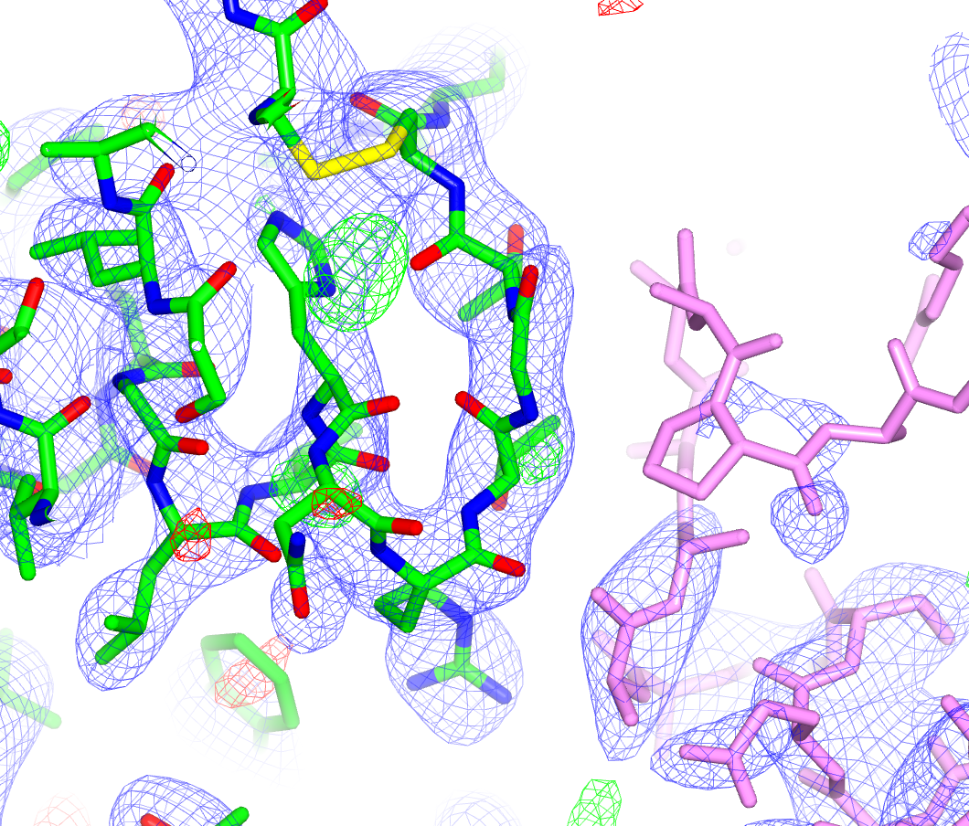

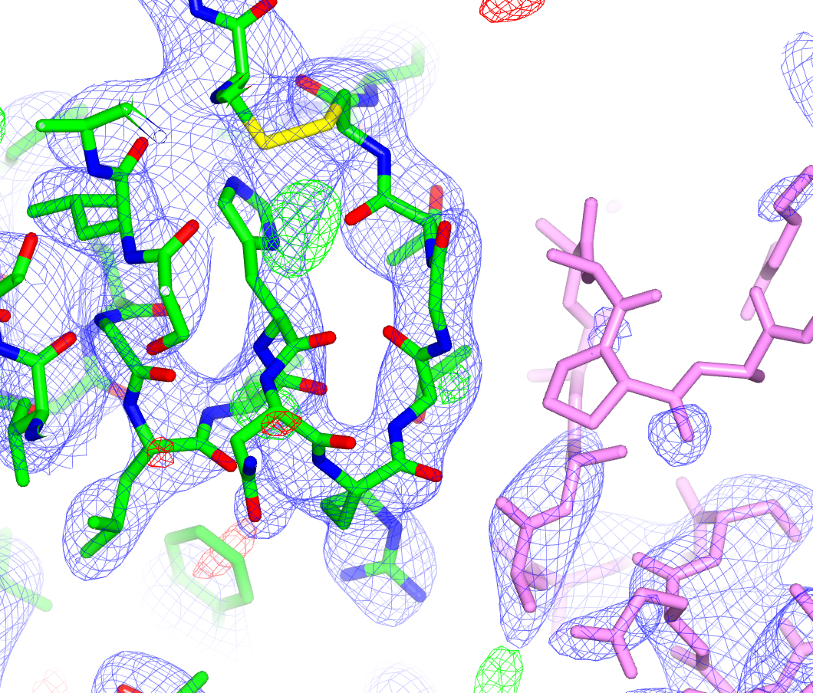

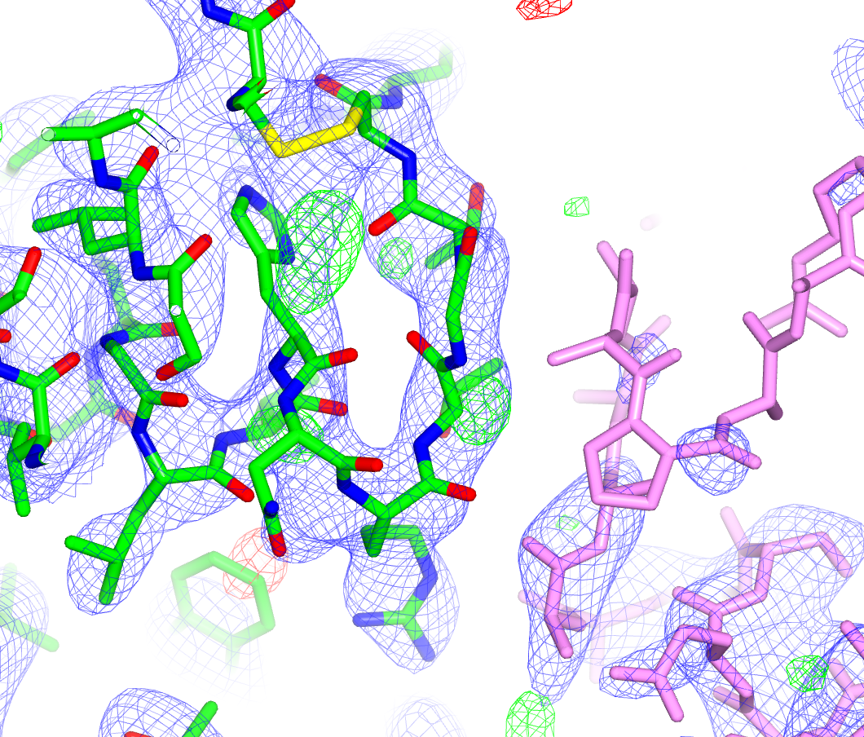
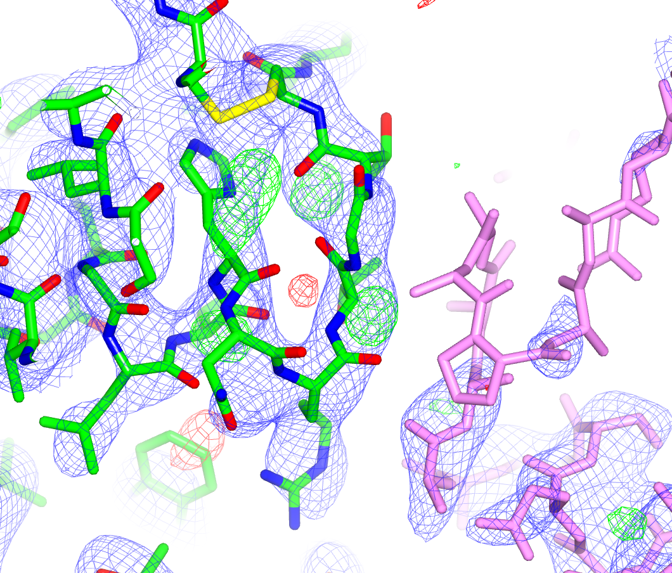
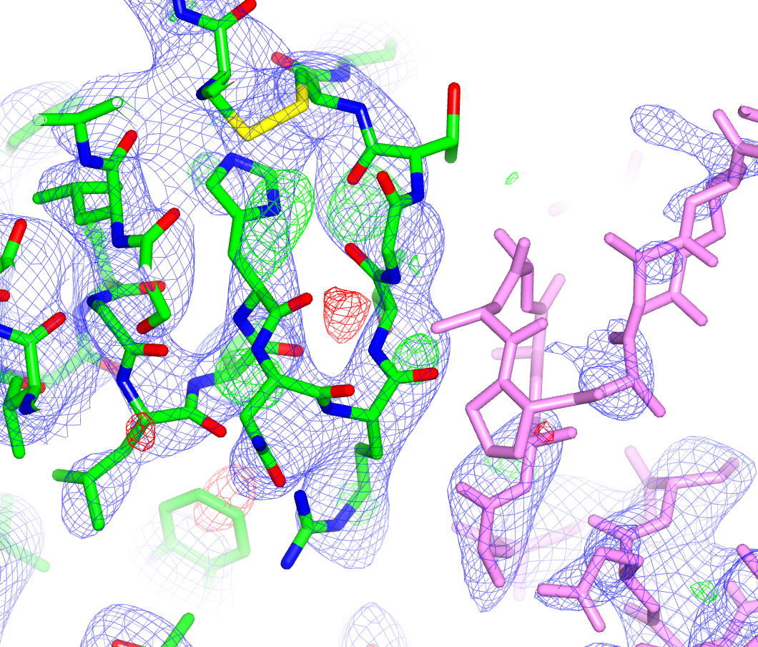
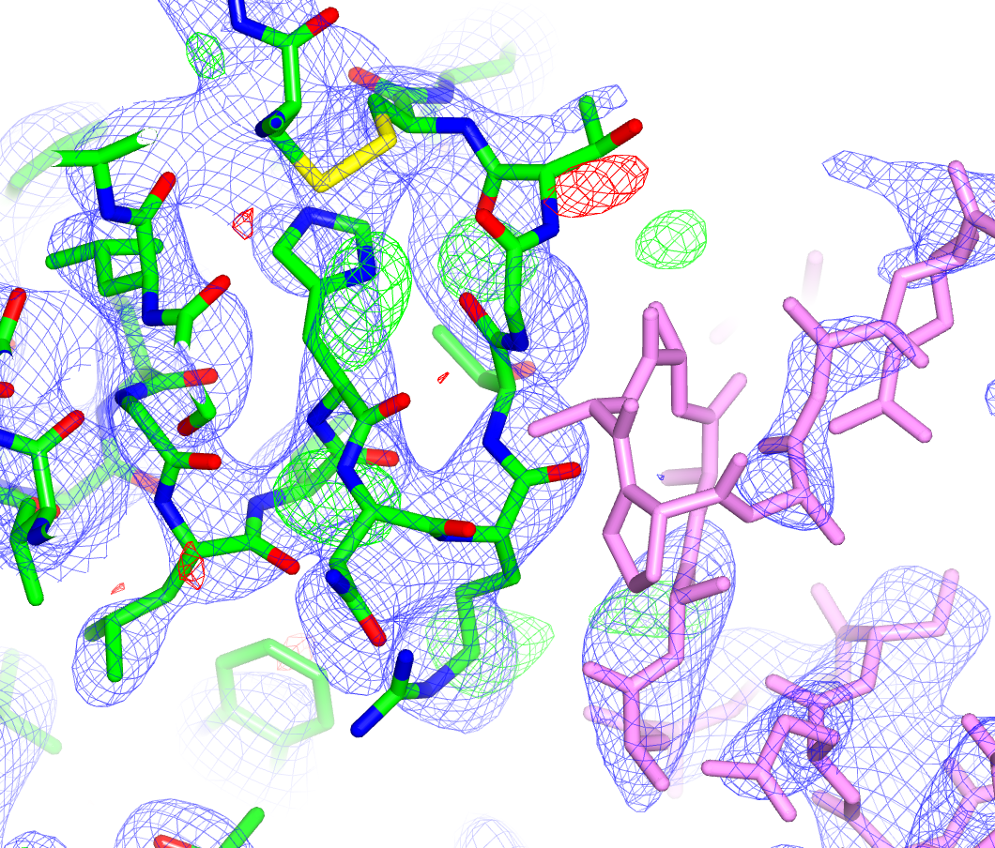
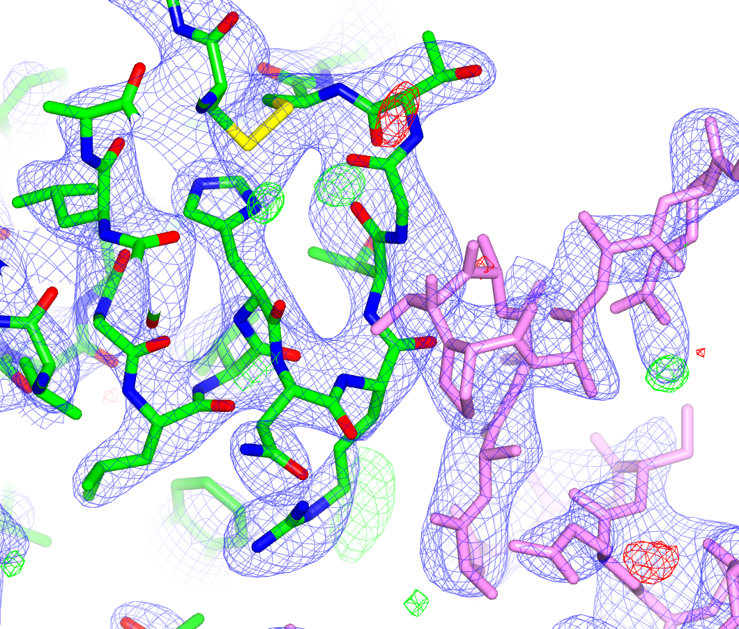
External Restraints
Original Structure
R/R_{free} : 0.286/0.330
⬇
External restraints
(40 cycles)
R/R_{free} : 0.263/0.307
1.3σ

Slide 44





External Restraints
Original Structure
R/R_{free} : 0.286/0.330
⬇
External restraints
(40 cycles)
R/R_{free} : 0.263/0.307
⬇
Modify
Real Space Refine
⬇
Jelly body
(40 cycles)
R/R_{free} : 0.253/0.304
1.3σ
Notes:
Not implying that this refined as well as it could be – much more work would have to be done to sort out this structure.

Slide 45
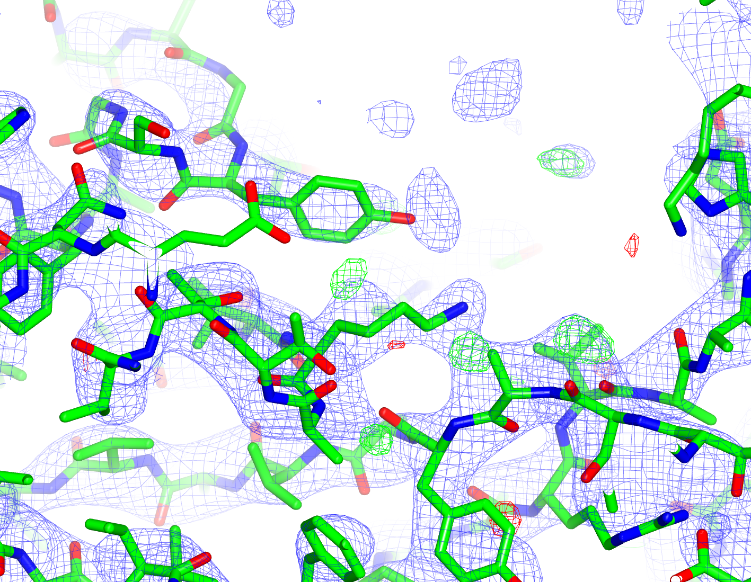


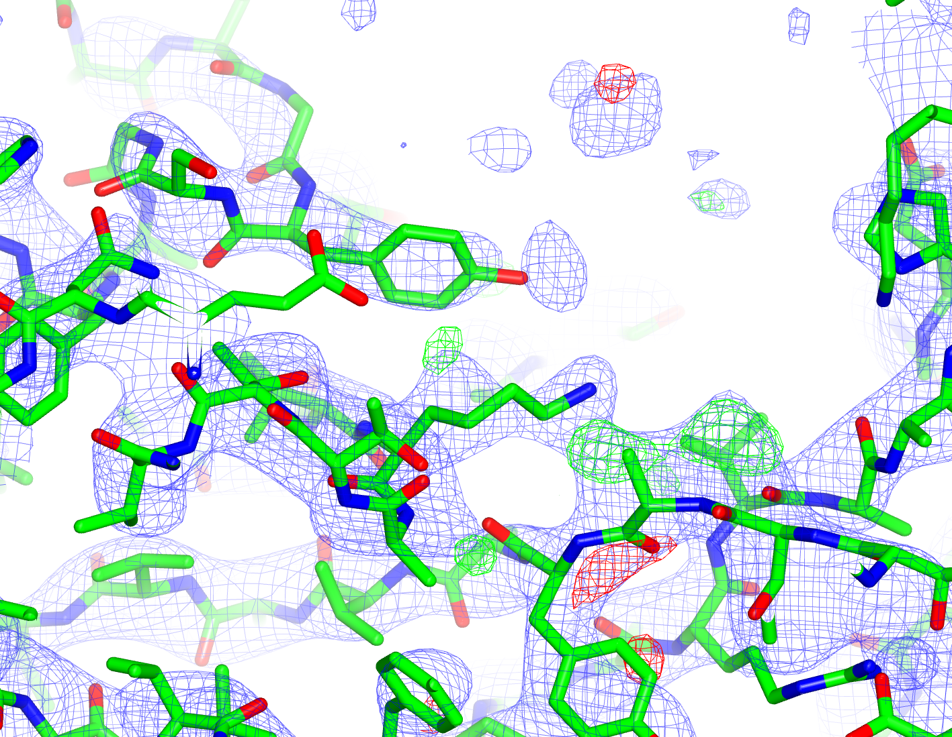
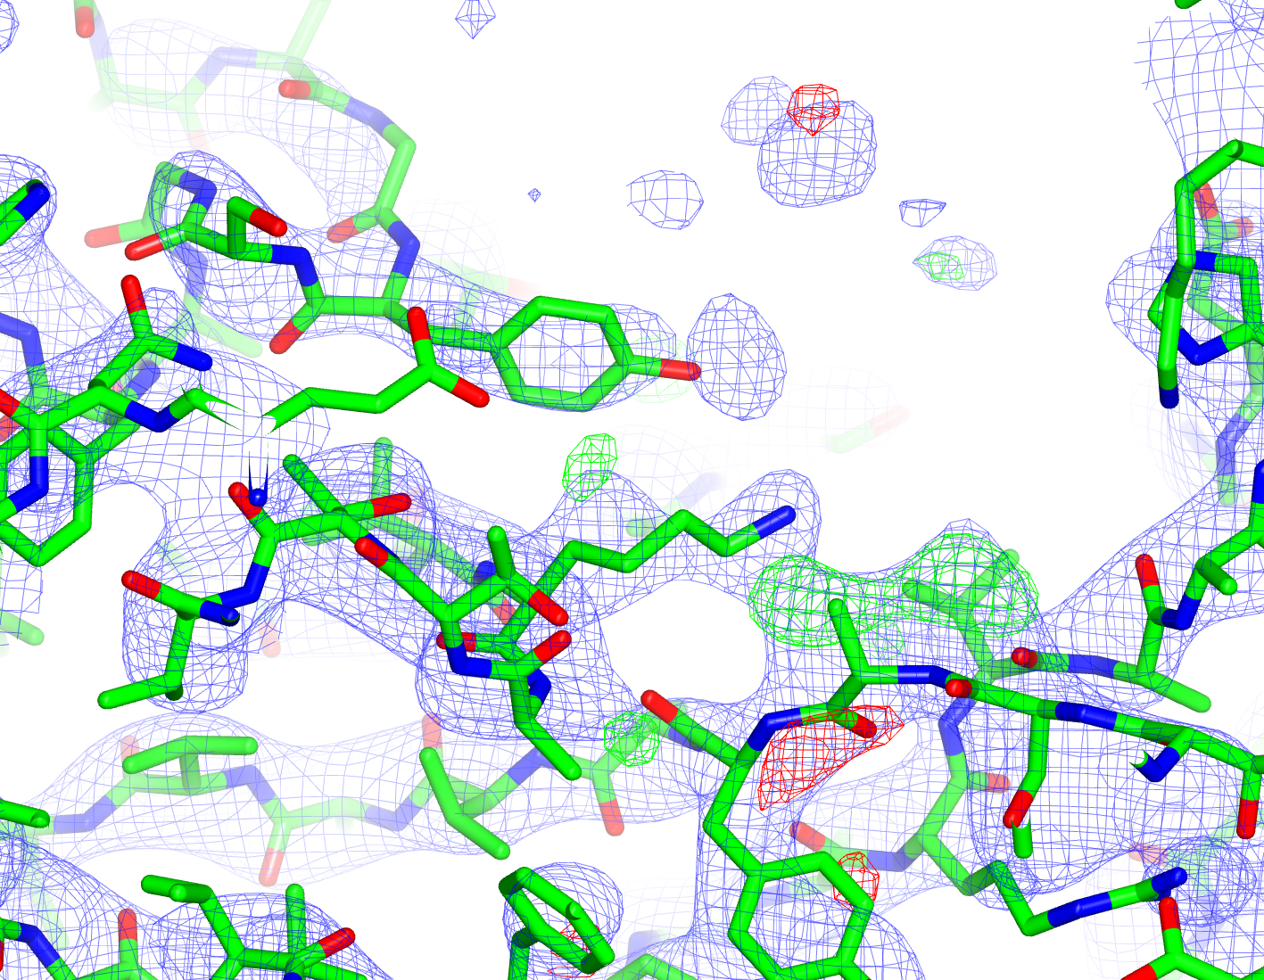
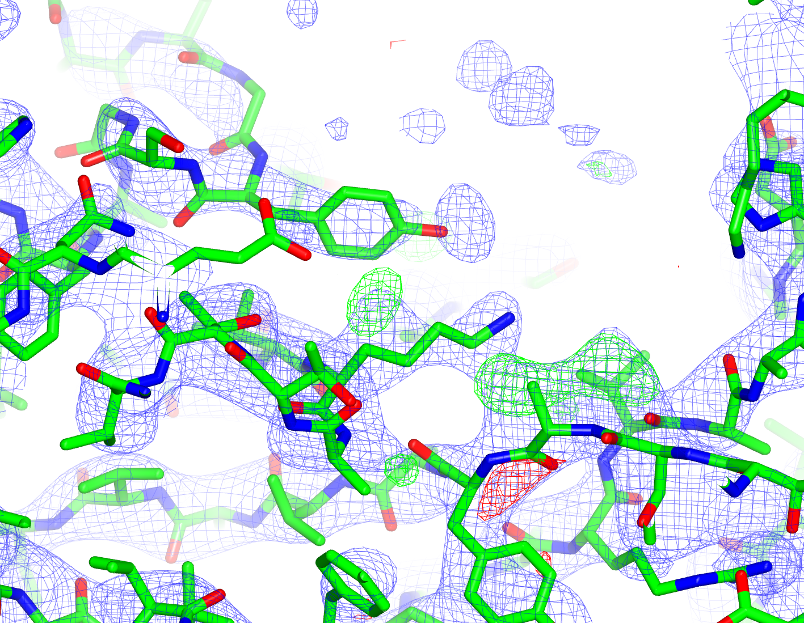
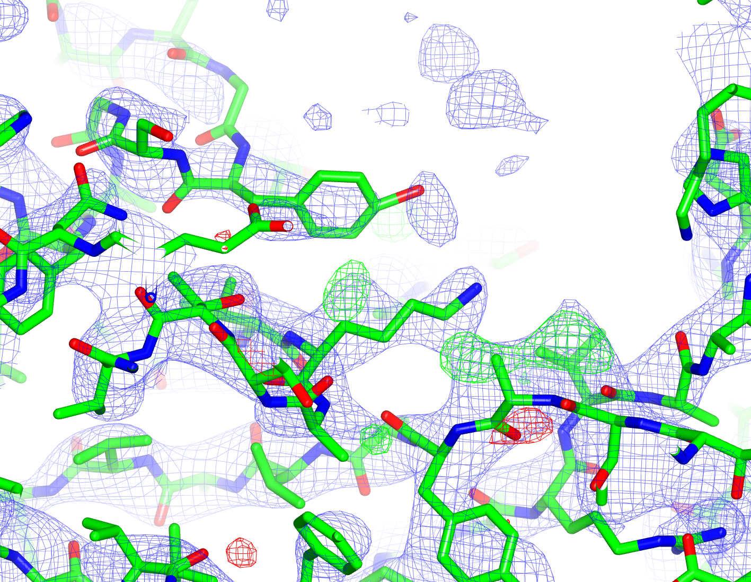
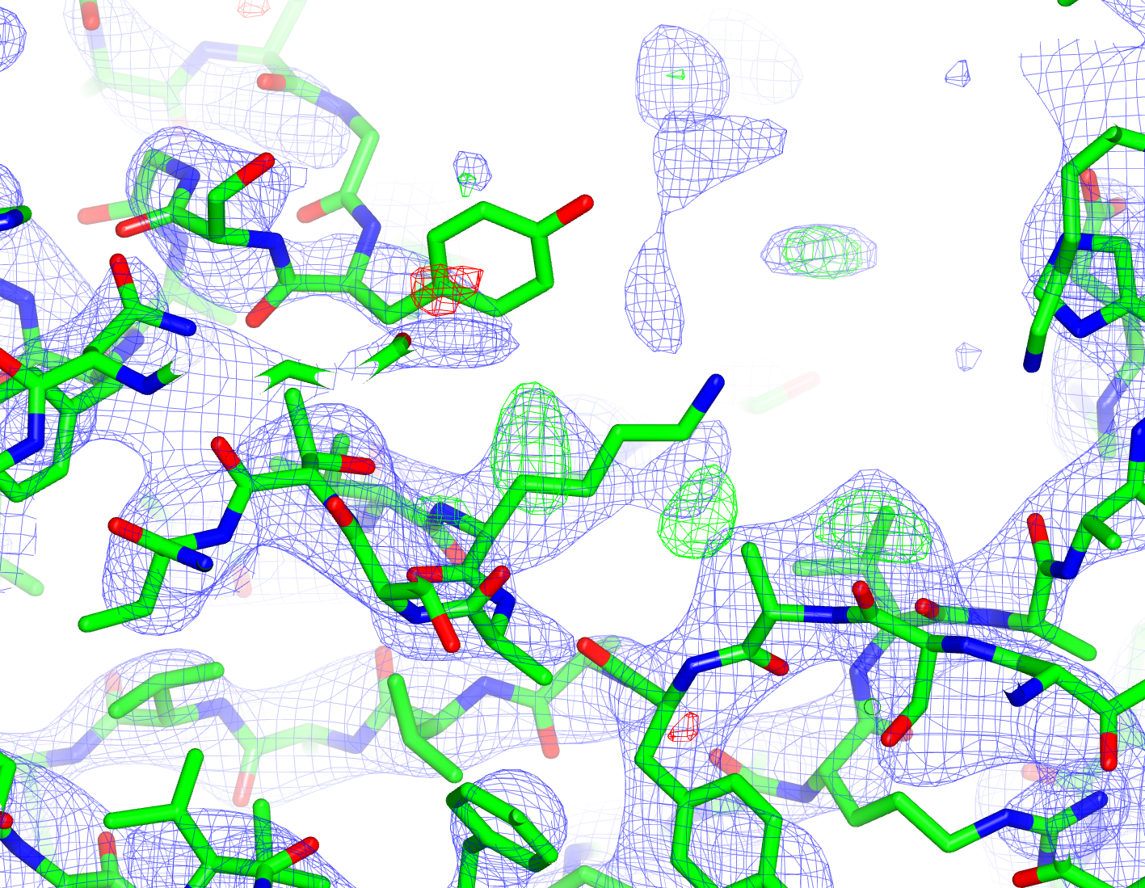
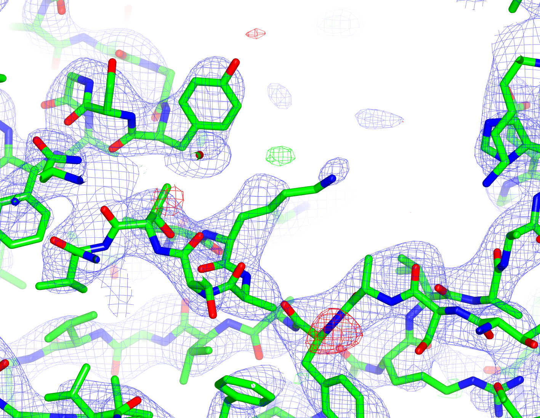
External Restraints
Original Structure
R/R_{free} : 0.286/0.330
⬇
External restraints
(40 cycles)
R/R_{free} : 0.263/0.307
1.3σ

Slide 46
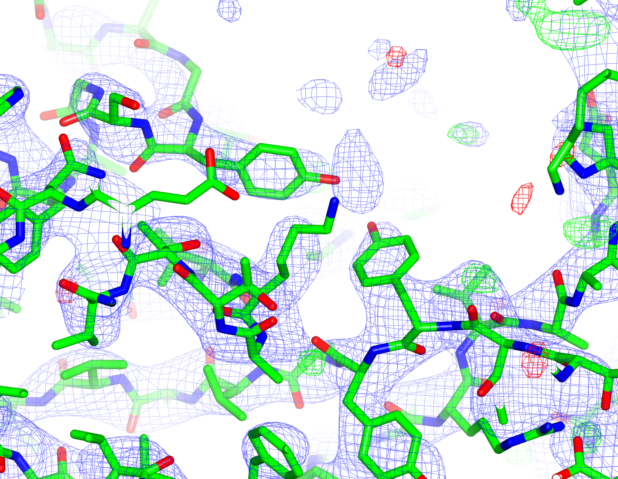
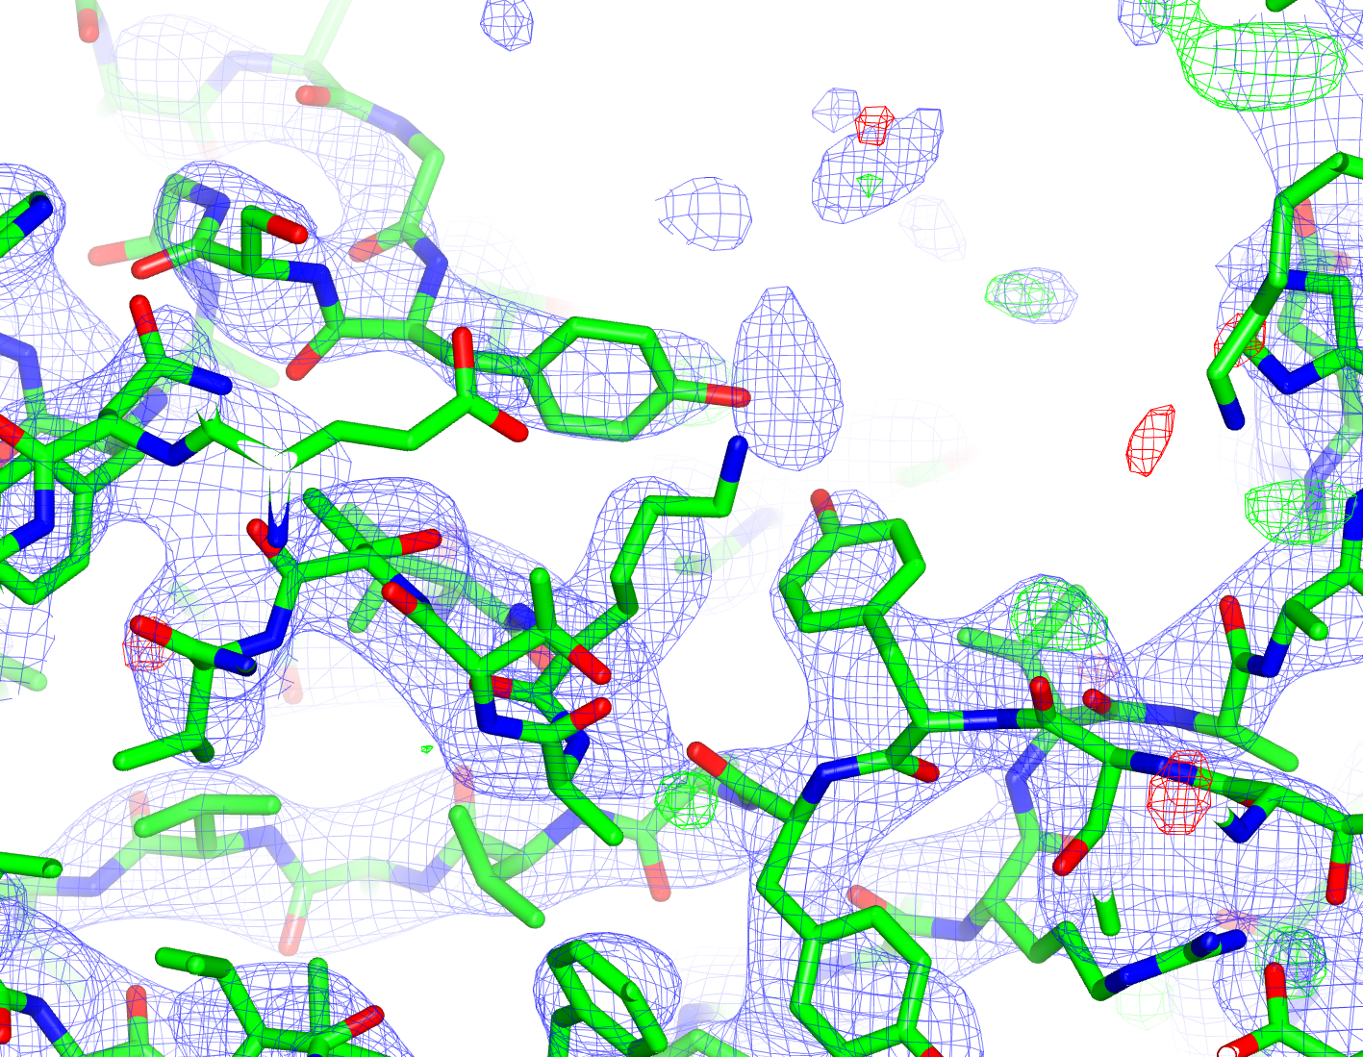


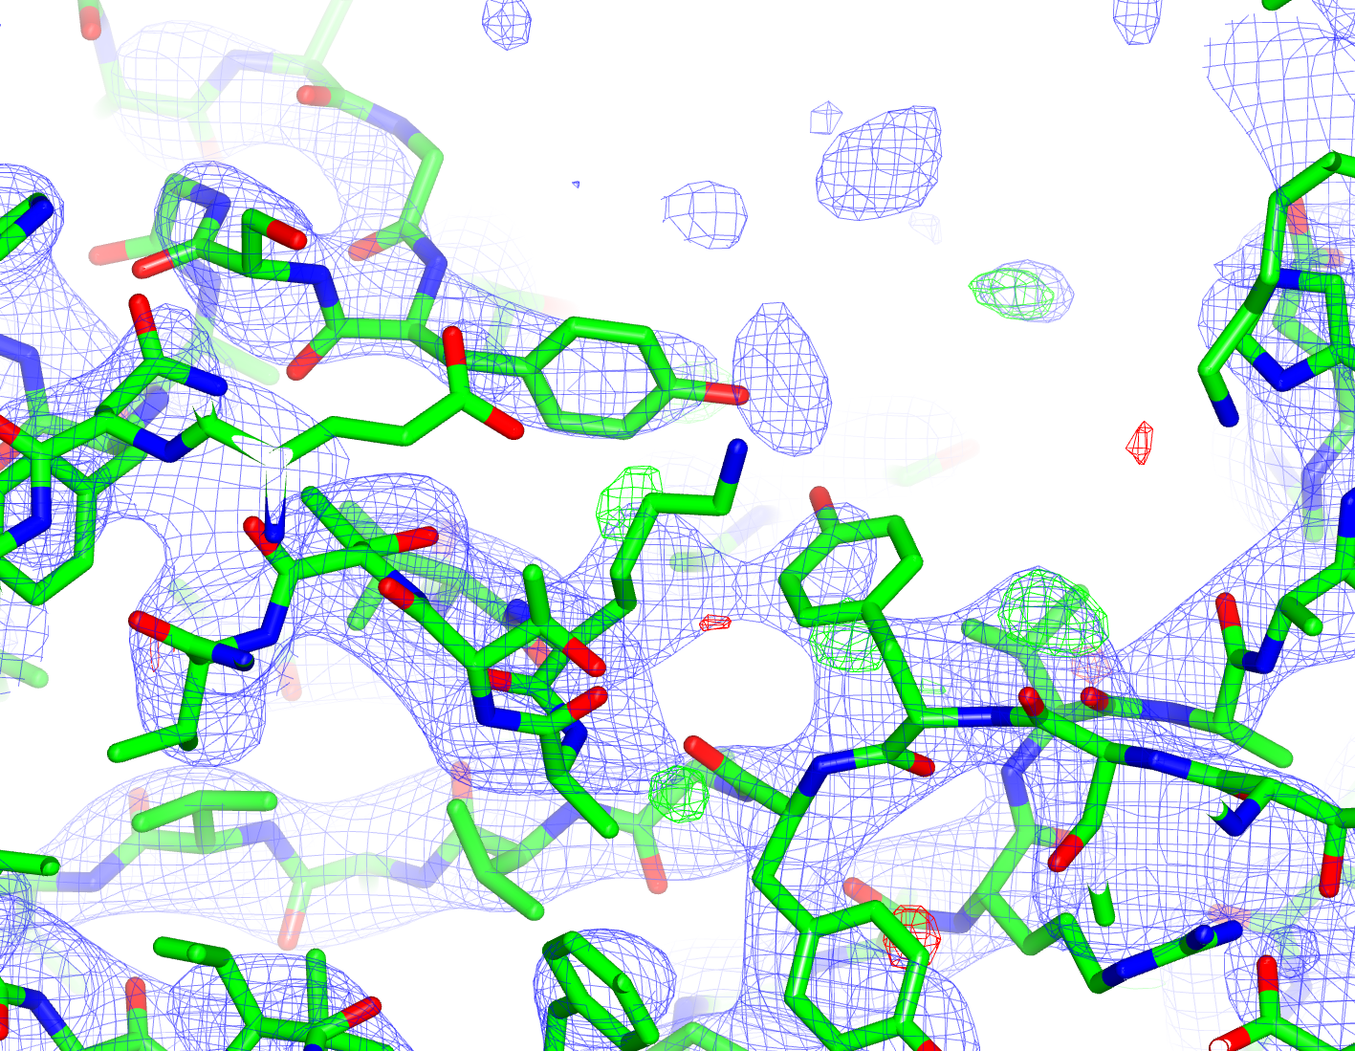
External Restraints
Original Structure
R/R_{free} : 0.286/0.330
⬇
External restraints
(40 cycles)
R/R_{free} : 0.263/0.307
⬇
Build TYR92
Modify LYS209
⬇
Jelly body
(40 cycles)
R/R_{free} : 0.252/0.307
1.3σ

Slide 47
External Restraints
When refining at low resolution, check:
Refinement statistics
Geometry
Electron density
Not always conclusive
Not always conclusive
Not always reliable
Conclusion: At low resolution, everything has to add up!
Take care; reflect
Quality of prior information is important – consider manual re-refinement
- PDB_REDO is useful

Slide 48
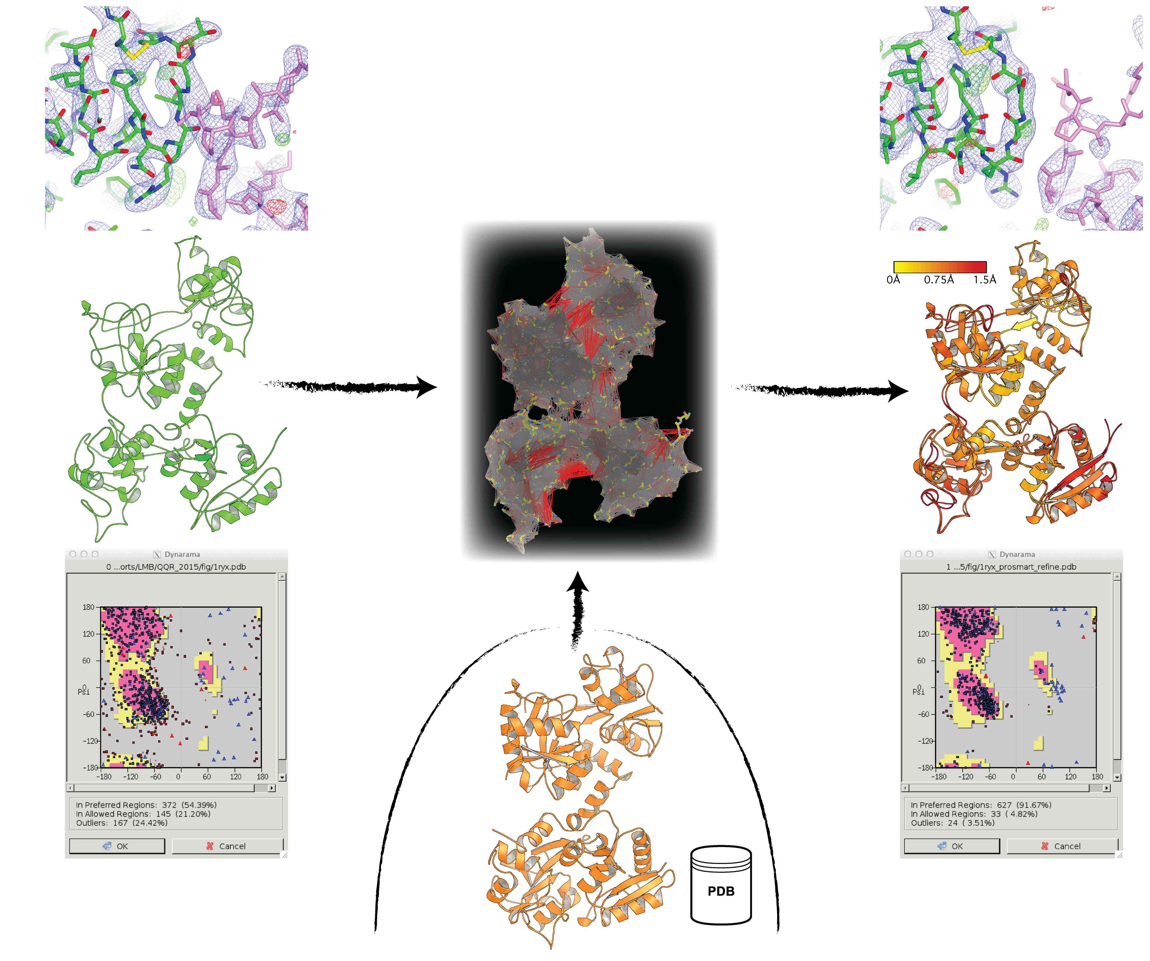
Low Resolution Refinement – Recap

Slide 49
Low Resolution Refinement – Recap

Slide 50
Low Resolution Refinement – Recap

Slide 51

Changes During Refinement
Ovotransferrin
1ryx – 3.5Å Re-refined with external restraints
Notes:
Better secondary structure geometry

Slide 52

Changes During Refinement
Ovotransferrin
original model vs. re-refined model
Notes:
Same global conformation; there are some local differences.
But how do we know which regions are locally similar, and which have changed during refinement?

Slide 53
ProSMART – Local Structural Comparison
Detailed analysis of local structure, e.g. side chains in binding sites, conserved regions
Main features:
Conformation-independent structural alignment
Local structural comparison and visualisation
Identification of rigidly conserved regions
Useful for comparing:
Homologous structures
Models at different stages of model-building/refinement
Results visualised using graphics software: CCP4mg, PyMOL, Chimera
Executed from: CCP4i, CCP4mg, command line
Notes:
e.g. 9 residues

Slide 54

ProSMART – Local Structural Comparison
How it works:
Backbone structural fragments:
Notes:
e.g. 9 residues

Slide 55

ProSMART – Local Structural Comparison
How it works:
Backbone structural fragments:
Notes:
e.g. 9 residues

Slide 56

ProSMART – Local Structural Comparison
How it works:
Backbone structural fragments:
Notes:
e.g. 9 residues

Slide 57

ProSMART – Local Structural Comparison
How it works:
Backbone structural fragments:
Notes:
e.g. 9 residues

Slide 58

ProSMART – Local Structural Comparison
How it works:
Backbone structural fragments:
Notes:
e.g. 9 residues

Slide 59

ProSMART – Local Structural Comparison
How it works:
Backbone structural fragments:
Notes:
e.g. 9 residues

Slide 60


ProSMART – Local Structural Comparison
How it works:
Fragment comparison:

Slide 61

ProSMART – Local Structural Comparison
How it works:
Fragment comparison:

Slide 62

ProSMART – Local Structural Comparison
How it works:
Fragment comparison:

Slide 63

ProSMART – Local Structural Comparison
How it works:
Fragment comparison:
Notes:
Result is RMSD / Procrustes score.
Uses Procrustes analysis, which is a fast method due to not having to physically superpose the structures in order to get the score.

Slide 64
Changes During Refinement
Example: Ovotransferrin
1ryx original versus re-refined

Slide 65

Changes During Refinement
Local Backbone RMSD
1ryx original versus re-refined
Noticeable backbone changes in loops

Slide 66

Changes During Refinement
Local Backbone RMSD Local Side Chain RMSD
1ryx original versus re-refined
Noticeable backbone changes in loops Differences in side chains everywhere!

Slide 67
Example: Comparing Homologues
Comparing the re-refined model and the high-res homologue
1ryx re-refined – 3.5Å 2d3i – 2.15Å

Slide 68

Example: Comparing Homologues
Comparing the re-refined model and the high-res homologue
Models don’t superpose well

Slide 69
Example: Comparing Homologues
Comparing the re-refined model and the high-res homologue
1ryx re-refined – 3.5Å 2d3i – 2.15Å

Slide 70


Example: Comparing Homologues
Comparing the re-refined model and the high-res homologue
1ryx re-refined – 3.5Å 2d3i – 2.15Å
Backbones are locally very similar, despite the difference in global domain arrangement

Slide 71
Example: Identifying Conserved Regions
Given that the models have locally similar backbones…
Can we analyse differences in global conformation?
(relative positions of domains)
Notes:
We can search for rigidly conserved structural regions, shared between the two models (these likely correspond to domains), and compare their relative coordinate frames.

Slide 72

Example: Identifying Conserved Regions
Identified 5 spatially-conserved regions between the two homologues

Slide 73

Example: Identifying Conserved Regions
Identified 5 spatially-conserved regions between the two homologues
Superposition of strictly conserved region

Slide 74

Example: Identifying Conserved Regions
Identified 5 spatially-conserved regions between the two homologues
Superposition of strictly conserved region

Slide 75

Example: Identifying Conserved Regions
Identified 5 spatially-conserved regions between the two homologues
Superposition of strictly conserved region

Slide 76

Example: Identifying Conserved Regions
Identified 5 spatially-conserved regions between the two homologues
Superposition of strictly conserved region

Slide 77

Example: Identifying Conserved Regions
Identified 5 spatially-conserved regions between the two homologues
Superposition of strictly conserved region

Slide 78
Example: Tyrosine Kinase
2z8c (2007) – 3.25Å 2z8c solved using 2auh,
re-refined using jelly-body
R_{work}/R_{free} : 21.7/29.2 % R_{work}/R_{free} : 20.2/25.8 %

Slide 79

Example: Tyrosine Kinase
2z8c (2007) – 3.25Å 2z8c solved using 2auh,
re-refined using jelly-body
R_{work}/R_{free} : 21.7/29.2 % R_{work}/R_{free} : 20.2/25.8 %

Slide 80
Example: Tyrosine Kinase
2z8c (2007) – 3.25Å 2z8c solved using 2auh,
re-refined using jelly-body
R_{work}/R_{free} : 21.7/29.2 % R_{work}/R_{free} : 20.2/25.8 %

Slide 81
Example: Tyrosine Kinase
before
after
2z8c (2007) – 3.25Å 2z8c solved using 2auh,
re-refined using jelly-body
R_{work}/R_{free} : 21.7/29.2 % R_{work}/R_{free} : 20.2/25.8 %

Slide 82

ProSMART Support for DNA/RNA
5S rRNA from yeast 80S ribsome
Blue - EM model
Orange – X-ray model
Yellow – similar
Red - dissimilar
Notes:
All comparative structural analysis features
External restraints to homologous structures

Slide 83
What if there are no high-resolution homologues?
We still need to stabilise refinement…
Jelly-body restraints
Generic external restraints:
  ProSMART - protein
    (secondary-structure)
  LIBG - DNA/RNA
  (base-pair, base-stacking)

Slide 84

Hydrogen Bond Restraints
Visualisation of ProSMART hydrogen bond restraints using PyMOL:
Notes:
Residues coloured blue are involved in helical restraints; those coloured yellow are involved in restraints between strands in a beta sheet.

Slide 85

LIBG Restraints for DNA/RNA
LIBG – for the generation of nucleic acid restraints
Base-pair restraints:
Notes:
Add Coot

Slide 86


LIBG Restraints for DNA/RNA
LIBG – for the generation of nucleic acid restraints
Base-stacking restraints:
(parallel plane restraints)
Notes:
Add Coot

Slide 87

LIBG Restraints for DNA/RNA
LIBG – for the generation of nucleic acid restraints
Base-stacking restraints:
(parallel plane restraints)
Example:
3.2Å cryo-EM
Purple – refined without LIBG
Yellow – refined with LIBG
Notes:
Add Coot

Slide 88

LIBG Restraints for DNA/RNA
LIBG – for the generation of nucleic acid restraints
Base-stacking restraints:
(parallel plane restraints)
Example:
3.2Å cryo-EM
Green – before refinement
Blue – refined without LIBG
Yellow – refined with LIBG
Notes:
Add Coot

Slide 89
Automated pipeline - LORESTR
Efficiency of ProSMART-generated restraints greatly depends on the homologues used
If several homologues are available, substantial manual effort is required to find their optimal combination
Other refinement parameters (scaling, solvent, etc) also affect efficiency of the process

Slide 90
Automated pipeline - LORESTR
Efficiency of ProSMART-generated restraints greatly depends on the homologues used
If several homologues are available, substantial manual effort is required to find their optimal combination
Other refinement parameters (scaling, solvent, etc) also affect efficiency of the process
Solution:
LOw-REsolution STructure Refinement
Notes:
Extensive testing… identified best-performing methods/protocols… implemented them in the automated pipeline LORESTR

Slide 91

Automated pipeline - LORESTR
Notes:
So, automated pipeline.

Slide 92
Automated pipeline - LORESTR
Notes:
So, automated pipeline.

Slide 93
Automated pipeline - LORESTR
Notes:
So, automated pipeline.

Slide 94
Automated pipeline - LORESTR
Notes:
So, automated pipeline.

Slide 95
Automated pipeline - LORESTR
Notes:
So, automated pipeline.

Slide 96
Automated pipeline - LORESTR
Notes:
So, automated pipeline.

Slide 97
Automated pipeline - LORESTR
Notes:
So, automated pipeline.

Slide 98
Automated pipeline - LORESTR
Notes:
So, automated pipeline.

Slide 99
Automated pipeline - LORESTR
Notes:
So, automated pipeline.

Slide 100
Automated pipeline - LORESTR
Notes:
So, automated pipeline.

Slide 101
Automated pipeline - LORESTR
Notes:
So, automated pipeline.

Slide 102

Automated pipeline - LORESTR
Notes:
So, automated pipeline.

Slide 103
Automated pipeline - LORESTR
Improves R-factors for 94% of the test structures from the PDB
Notes:
104 test cases:
at least one low-resolution structure (3.0Å – 6.7Å )
1 to 49 high-resolution homologues (1.3Å – 2.9 Å)
homologues share at least 80% of sequence identity
low-resolution structure has single protein chain
low-resolution structure has adequate X-ray data deposited to the PDB

Slide 104
REFMAC Anisotropic Map Sharpening
Idea – remove an overall B value

Slide 105


REFMAC Anisotropic Map Sharpening
Idea – remove an overall B value
Original Map
Sharpened map from REFMAC
Green: original structure 2r6c (4.0Å) – helix unmodelled
Blue: homologous structure 2r6a (2.9Å)

Slide 106
Map Blurring
Idea - apply an overall B value
Notes:
Should help to reduce noise, but low resolution completeness is important.
Acknowledge dependency of B-factor and σ

Slide 107



Map Blurring
Idea - apply an overall B value
Blue - electron density (1σ)
Orange - blurred map (B=200)
1s3e
Notes:
Should help to reduce noise, but low resolution completeness is important.
Acknowledge dependency of B-factor and σ

Slide 108

Map Blurring
2whq
Notes:
Should help to reduce noise, but low resolution completeness is important.
Acknowledge dependency of B-factor and σ

Slide 109


Map Blurring
2whq
Notes:
HI-6: [(E)-[1-[(4-carbamoylpyridin-1-ium-1-yl)methoxymethyl]pyridin-2-ylidene]methyl]-oxoazanium dichloride

Slide 110



Map Blurring
Electron density at 1.7σ; Residual density at 3.5σ
Blurred residual map, B = 200
2whq
Notes:
Should help to reduce noise, but low resolution completeness is important.
Acknowledge dependency of B-factor and σ

Slide 111
Map Sharpening/Blurring
Output Array of Sharpened Maps
Standard:
4iwo (2.6Å)
Notes:
Refmac keyword:
sfcalc sharp | blur [ values ]

Slide 112
Map Sharpening/Blurring
Output Array of Sharpened Maps
Sharpen 50:
4iwo (2.6Å)
Notes:
Refmac keyword:
sfcalc sharp | blur [ values ]

Slide 113
Map Sharpening/Blurring
Output Array of Sharpened Maps
Standard:
4iwo (2.6Å)
Notes:
Refmac keyword:
sfcalc sharp | blur [ values ]

Slide 114
Map Sharpening/Blurring
Output Array of Sharpened Maps
Blur 50:
4iwo (2.6Å)
Notes:
Refmac keyword:
sfcalc sharp | blur [ values ]

Slide 115
Map Sharpening/Blurring
Output Array of Sharpened Maps
Blur 150:
4iwo (2.6Å)
Notes:
Refmac keyword:
sfcalc sharp | blur [ values ]

Slide 116
Map Sharpening/Blurring
Not only X-ray, but also cryoEM maps
Notes:
Refmac keyword:
sfcalc sharp | blur [ values ]

Slide 117
Map Sharpening/Blurring
Not only X-ray, but also cryoEM maps
Notes:
Refmac keyword:
sfcalc sharp | blur [ values ]

Slide 118
Map Sharpening/Blurring
Not only X-ray, but also cryoEM maps
Notes:
Refmac keyword:
sfcalc sharp | blur [ values ]

Slide 119
What and When
Early stages (e.g. straight after MR)
Rigid body refinement
Jelly body – sometimes up to 200 cycles
Medium stages – during model building
Auto local NCS – wherever possible
External restraints (40 cycles) – homologue available
Otherwise, jelly body… but not together
H-bond restraints – no homologue available
Secondary structure conformation restraints – model building tool
Add hydrogens (?)
Medium-final stages
TLS – at medium resolutions
Anisotropic B-factors – only at high resolution
Twin refinement – only if you are sure
Final stages of refinement
Jelly body – around 20 cycles
Many tools are applicable to cryo-EM as well as MX

Slide 120

Acknowledgements
Contact: nicholls@mrc-lmb.cam.ac.uk
okovalev@mrc-lmb.cam.ac.uk
Computational Crystallography Group:
Garib Murshudov
Paul Emsley
Oleg Kovalevskiy
Fei Long
Rob Nicholls
Michal Tykac
Many Thanks:
Marcus Fischer
CCP4 core team
CCP4i2 development team
Colleagues from MRC-LMB and CCP4
Software available for Mac/Linux/Windows via CCP4
Computational Crystallography Group website:
www2.mrc-lmb.cam.ac.uk/groups/murshudov/
REFMAC:
Murshudov et al. (2011) REFMAC5 for the refinement of macromolecular crystal structures. Acta Cryst. D67, 355-67.
ProSMART:
Nicholls et al. (2014) Conformation-Independent Structural Comparison of Macromolecules with ProSMART. Acta Cryst. D70, 2487-99.
LORESTR:
Kovalevskiy et al. (2016) Automated refinement of macromolecular structures at low resolution using prior information.
Acta Cryst. D72, 1149-61.
Low-resolution refinement with REFMAC and ProSMART:
Nicholls et al. (2013) Recent Advances in Low Resolution Refinement Tools in REFMAC5. Adv. Methods for Bio. Xtallography, 231-58.
Nicholls et al. (2012) Low Resolution Refinement Tools in REFMAC5. Acta Cryst. D68, 404-17.
Tools for cryo-EM fitting:
Brown et al. (2015) Tools for macromolecular model building and refinement into electron cryo-microscopy reconstructions. Acta Cryst. D71, 136-53.

Slide 122
Extra Slides

Slide 123

Automated pipeline - LORESTR
Notes:
Self-explanatory table from the paper with several selected examples before and after refinement with LORESTR. We can see decrease of Rfree, substantial RMS difference, Ramachandran and Molprobity statistics improved.

Slide 124




External Restraints
Restraint Parameter Estimation:
Atoms in homologous structure:
σ_{i} estimated as by Murshudov & Dodson (CCP4 Newsletter 1997)
Dependencies:
B-value
Resolution
Model/data completeness
Data quality
Plus a modification that increases robustness to outliers (use of Geman-McClure function)

Slide 125

Example: Ligand-Induced Changes
Sialic acid binding protein in different bound states
Describing domain motion - screw axis and angle

Slide 126

Example: Ligand-Induced Changes
Sialic acid binding protein in different bound states
Describing domain motion - screw axis and angle

Slide 127

Example: Ligand-Induced Changes
Sialic acid binding protein in different bound states
Describing domain motion - screw axis and angle

Slide 128


Example: Comparing Distant Structures
Comparison of open forms of binding proteins - 14% sequence identity
2cex – Sialic acid binding protein 2hzk – sodium-alpha-keto binding protein

Slide 129

Example: Comparing Distant Structures
Comparison of open forms of binding proteins - 14% sequence identity
2cex and 2hzk, superposed

Slide 130


Example: Comparing Distant Structures
Comparison of open forms of binding proteins - 14% sequence identity
Coloured by local backbone RMSD
2cex – Sialic acid binding protein 2hzk – sodium-alpha-keto binding protein

Slide 131


Example
Example: structural analysis of domain swaps (Barnase - 2za4, 1yvs)

Slide 132

Example
Example: structural analysis of domain swaps (Barnase - 2za4, 1yvs)

Slide 133

Example
Example: structural analysis of domain swaps (Barnase - 2za4, 1yvs)

Slide 134

Example
Example: structural analysis of domain swaps (Barnase - 2za4, 1yvs)
Coloured by local backbone RMSD

Slide 135

Example
Example: structural analysis of domain swaps (Barnase - 2za4, 1yvs)
Coloured by local side chain conservation

Slide 136


Identifying Conserved Regions
Cluster aligned fragment-pairs by comparing their coordinate frames
yellow – similar
red - dissimilar

Slide 137


Motif Identification and Scoring
Identifying an ideal α-helix
and a representative β-strand
Similarity to the ideal helix
3dt1 - MAP kinase
This is not equivalent to traditional secondary structure identification.
May be used to generate external restraints for use in refinement.

Slide 138

Multi-Chain Comparison
Comparison of 19 models of trypsin
Same sequence, different space group, 0.8-2.0Å
Max atomic deviation

Slide 139

Multi-Chain Comparison
Comparison of 19 models of trypsin
Same sequence, different space group, 0.8-2.0Å
Max atomic deviation Max local backbone RMSD

Slide 140

Multidisciplinary Usage
NMR solution ensemble of hen egg white lysozyme (50 models)
Max local backbone RMSD

Slide 141

Multidisciplinary Usage
Ensemble from a 55ns MD simulation of WaaG
Images thanks to Jens Landström

Slide 142


Multidisciplinary Usage
Ensemble from a 55ns MD simulation of WaaG
Images thanks to Jens Landström

Slide 143




Anisotropic Regularised Map Sharpening
Map sharpening attempts to remove overall B-value.
Can be considered as an inverse de-blurring problem:
Assume blurring is homogeneous:
Use regularisation:
Solution:
k(x,y) is unknown
Problem is ill-posed

