Slide 1
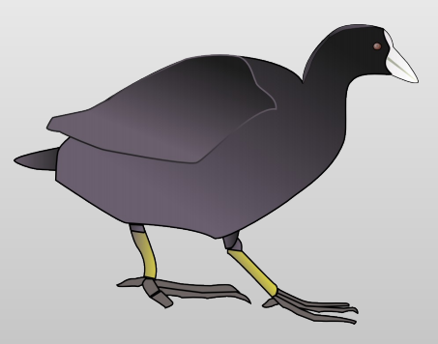
Introduction to Coot
Paul McEwan Ph.D.
Evotec

Slide 2
Agenda
Introduction
The basics
  The various tool bars
Ligands
  Starting out
  Obtaining the ligand structure
  Where are my ligands
  Fitting ligands
Sources of help
Tomorrows Practical Session

Slide 3
Coot
Crystallographic Object-Oriented Toolkit
A crystallographers workhorse interface
Primarily developed by Paul Emsley (LMB)
  Contributions from numerous other authors
  Open source and designed to be easily learned
Huge capability and this presentation will only skim the surface

Slide 4
Restraints
libcheck
Acedrg
cProdrg
Grade
AFITT
Refinement
Refmac
Shelx
Buster
Phenix
Validation
Molprobity
Mogul
Refinement (restraints) and validation should go hand-in-hand.
Not an afterthought

Slide 5
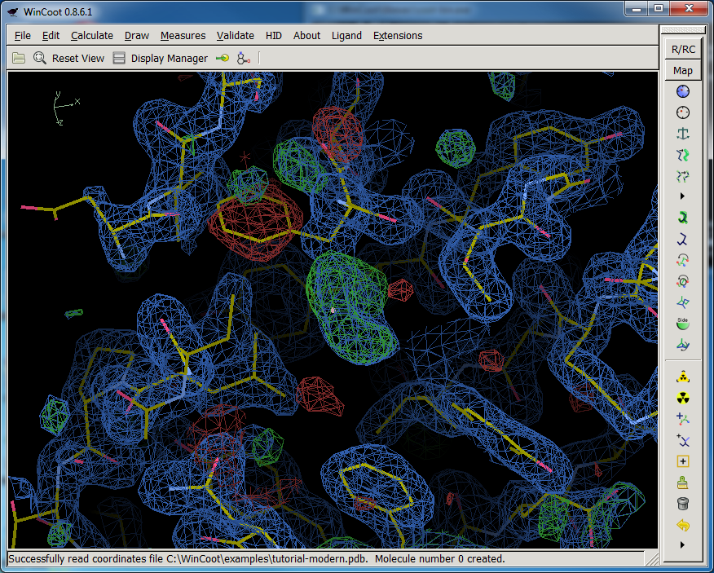
The Interface

Slide 6
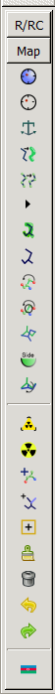
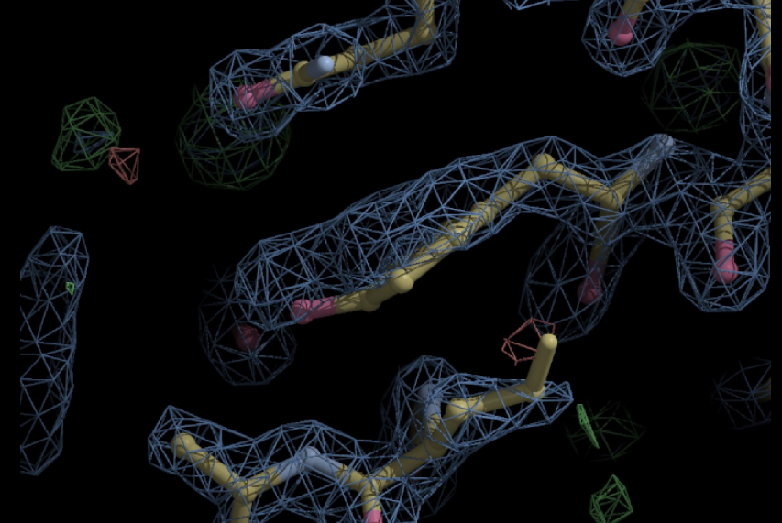
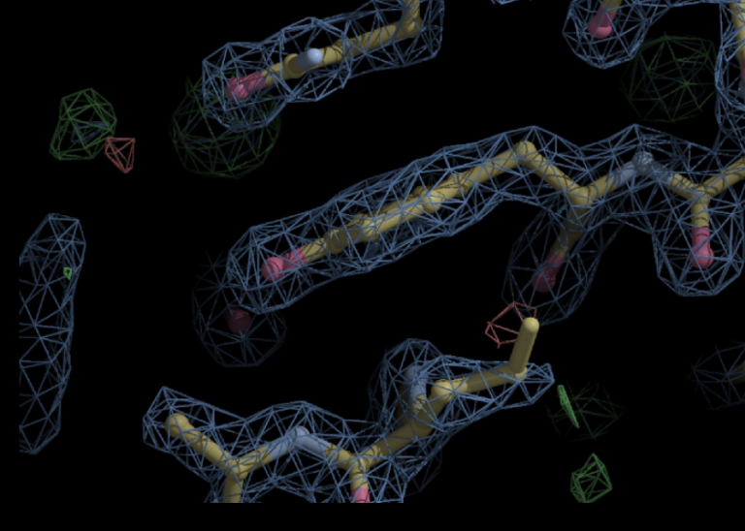
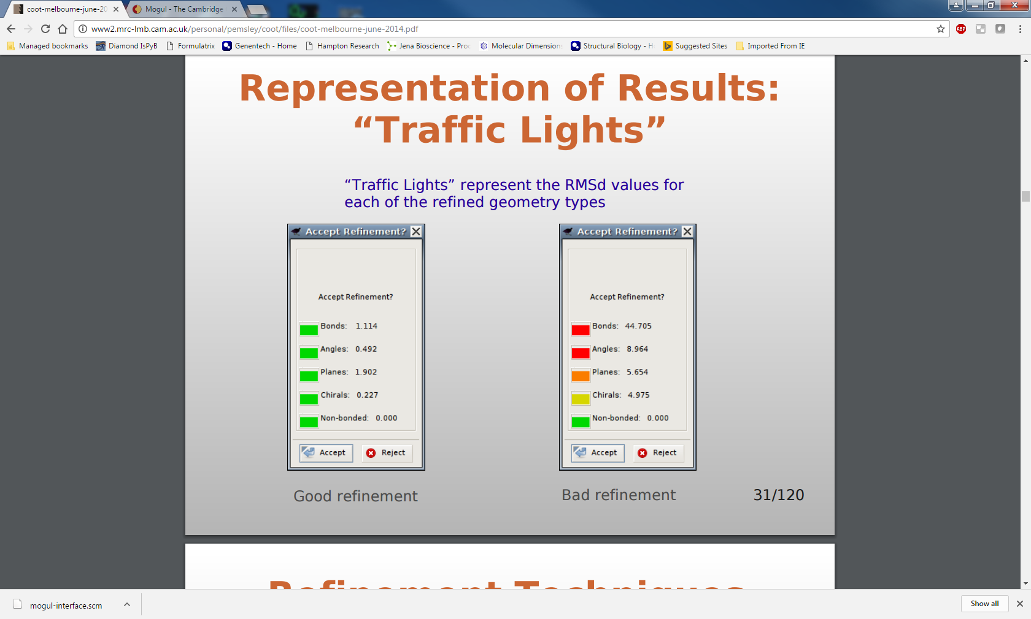
The tool bar(model/fit/refine shortcuts)
Which map?
Additional restraints?
Grab and drag
Traffic light warnings

Slide 7
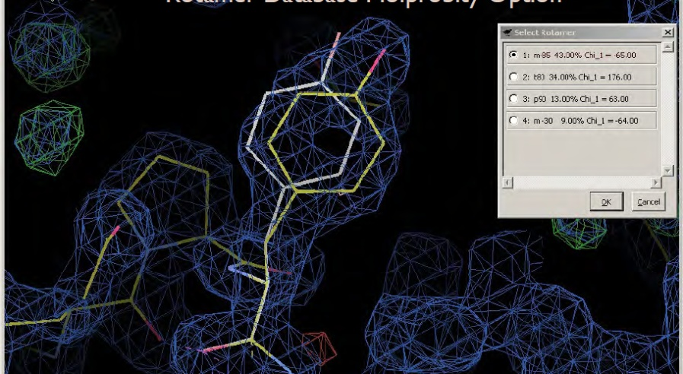
The tool bar(model/fit/refine shortcuts)
Rotamers (low resolution “back rub” method)
Extensions → Modelling → Rotamer Search
“mutate” /change residue
Add terminal residue
Add conformation

Slide 8
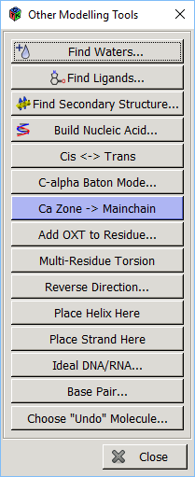
Automation for bulk fitting tasks
Secondary structures
De novo modelling… Should you use Buccaneer?
Waters
Ligands… wait for it!

Slide 9
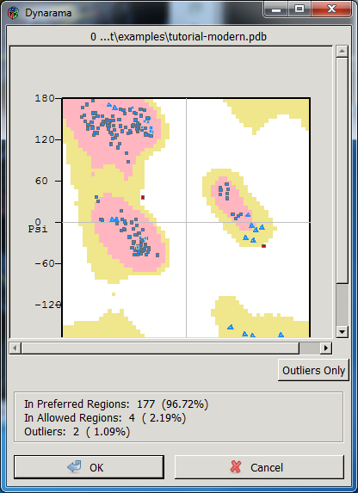
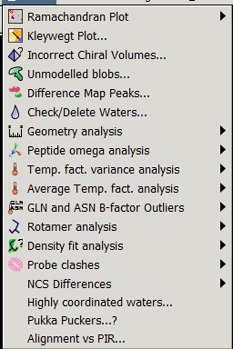
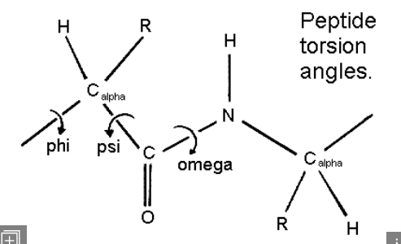
Validation Tools

Slide 10
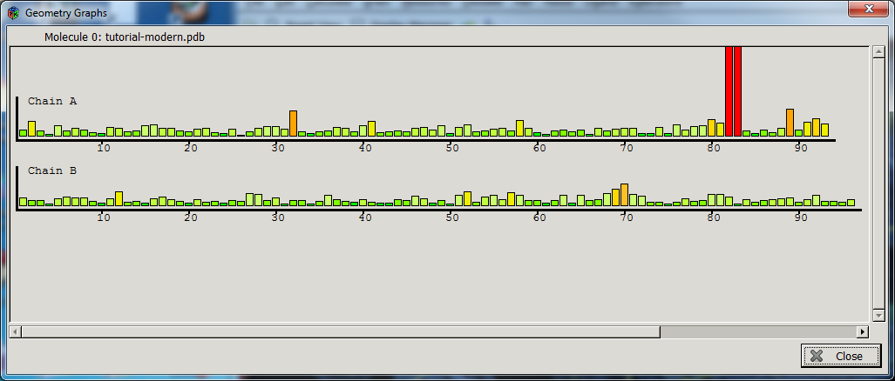
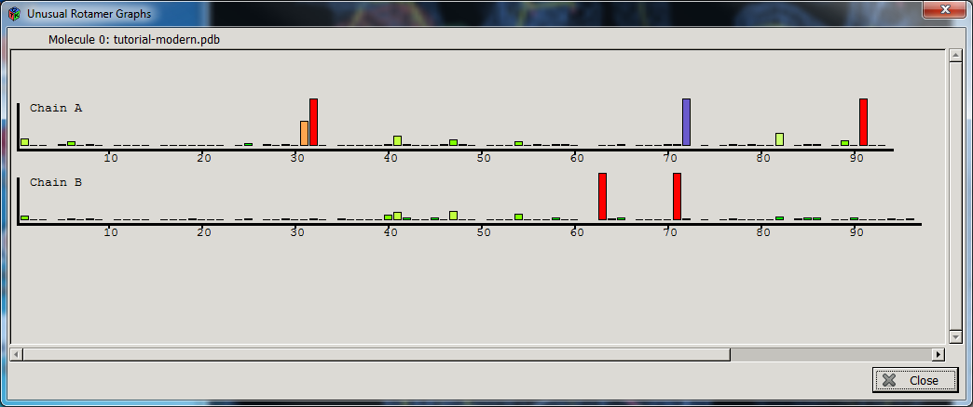
Validation Tools

Slide 11
Validation Tools
Ligands? Unmodelled protein? Incomplete model
B- factors, weak density or poor fit?
Probe/Reduce and Molprobity

Slide 12
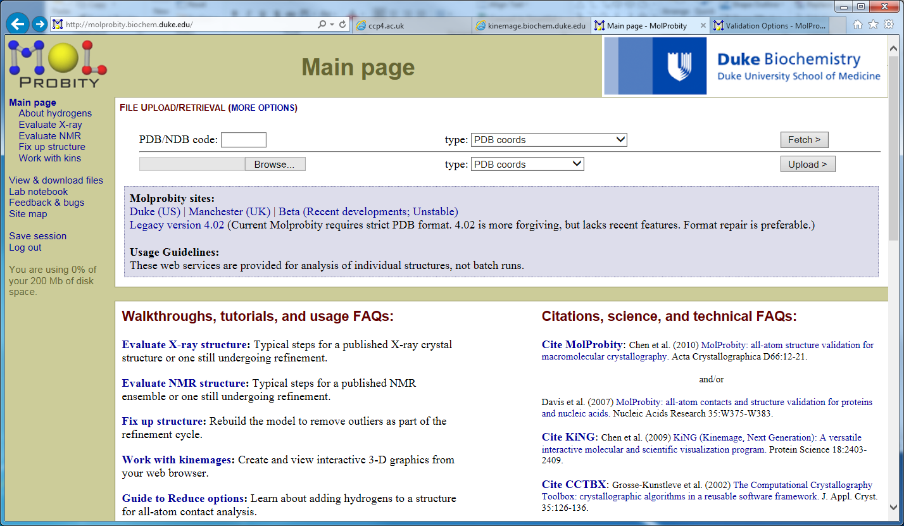
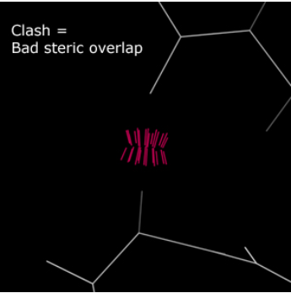
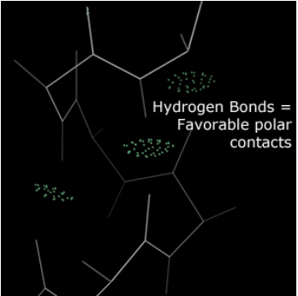
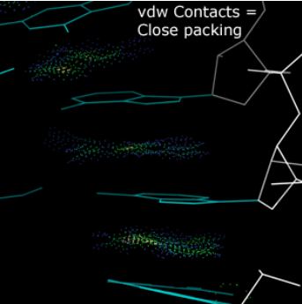
Molprobity
Amazing tool to look at geometry
Coot plugin to interpret output and to make “problem-fixing” easier
List of specific problems
Coot visualisation

Slide 13
Ligands
Building and obtaining restraint information for non-protein components

Slide 14
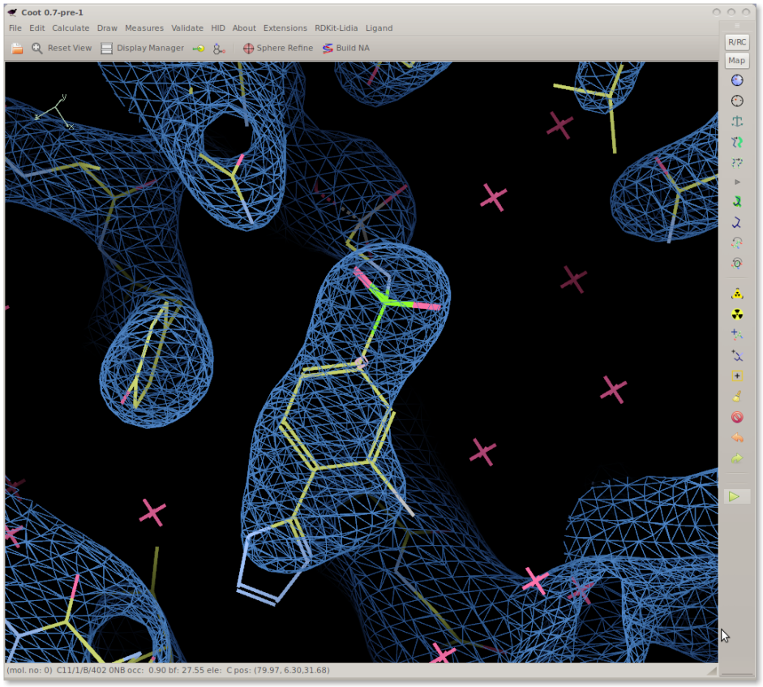
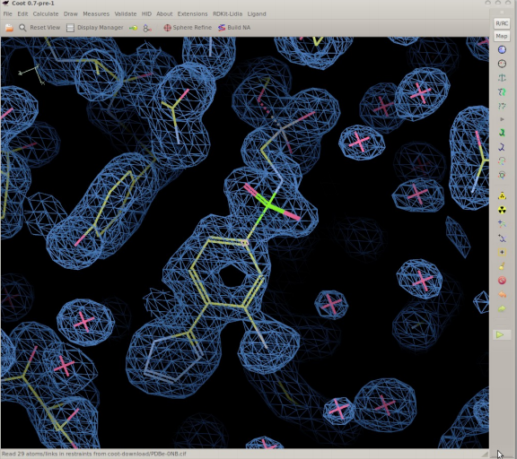
Ligand and Density...
Protein-ligand complex models are often a result of subjective interpretation
Combination of map quality and ligand restraints

Slide 15
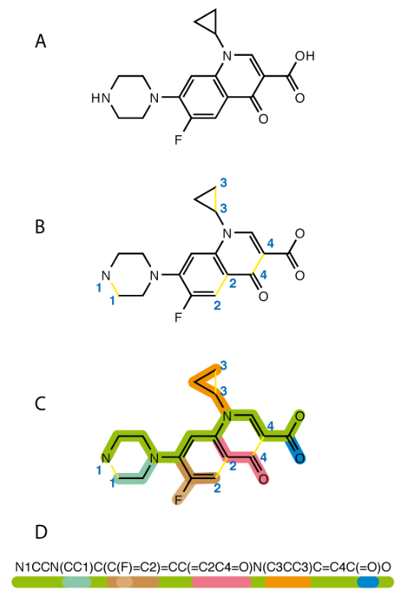
Ligand Starting Point
Drawing
SMILES string
For common “ligands” restraints may already be available in the CCP4 library

Slide 16
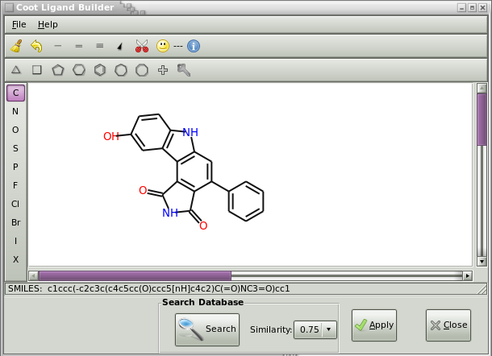
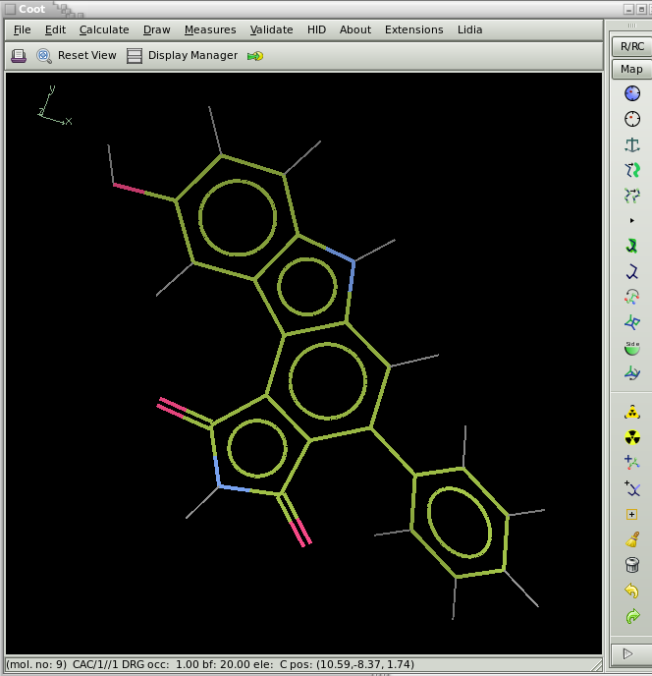
2D Ligand Builder
External tools
COOT
  Free sketch
  SBase search
  Eventually direct de novo Acedrg restraints from Coot ligand sketcher
Notes:
Stamp out fragments, change atom types, and has interactive SMILES string

Slide 17
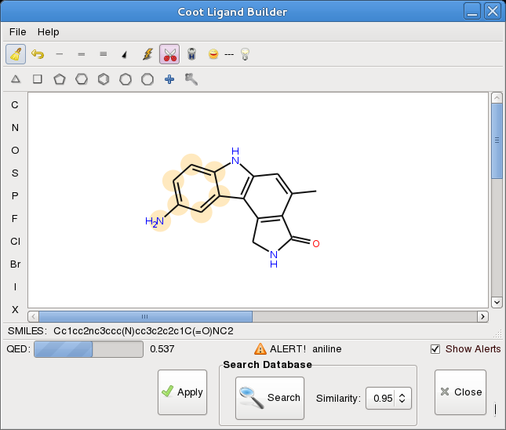
2D Sketcher
Structural Alerts

Slide 18
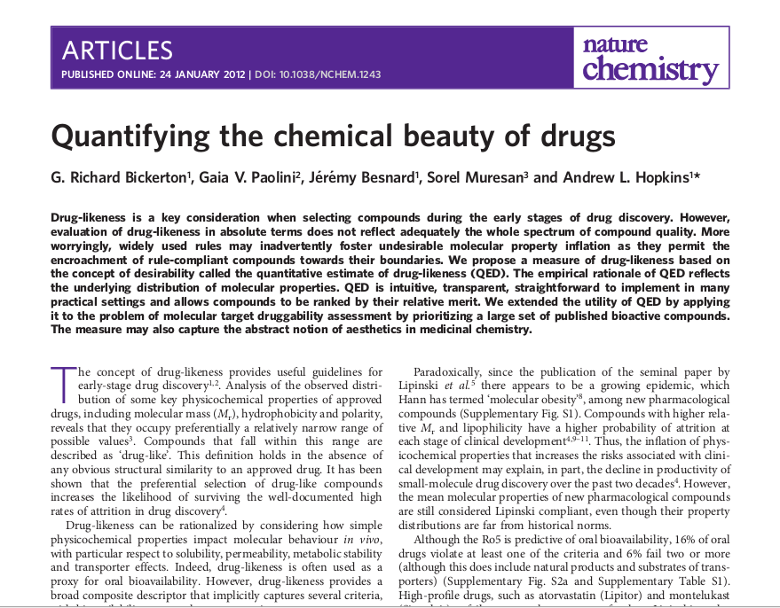
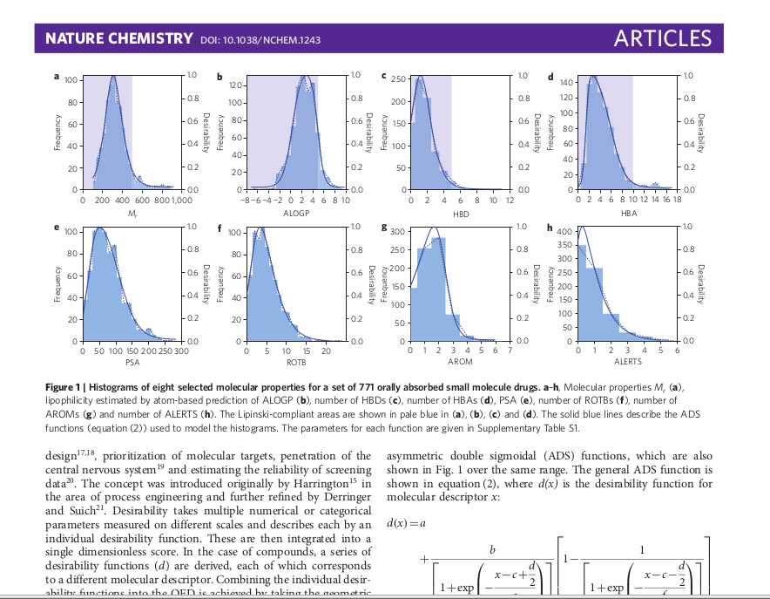
QED Score
Quantitative Evaluation of Drug-likeness
Bickerton et al (2012) Nature Chemistry

Slide 19
Ligand Utils
“Get Drug”
  Uses network connection to Wikipedia
Get comp-id ligand-description from PDBe
  downloads and reads (e.g.) AAA.cif
    (extracted from chemical component library)
Drag and drop
  Uses network connection to get URLs
  or file-system files
pyrogen
  restraints generation (Acedrg connection under development)

Slide 20
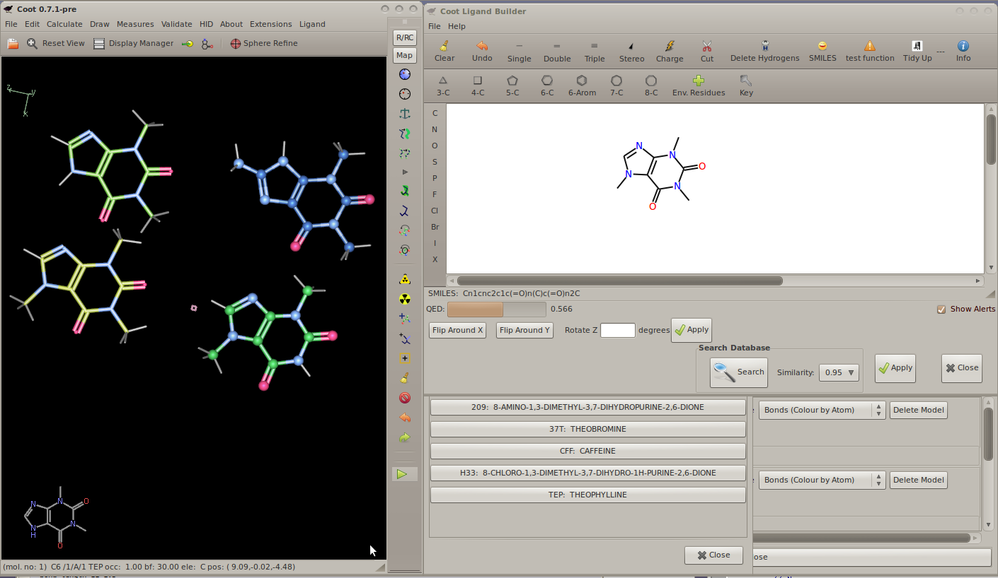
Ligand Utils – CCP4

Slide 21
Acedrg:
  Structural database is the Crystallography Online Database
  Bond and angle table generation
  Use tables to generate dictionaries
    Given a molecular description (mol, SMILES)
  Fei Long (Murshudov Group)
Pyrogen:
  Based on:
    Refmac Monomer Library Base Tables
    MMFF94s Forcefield
    CCDC Mogul
  Available with Coot

Slide 22
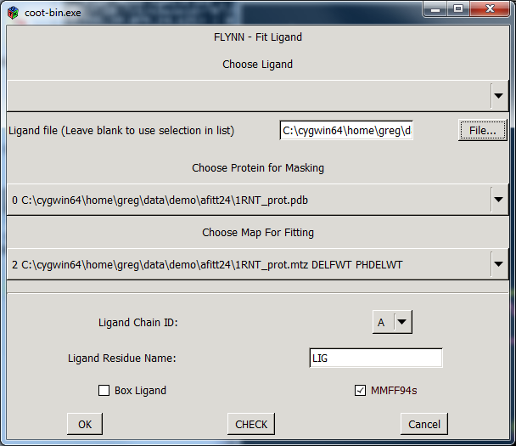
AFITT
AFITT (Openeye scientific)
  Combined automated fitting and restraint tool
  Most used restraint tool at Evotec
  Coot Plugin
  Utilisation of MMFF94
  Steered towards low energy/strain conformations compatible with the density
S. Wlodek, A.G. Skillman and A. Nicholls, "Automated ligand placement and refinement with a combined force field and shape potential", Acta Cryst., 2006, D62 (7), pp 741-749

Slide 23
Generating Conformers
Using restraint information...

Slide 24
REFMAC Monomer Library chem_comp_bond
loop_
_chem_comp_bond.comp_id
_chem_comp_bond.atom_id_1
_chem_comp_bond.atom_id_2
_chem_comp_bond.type
_chem_comp_bond.value_dist
_chem_comp_bond.value_dist_esd
ALA N H single 0.860 0.020
ALA N CA single 1.458 0.019
ALA CA HA single 0.980 0.020
ALA CA CB single 1.521 0.020
ALA CB HB1 single 0.960 0.020
ALA CB HB2 single 0.960 0.020

Slide 25
REFMAC Monomer Library chem_comp_tor
loop_
_chem_comp_tor.comp_id
_chem_comp_tor.id
_chem_comp_tor.atom_id_1
_chem_comp_tor.atom_id_2
_chem_comp_tor.atom_id_3
_chem_comp_tor.atom_id_4
_chem_comp_tor.value_angle
_chem_comp_tor.value_angle_esd
_chem_comp_tor.period
ADP var_1 O2A PA O3A PB 60.005 20.000 1
ADP var_2 PA O3A PB O1B 59.979 20.000 1
ADP var_3 O2A PA "O5'" "C5'" -59.942 20.000 1
ADP var_4 PA "O5'" "C5'" "C4'" 179.996 20.000 1
ADP var_5 "O5'" "C5'" "C4'" "C3'" 176.858 20.000 3
ADP var_6 "C5'" "C4'" "O4'" "C1'" 150.000 20.000 1
ADP var_7 "C5'" "C4'" "C3'" "C2'" -150.000 20.000 3

Slide 26
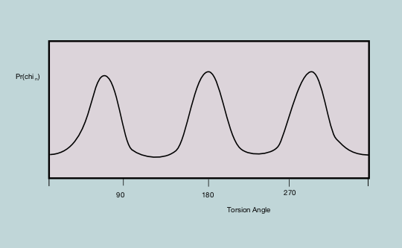
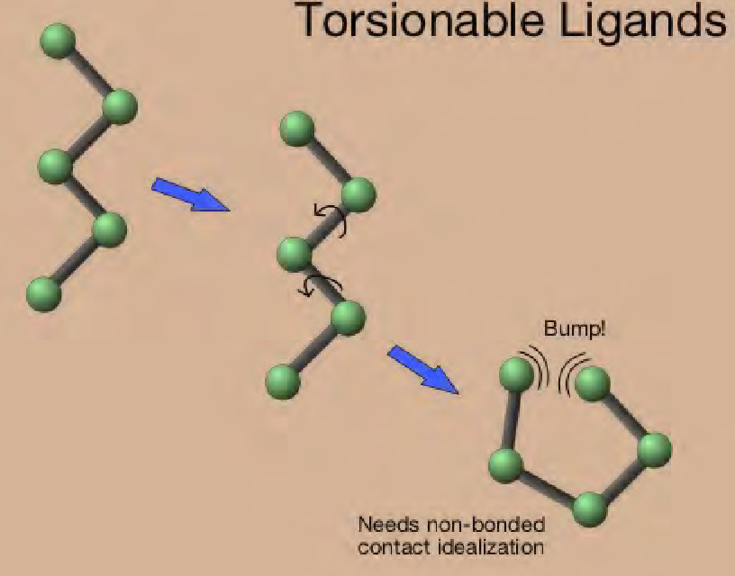
Ligand Torsionable Angle Probability from CIF file

Slide 27
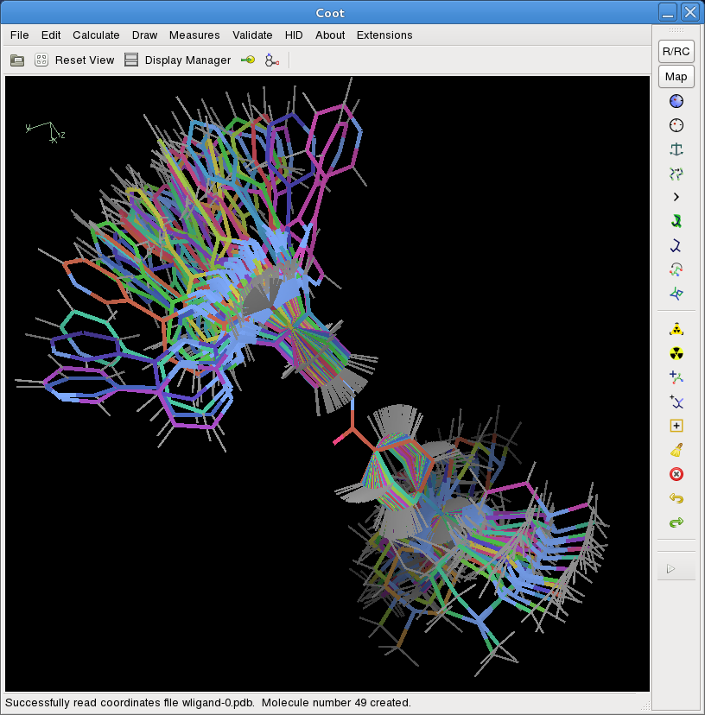
Conformer Generation
Non-Hydrogen
Non-CONST
Non-Ring

Slide 28
Chirality
loop_
_chem_comp_chir.comp_id
_chem_comp_chir.id
_chem_comp_chir.atom_id_centre
_chem_comp_chir.atom_id_1
_chem_comp_chir.atom_id_2
_chem_comp_chir.atom_id_3
_chem_comp_chir.volume_sign
DRG chir_01 C7 C5 C8 O9 positiv
Many compounds are chiral and will have a significant impact on the overall conformation

Slide 29
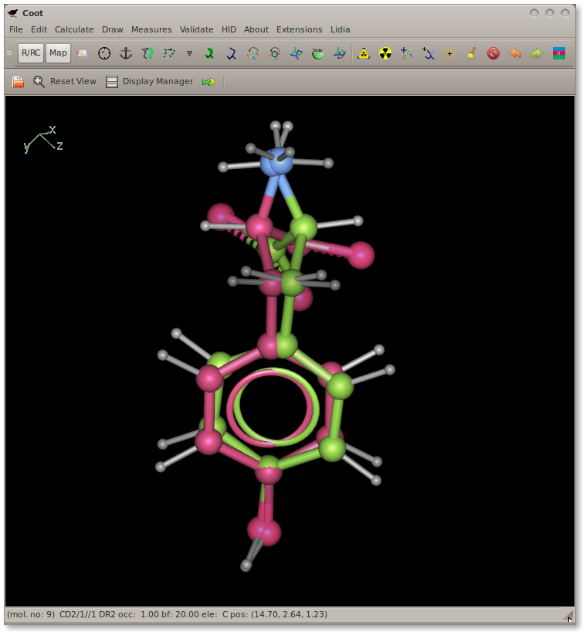
Chiral Centre Inversion
Inverted chiral centre refinement pathology detection

Slide 30
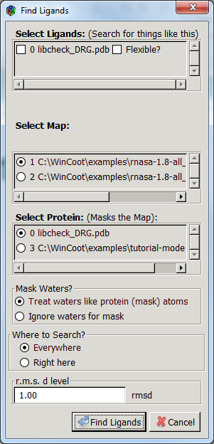
Fitting Ligands
Calculate> Other modelling tools> find ligands
Simple interface
Most recent interface is extended
conformers
automated real space refine

Slide 31
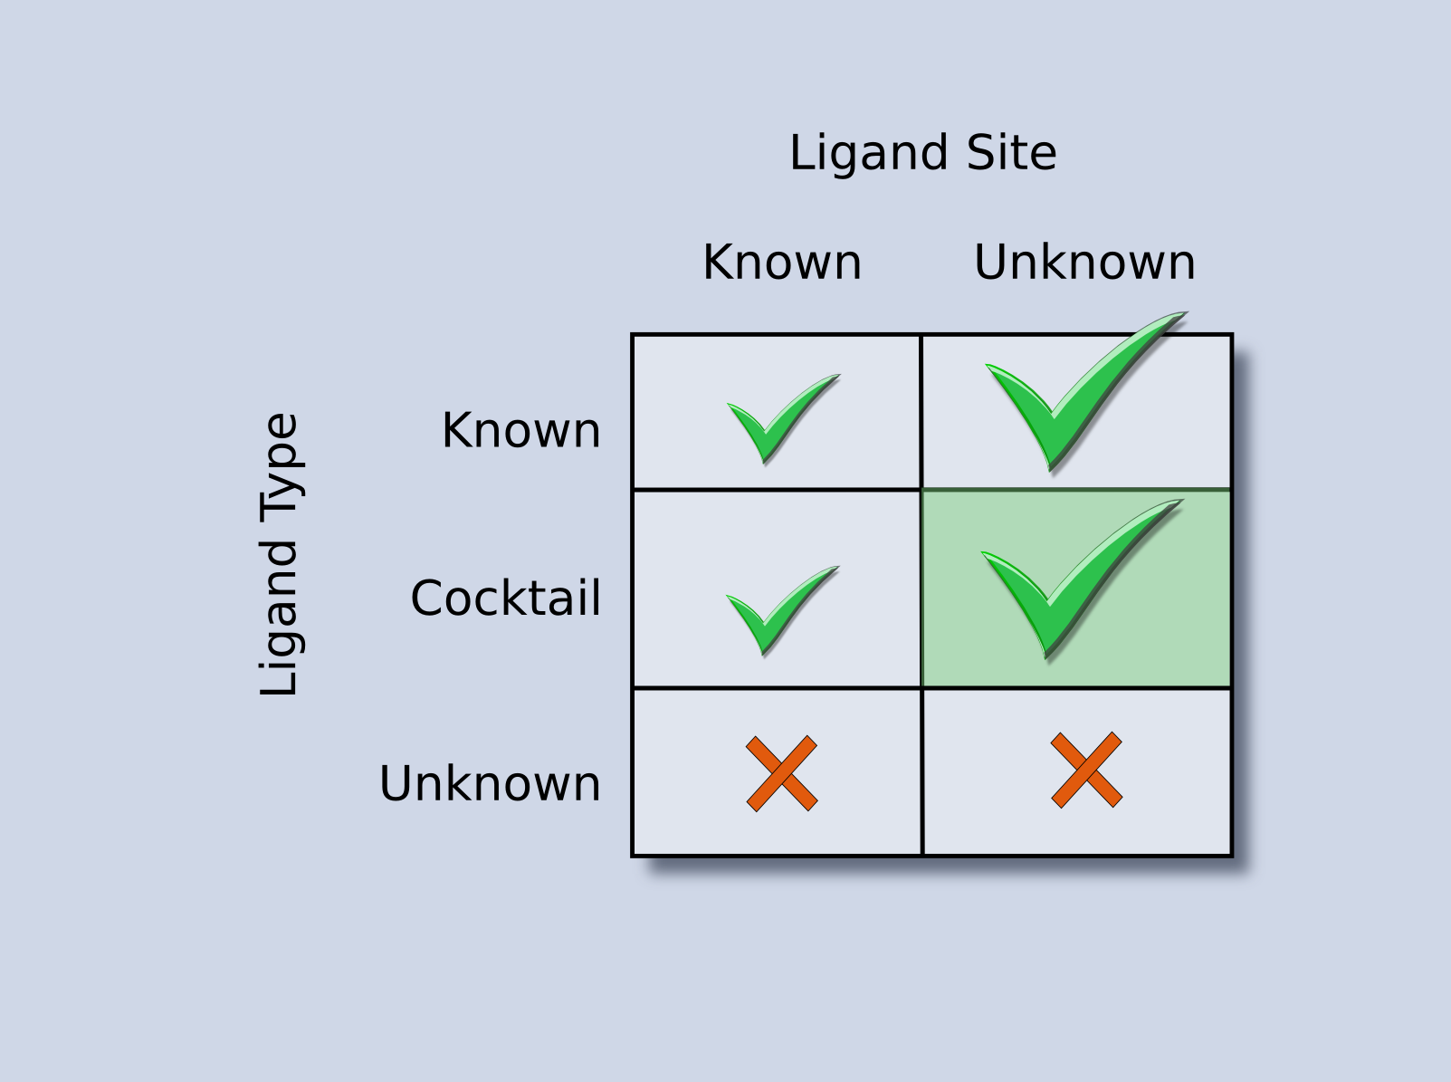
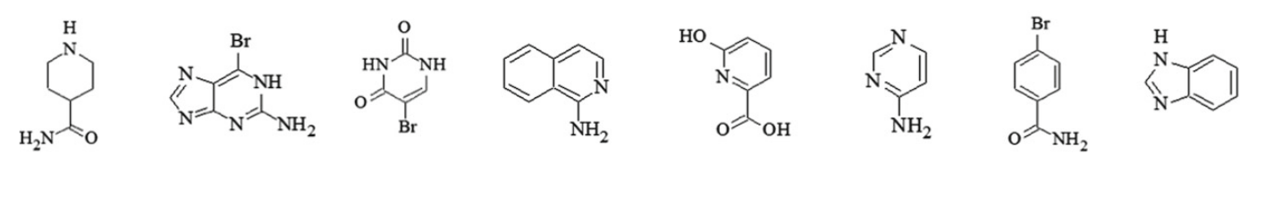
Cocktail Examples

Slide 32
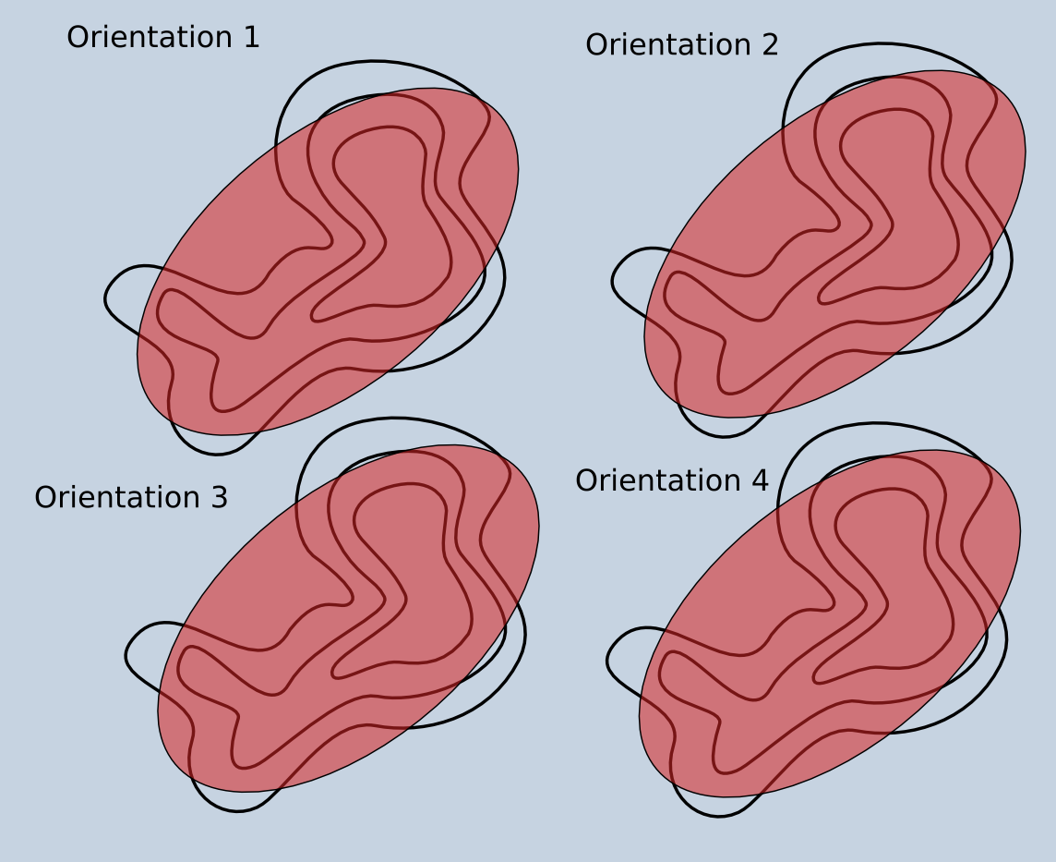
Orienting the ligand

Slide 33
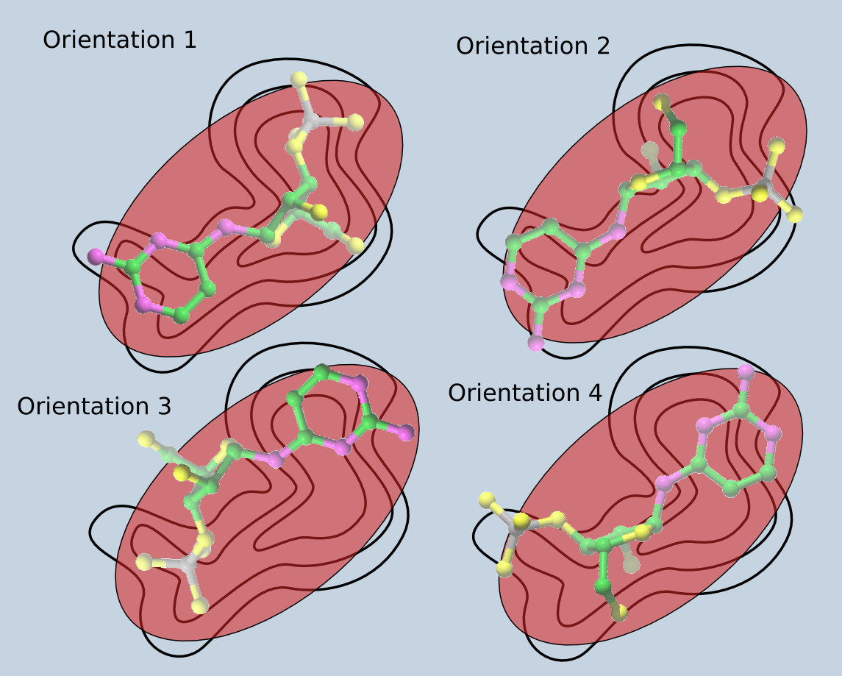
Orienting the ligand

Slide 34
Ligand Validation
Mogul plugin in Coot
  Run mogul, graphical display of results
  Update/review restraints (target and esds for bonds and angles)

Slide 35
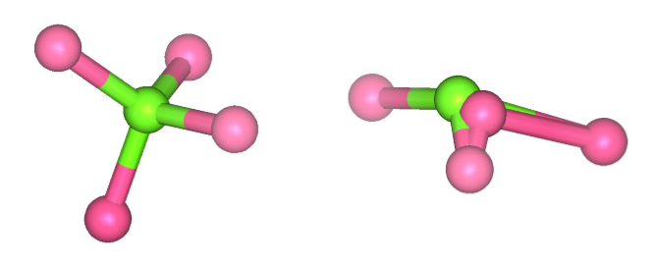
Why bother?
1.65 Å
11,000 chemical compounds in the PDB!
Analysis of structures in the public domain
Iridium: A Highly Trustworthy Protein-Ligand Structure Database
Drug Disc. Today, 12, 1270 (2012)
19% of the ligands in this data set contained errors
wwPDB: Greater focus on validation tools for PDB

Slide 36
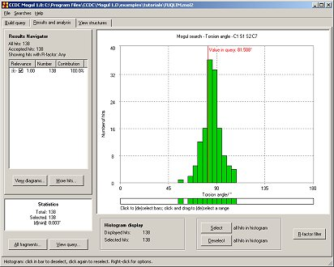
Parametisation issues...
Perfect refinement with incorrect parameters → distorted structure
Mogul - A knowledge-based library of molecular geometry derived from the Cambridge Structural Database (CSD)
access to millions of chemically classified bond lengths, valence angles, acyclic torsion angles, and ring conformations

Slide 37
Assessing Ligand Geometry Accuracy
CSD's Mogul
  Knowledge-base of geometric
  parameters based on the CSD
  Can be run as a “batch job”
  Mean, median, mode,
  quartiles, Z-scores.

Slide 38
Example Coot Ligand Distortion Score
Residue Distortion List:
plane O3 C19 C20 C18 C16 C15 C17 C13 C14 N2 C4 C5 O1 C3 C6 O2 penalty-score: 36.51
plane C2 C7 C8 C9 C10 C11 C12 penalty-score: 8.82
bond C13 to C4 target_value: 1.490 d: 1.432 sigma: 0.020 length-devi -0.058 penalty-score: 8.44
bond C4 to C3 target_value: 1.490 d: 1.436 sigma: 0.020 length-devi -0.054 penalty-score: 7.21
bond O3 to C19 target_value: 1.362 d: 1.318 sigma: 0.020 length-devi -0.044 penalty-score: 4.75
bond C19 to C20 target_value: 1.390 d: 1.433 sigma: 0.020 length-devi 0.043 penalty-score: 4.67
bond C1 to C2 target_value: 1.390 d: 1.428 sigma: 0.020 length-devi 0.038 penalty-score: 3.70
bond C4 to C5 target_value: 1.490 d: 1.454 sigma: 0.020 length-devi -0.036 penalty-score: 3.26
bond C13 to C14 target_value: 1.490 d: 1.456 sigma: 0.020 length-devi -0.034 penalty-score: 2.91
bond C15 to C13 target_value: 1.490 d: 1.458 sigma: 0.020 length-devi -0.032 penalty-score: 2.57
bond C16 to C15 target_value: 1.490 d: 1.459 sigma: 0.020 length-devi -0.031 penalty-score: 2.45
angle C13 - C4 - C5 target: 108.00 model_angle: 133.80 sigma: 3.00 angle-devi 25.80 penalty-score: 73.93
angle O1 - C5 - C4 target: 108.00 model_angle: 126.59 sigma: 3.00 angle-devi 18.59 penalty-score: 38.38
angle C13 - C15 - C16 target: 120.00 model_angle: 102.30 sigma: 3.00 angle-devi 17.70 penalty-score: 34.83
angle O2 - C6 - N1 target: 108.00 model_angle: 122.80 sigma: 3.00 angle-devi 14.80 penalty-score: 24.34
angle O2 - C6 - C3 target: 108.00 model_angle: 122.76 sigma: 3.00 angle-devi 14.76 penalty-score: 24.19
angle C13 - C15 - C17 target: 120.00 model_angle: 133.33 sigma: 3.00 angle-devi 13.33 penalty-score: 19.76
angle C4 - C13 - C15 target: 120.00 model_angle: 132.99 sigma: 3.00 angle-devi 12.99 penalty-score: 18.76
angle N1 - C5 - O1 target: 108.00 model_angle: 120.48 sigma: 3.00 angle-devi 12.48 penalty-score: 17.32
angle C15 - C13 - C14 target: 120.00 model_angle: 110.43 sigma: 3.00 angle-devi -9.57 penalty-score: 10.18
angle N1 - C6 - C3 target: 108.00 model_angle: 114.28 sigma: 3.00 angle-devi 6.28 penalty-score: 4.38
angle C6 - C3 - C4 target: 108.00 model_angle: 101.75 sigma: 3.00 angle-devi -6.25 penalty-score: 4.34
Residue Distortion Summary:
29 bond restraints
44 angle restraints
sum of bond distortions penalties: 59.5697
sum of angle distortions penalties: 300.405
average bond distortion penalty: 2.05413
average angle distortion penalty: 6.82739
total distortion penalty: 405.304
average distortion penalty: 4.93116

Slide 39
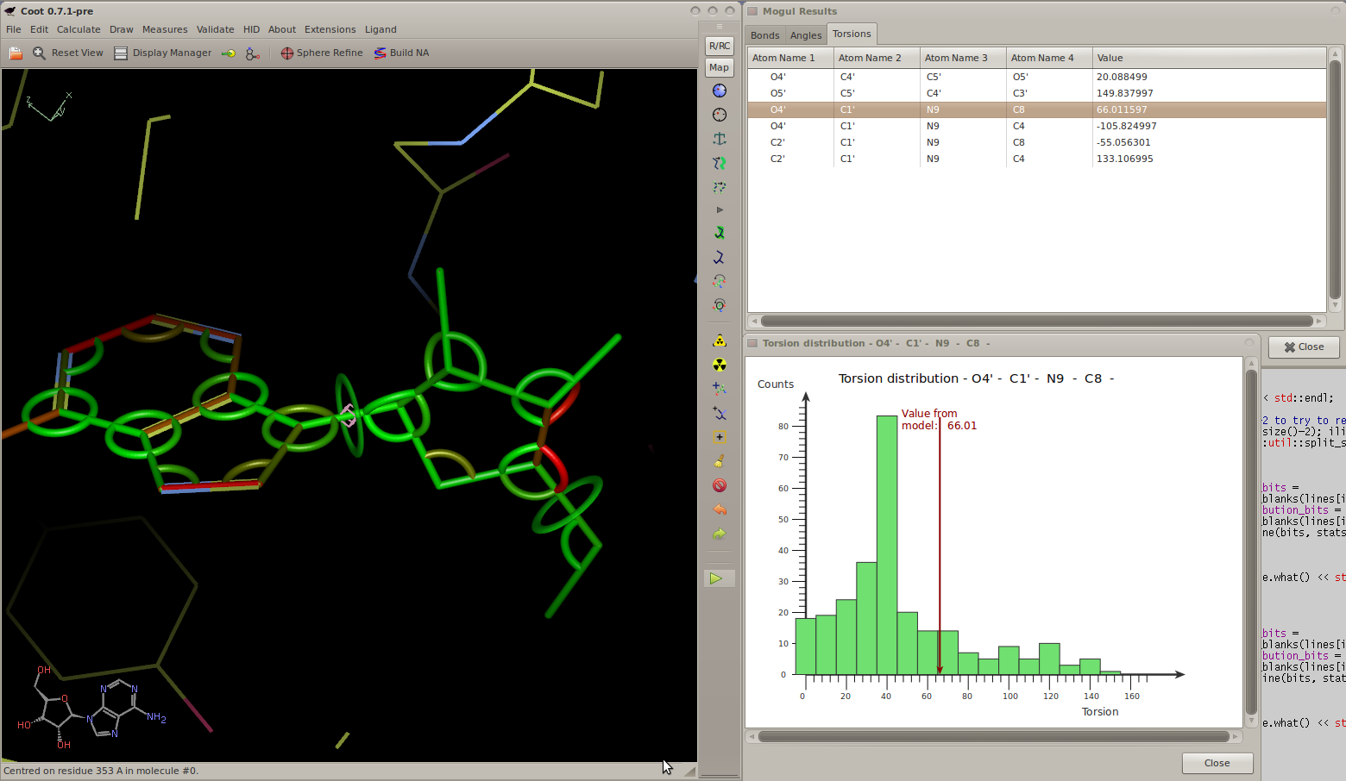
Mogul Results Representation

Slide 40
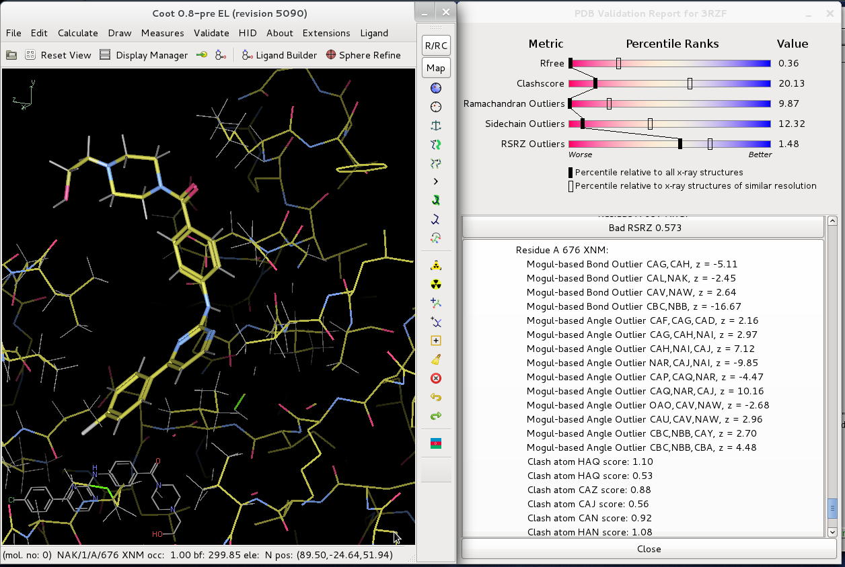

Slide 41
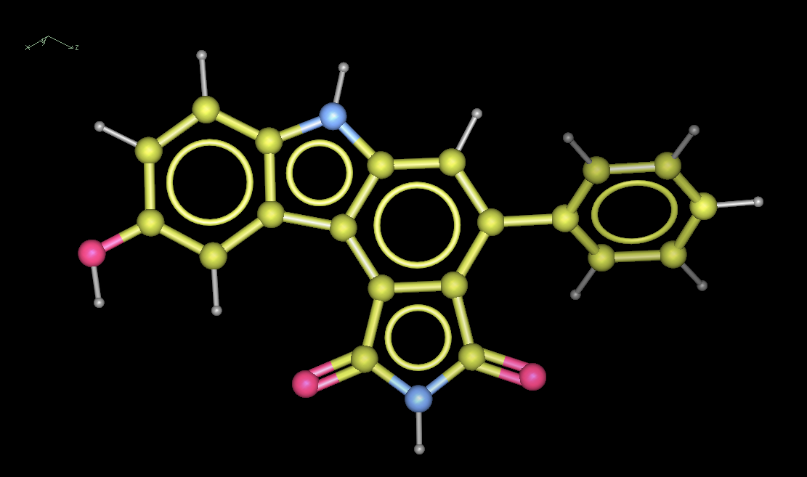
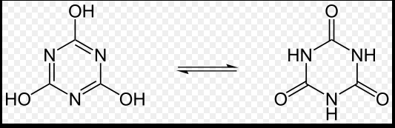
Ligand Represenation
Bond orders (from dictionary restraints)
Be critical- are you sure? Check your chemistry Beware of issues such as tautomers, nitrogen hybridisation (planarity), protonation states…
Are your assumptions correct for your restraints

Slide 42
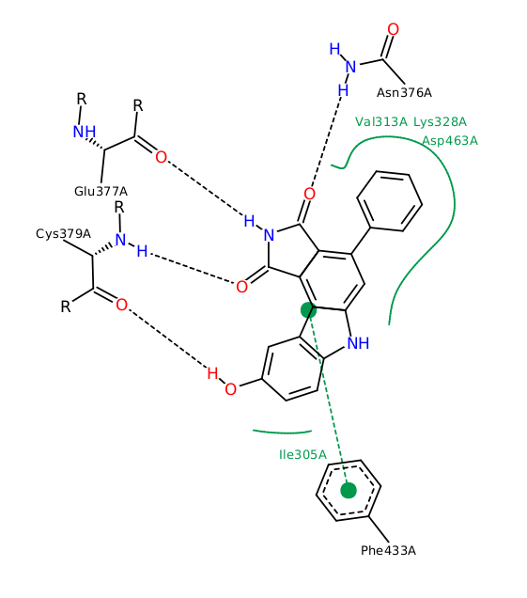
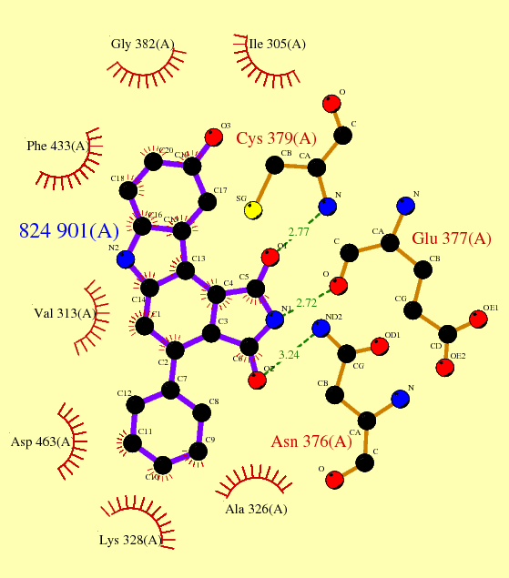
Ligand Environment Layout
2d Ligand pocket layout (ligplot, poseview)
New tools in Coot!

Slide 43
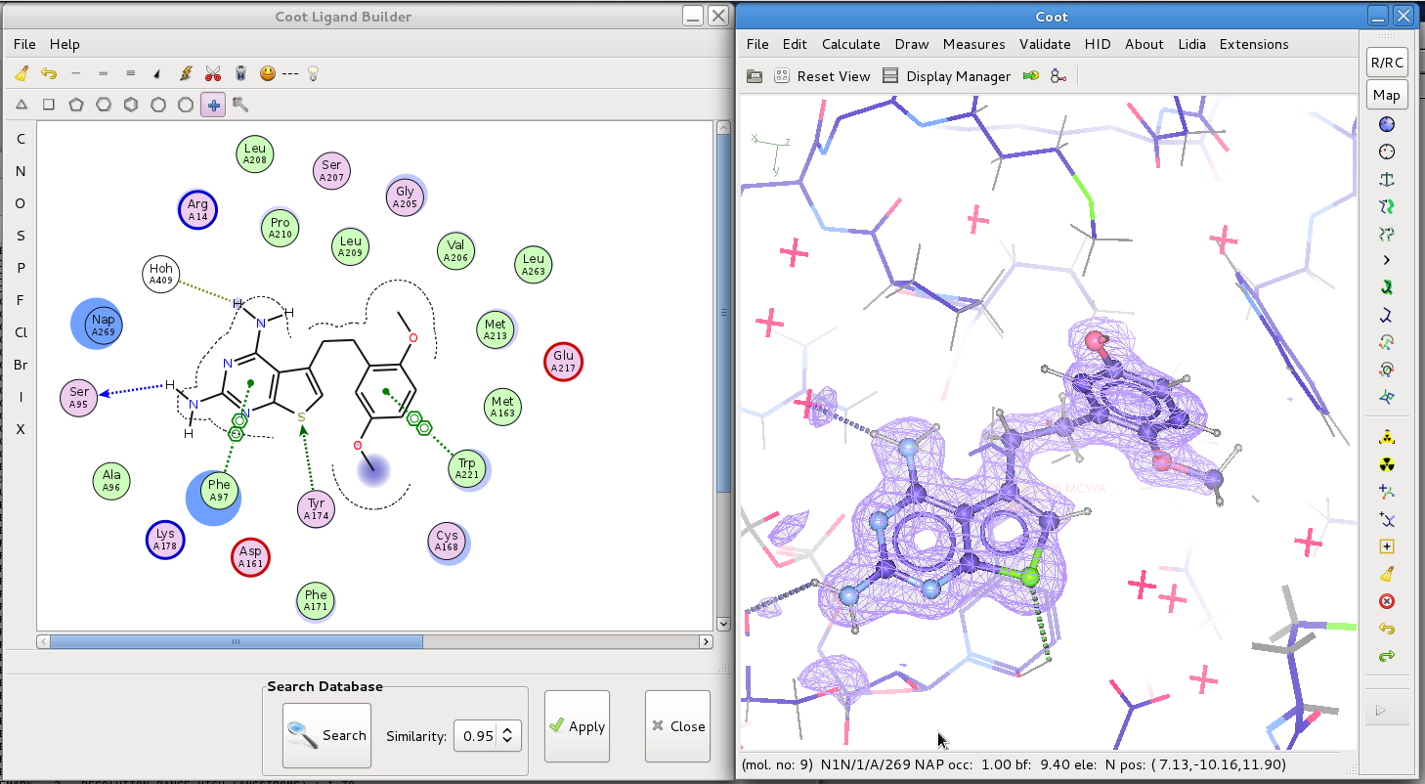
FLEV: Flatland Ligand Environment

Slide 44
Sources of help
  The Homepage, F.A.Q, documentation
  http://www2.mrc-lmb.cam.ac.uk/Personal/pemsley/coot/
  Coot Wiki
  http://strucbio.biologie.uni-konstanz.de/ccp4wiki/index.php/Coot
  The mailing list
  http://www.jiscmail.ac.uk/lists/coot.html
  Ligand validation (recommendations for best practise)
  Outcome of the First wwPDB/CCDC/D3R Ligand Validation Workshop.
  Structure. 2016 Apr 5;24(4):502-8. doi: 10.1016/j.str.2016.02.017.

Slide 45
Ligand Fitting Practical
Handout with instructions
Starting files
Focus on Acedrg, jLigand and Coot
Simple ligand fitting case
  If you have time please also give the in-built ligand sketcher to generate a *.mol file to feed into Acedrg
More problematic case, restraint modification
“Free play” opportunity to ask questions and try out other tools

Slide 46
Acknowledgements
Paul Emsley
Kevin Cowtan
Bernhard Lohkamp
Judit Debreczeni
Libraries, Dictionaries
  Alexei Vagin
  Garib Murshudov
  Eugene Krissinel
  Greg Landrum
  Molprobity
  David Richardson
  Jane Richardson
BBSRC & CCP4
Previous presentations

