Slide 1

Practical MX data collection
Neil Paterson
neil.paterson@diamond.ac.uk
Thanks to Gwyndaf Evans for slides

Slide 2
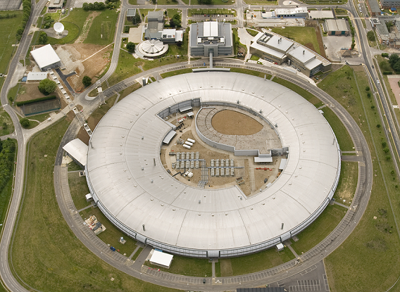
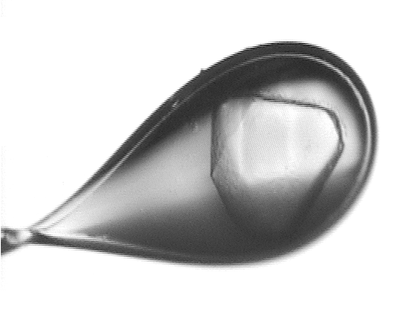
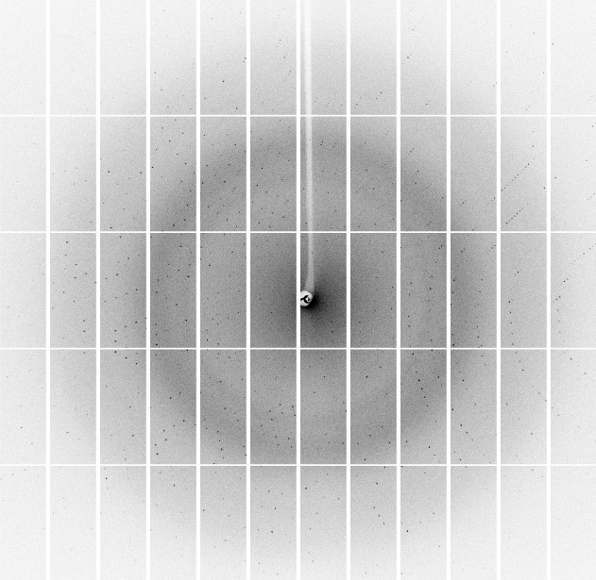

Slide 3
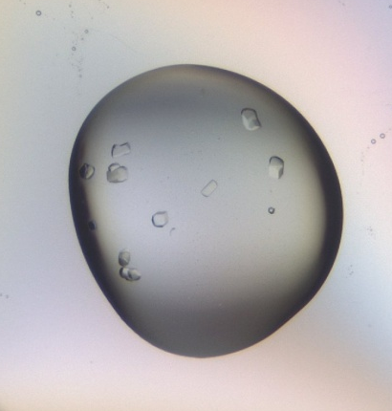
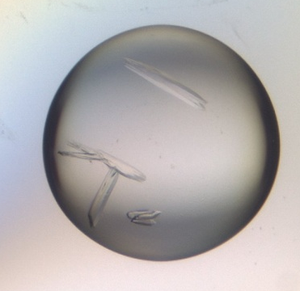
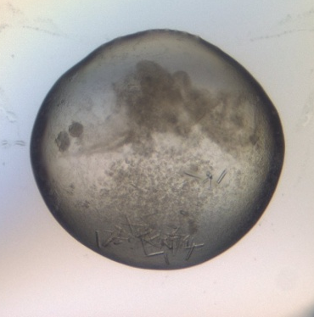
Data collection is important!
This is the last experimental step
Time taken now to collect the best possible data can prevent pain and possible failure later on.
If the original data are poor then not much can be done about it later.
Ask your local contact for advice if you are unsure, ideally drop an email through before your trip.

Slide 4
What’s the goal?
Aim | High priorities | Lower priority
Native data collection | High resolution, complete data | High redundancy
MAD, SAD | Accurate, complete and highly redundant Very little radiation damage Choice of wavelength | High resolution data
-> Sulphur SAD | As above + extra high redundancy (40-200fold)
Molecular replacement | Completeness at low resolution (< 3Å)
Ligand/mutation | High resolution, complete data. High throughput | High redundancy
Trying to collect everything at once will usually result in failure

Slide 5
Preparation
Sample centering
Screening, analysis & strategy
Data collection & evaluation
Post beamtime

Slide 6
Preparation
Prior knowledge
Protein features
Cell/SG
Strategy
Solvent content
Crystal size
Radiation sensitivity
Expected fold/homologues?

Slide 7
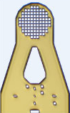
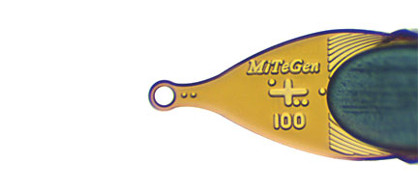
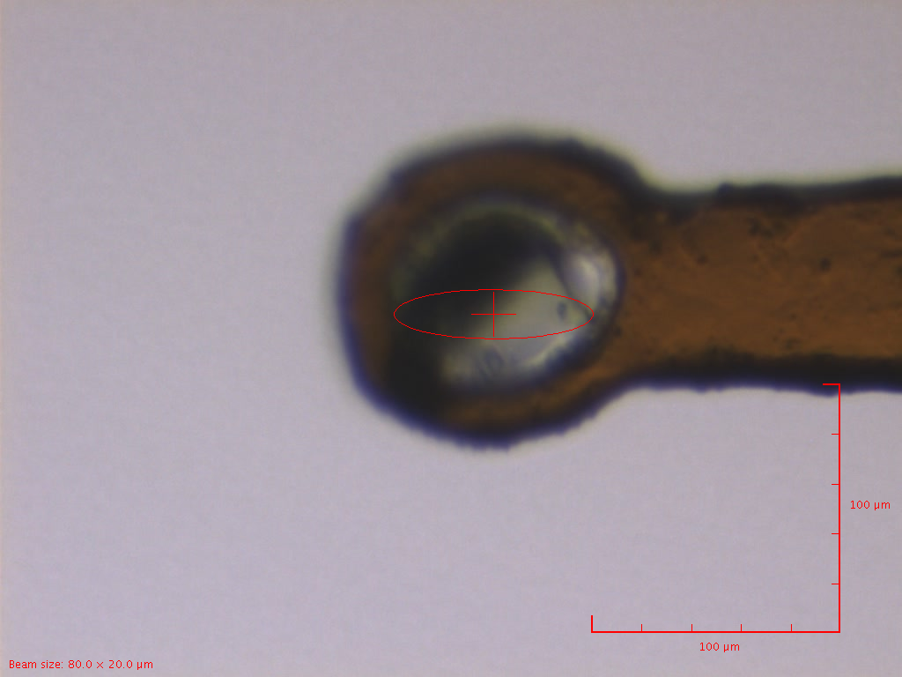
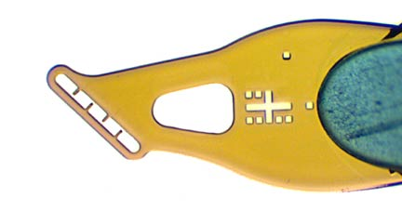
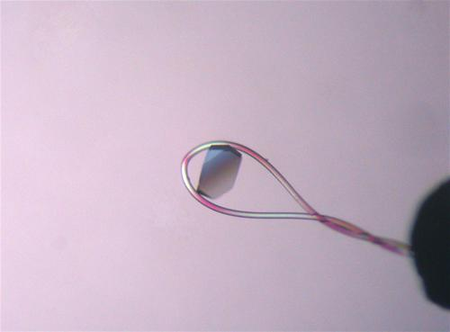
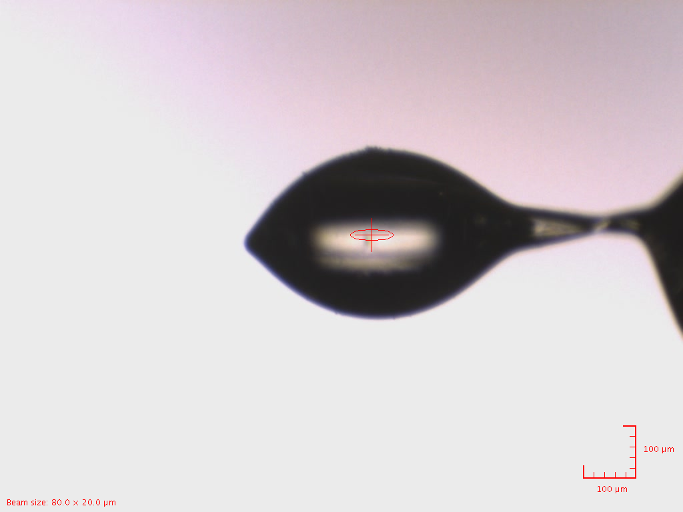
Preparation
Sample mounting

Slide 8
Preparation
Choice of beamline
Energy range – does it cover what you need?
Kappa? P1, experimental phasing
Biological containment?
Cryo or room temperature collection?
Can the beam size match your crystals?
Flux – important for radiation damage

Slide 9
Beam and sample size
Both the crystal and the solvent surrounding the crystal interact with X-rays resulting in diffuse scatter on the detector
X-rays
X-ray background reduction
In this example reducing beamsize by ~ ×3 in both directions will reduce background by ×9

Slide 10
Match beam to sample
AcMNPV polyhedra crystals approx 5×5×5 µm³ in size were mounted on a micromesh grid. Data were collected with two beamsizes: 8×8 µm² and 4.5×5 µm²
I/ σ(I) = 1.5 at 2.9Å
Average background reduced by 3
I/ σ(I) = 1.5 at 2.5Å

Slide 11
Beam size and flux density
Be mindful of how the beamline generates a small beam size. Focusing (I04 +I24) can increase the flux density massively compared to apertures (I03)
Radiation damage is related to the flux density so small beam sizes on I04/I24 can kill a crystal very quickly.
E.g. 50x50 beam will deliver around 45x less dose than 9x6 on I24
So match beam to crystal, but attenuate when required

Slide 12
Preparation
Sample centring
Screening, analysis & strategy
Data collection & evaluation
Post beamtime

Slide 13
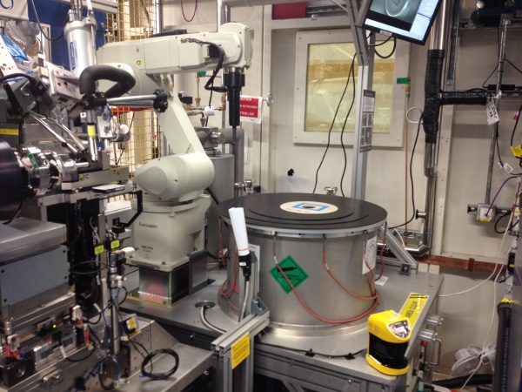
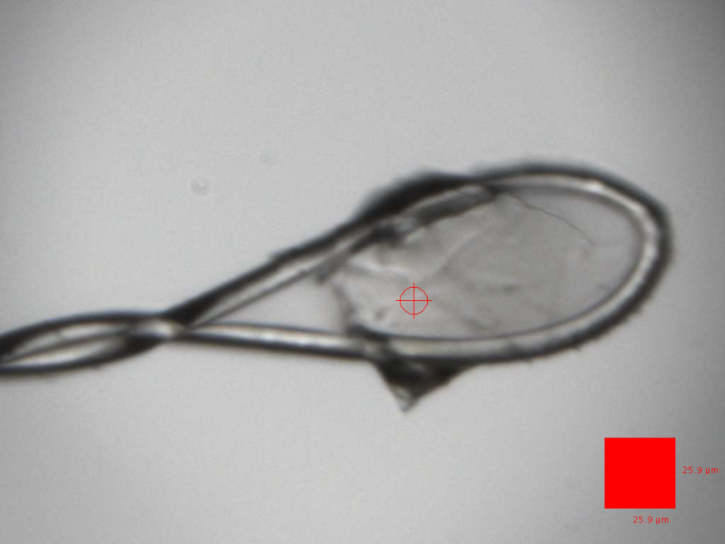
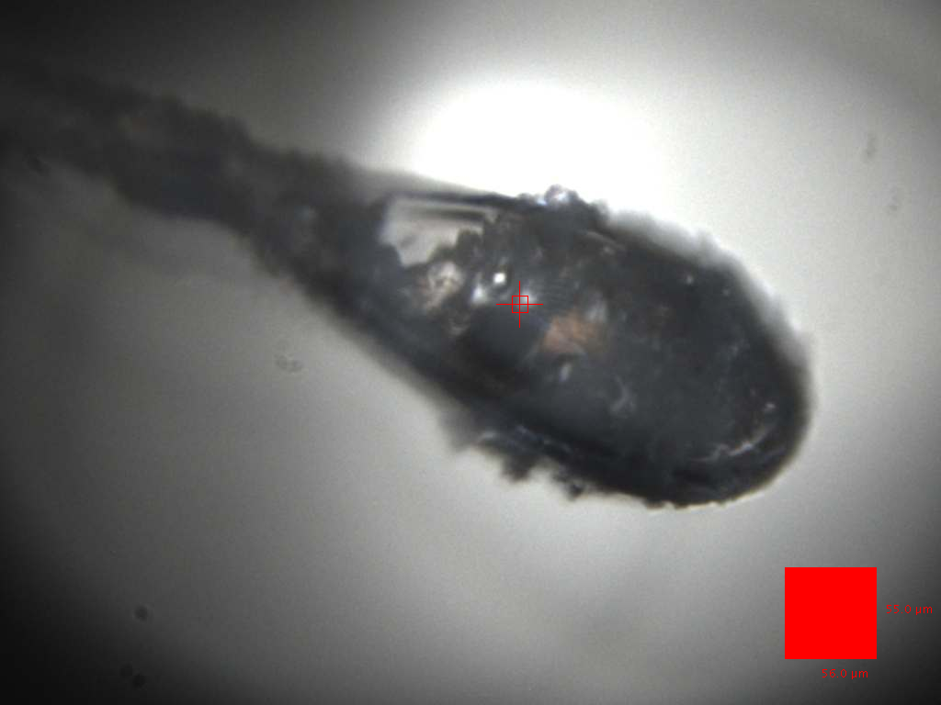
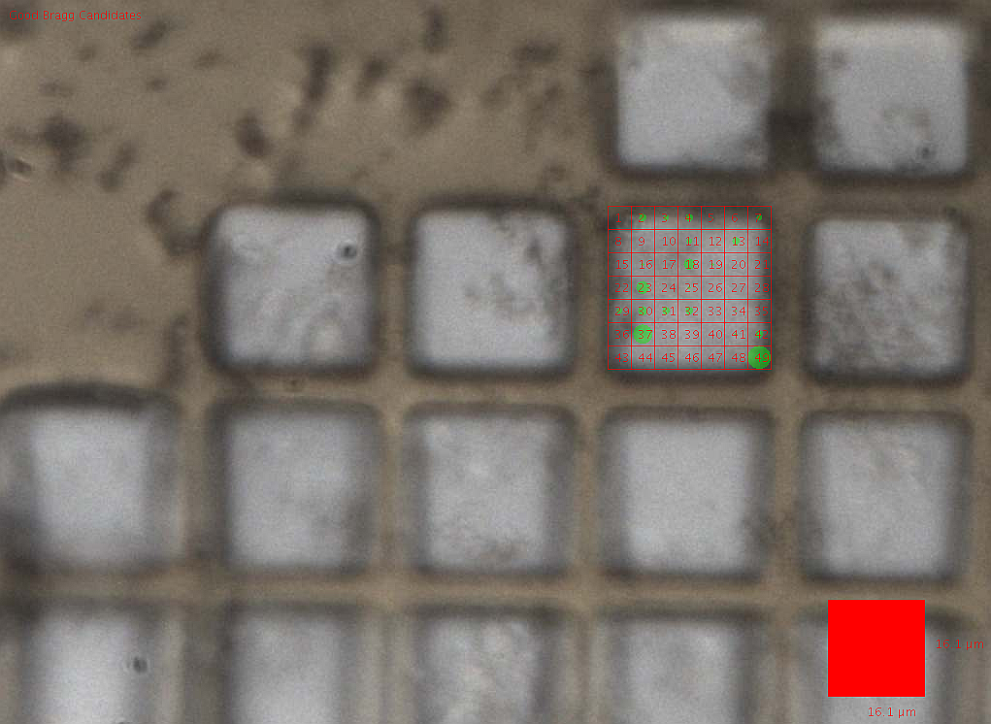
Mount and centre crystal
Mounting now automated at most beamlines.
Centring can be:
Easy
Challenging
Very very difficult
Make the most of tools
developed to make these cases easier

Slide 14
Centring in difficult cases
Making this easier: grid scanning
Allows large areas to be quickly rastered over and small or hard to see crystals found.
Also eliminates optical effects: crystal may not be where it seems..
Try to crudely centre first and collect a test shot. Is it worth spending a lot of time on this sample?
If yes Spend more time
If no Move on
If maybe Take advantage of the robot: dismount and see what your other samples are like

Slide 15
Preparation
Sample centring
Screening, analysis & strategy
Data collection & evaluation
Post beamtime

Slide 16
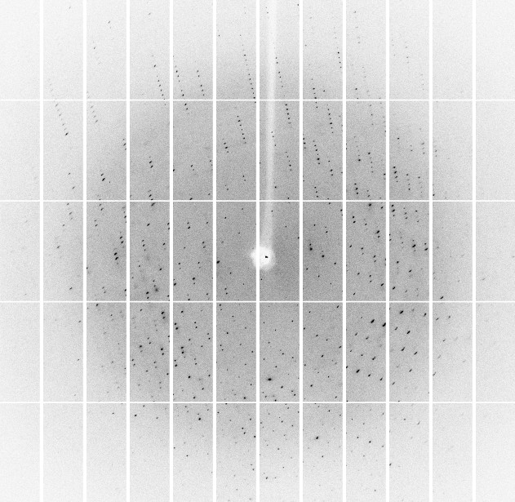
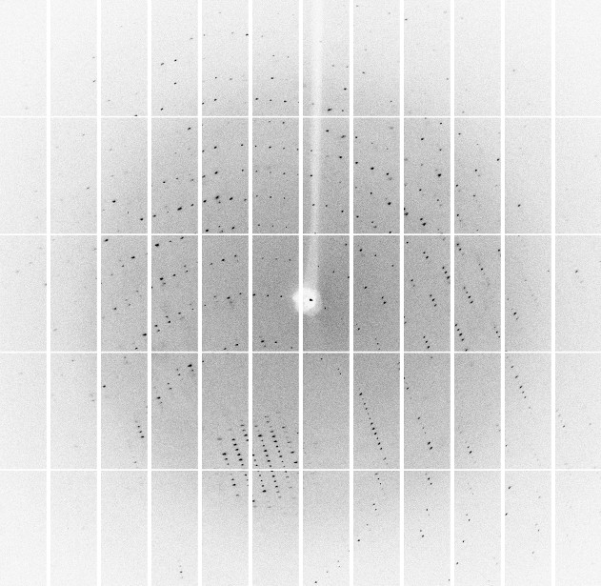
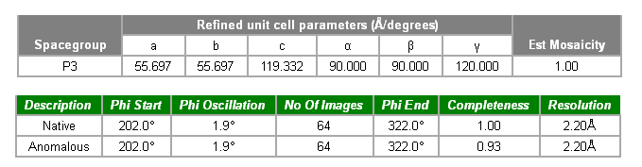
Screening & analysis
Determine crystal diffraction properties, orientation matrix and appropriate settings for data collection
Usually by collecting 3 or 4 images, each separated by 45 degrees.
Phi = 0°
Important to check the images
Spot quality – circular, well spaced
Similar at 0° and 90°?
Resolution appropriate?
Autoindexing successful?
Phi = 90°

Slide 17
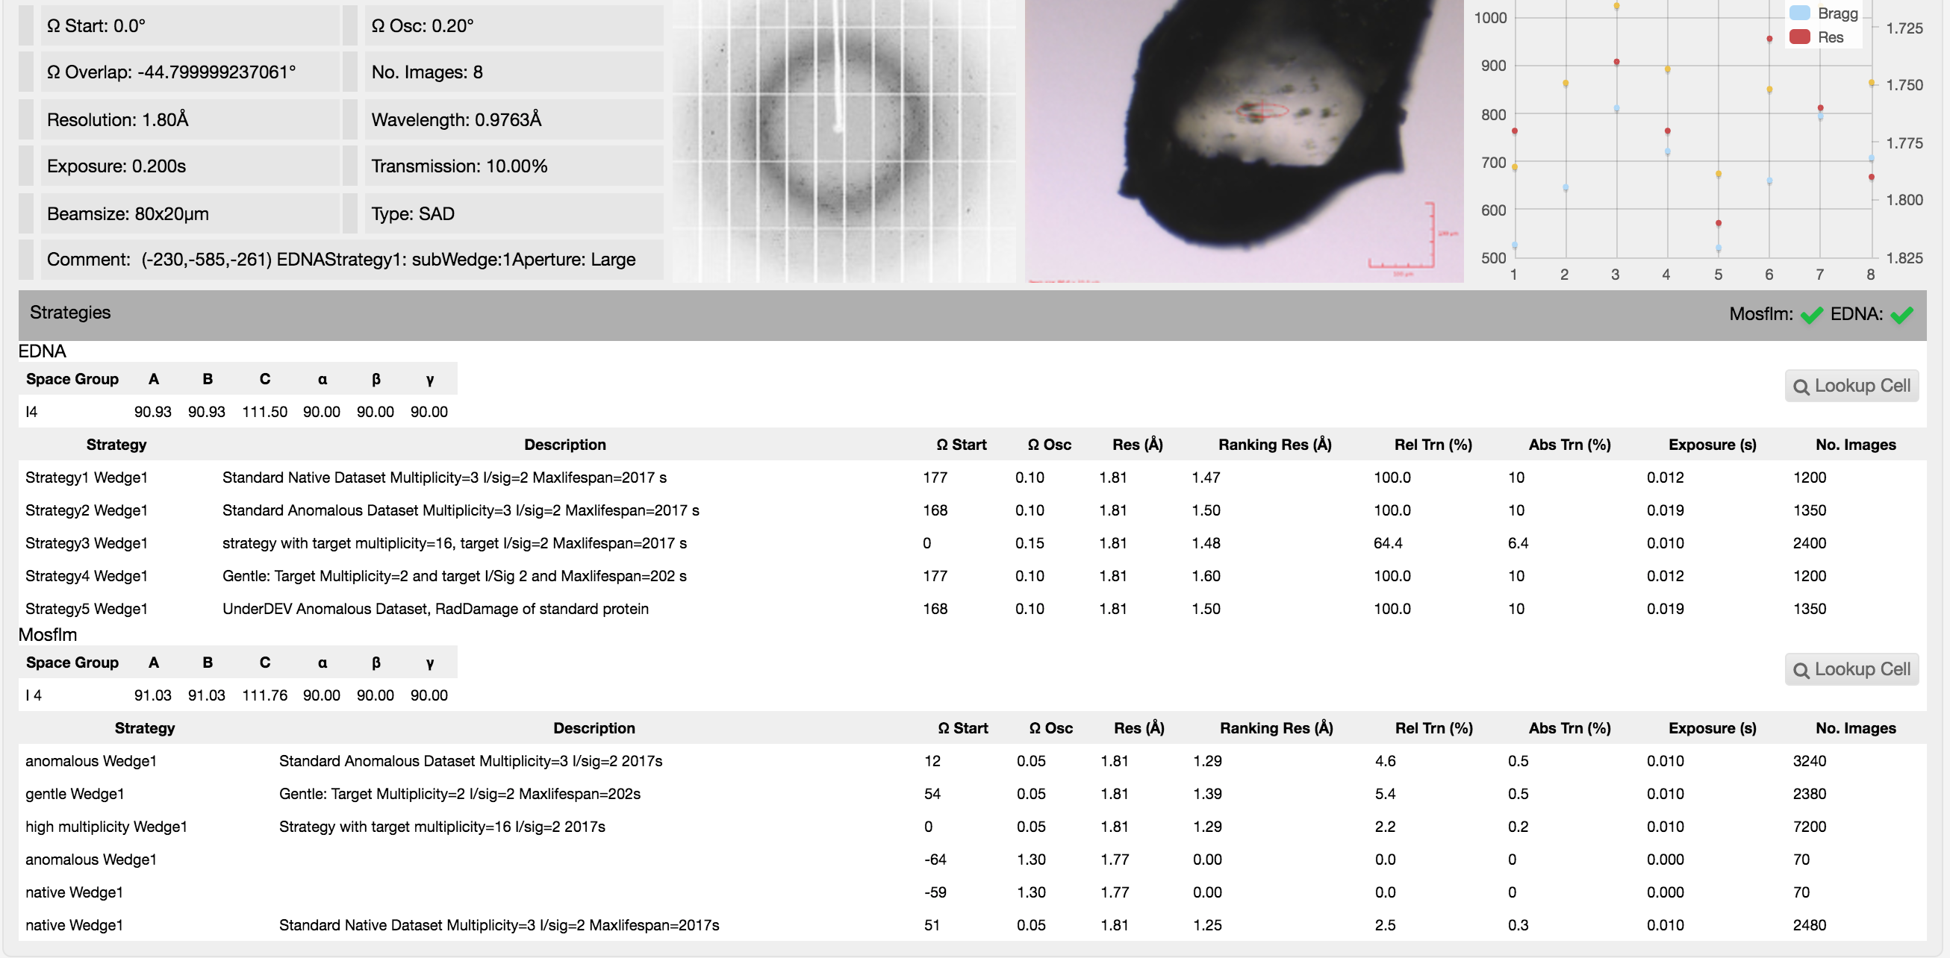
IspyB will display indexing results and suggested strategies for several scenarios. Results depend on the input quality! Repeat if necessary.
Not looking good? What else to try?

Slide 18
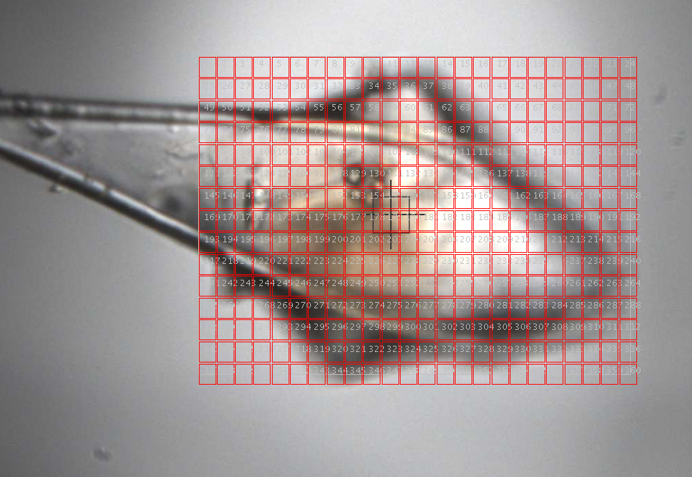
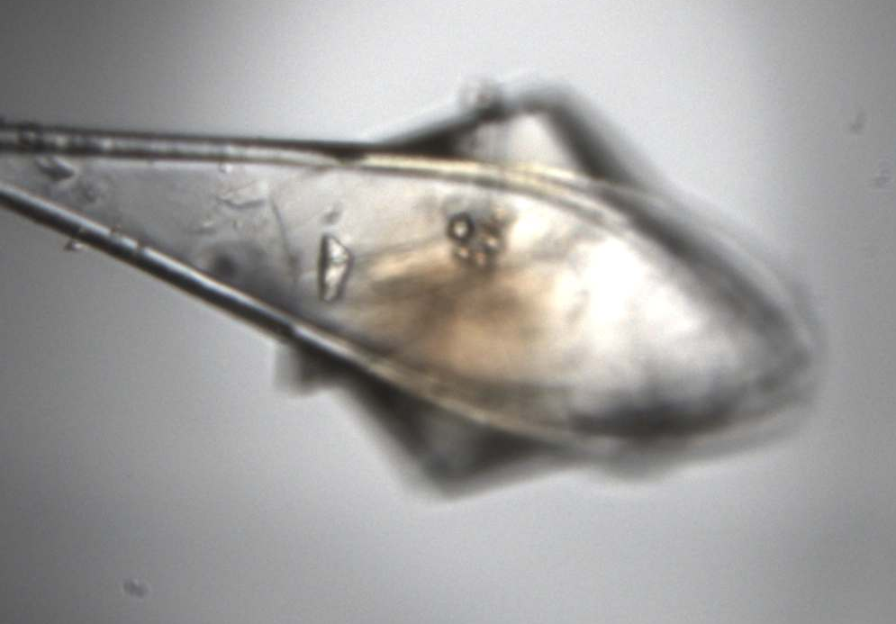
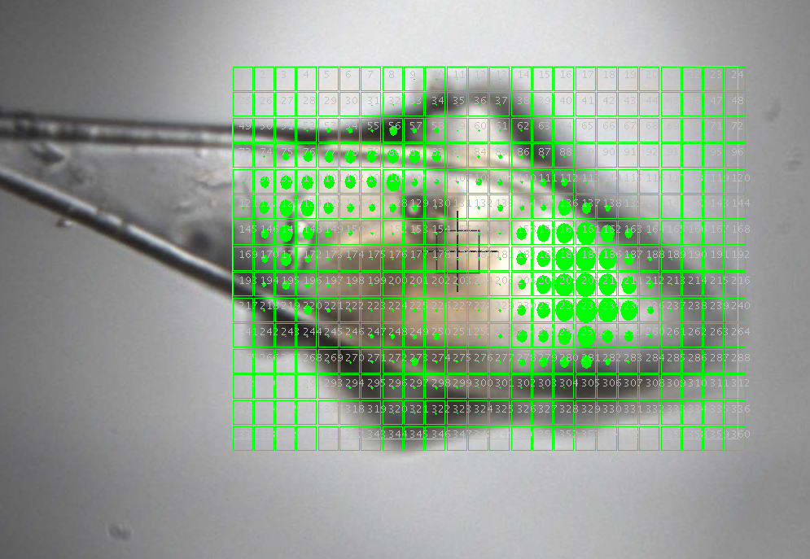
Other practicalities: does all of my crystal diffract
well
badly?
Beam
10 ×10 µm
50 µm

Slide 19
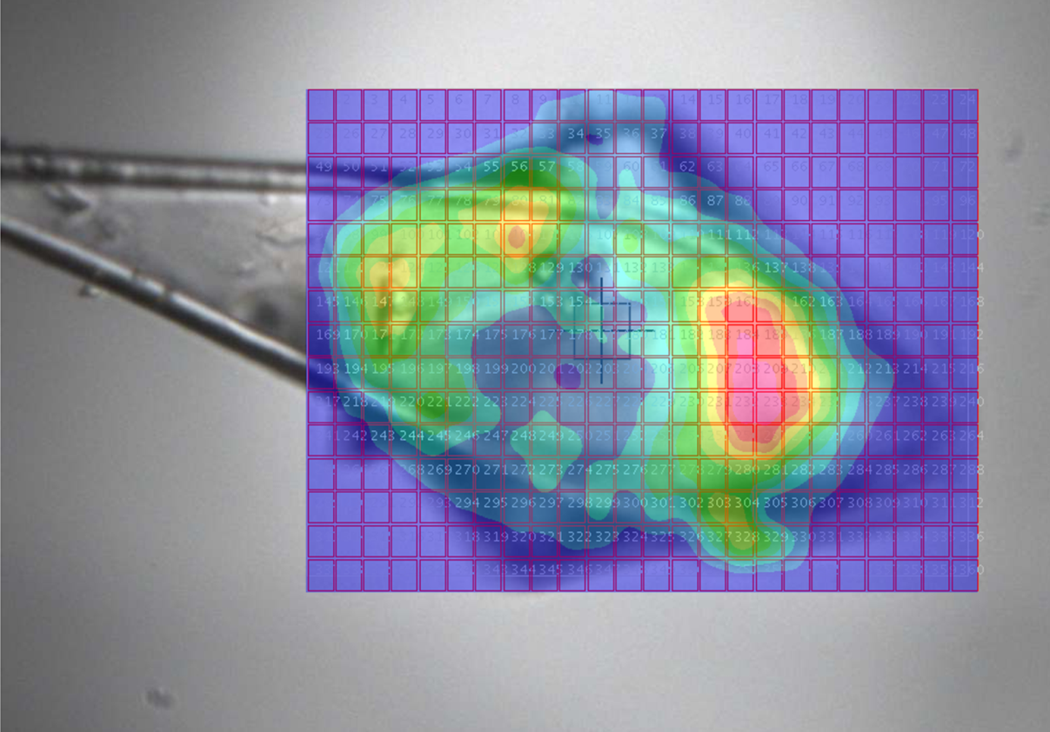
Even the same crystal can show a lot of variation..
3.04 Å
Wedge 3
Wedge 4
2.98 Å
2.64 Å
Wedge 1
Wedge 2
Beam
10 ×10 µm
3.44 Å
50 µm
Sometimes worthwhile, sometimes not. Learn when to move on.

Slide 20
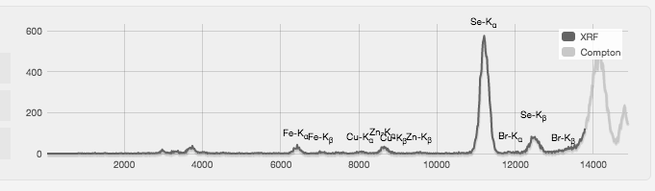
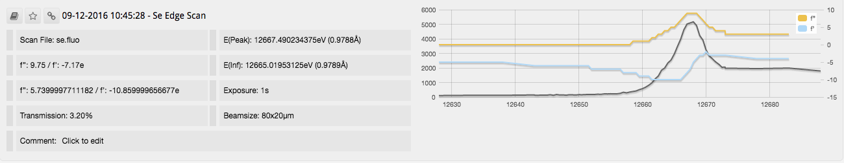
More screening?
Fluorescence spectrum/scans give you information about the elements in your sample.
Spectrum will suggest what elements are present – remember to set energy to a high value (e.g. 15-18keV) first.
If an anomalous scattering atom is present then you can also scan a particular edge to obtain peak/inflection energies and values.

Slide 21
Preparation
Sample centring
Screening, analysis & strategy
Data collection & evaluation
Post beamtime

Slide 22
Decision time
Remember the aim of your experiment – will this sample give you what you need, or get you closer to your goal? If not, move on.
Experimental phasing is the most critical at this point, a trivial case can be made borderline by bad choices. Most common error is overexposing the crystal, next is not collecting enough data.
Remember that low energy = stronger diffraction and faster radiation damage. Transmission of <1% not uncommon. If the edge is very different to the screening energy then consider repeating the screening shots.

Slide 23
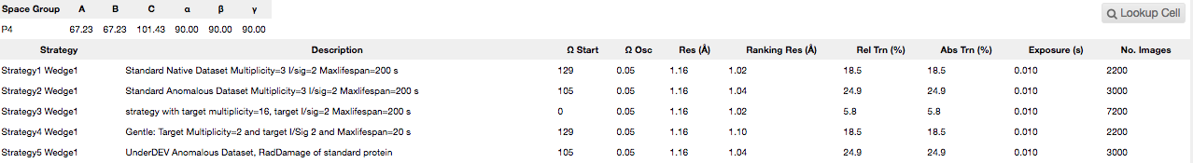
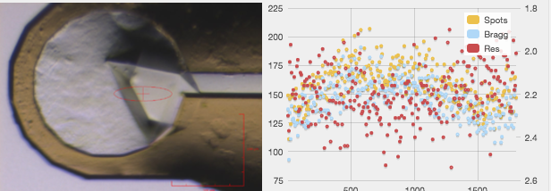
Data collection
Strategies are a good place to start. Choose the appropriate one for your experiment aim.
Watch the frames as they come in, look for signs of radiation damage. Per image analysis is performed automatically.

Slide 24
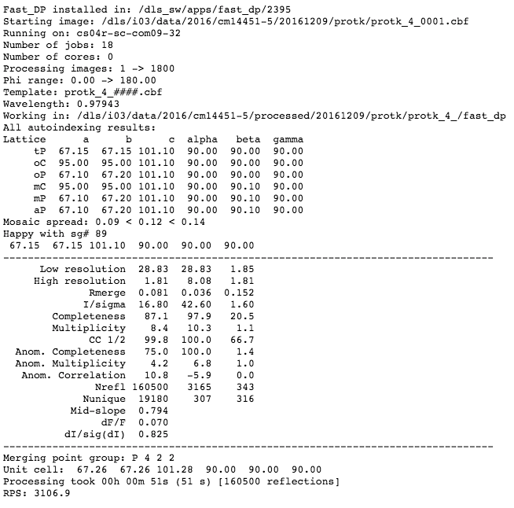
Data analysis
Process as you go, thankfully automatic these days! Fast_dp results usually keep up with data collection.
Analysis:
Use these results to update your data collection strategy.
Good low resolution statistics
Detector too far away, good data at edge
No anomalous signal of note

Slide 25
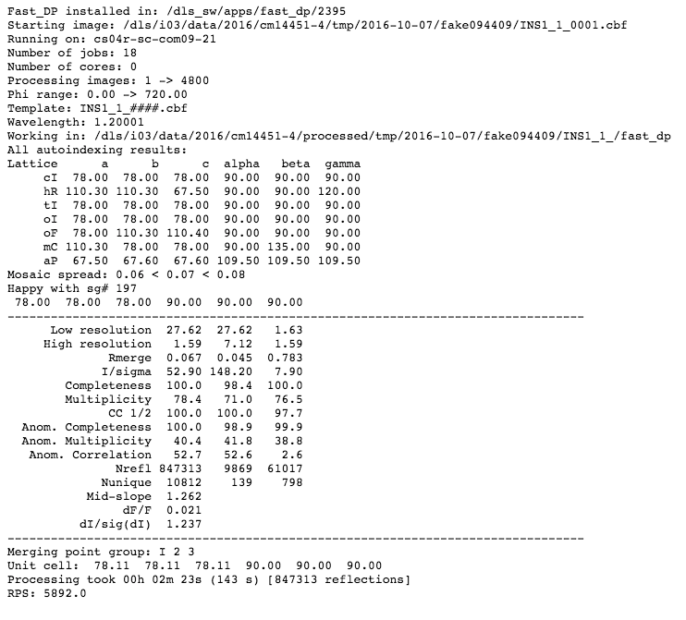
Data analysis
Strong anomalous signal, fast_ep successful – note the anomalous multiplicity for sulfur SAD

Slide 26
Trickier cases
Low solvent content, low resolution, low anomalous signal cases may require more than 1 dataset or even crystal to solve.
Low solvent content usually requires MAD phasing, 2 or 3 energies - some excellent talks covering this on Saturday!
From a data collection point of view you have options here:
Collect all on same part of crystal, interleaved. Chief concern is radiation damage.
Collect each energy on a separate part of the same crystal, small beam and large crystal.
Collect data from several crystals and combine (isomorphous?).

Slide 27
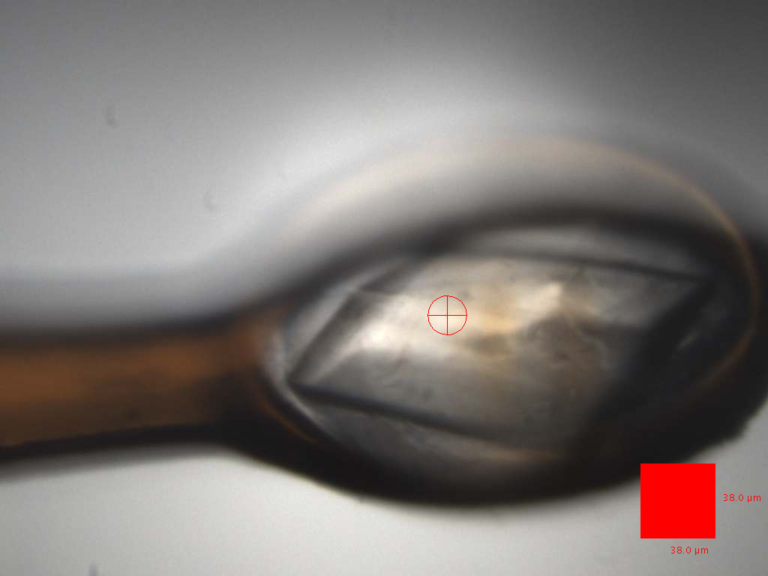
LptDE
Outer-membrane pore, beta barrel. Low resolution (3 Å) and low symmetry (I2). 20 Se per monomer and 2-3 in the ASU. 3 crystals available. 90min beamtime left.
Mainly beta strand so good experimental map needed for model building.
Strategy: 3-wavelength MAD using 20x20 μm beam on I24. Collect 720 deg at 1 energy, then translate, change energy and repeat. Do the same on all 3 crystals.

Slide 28
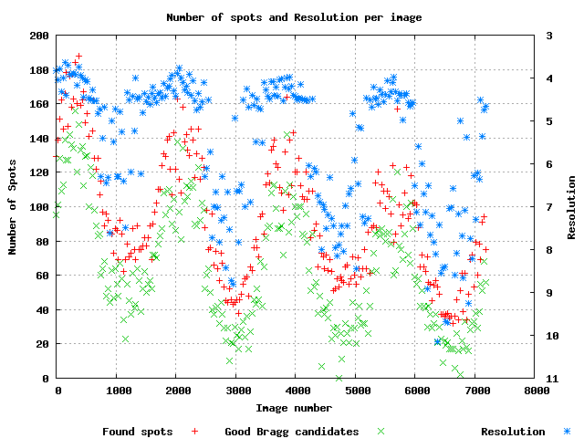
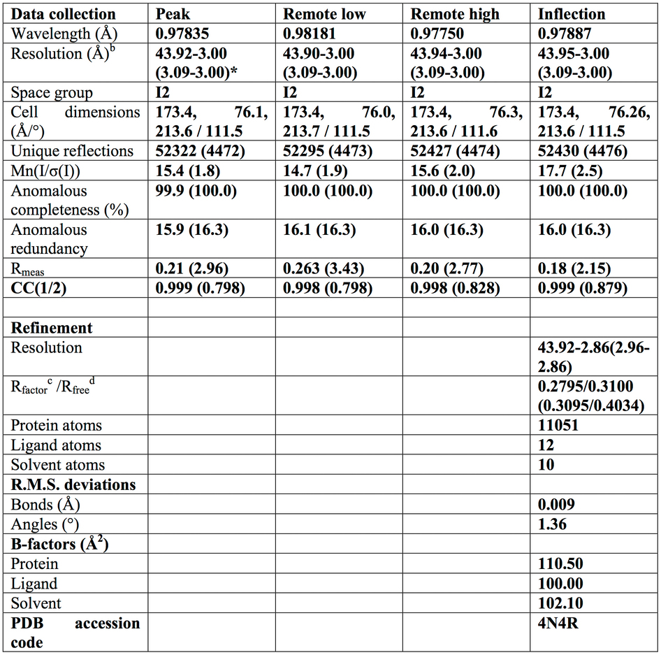
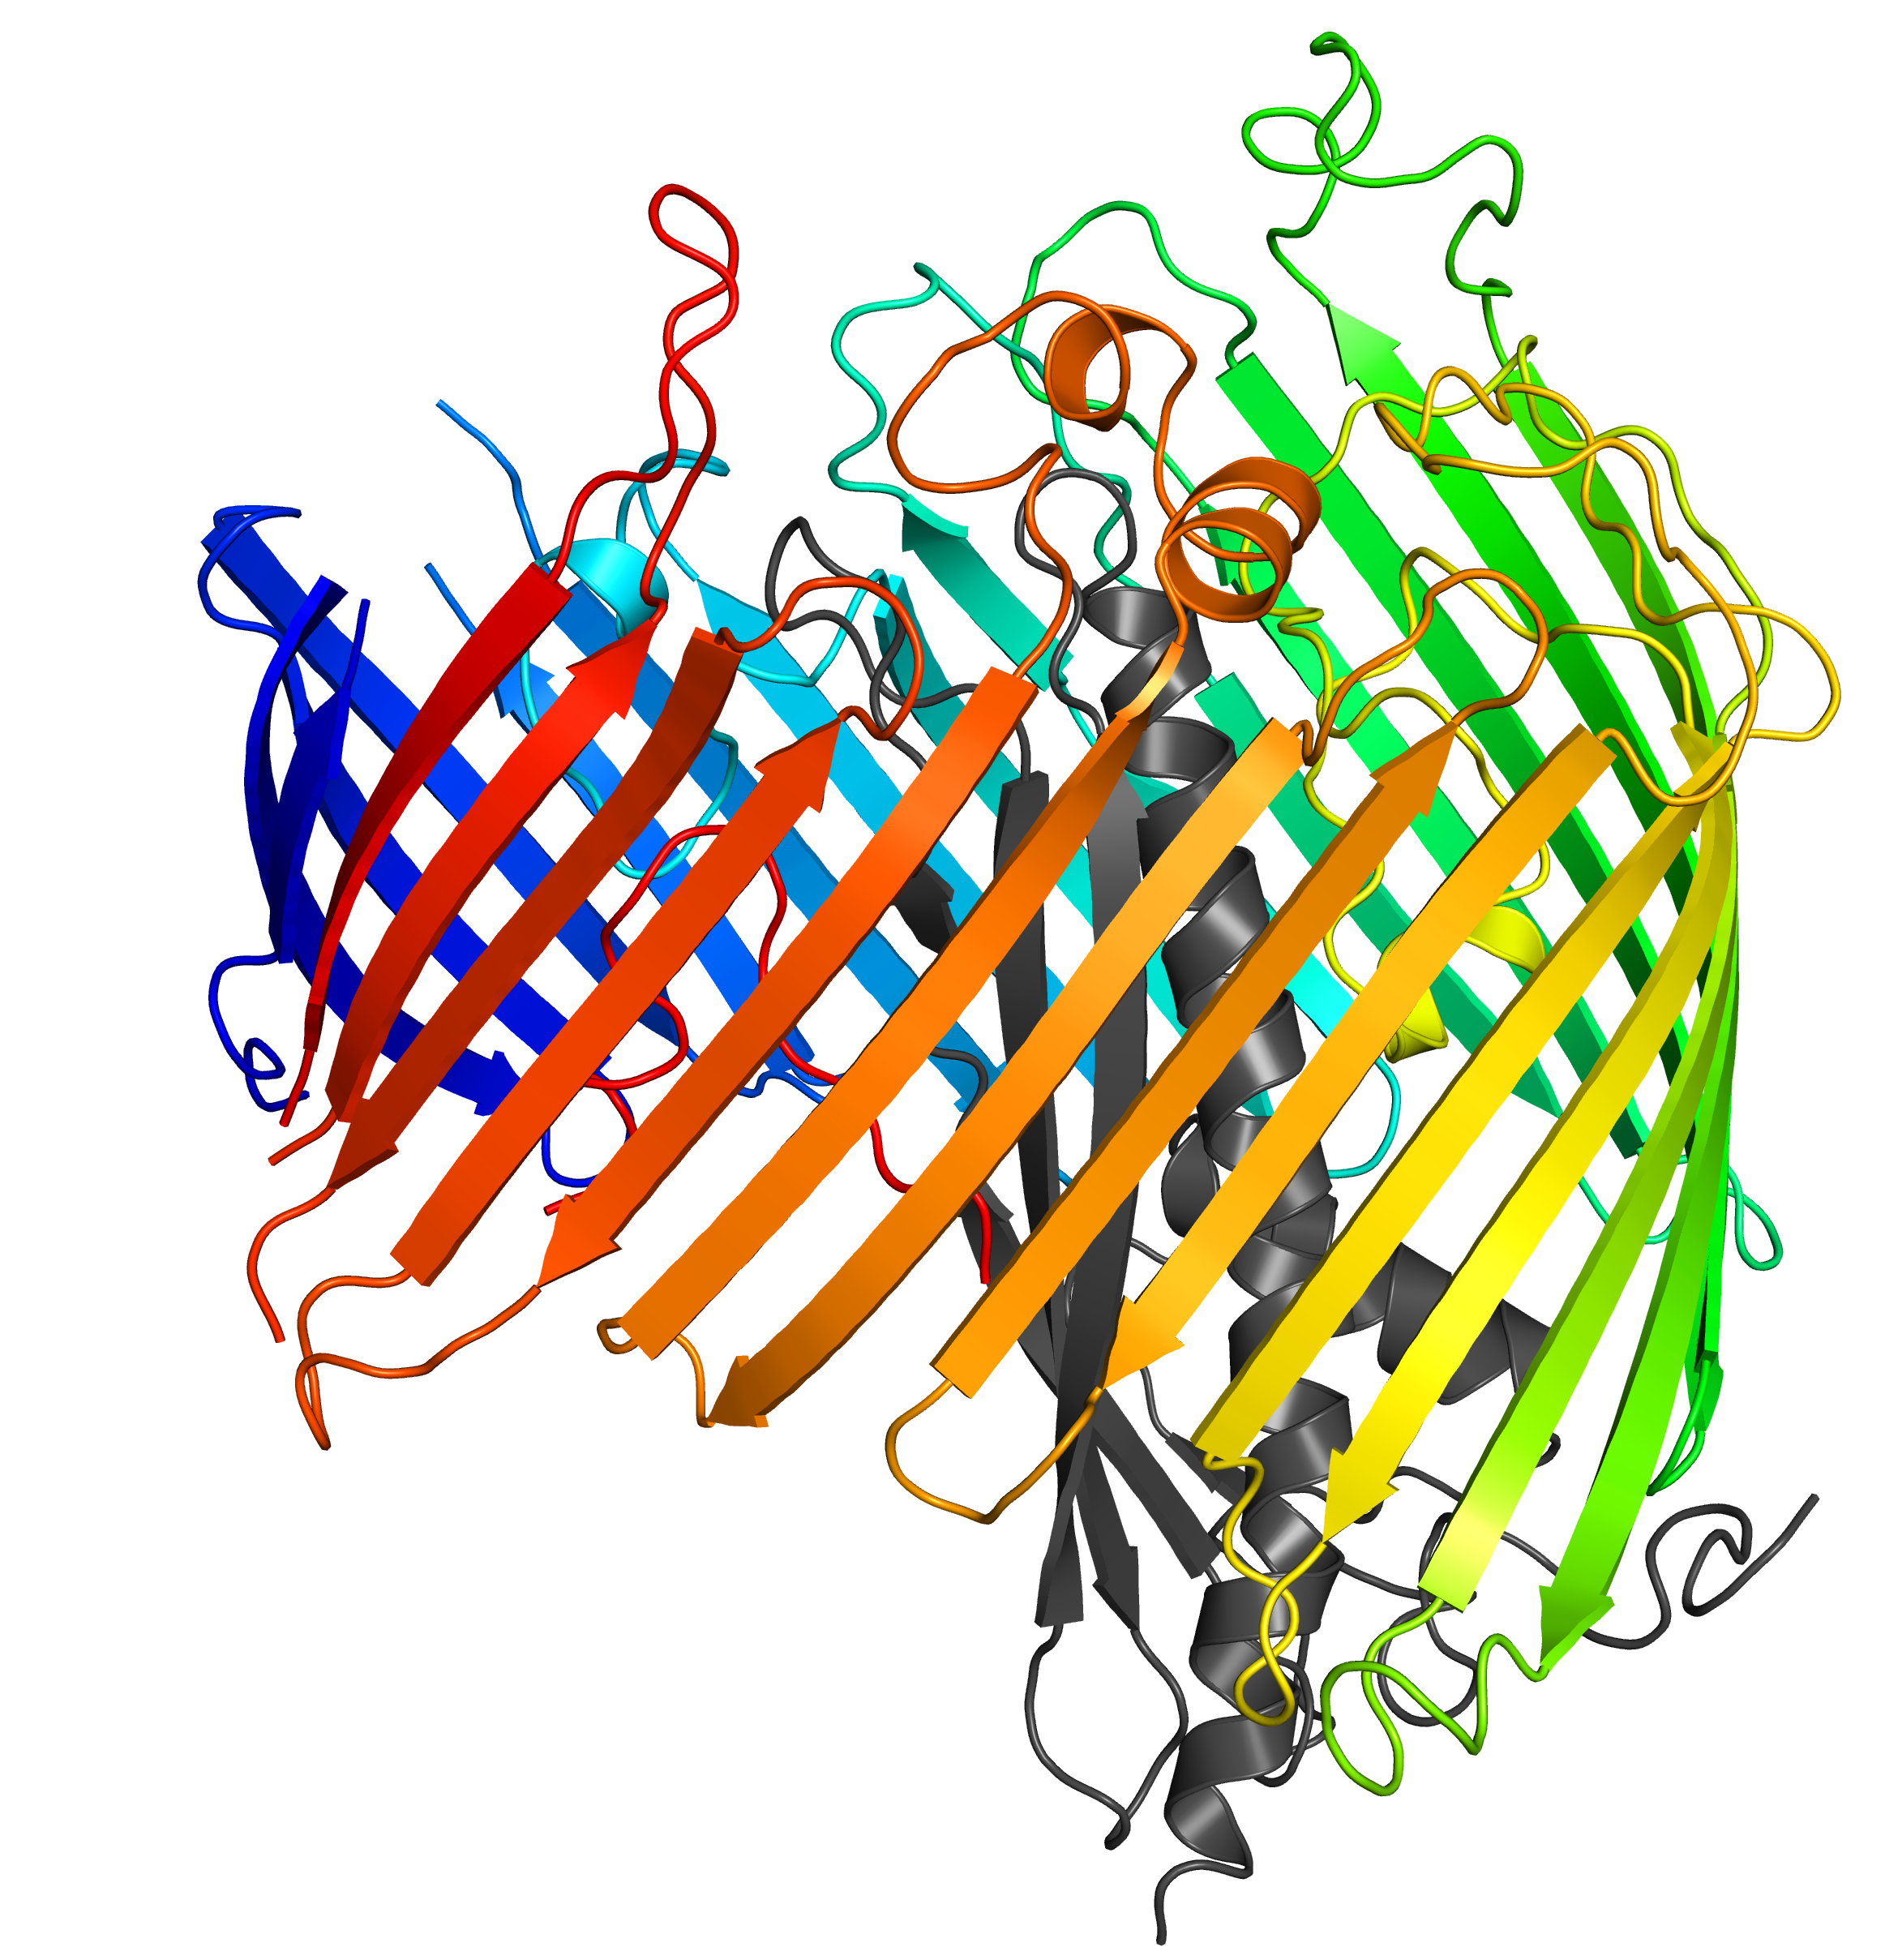
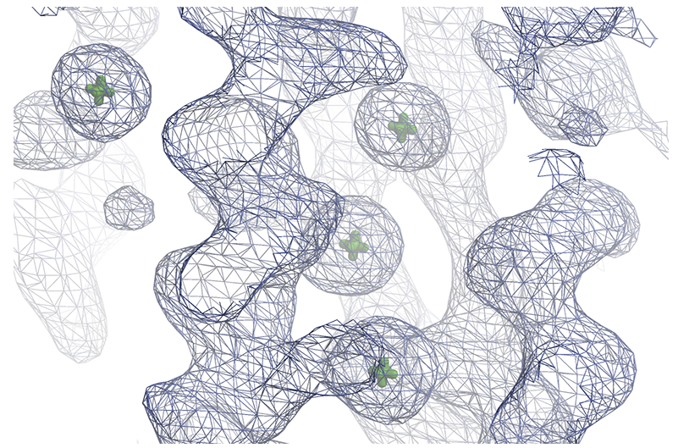
LptDE
Fast_dp integration files combined in AIMLESS, last 1200 frames trimmed from each for radiation damage.
Phasing with SHARP and SHELXD, 40 Se found. 715 residues built automatically (from ~1500).

Slide 29
Preparation
Sample centring
Screening, analysis & strategy
Data collection & evaluation
Post beamtime

Slide 30
Post beamtime
Ideally you’d want to confirm on the beamline that your structure is solved and gives you what you need. Doesn’t always happen.
Post beamtime is your chance to take your time and do things carefully. Reprocessing, exclusion of radiation damage, data combination etc. Don’t assume that autoprocessing failure means your data is useless.
How to do this is what you’ll learn through the rest of this course

