Slide 1
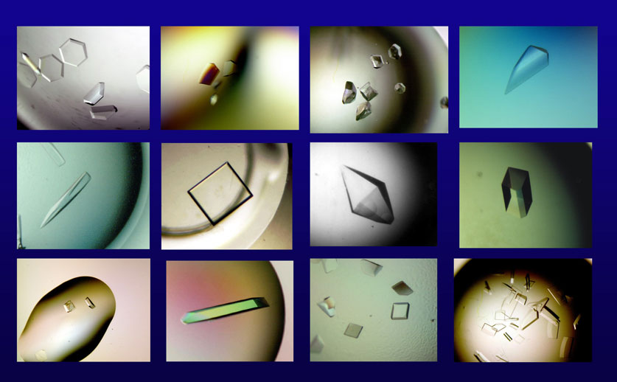
Introduction to symmetry
Andrey Lebedev, CCP4
Notes:
So crystals are very good: 10^12 molecules all arranged in an orderly manner.

Slide 2


Slide 3
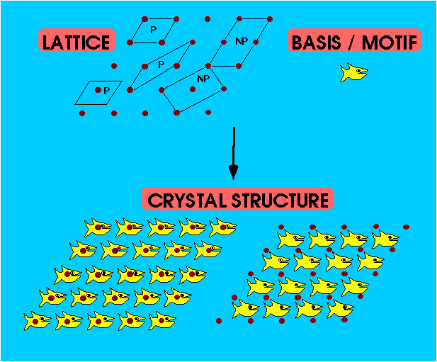
Crystal: unit cell + lattice
Notes:
This slide illustrates that we can build the crystal from knowing the lattice dimensions and the contenst of the unit cell.

Slide 12


Slide 13
1
1
2
2

Slide 14

1
1
2
2

Slide 15
1
1
2
2

Slide 16
1
1
2
2

Slide 17
1
1
2
2

Slide 18
1
1
2
2

Slide 19
1
1
2
2

Slide 20
1
1
2
2

Slide 22
b
a

Slide 23
b
a
2 a + b

Slide 24
b
a

Slide 25
b
a

Slide 26
b
γ
a

Slide 27
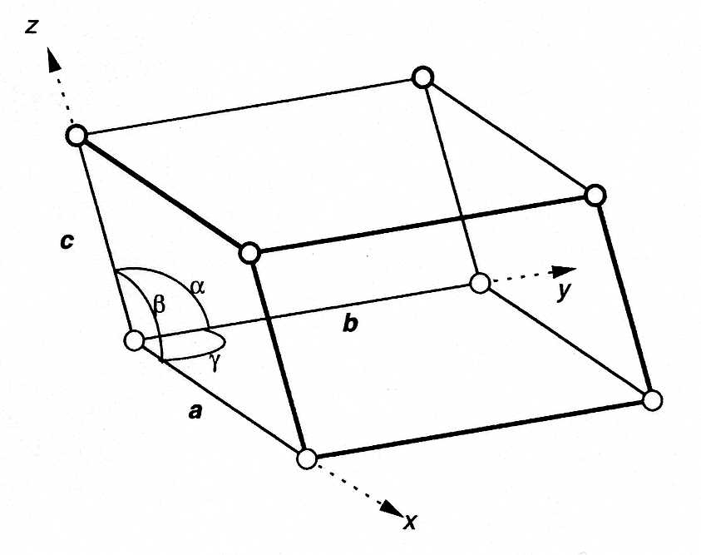
Unit cell parameters
Translation symmetry is defined
by three base vectors a, b, and c.
b
γ
a
α
β
c
Unit cells are usually defined in terms of the lengths of these vectors and angles between them. For example,
a=94.2Å, b=72.6Å, c=30.1Å, α=90°, β=102.1°, γ=90°.

Slide 28
choice of unit cell
Notes:
Many cells can be chosen to describe a lattice. Certain conventions create some order in this potential chaos.

Slide 29


b
a

Slide 30
b
a
2
1
180°
2
1
b/2

Slide 31
b
2
a
180°
1
b/2

Slide 32

b
a
2₁ (plane of figure):

Slide 33
b
a
2₁ (plane of figure):

Slide 34
b
a
2₁ (plane of figure):

Slide 35
b
a
1
2
180°
1
2
◉
c/2

Slide 36
2
b
a
180°
1
◉
c/2

Slide 37

b
a
2₁ (along view):

Slide 38
b
a
2₁ (along view):

Slide 39
b
a
2₁ (plane of figure):
2₁ (along view):

Slide 40
b/4
b
a
2₁ (plane of figure):
2₁ (along view):

Slide 41
b/4
b
a
¼
¼
¼
¼
¼
¼
¼
¼
2₁ (plane of figure):
¼
¼
2₁ (along view):
¼
¼
¼
¼
¼
¼

Slide 42
b
a
¼
¼
¼
¼
¼
¼
¼
¼
2₁ (plane of figure):
¼
¼
2₁ (along view):
¼
¼
¼
¼
¼
¼

Slide 43
b
a
¼
¼
¼
¼
¼
¼
¼
¼
2₁ (plane of figure):
¼
¼
2₁ (along view):
¼
¼
¼
¼
¼
¼

Slide 44
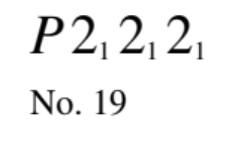
b
a
¼
¼
¼
¼
2₁ (plane of figure):
¼
¼
2₁ (along view):

Slide 45
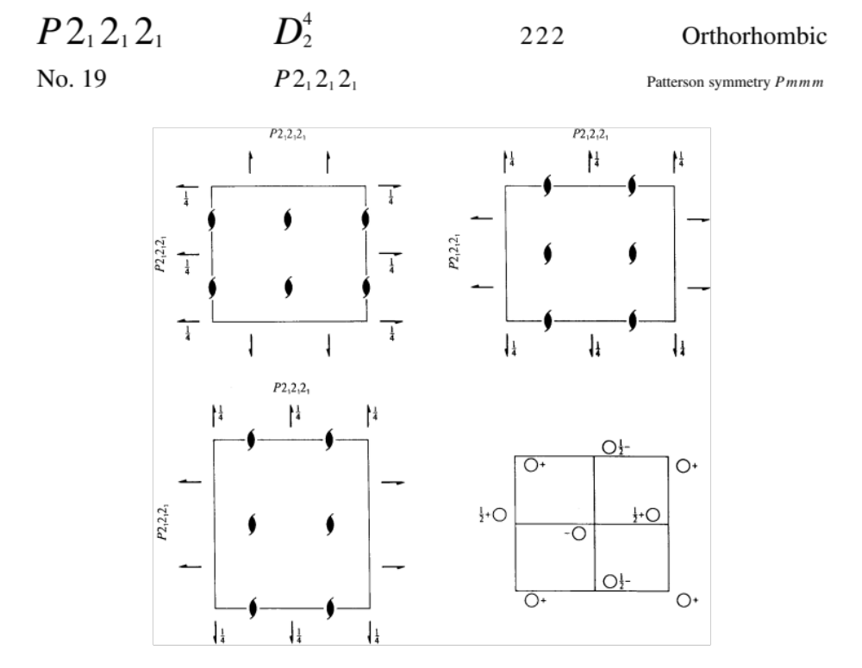

Slide 46
Symmetry Operators and Elements
Apart from the identity and translational symmetry, protein crystals can only contain the following symmetry elements:
Proper rotation: Rotate by 360°/n.
Screw rotation: Rotate by 360°/n & translate by d(m/n); d= unit cell edge.
Proper Rotations
Screw Rotations
Symbol (n)
Symbol (nm)
Two-fold
Three-fold
Four-fold
Six-fold
2
3
4
6
2₁
3₁, 3₂
4₁, 4₂, 4₃
6₁, 6₂, 6₃, 6₄, 6₅

Slide 47
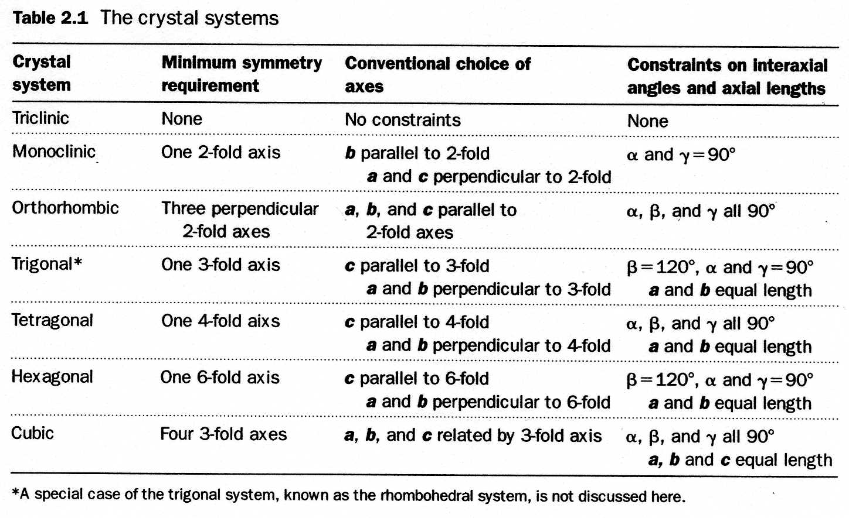
The Seven Crystal Systems
The 230 space groups can be grouped into seven crystal systems

Slide 48
In each crystal system, we constrained orientation of axis,
therefore we have to allow for non-primitive cells
These are sufficient to account for all cases:
P - primitive
I – body centred
A, B, C – face centred
F – all-face centred unit cells
F
P
I
c
b
a
C
B
A

Slide 49
Crystal System | Minimum Symmetry | Bravais Lattices | Unit Cell Geometry
1. Triclinic | None | 1. Primitive (P) | a ≠ b ≠ c; α ≠ β ≠ γ
2. Monoclinic | One 2fold axis | 2. Primitive (P) 3. Base-Centered (C) | a ≠ b ≠ c; α = γ = 90° ≠ β
3. Orthorhombic | Three orthogonal 2fold axes | 4. Primitive (P) 5. Base-Centered (C) 6. Body-Centered (I) 7. Face-Centered (F) | a ≠ b ≠ c; α = β = γ = 90°
4. Tetragonal | One 4fold axis | 8. Primitive (P) 9. Body-Centered (I) | a = b ≠ c; α = β = γ = 90°
5. Trigonal | One 3fold axis | 10. Primitive (P) | a = b ≠ c; α = β = 90°, γ = 120°
 |  | 11. Rhombohedral (R) | a = b = c; α = β = γ ≠ 90°
6. Hexagonal | One 6fold axis | 10. Primitive (P) | a = b ≠ c; α = β = 90°, γ = 120°
7. Cubic | Four 3fold axes | 12. Primitive (P) 13. Body-Centered (I) 14. Face-Centered (F) | a = b = c; α = β = γ = 90°

Slide 50
So 7 crystal systems, combined with P,I,C,A,B,F this gives
14 Bravais lattices

Slide 51
Space groups
Lattice + symmetry => 230 space groups
Because protein and nucleic acid molecules are chiral, there are only 65 “biological” space groups.

Slide 52
Space group names
P12₁1 (P2₁)
a b c
2₁ axes along unique axis b
highest symmetry is a 2-fold
=> monoclinic

Slide 53
Space group names
P2₁2₁2₁
a b c
Highest symmetry is a 2fold
Three 2-folds that do not make axes equivalent
=> orthorhombic

Slide 54
Space group names
P422
4fold highest symmetry, no 3folds
=> tetragonal
Unique axis c (4fold along c) (convention)
4fold makes a and b equivalent
2fold along a and b
So: P 4 2 2
c a b
2fold along face diagonal between a and b

Slide 55
Space group names
P23
3fold highest symmetry
2fold first => 2fold along crystal axis
3fold ‘elsewhere’
Cant be trigonal/hexagonal: 3 or 6fold along axis
=> must be cubic
Note: cubic does not always have 4fold!

Slide 56
Reflection indices
Reflections are said to originate from planes
Planes are described by Miller indices
The indices are also the reflection indices

Slide 57
Bragg condition (constructive interference):
path difference between two rays has to be an integral number of wavelengths.
d
θ
nλ
nλ = 2d sinθ

Slide 58
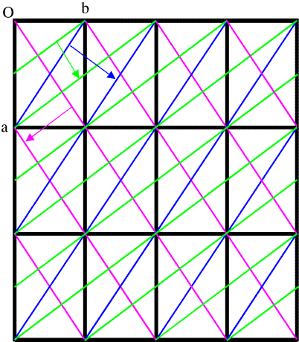
In order for the unit cells to diffract in phase, the Bragg planes must pass through the same points (atoms!) in all the unit cells in the crystal
Only planes that divide the unit cell edge by an integral number will diffract in phase

Slide 59
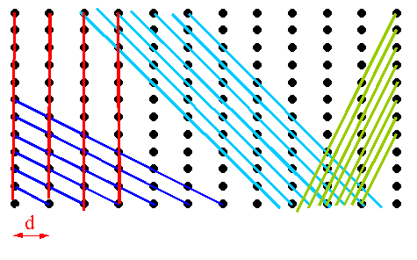
= inter-plane spacing measured at 90º to the planes

Slide 60
(a*, a) = 1
(b*, b) = 1
(a*, b) = 0
(b*, a) = 0
similar for c, c*
RECIPROCAL LATTICE
b*
a*
REAL LATTICE
b
a

Slide 61
RECIPROCAL LATTICE
b*
length=1/d_{0,1}
a*
(0,1)
(0,1) planes
REAL LATTICE
b
a

Slide 62
RECIPROCAL LATTICE
b*
(1,1)
length=1/d_{1,1}
a*
(0,1)
length is longer than (0,1) since spacing between (1,1) planes is smaller.
REAL LATTICE
(1,1) planes
b
a
1
1

Slide 63
RECIPROCAL LATTICE
b*
(2,1)
length=1/d_{2,1}
(1,1)
a*
(0,1)
REAL LATTICE
b
(2,1) planes
a
1
1/2

Slide 64
RECIPROCAL LATTICE
(3,1)
b*
(2,1)
(1,1)
a*
(0,1)
length=1/d_{3,1}
REAL LATTICE
b
a
1
(3,1) planes
1/3

Slide 65
RECIPROCAL LATTICE
(3,1)
b*
(2,1)
(1,1)
a*
(0,1)
(0,1) planes
REAL LATTICE
(1,1) planes
b
(2,1) planes
a
(3,1) planes

Slide 66
RECIPROCAL LATTICE
(0,2)
(3,1)
b*
(2,1)
(1,1)
a*
(0,1)
length=1/d_{0,2}
(0,2) planes
REAL LATTICE
b
a

Slide 67
RECIPROCAL LATTICE
(1,2)
(0,2)
(3,1)
b*
(2,1)
(1,1)
a*
(0,1)
length=1/d_{1,2}
REAL LATTICE
(1,2) planes
b
a

Slide 68
RECIPROCAL LATTICE
(2,2)
(1,2)
(0,2)
(3,1)
b*
(2,1)
(1,1)
a*
(0,1)
length=1/d_{2,2}
REAL LATTICE
(2,2) planes
b
a

Slide 69
RECIPROCAL LATTICE
(3,2)
(2,2)
(1,2)
(0,2)
(3,1)
b*
(2,1)
(1,1)
a*
(0,1)
length=1/d_{3,2}
REAL LATTICE
b
a
(3,2) planes

Slide 70
RECIPROCAL LATTICE
(3,2)
(2,2)
(1,2)
(0,2)
(3,1)
b*
(2,1)
(1,1)
a*
(0,1)
(0,1) planes
REAL LATTICE
(0,2) planes
(1,1) planes
(1,2) planes
b
(2,1) planes
(2,2) planes
a
(3,1) planes
(3,2) planes

Slide 71
Observed intensities
Nodes of the reciprocal lattice are enumerated by Miller indices
Each measured intensities is associated with a certain Miller index
We may say that intensities are defined in the reciprocal space, on the nodes of the reciprocal space lattice

Slide 72
Observed intensities

Slide 73
(3,1)
(2,1)
(1,1)
(0,1)
(0,0)
(0,0)
θ
nλ=2dsinθ
(0,1) planes

Slide 74
(3,1)
(2,1)
(1,1)
(0,1)
(0,0)
(0,0)
(1,1) planes

Slide 75
(3,1)
(2,1)
(1,1)
(0,1)
(0,0)
(0,0)
(2,1) planes

Slide 76
Symmetry of intensities
The Ewald construction is based on angular relation between the direction of incident beam and the normal direction to the Bragg planes. Therefore:
Reciprocal lattice rotates together with crystal
However, Reciprocal lattice is not translated together with crystal

Slide 77
Symmetry of intensities
Real space
Reciprocal space
Crystal structure
Intensities at Bragg points
Strip any translation component from the space group operation:
Point group operation
Space group operation
The same crystal structure
The same set of intensities

Slide 78
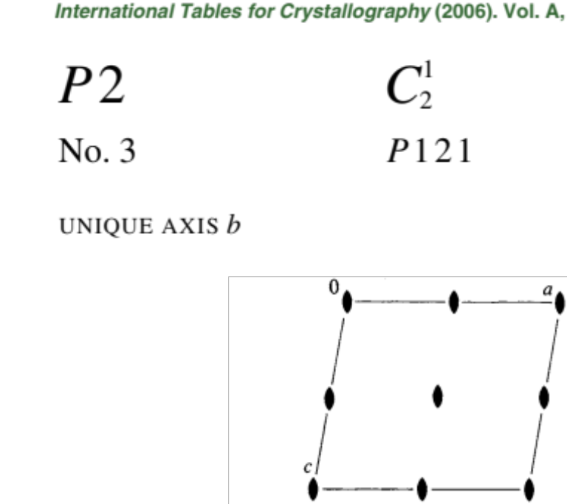


Space group and point group
Crystal space group
Arithmetic crystal class
2P
Crystal point group

Slide 79
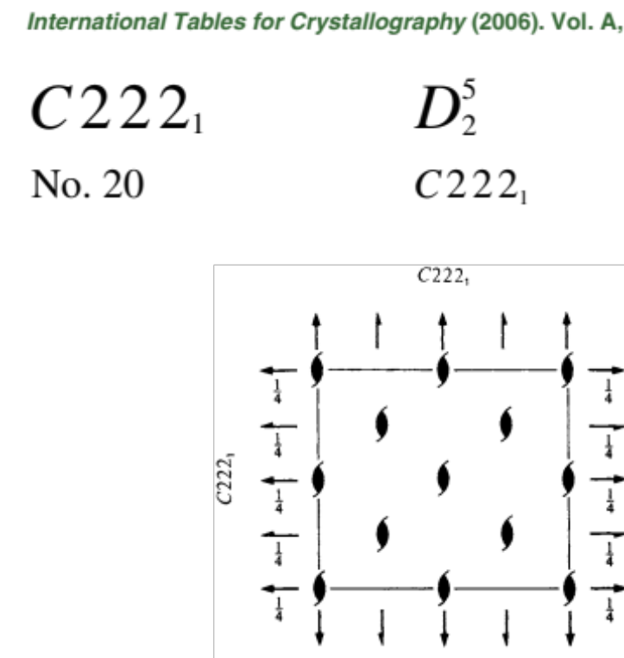
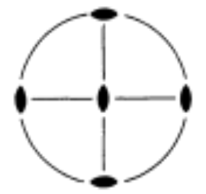

Space group and point group
Crystal space group
Arithmetic crystal class
222C
Crystal point group

Slide 80
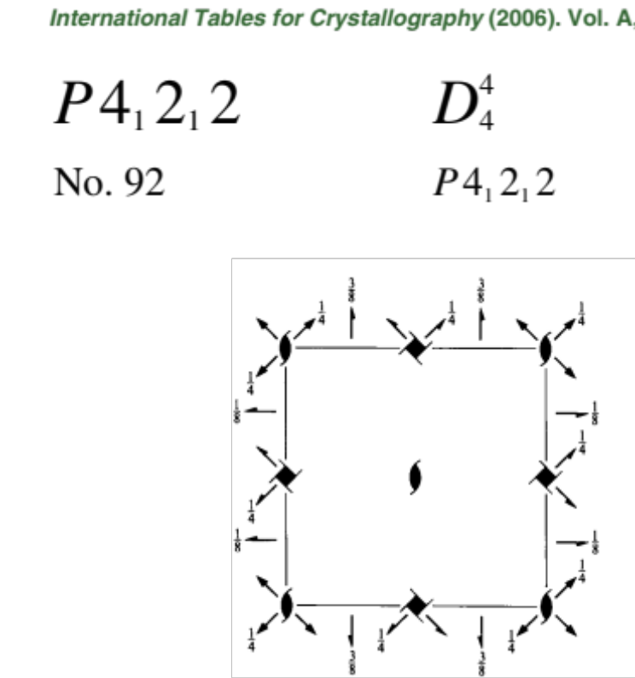

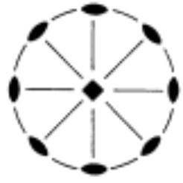

Space group and point group
Crystal space group
Arithmetic crystal class
422P
Crystal point group

Slide 81

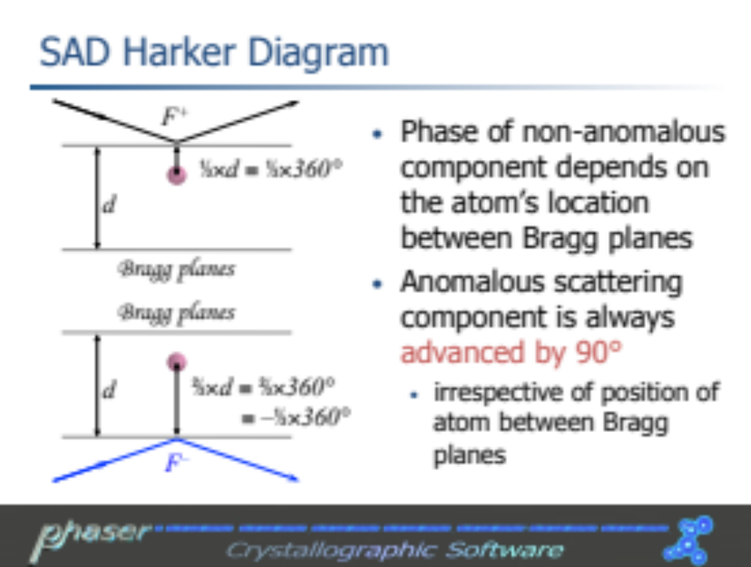
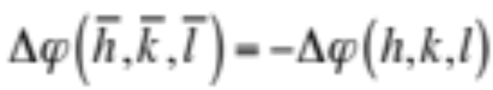
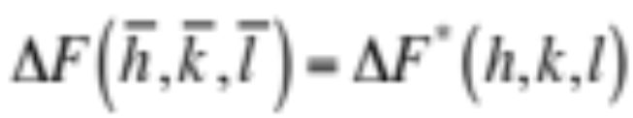
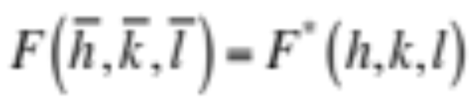
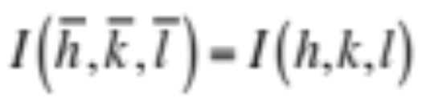

Friedel's law
Bragg planes
  define reference phase
Probe atom:
Total:

Slide 82

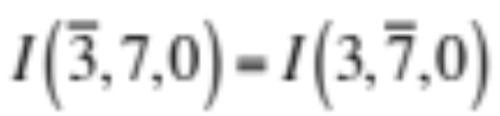

Friedel's law

Slide 83
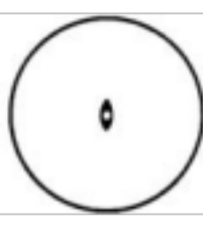
Point group and Laue group
+ inversion =
Arithmetic crystal class
Patterson space group
P 1 2/m 1
2P
(P2/m)
Crystal point group
Laue point group
2/m

Slide 84
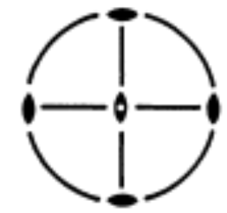
Point group and Laue group
+ inversion =
Arithmetic crystal class
Patterson space group
C m m m
222C
(P2/m)
Crystal point group
Laue point group
222
m m m

Slide 85

Point group and Laue group
+ inversion =
Arithmetic crystal class
Patterson space group
422P
P 4/m m m
Crystal point group
Laue point group
4/m m m

Slide 86
The Seven Crystal Systems
The 230 space groups can be grouped into seven crystal systems

Slide 87
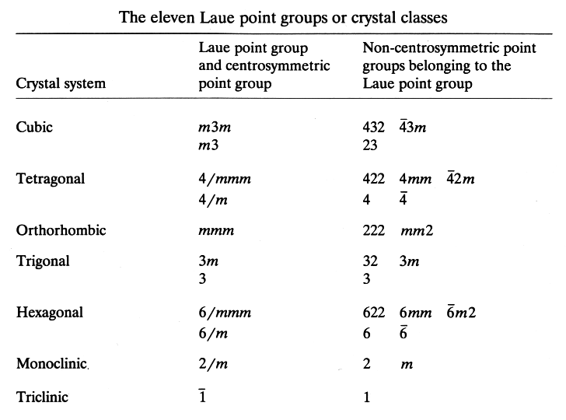

Slide 88
How do we deduce the Space Group in practice?
We start in reciprocal space!
We go all way back from symmetry in reciprocal space to crystal space group

Slide 89
step | result | example
⁽¹⁾ analyse diffraction | unit cell parameters | 111.0, 111.0, 222.0 90.0, 90.0, 90.0
^{(1, 2)} analyse lattice symmetry | lattice point group and type = highest possible Patterson space group | P m m m
⁽²⁾ analyse operations of lattice point group | - list of operations with scores - list of possible Patterson groups (with scores) -- includes Laue group | P m m m (0.01) P 1 2/m 1 (0.99) P 1 2/m 1 (0.01) P 1 2/m 1 (0.01) P -1 (0.01)
⁽²⁾ macromolecular crystals | list of possible arithmetic crystal classes (with scores) | 2 2 2 P (0.01) 1 2 1 P (0.99) 1 2 1 P (0.01) 1 2 1 P (0.01) 1 P (0.01)
⁽²⁾ analysis of systematic absences | probable space group | P 1 2₁ 1
⁽¹⁾ integration program, ⁽²⁾ scaling program

Slide 90
iMosflm: integration of diffraction spots
Automatic choice
Bravais lattice:
hP
highest possible Patterson space group
P 6/m m m

Slide 91
Pointless: automatic space group assignment

Slide 92
Space group assignment
Automatic space group assignment at data integration/merging stops should not be taken as absolute truth
Revision is frequently required during attempts at structure solution
MR in subgroups of Patterson space group
Density modification in enantiomorphic space groups
Sometimes, it should be revised after initial round of refinement
cases of pseudosymmetry

