Slide 1
ISPyB2
Stu Fisher

Slide 2
What does ISPyB do?
Sample Registration
Shipping
Data Collection Monitoring
Pipeline Results / Evaluation
Log Book

Slide 3
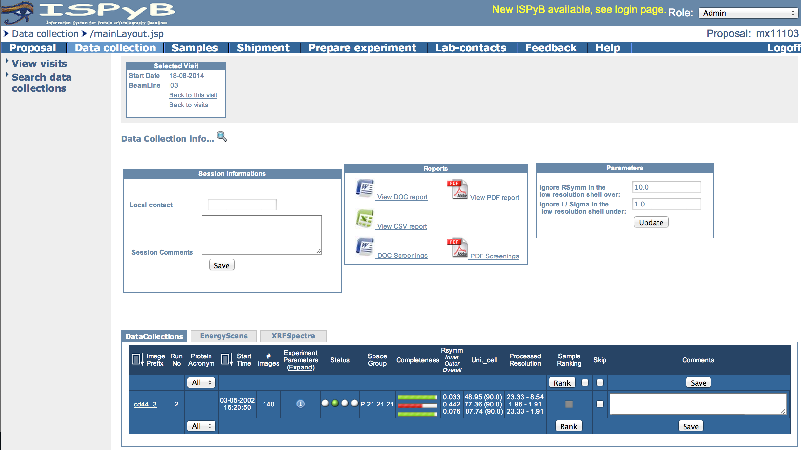
OldSPyB

Slide 4
Sample Registration
Shipment
Dewar
Container
Sample

Slide 5
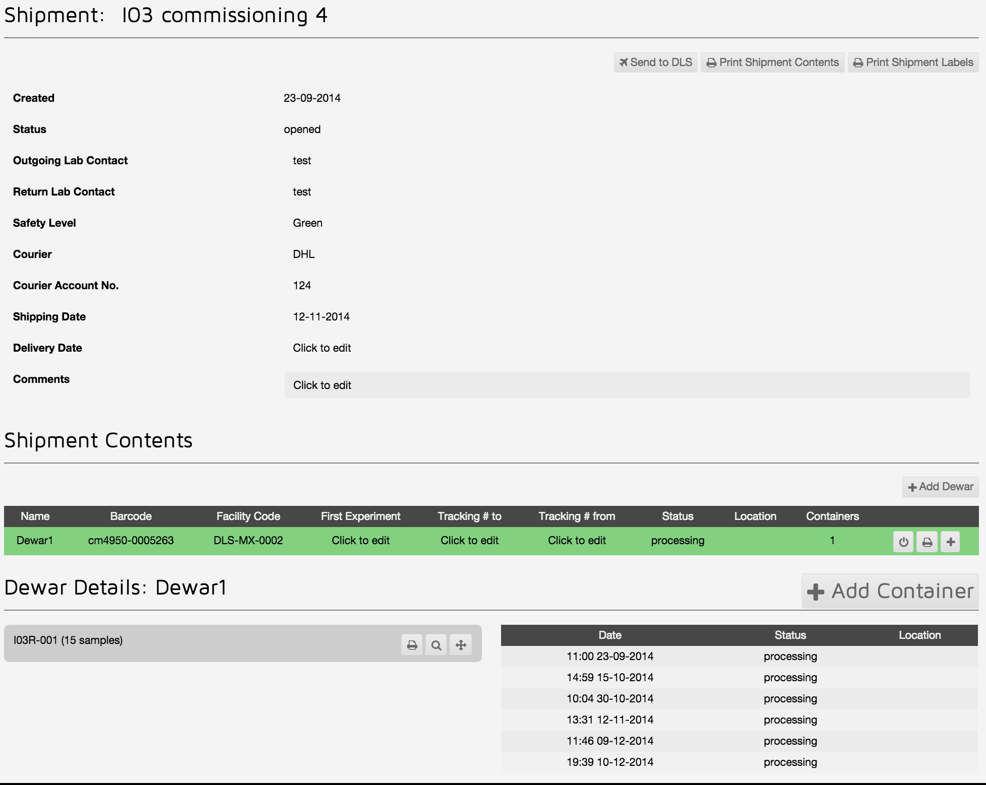
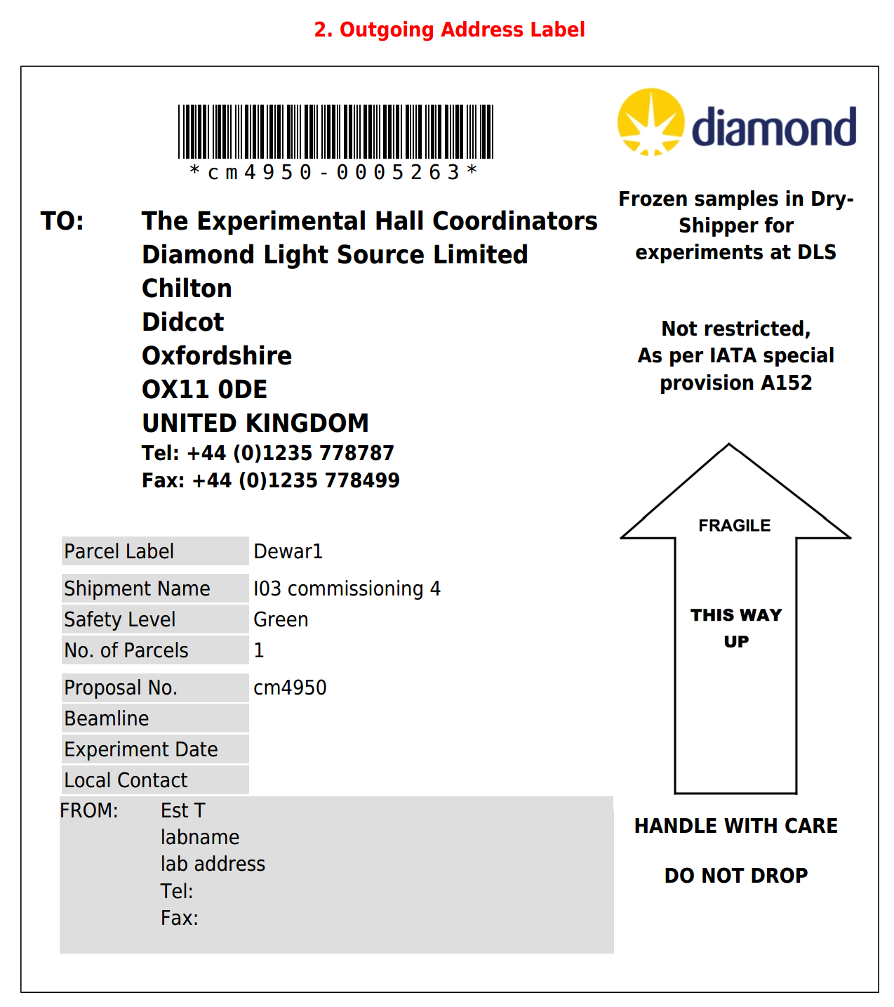


Slide 6
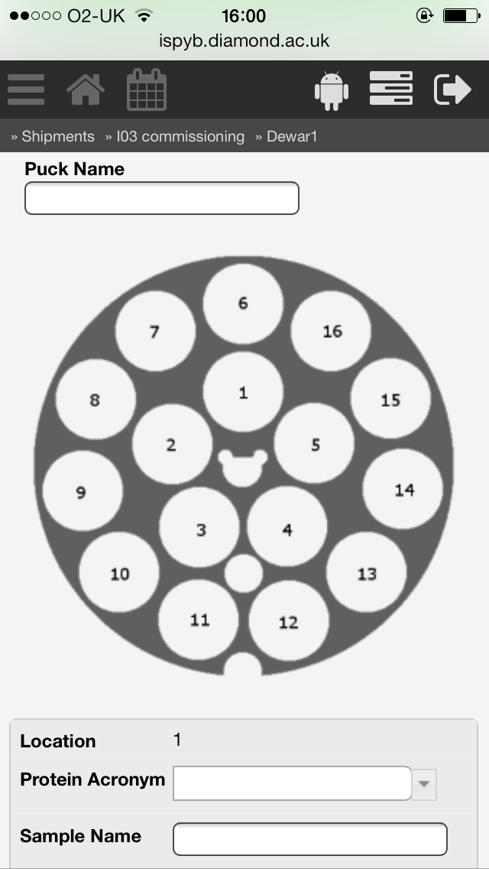
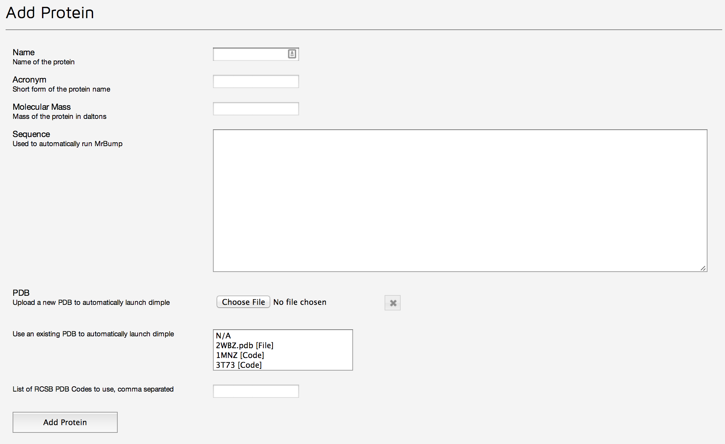
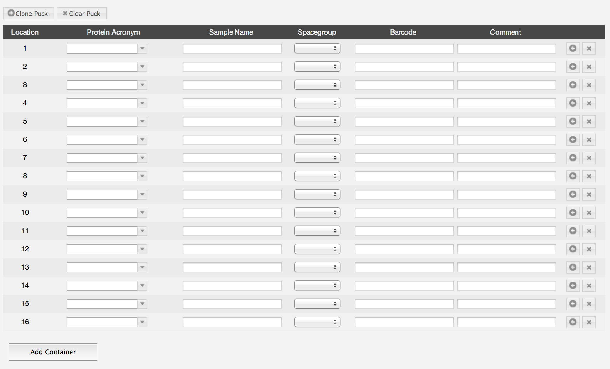
Sample Registration
For each sample
  Protein
  Sample Name
Optionally
  Spacegroup
  Barcode
  Comments

Slide 7
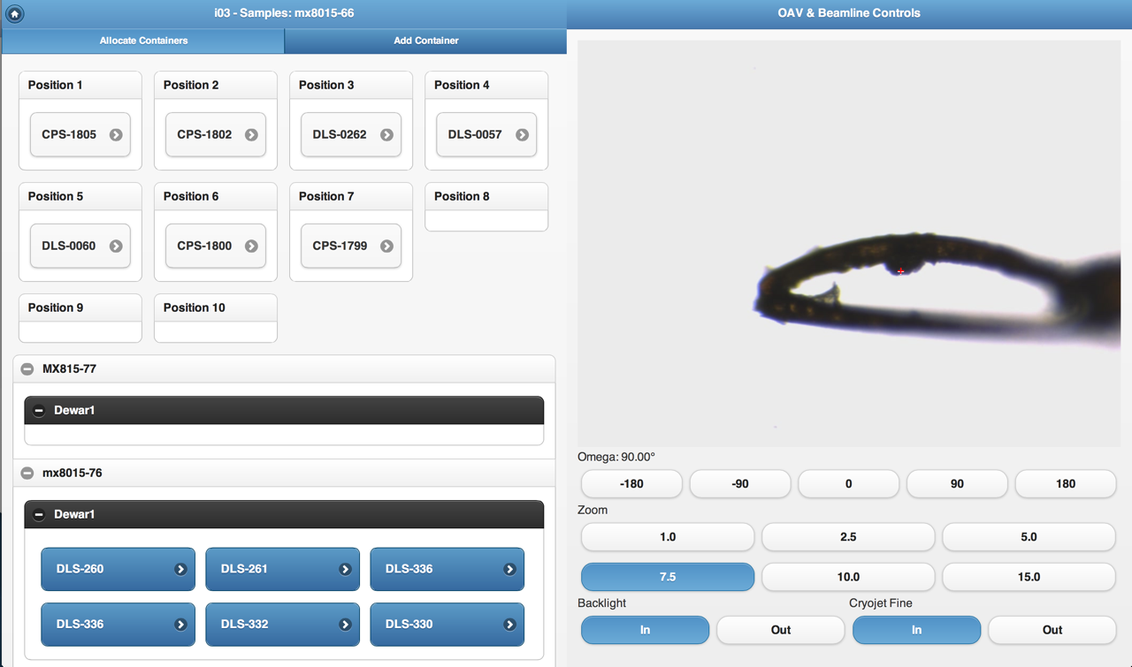
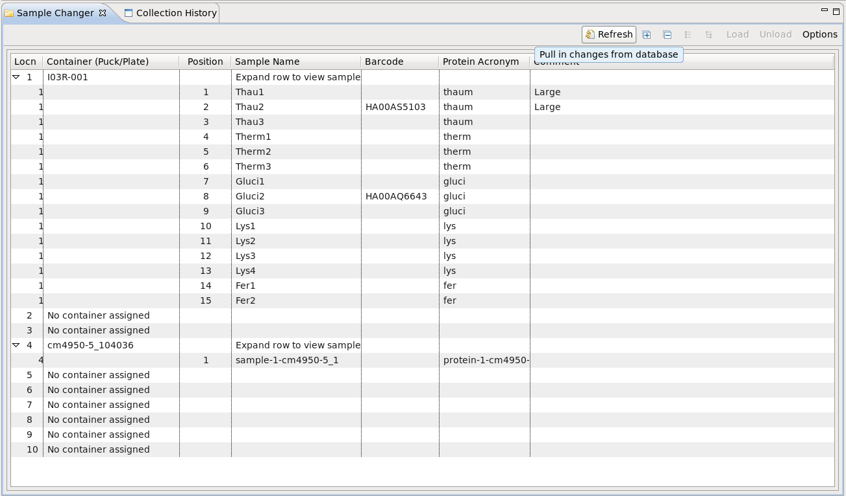
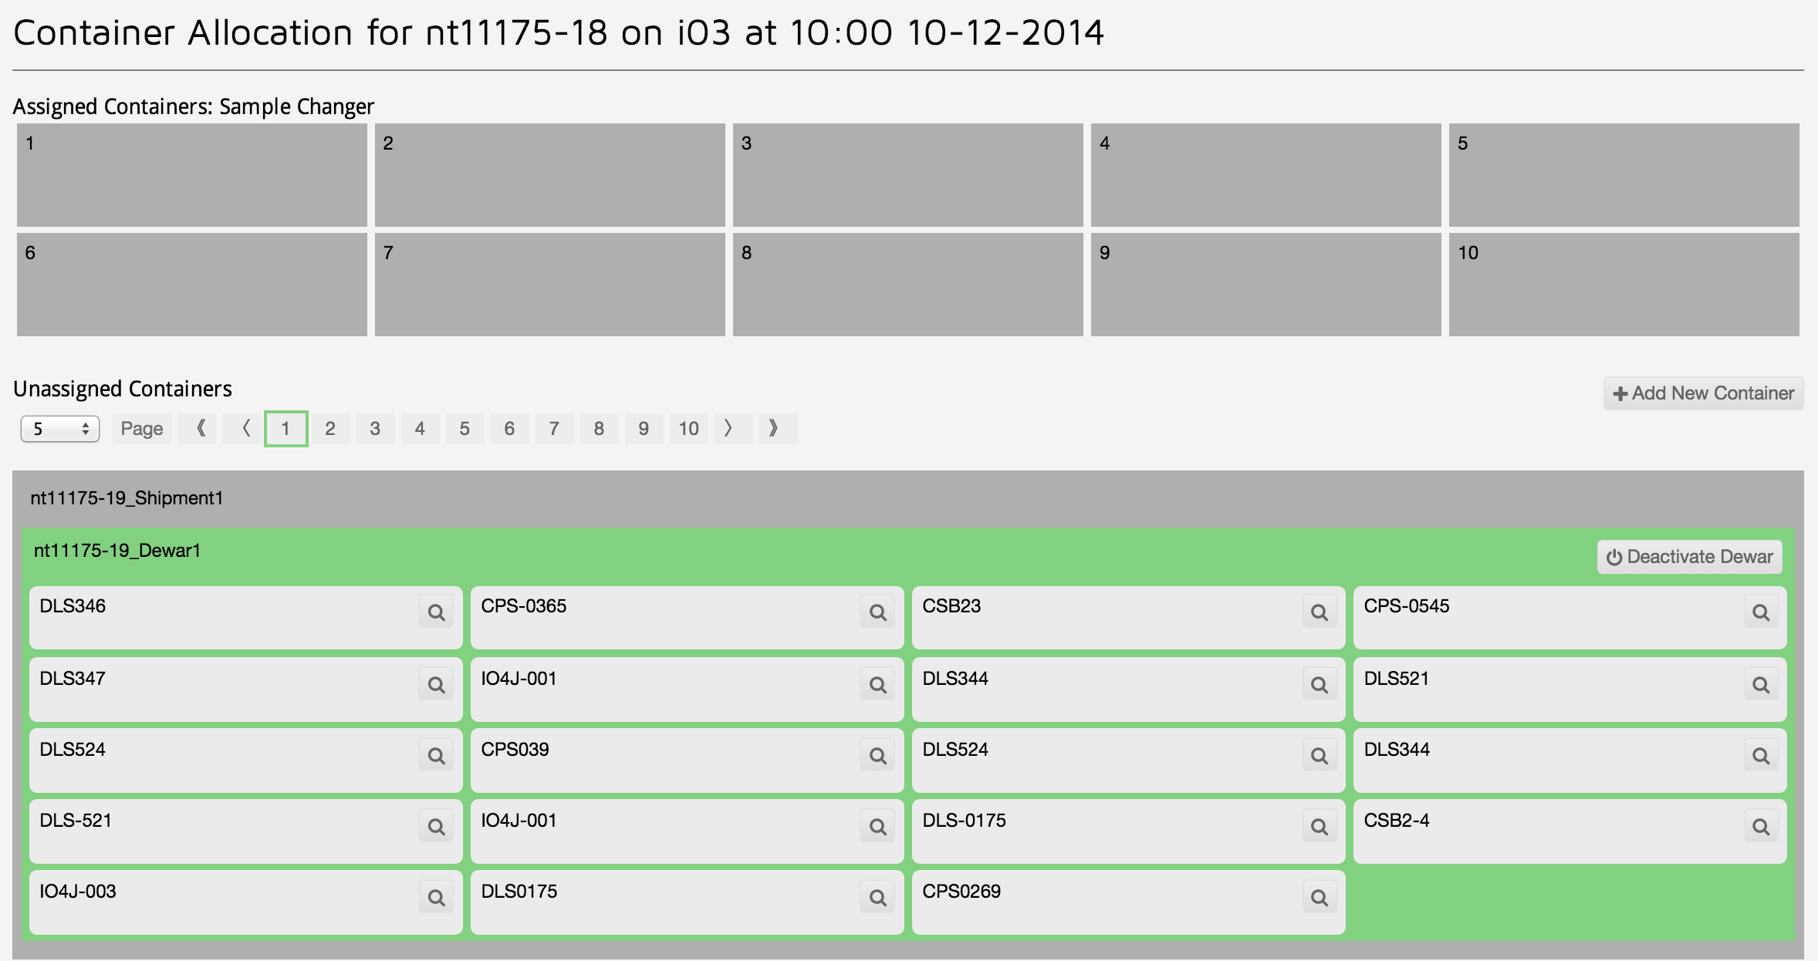

Slide 8
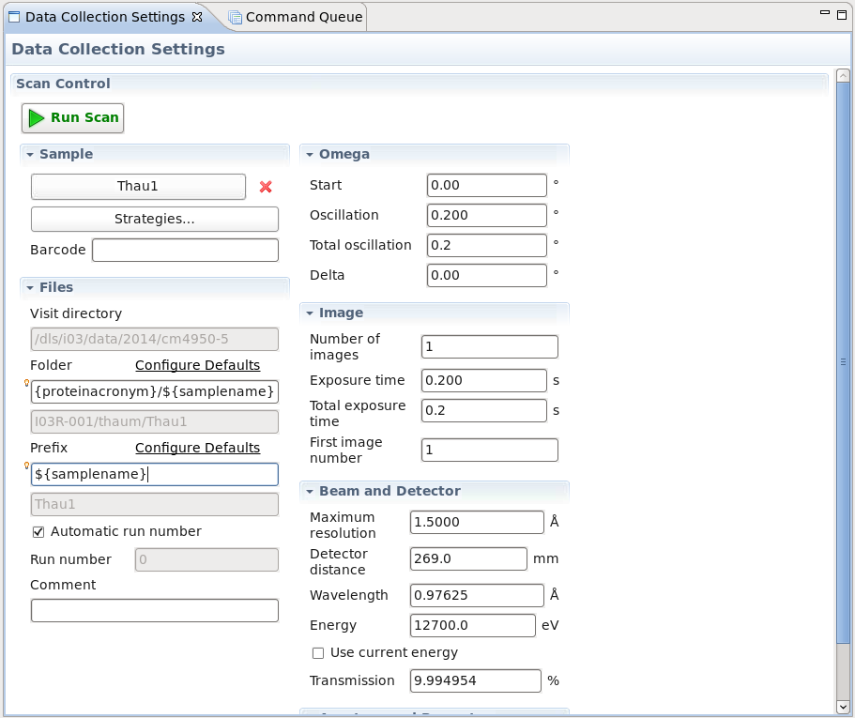
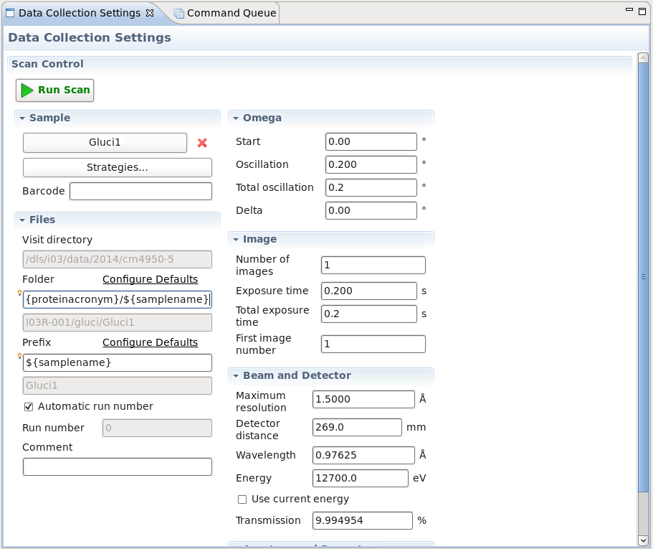
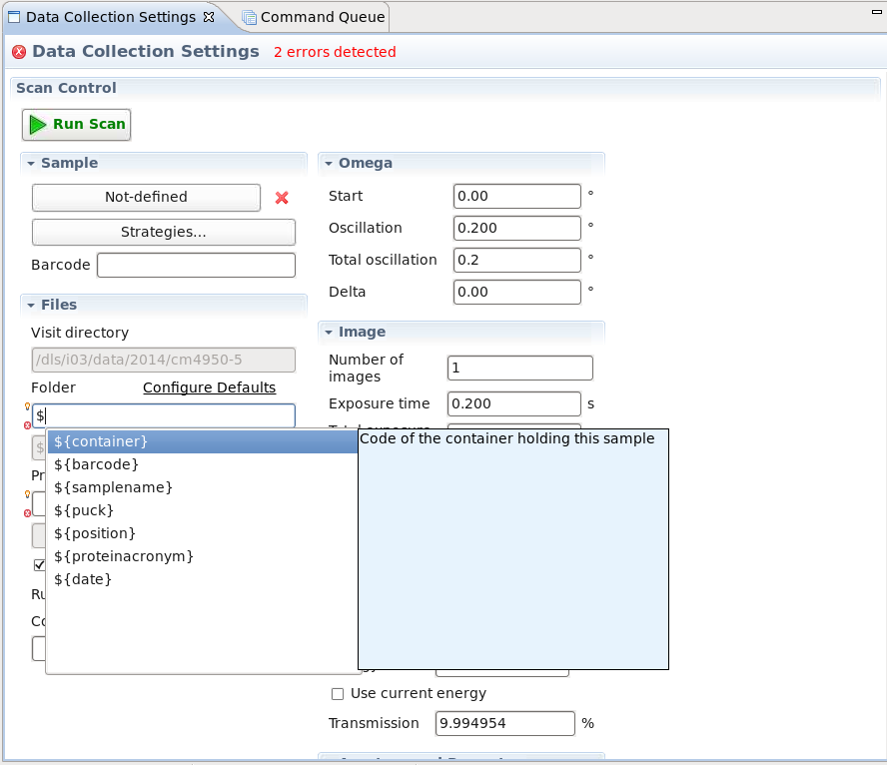

Slide 9
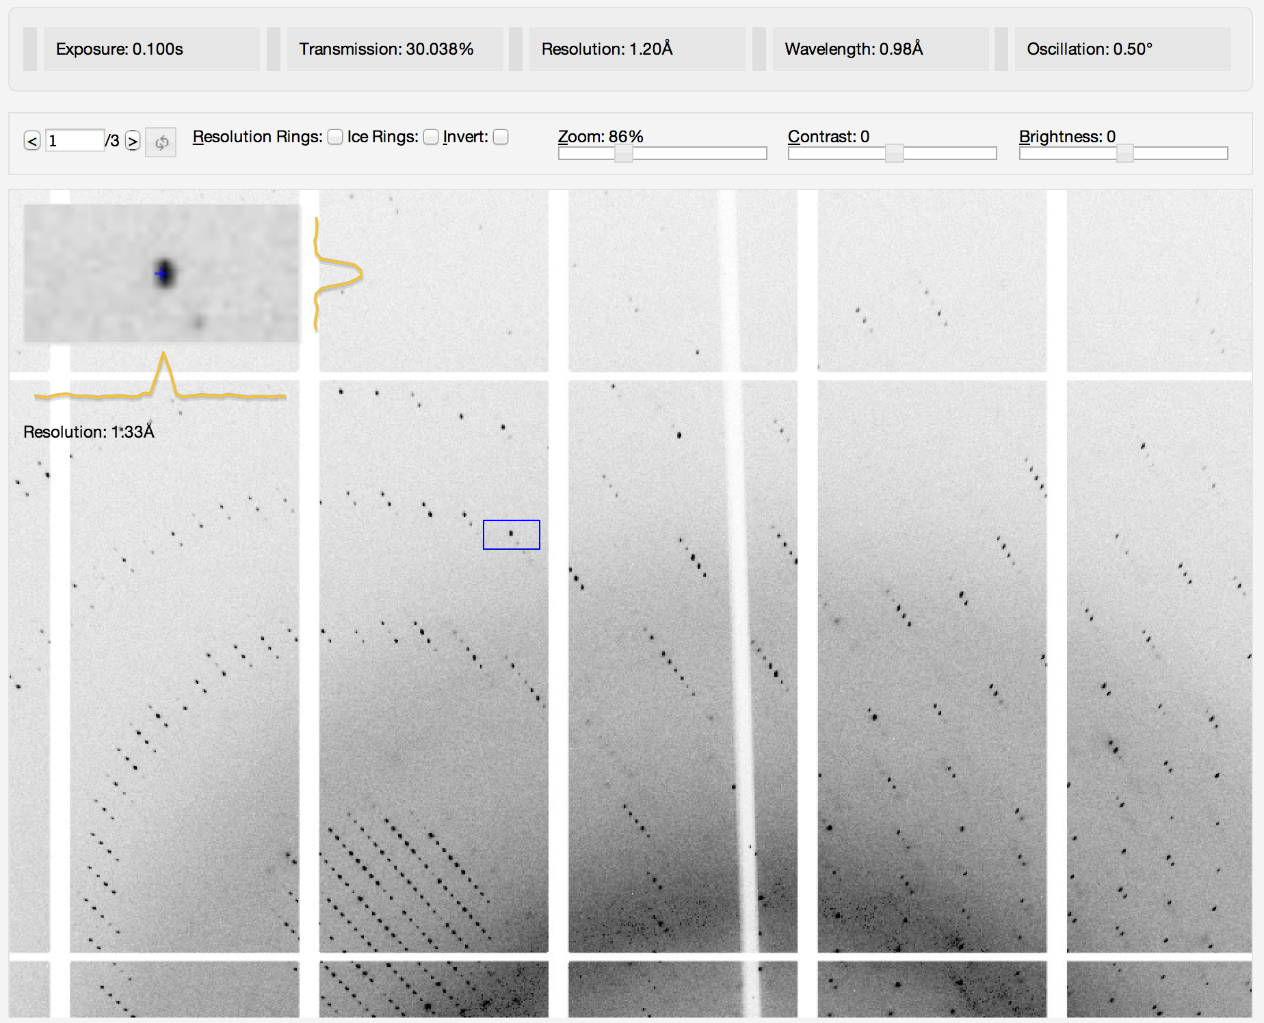
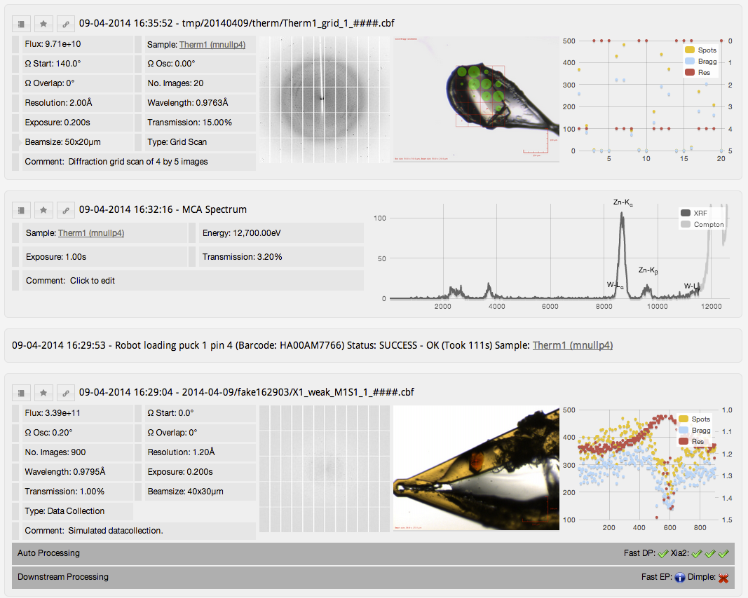
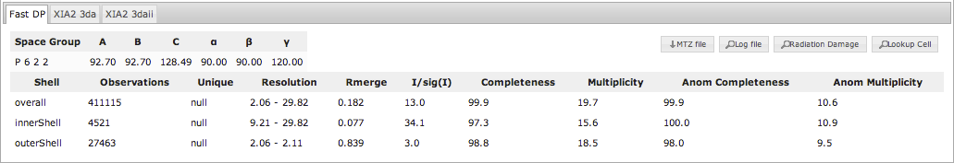
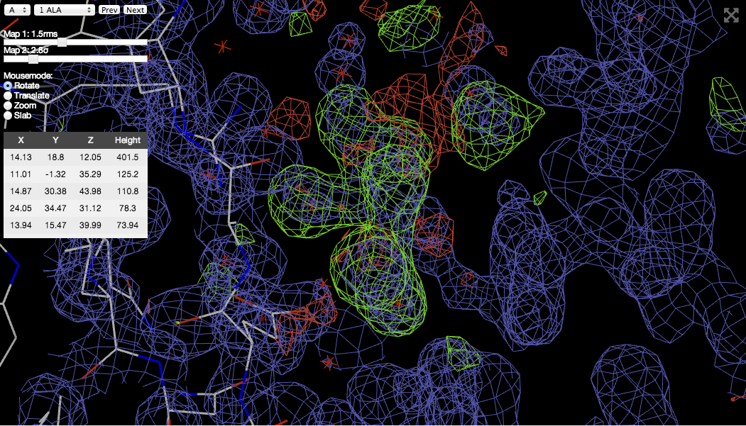
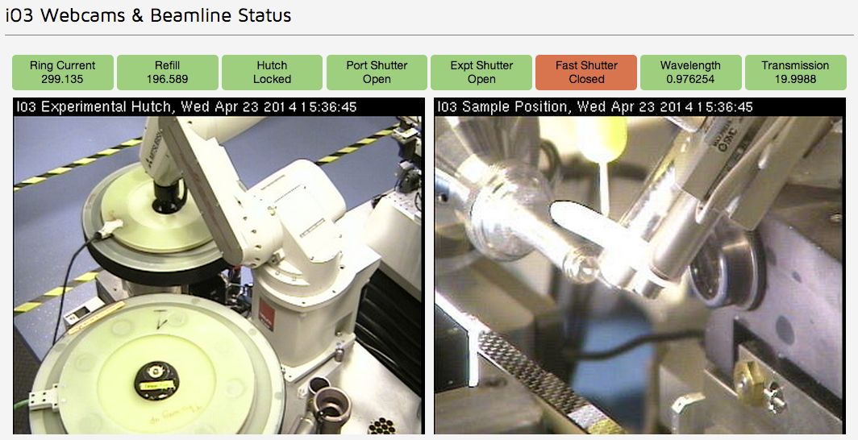
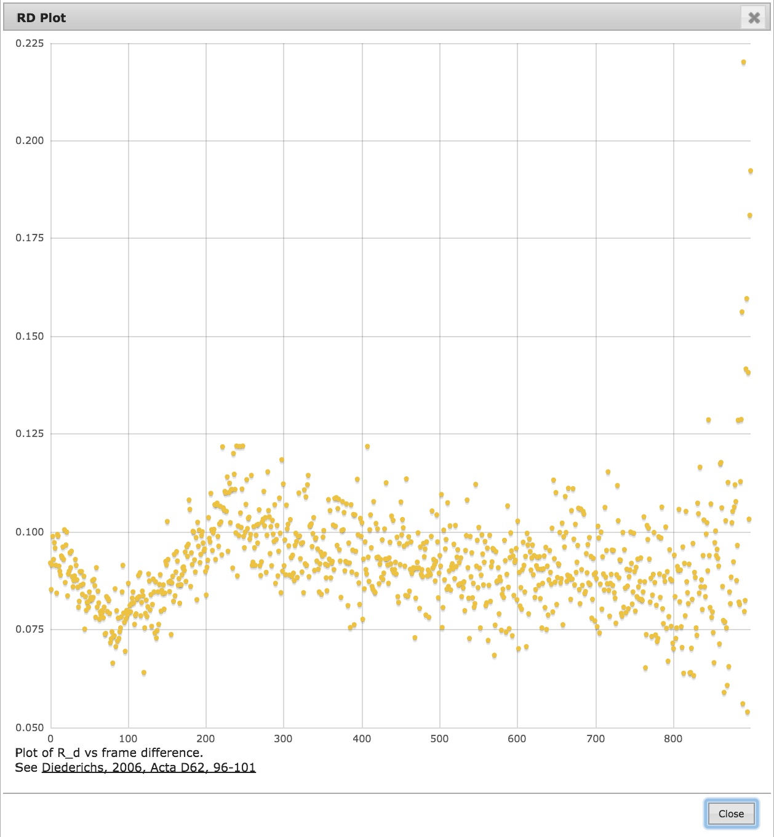
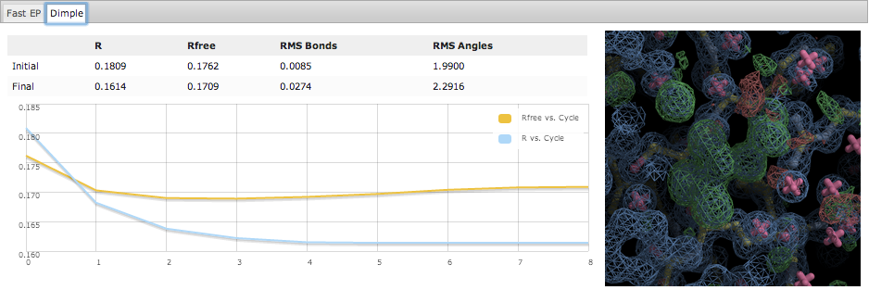
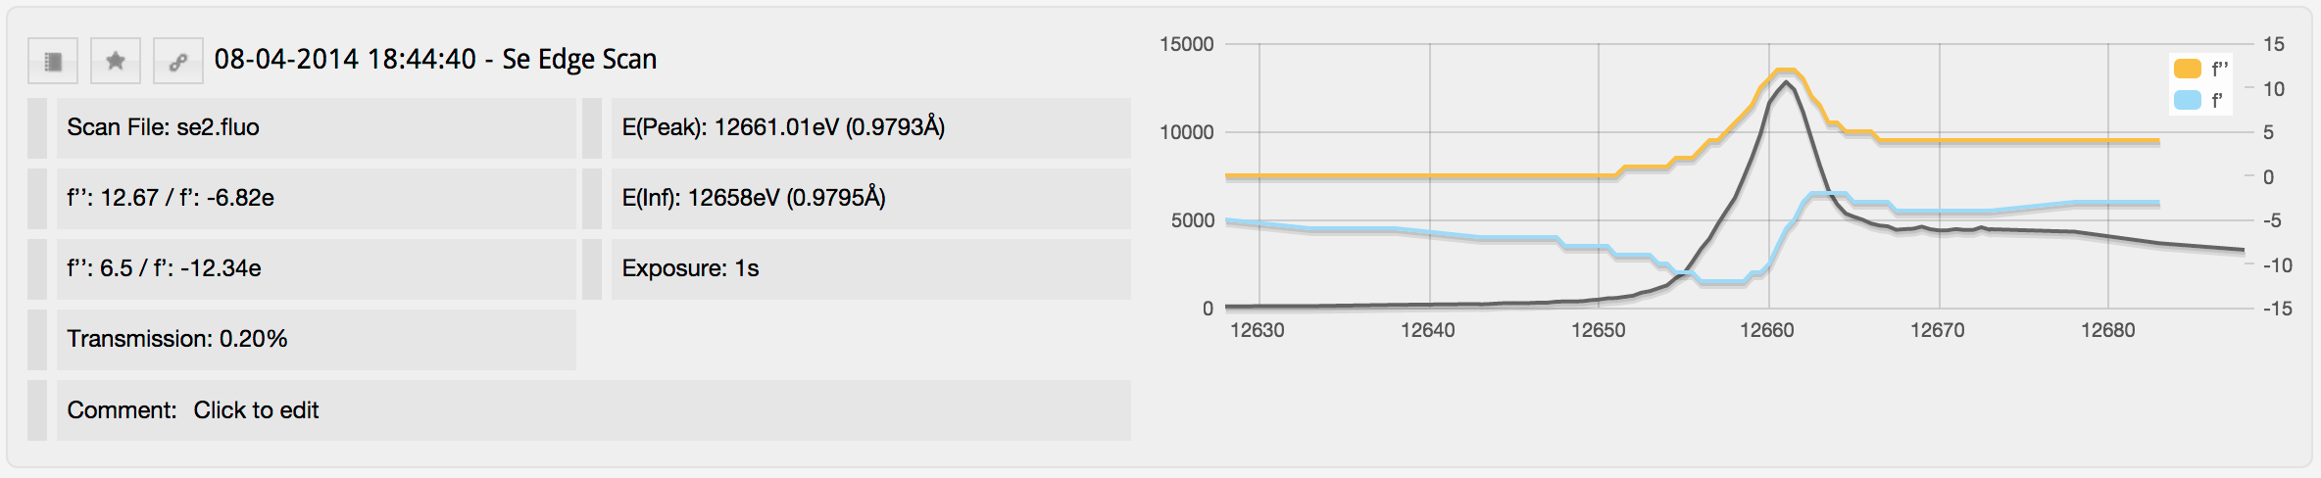
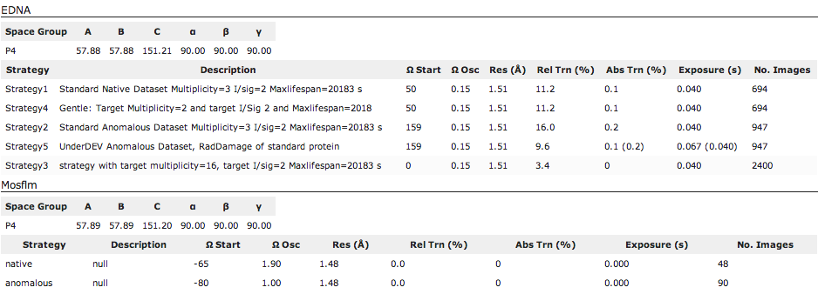

Slide 10
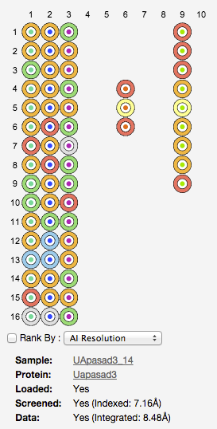

Sample Changer Status
Pucks 1 – 10 are shown horizontally
Samples within puck are shown vertically
Protein Acronym
Sample State

Slide 11
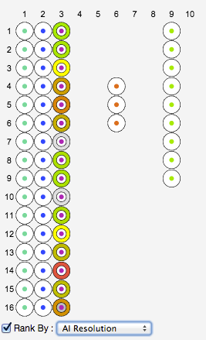
Sample Changer - Ranking View
Hover over a sample to show all of that particular protein acronym
Samples are coloured from bad (red) to good (green)
AI – Auto Indexing
  Results from EDNA
  Order by resolution or completeness
AP – Auto Processing
  Results from Fast DP / XIA2
  Order by resolution or completeness

Slide 12
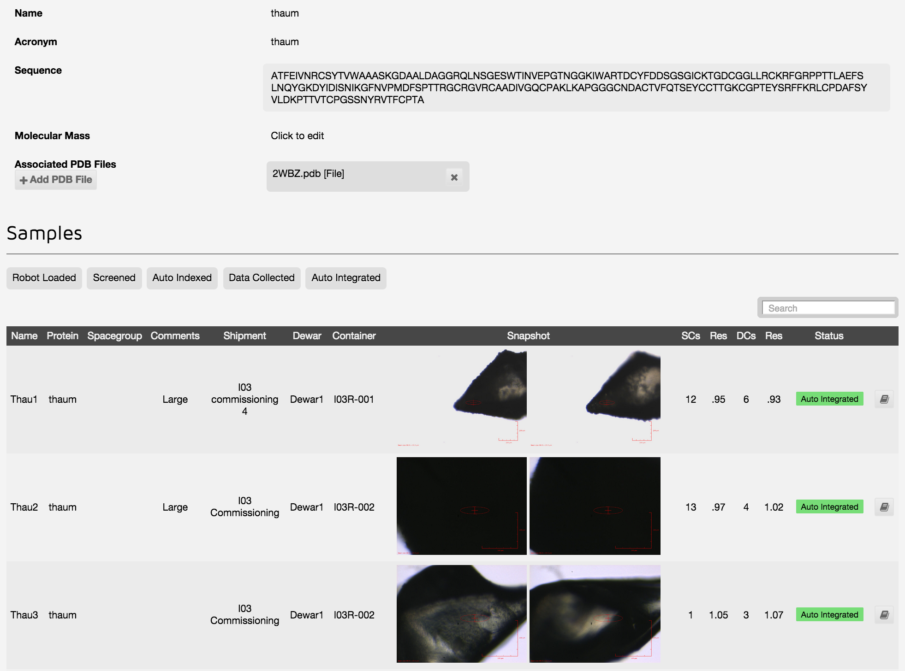

Slide 13
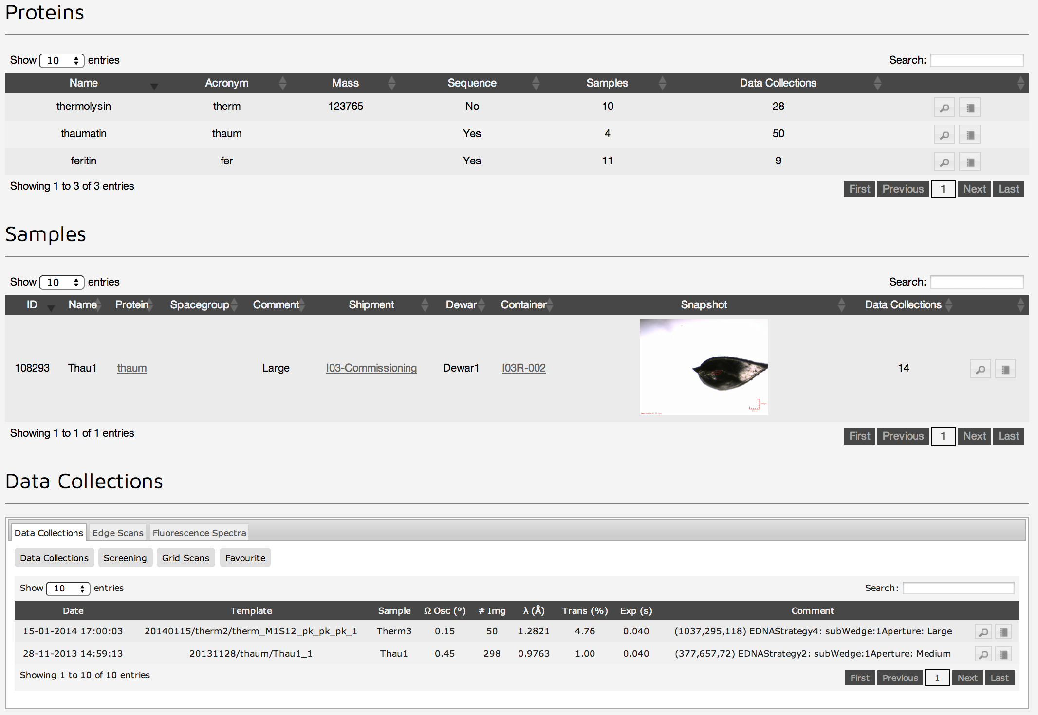
Projects

Slide 14
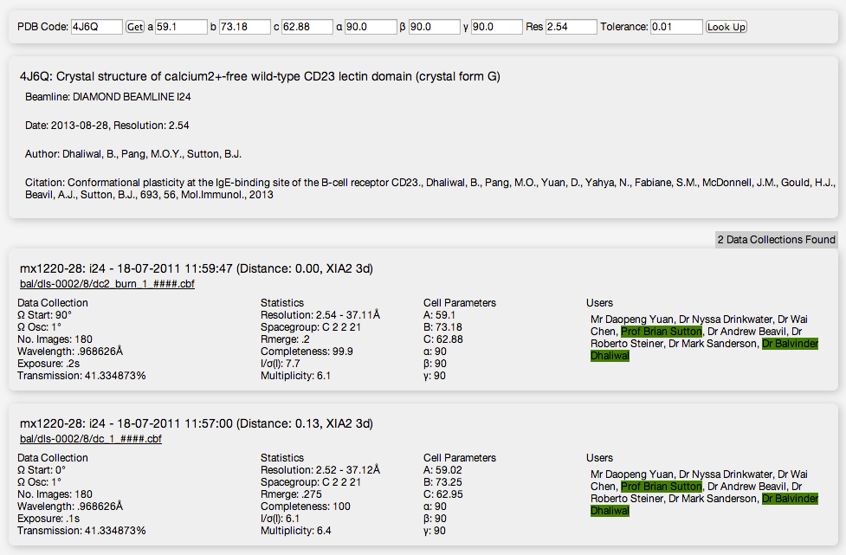

Slide 15
Acknowledgments
http://ispyb.diamond.ac.uk
I03
  Katherine McAuley
  Mark Williams
SciSoft
  Alun Ashton
  Karl Levik

