Slide 1

Crystallographic data collection for MX
Gwyndaf Evans
gwyndaf.evans@diamond.ac.uk
Thanks to those who provided slides..
Elspeth Garman,
James Holton,
Phil Evans,
Andrew Leslie,
Robin Owen

Slide 2
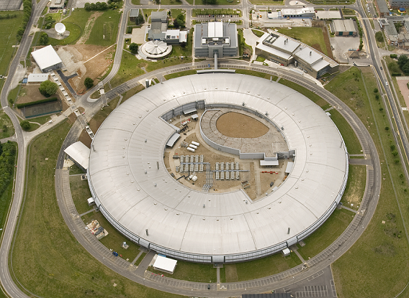
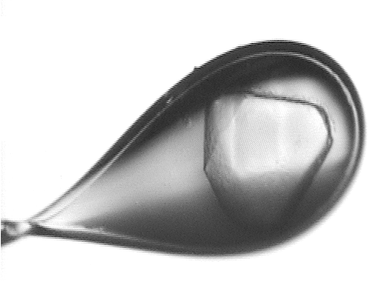
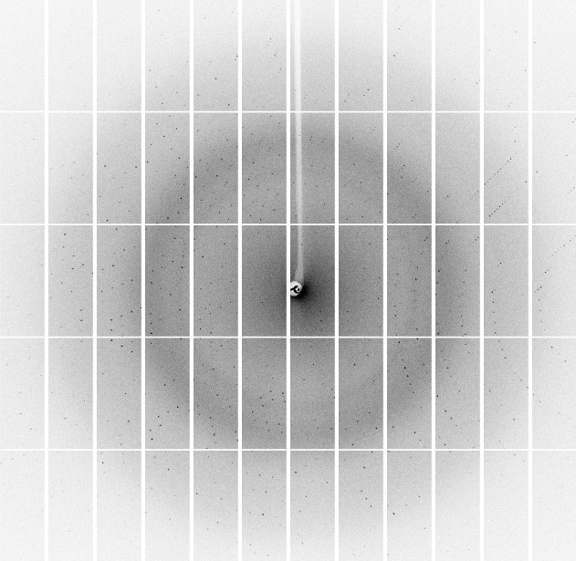

Slide 3
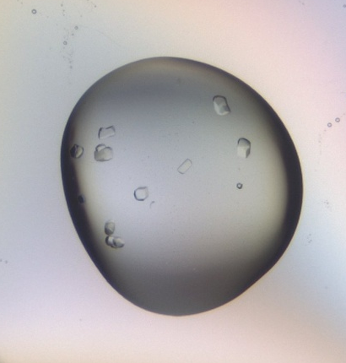
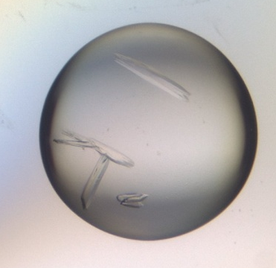
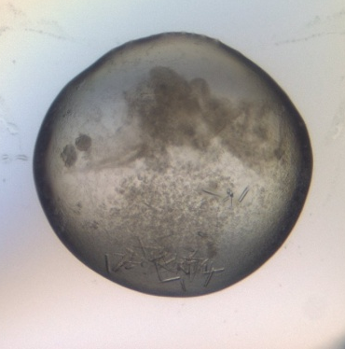
Data Collection
Optimising output from what crystallisation has provided
This is the last experimental step
Time taken now to collect the best possible data can prevent pain and possible failure later on.
If the original data are poor then not much can be done about it later.

Slide 4
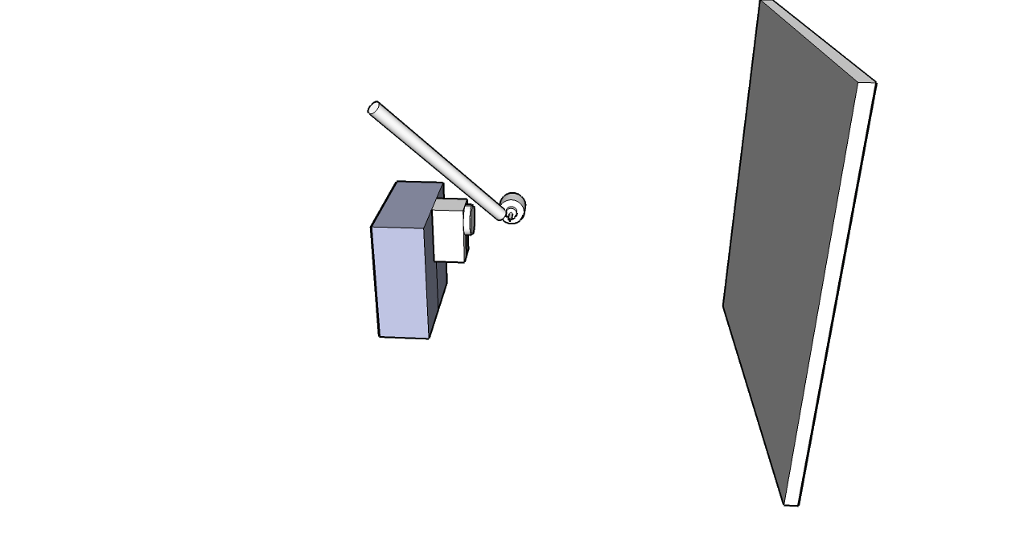
The experiment
sample cooling
Detector:
PAD
or CCD
goniometer rotation, ϕ
X-rays
2θ
On-axis viewing system

Slide 5
Steps in setting up a data collection
What is the objective of this data collection?
Mount and centre crystal
How big is my crystal and how big is the beam?
Test crystal diffraction
Determine data collection strategy
Setup data collection
Collect the data

Slide 6
You need to know…
What you want
What you need (probably different to (1))
Aim | High priorities | Lower priority
Native data collection | Collection of high resolution data Completeness of low resolution data
MAD, SAD | Accuracy and completeness of low res data Choice of wavelength | High resolution data
Sulphur SAD | High redundancy
Molecular replacement | Completeness at low resolution
3. Prior knowledge - what you already have/know
  e.g. until cell, symmetry, result of previous data collection trips

Slide 7
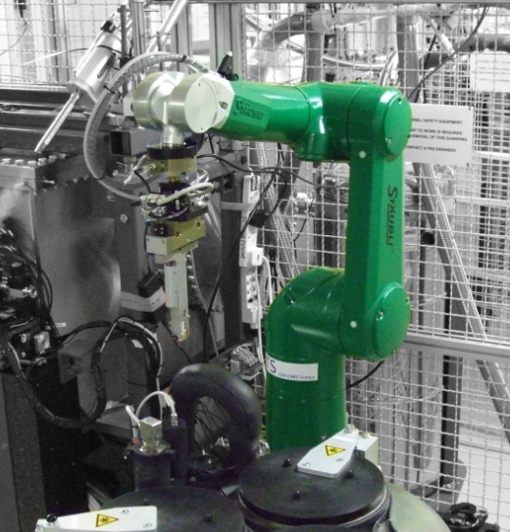
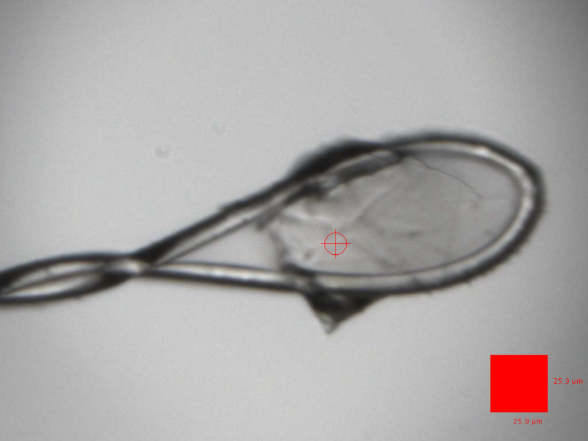
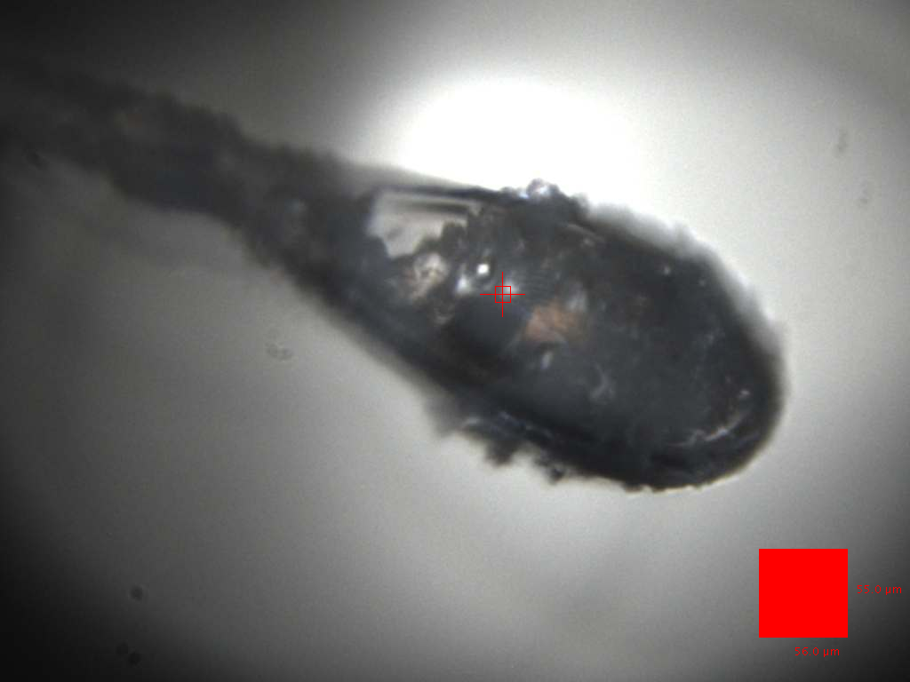
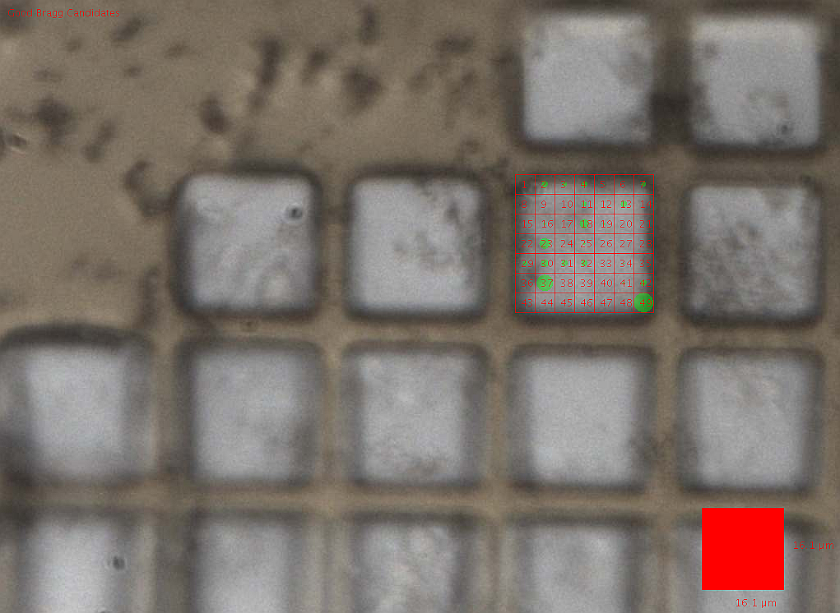
Mount and centre crystal
Mounting now automated at most beamlines.
Centering can be
Easy
Challenging
Very very difficult
Make the most of tools
developed to make these cases easier

Slide 8
Centering in difficult cases
Making this easier: grid scanning
Allows large areas to be quickly rastered over and small or hard to see crystals found.
Also eliminates optical effects: crystal may not be where it seems..
Now available at most beamlines
Try to crudely centre first and collect a testshot. Is it worth spending a lot of time on this sample?
If yes Spend more time
If no Move on
If maybe Take advantage of the robot: dismount and see what your other samples are like

Slide 9
What is the objective of this data collection?
Mount and centre crystal
How big is my crystal and how big is the beam?
Test crystal diffraction
Determine data collection strategy
Setup data collection
Collect the data

Slide 10
Beam and sample size
Both the crystal and the solvent surrounding the crystal interact with X-rays resulting in diffuse scatter on the detector
X-rays
X-ray background reduction
In this example reducing beamsize by ~ ×3 in both directions will reduce background by ×9

Slide 11
Matching your beam to your sample
AcMNPV polyhedra crystals approx 5×5×5 µm³ in size were mounted on a micromesh grid
Data were collected with two beamsizes: 8×8 µm² and 4.5×5 µm²

Slide 12
Matching your beam to your sample
I/ σ(I) = 1.5 at 2.9Å
Average background reduced by 3
I/ σ(I) = 1.5 at 2.5Å

Slide 13
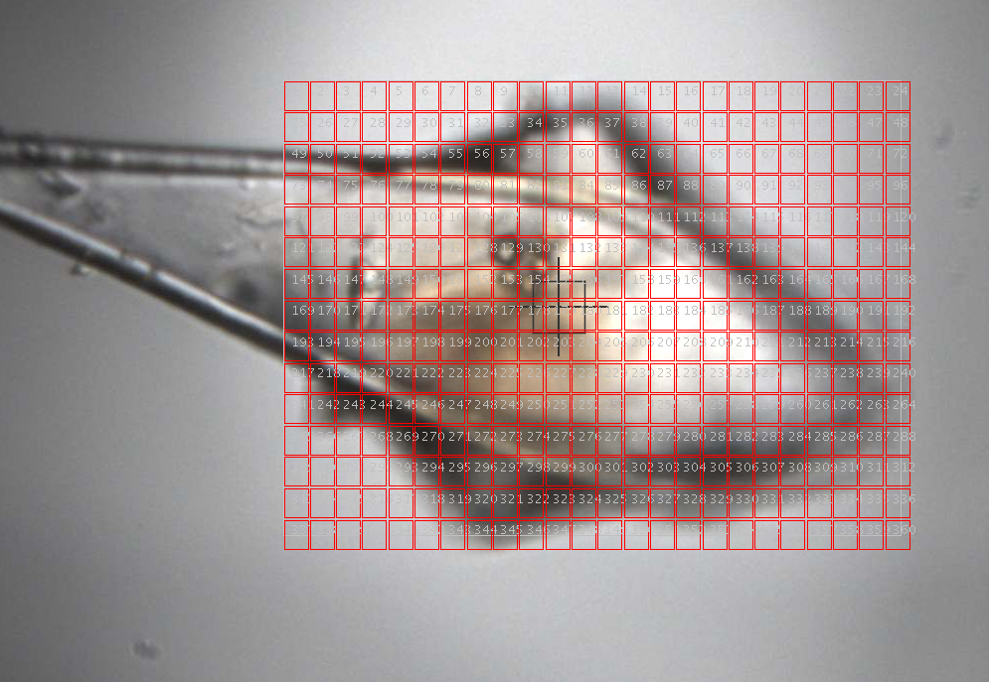
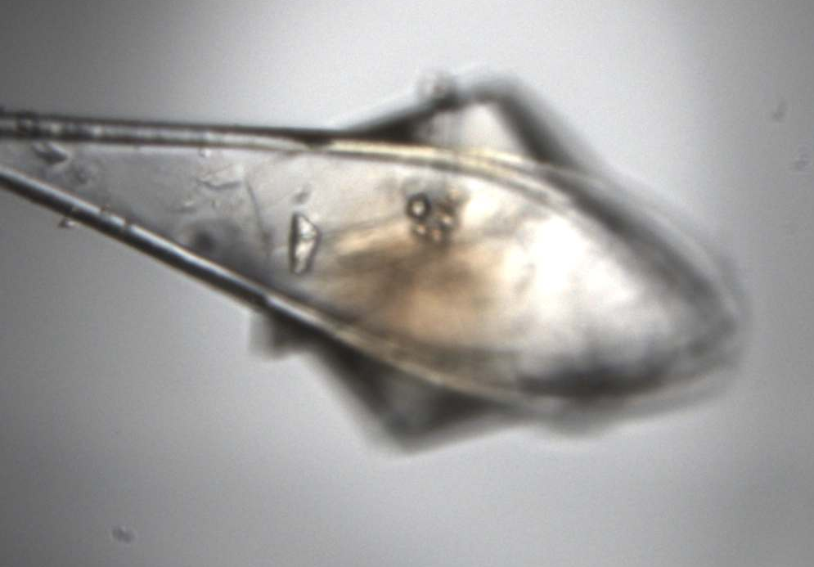
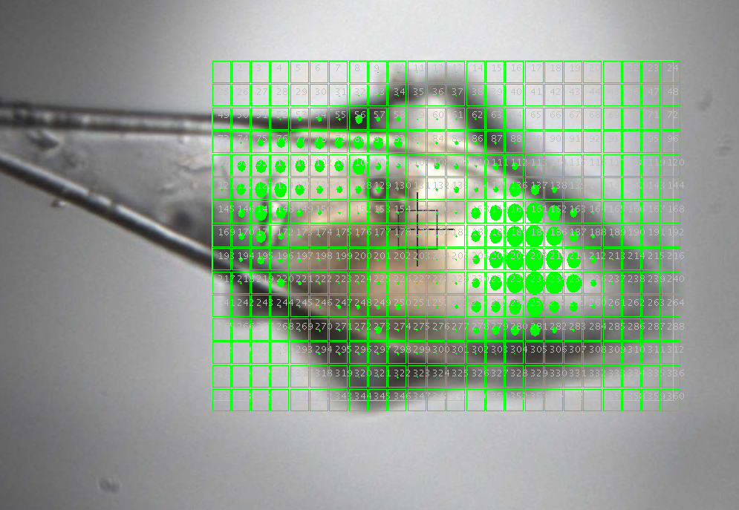
Other practicalities: does all of my crystal diffract
well
badly?
For this grid
0.2 s exposures
25% transmission
Total time for grid 150s
Beam
10 ×10 µm
50 µm
Grid scans can also be use to look at sub-areas of crystals

Slide 14
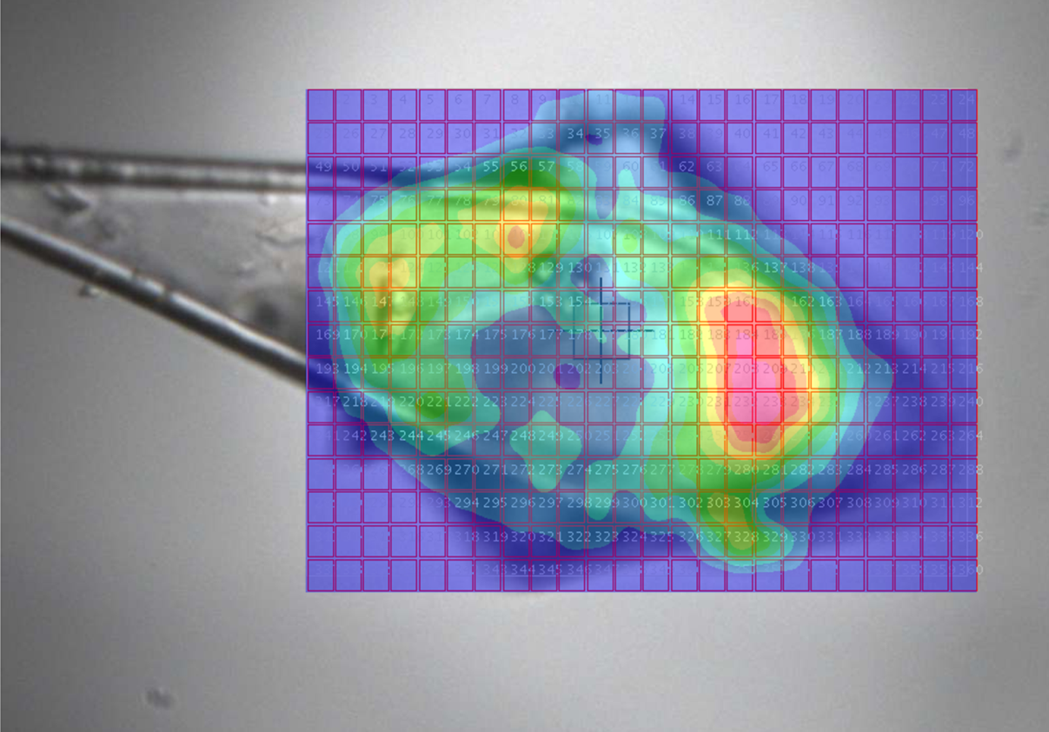
Even the same crystal can show a lot of variation..
3.04 Å
Wedge 3
Wedge 4
2.98 Å
2.64 Å
Wedge 1
Wedge 2
Beam
10 ×10 µm
3.44 Å
50 µm

Slide 15
Resolution and detector distance
From Bragg’s law
nλ = 2dsinθ
d_{max} = λ
2sinθ
From the geometry of the experiment
tan 2θ_{max}= L
S
For example
S = 300mm
L = 215 mm (P6M detector)
λ = 1.0 Å
d_{max} = 1.6Å
S
2θ_{max}
L
Moving the detector closer lets us collect higher resolution data but a closer detector isn’t always better…

Slide 16
Detector distance and signal to noise
Diffuse scatter (background) falls off as 1/S²
(surface of a sphere)
Bragg intensity falls off as the beam divergence.
The beam divergence is small so background falls off faster than peak intensity
increase crystal to detector distance for improved signal-to-noise
S
2θ_{max}
L

Slide 17
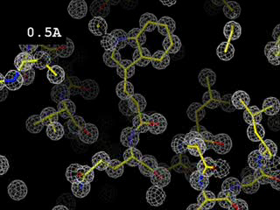
What resolution do we need?
~ 4 Å
Polypeptide chain. β–sheets traceable
~ 3 Å
Can see where side chains are
~ 2.5 Å
Main chain has carbonyl bulges, clear choice of side chain rotamers
~ 1.5 Å
Essentially atomic resolution
Animation – James Holton ALS

Slide 18
Effect of beamstop distance
Have to compromise
Close to the sample:
fewer data
lower background
No data
X-ray beam
Crystal
Beamstop
Far from the sample:
more data
higher background
Detector
Air scatter from X-ray beam
No data
X-ray beam
Crystal

Slide 19
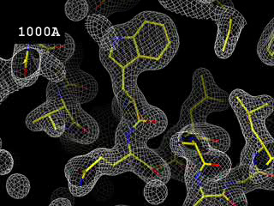
The importance of low resolution data
Essentially no change in the map until a low-res cutoff of 6Å, and then all hell breaks loose.
Note this does not imply a low resolution cut off of 6 Å is ok.
The importance of low-res spots for solvent-flattening and phase extension are well established, and low-angle data should still be collected for these reasons.
Animation – James Holton ALS

Slide 20
What is the objective of this data collection?
Mount and centre crystal
How big is my crystal and how big is the beam?
Test crystal diffraction
Determine data collection strategy
Setup data collection
Collect the data

Slide 21
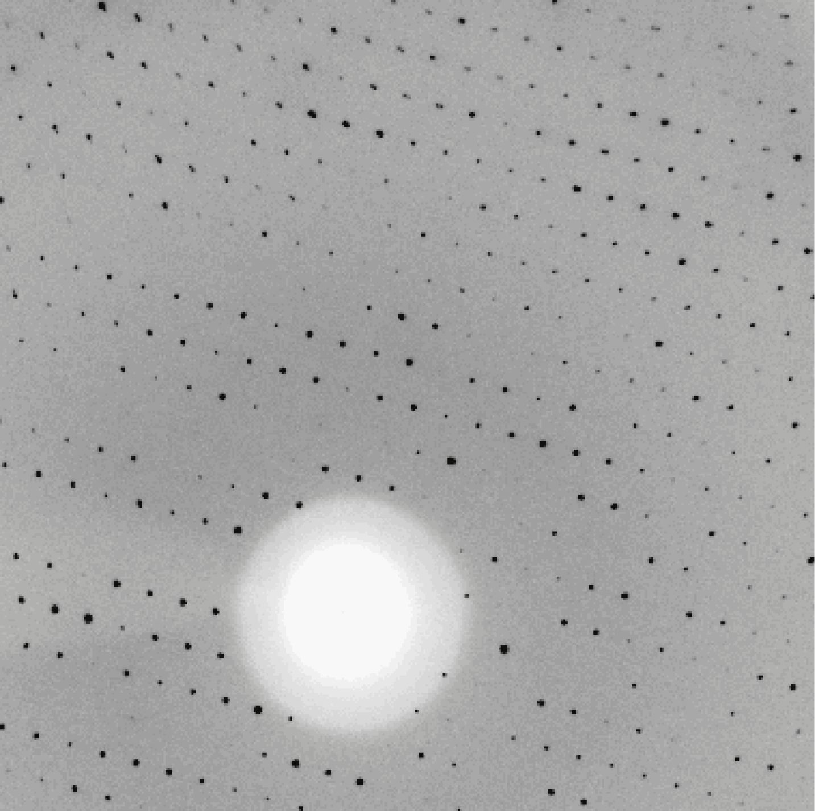
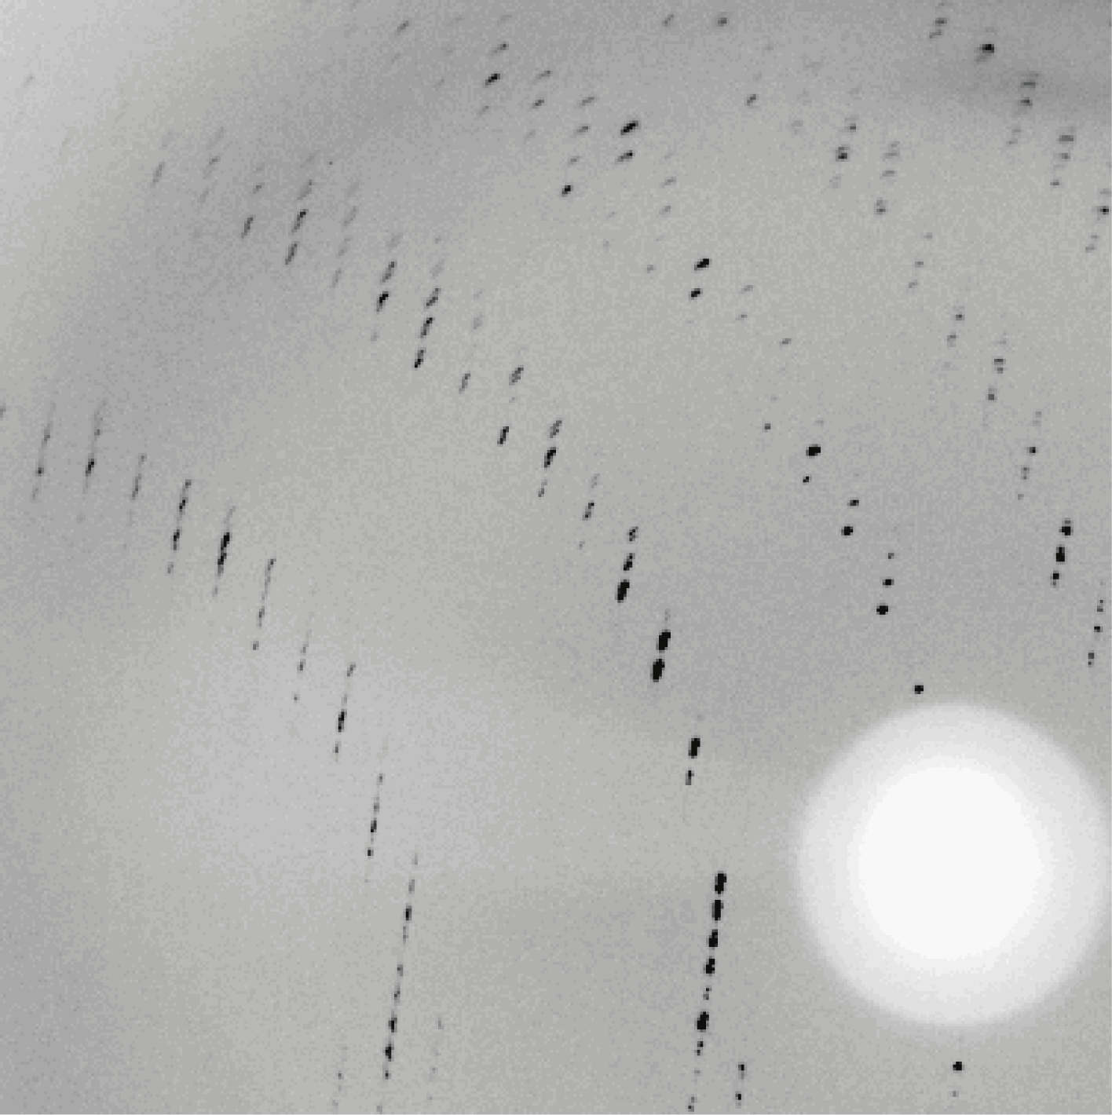
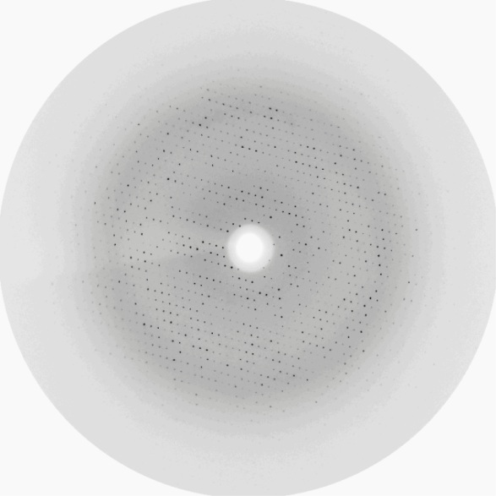
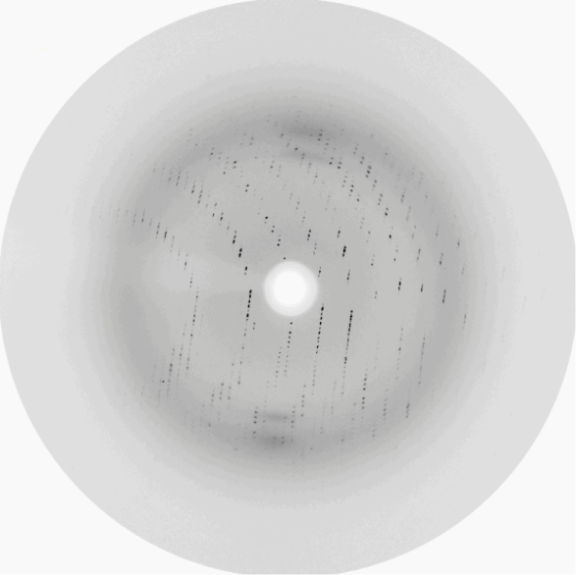
Phi = 0°
Phi = 90°
Always check diffraction in two orthogonal images !

Slide 22
What does my diffraction pattern look like and why?
It helps to understand the concept of reciprocal space and the Ewald construction.
Rearrange Bragg:
2 sin θ = n λ θ: deviation of d diffracted beam
i.e. θ ∝ 1/d d: distance between diffraction planes
d
θ
reflecting plane
Large d – compressed pattern.
Small d – widely spaced pattern.
Easier to interpret diffraction patterns if we replace INVERSE relationship with a DIRECT one
⇒ Construct a reciprocal lattice, based on 1/d, which varies directly as sin θ

Slide 23
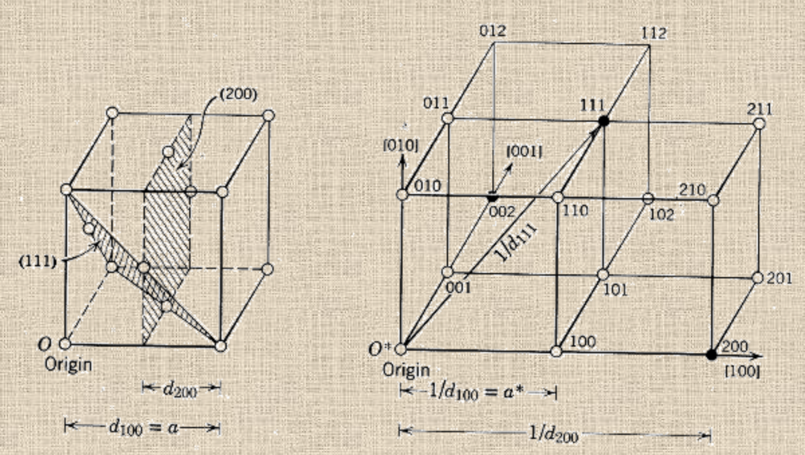
The reciprocal lattice
A lattice based on 1/d or d*
Real space
plane intersect axes at 1/h, 1/k, 1/l
Reciprocal space
reciprocal lattice vectors are normal to planes
from http://labs.mete.metu.edu.tr/tem/TEMtext/TEMtext.html

Slide 24
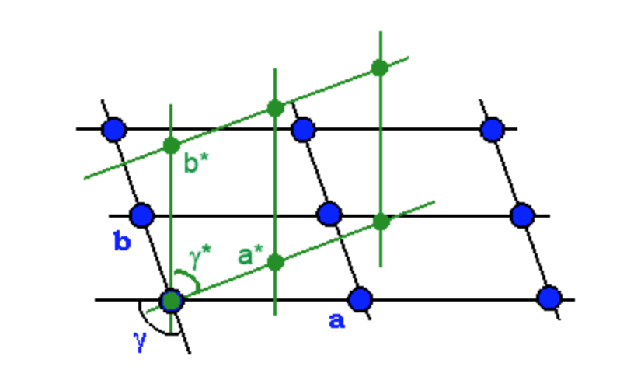
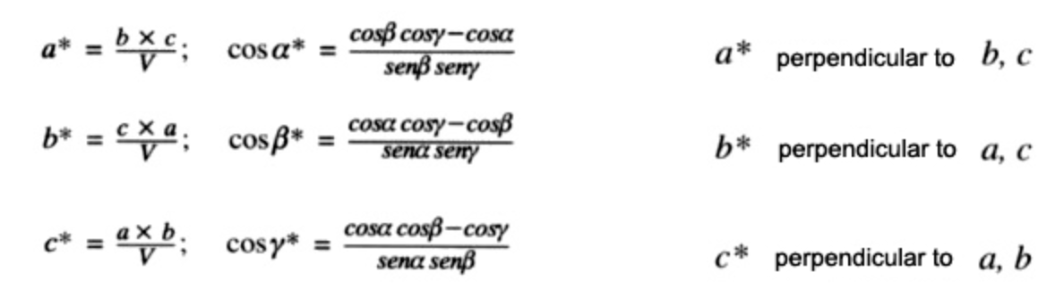
The reciprocal lattice
real lattice in blue
reciprocal lattice in green

Slide 25
Ewald’s construction
To relate planes in the crystal lattice to points in the diffraction pattern we use Ewald’s construction
A
Ewald sphere
radius = 1/λ
(OA/2)/(1/λ) =sinθ
or
λ=2 sinθ / OA
If 1/OA is equivalent to d this represents Braggs’ law
S₁
θ
Incoming X-ray
S₀
θ
O
Note that the vector OA (1/d) is perpendicular to the reflecting plane.
The Ewald construction exists in a space with dimensions of reciprocal distance.
We no longer think about Bragg planes, but of reciprocal lattice vectors perpendicular to the lattice planes.

Slide 26
Diffraction occurs when a reciprocal lattice point lies on the Ewald sphere
a*
Ewald sphere
r = 1/λ
S₁
1/d_{hkl}
Incoming X-ray
S₀
X
0 0 0
b*
Origin of reciprocal space (0 0 0) is where the main beam passes through the sphere

Slide 27
Diffraction occurs when a reciprocal lattice point lies on the Ewald sphere
a*
S₁
1/d_{hkl}
Incoming X-ray
S₀
X
0 0 0
b*
Rotation of the crystal is equivalent to rotation of the reciprocal lattice about the origin and causes more reciprocal lattice points to satisfy the Bragg condition, passing through the Ewald sphere.
Notes:
A reflection with a given set of Miller indices satisfies the Bragg condition (and so a diffracted beam occurs) when the equivalent reciprocal lattice point touches the Ewald sphere

Slide 28
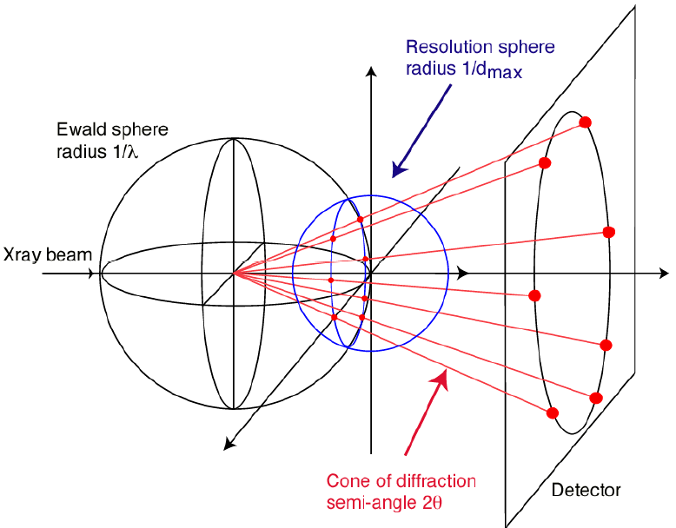
Resolution and the reciprocal lattice
For a maximum resolution of d_{max}, all diffraction vectors S must lie within a resolution sphere of radius 1/d_{max}
As the crystal rotates, the diffracted beams all lie within a cone of semi-angle 2θ_{max}
λ/d_{max} = 2 sin θ_{max}
A detector centered on the beam collects the whole cone
This gives optimum efficiency and simple strategy
For long axes (close spot separation) it may be necessary to use a long detector distance and an offset detector
This gives a lower efficiency, and to get complete data requires a complicated strategy
The corners of a square detector collect incomplete data

Slide 29
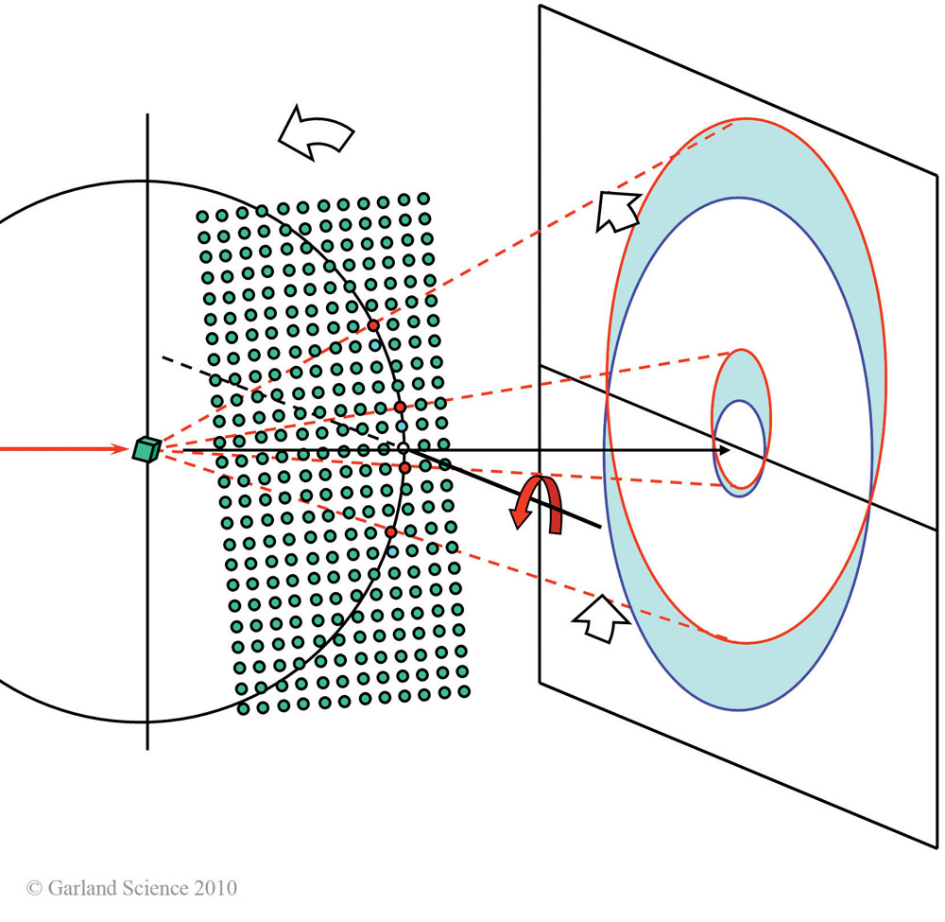
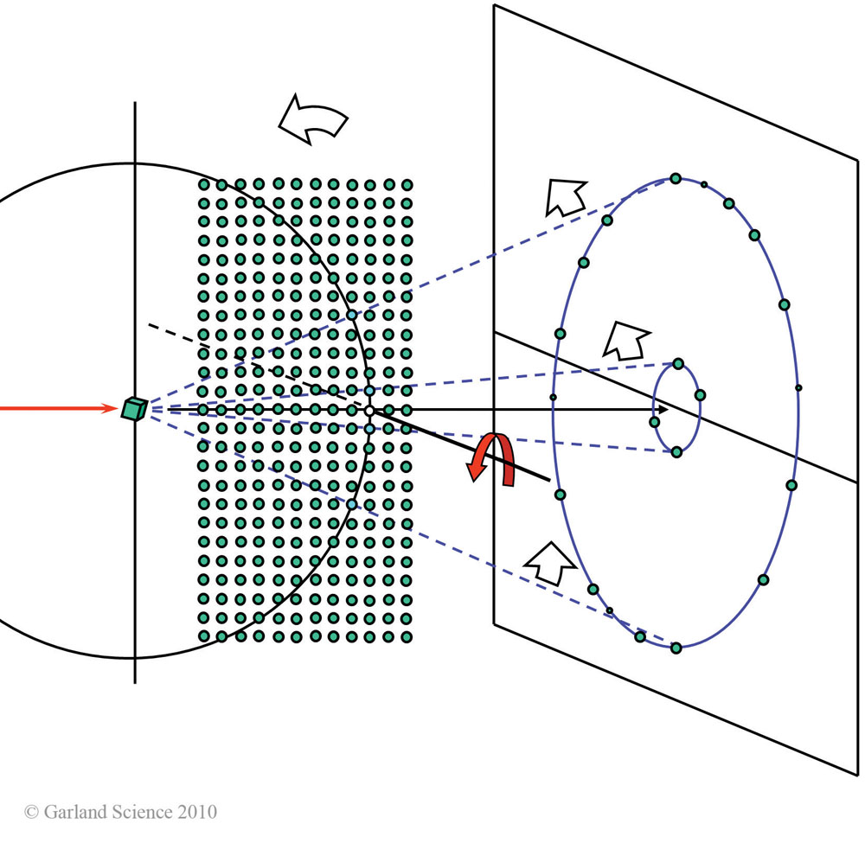
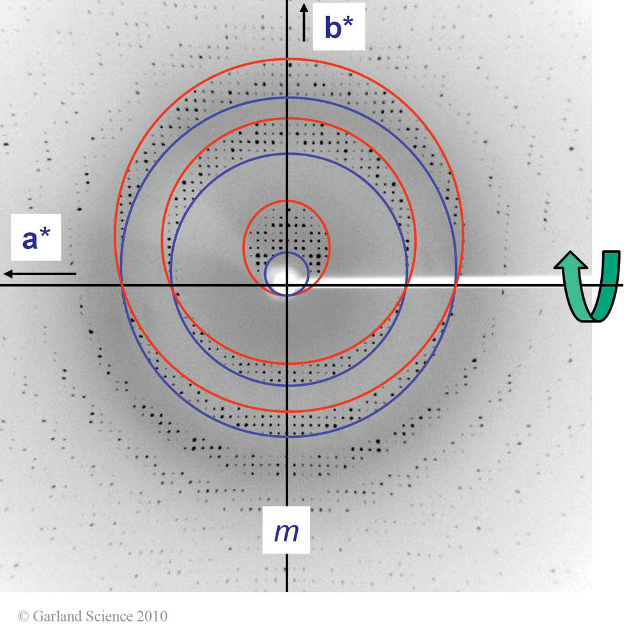
Lattice planes result in lunes
nb one image alone not enough to accurately determine lattice symmetry. Need two widely spaced images (ie 90° apart).
Images from Bernhard Rupp, Bimolecular Crystallography
Garland Science, Taylor & Francis Publishing 2010

Slide 30
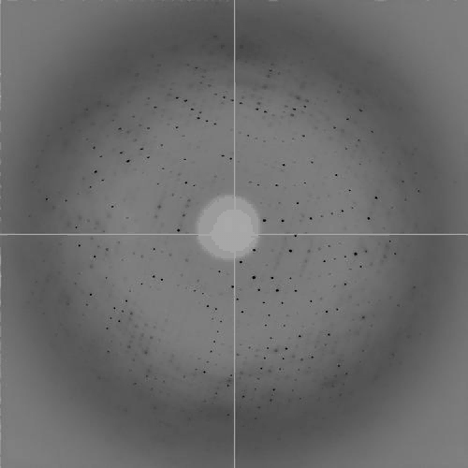

Slide 31
What about spot shape?
Consider a single reflection on the Ewald sphere
Ewald sphere
Φ circle
(h,k,l)
λ*
d*
spindle axis
diffracted ray
λ*
Schematics from James Holton, APS

Slide 32
Mosaic spread
Reciprocal lattice points are broadened
Ewald sphere
Φ circle
(h,k,l)
λ*
d*
diffracted ray
d*
spindle axis
λ*

Slide 33
Mosaic spread
Reciprocal lattice points are broadened
Ewald sphere
Φ circle
(h,k,l)
d*
diffracted rays
d*
spindle axis

Slide 34
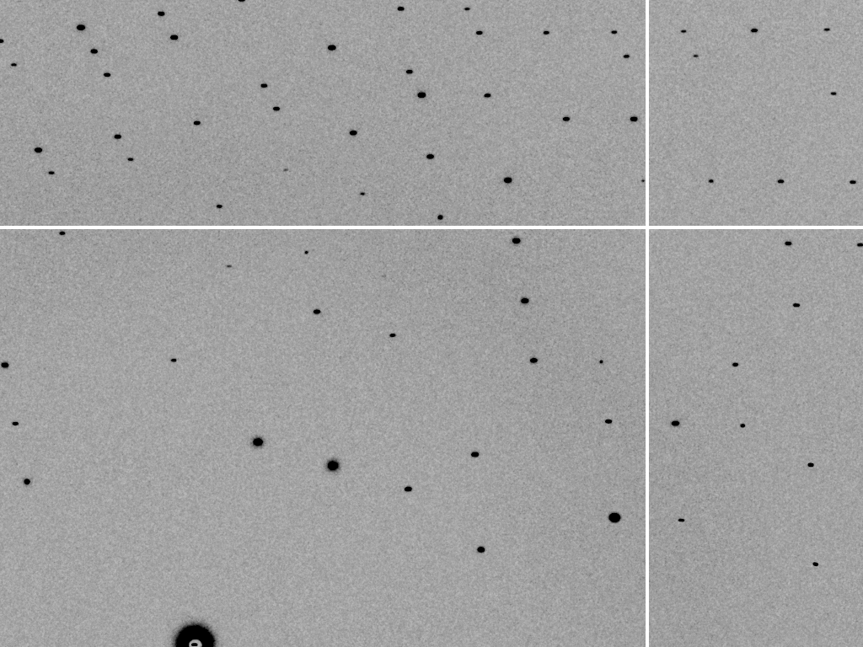
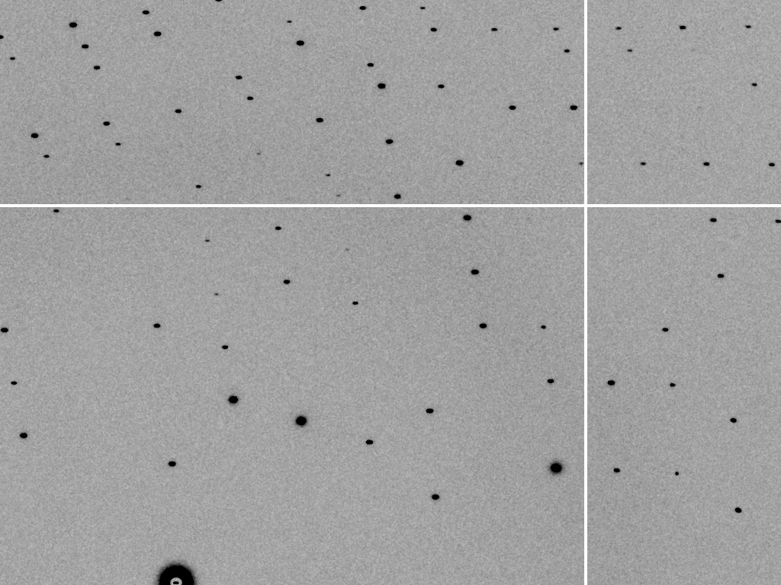
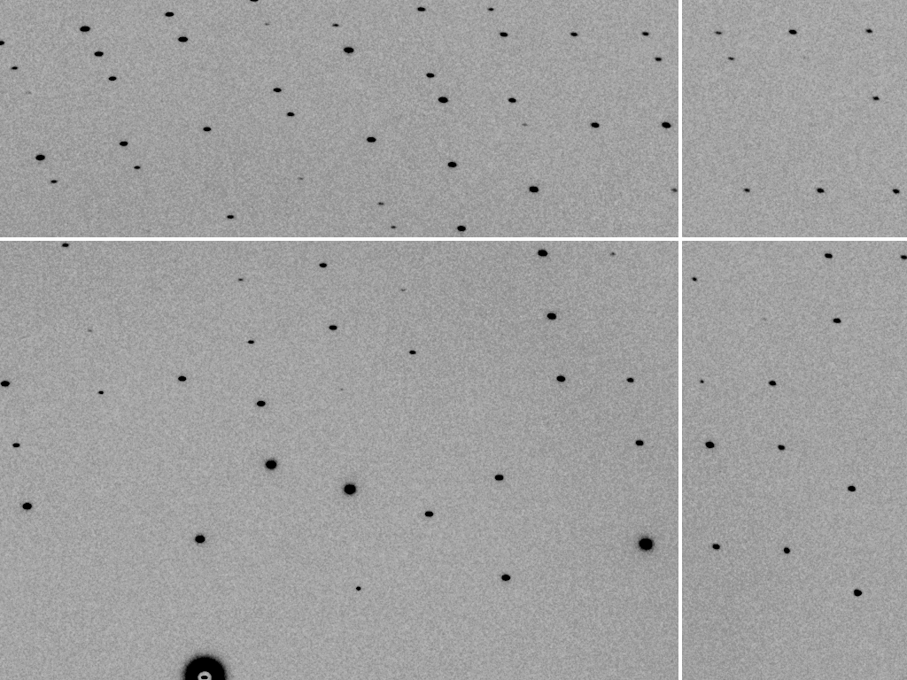
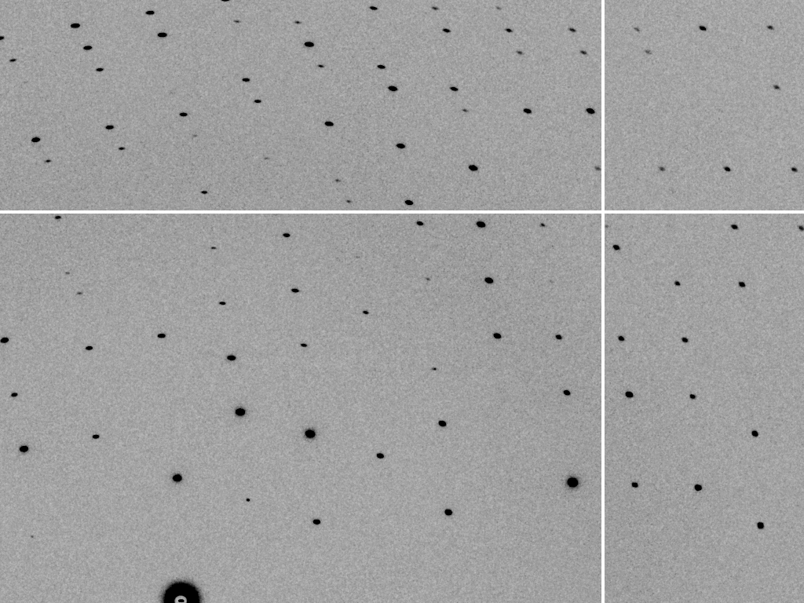

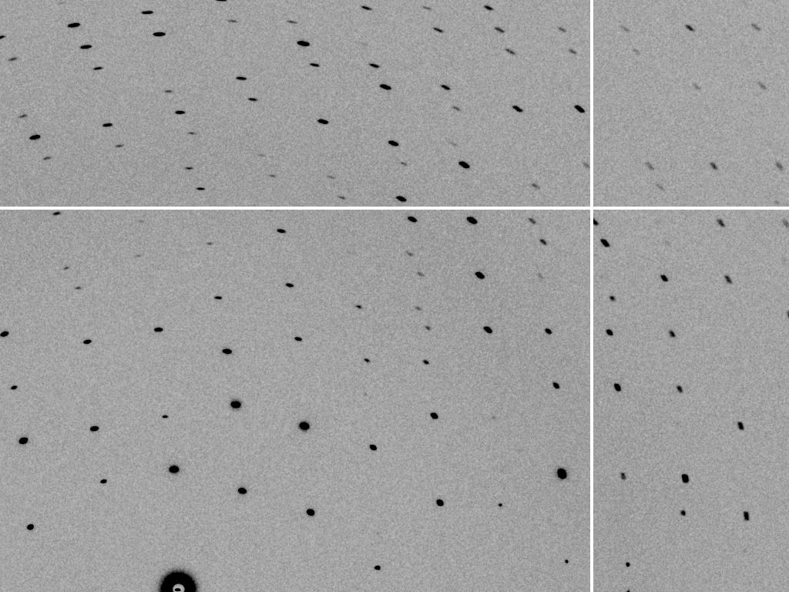
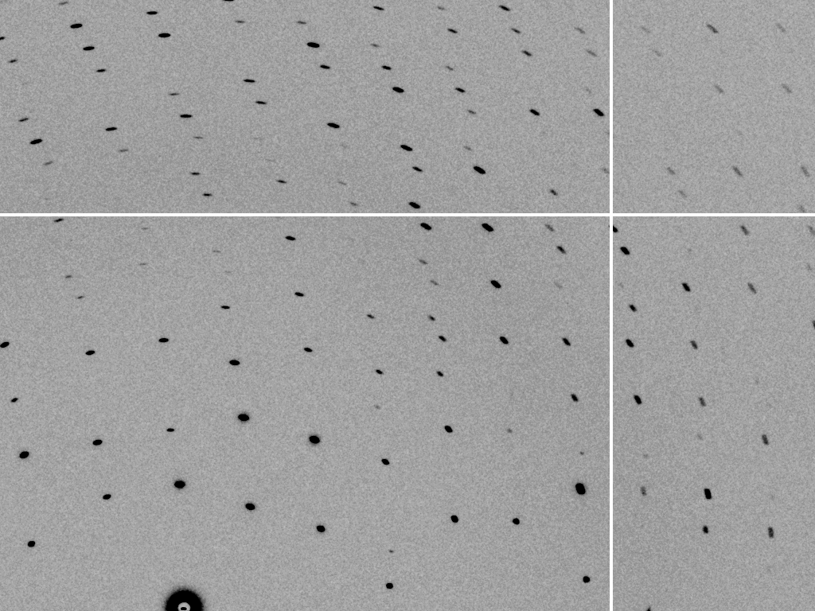
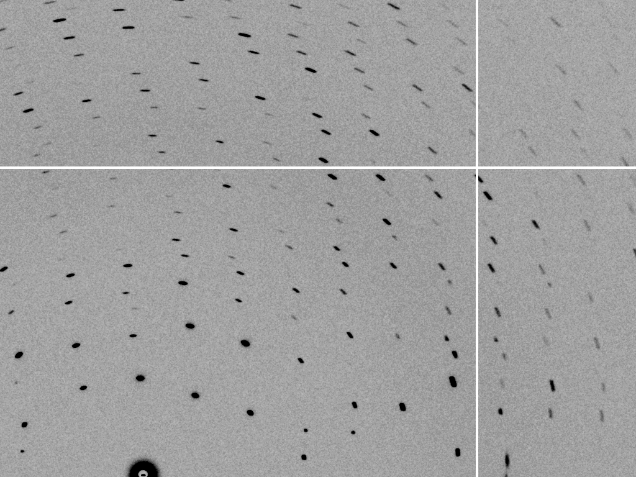
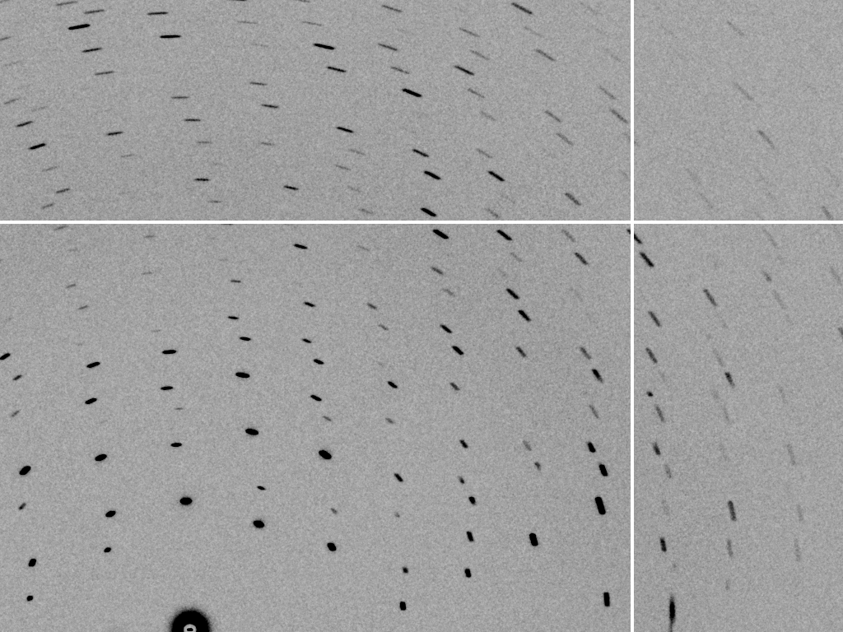
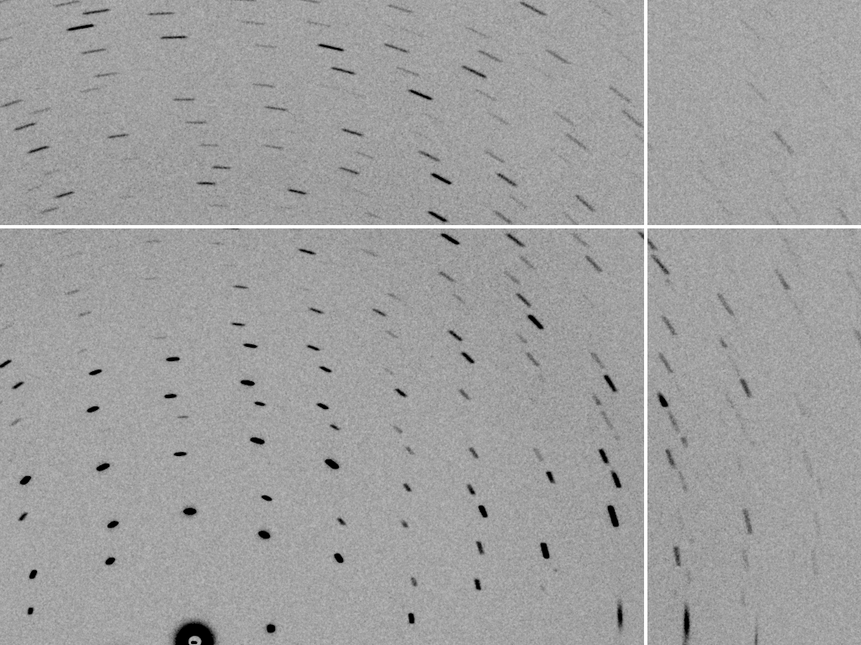
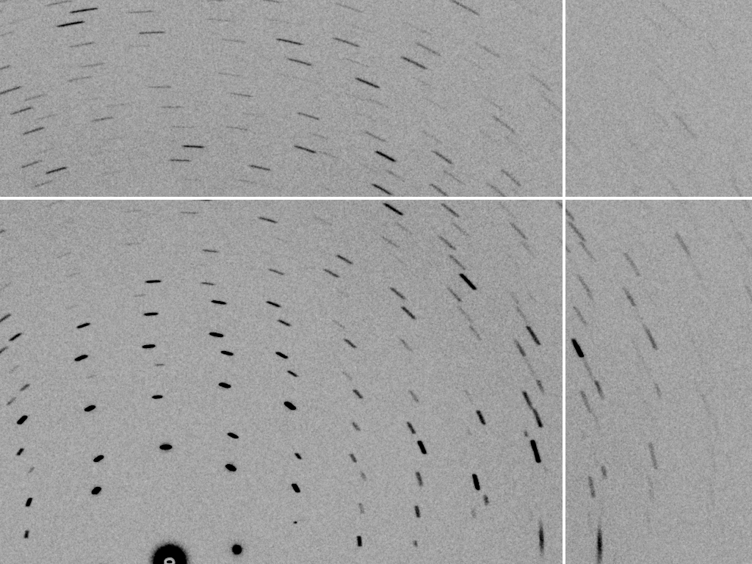
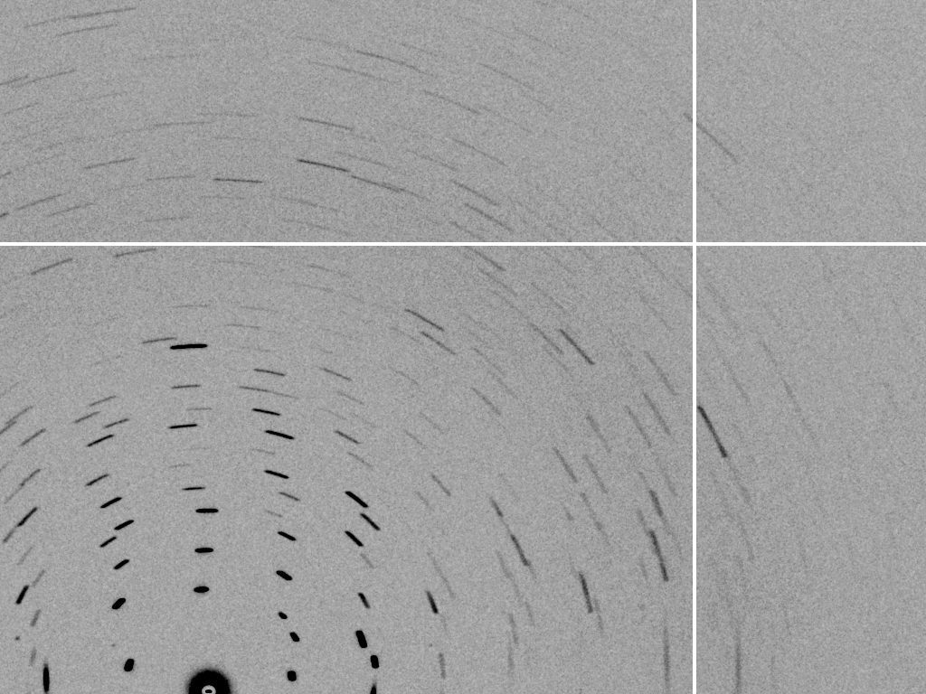
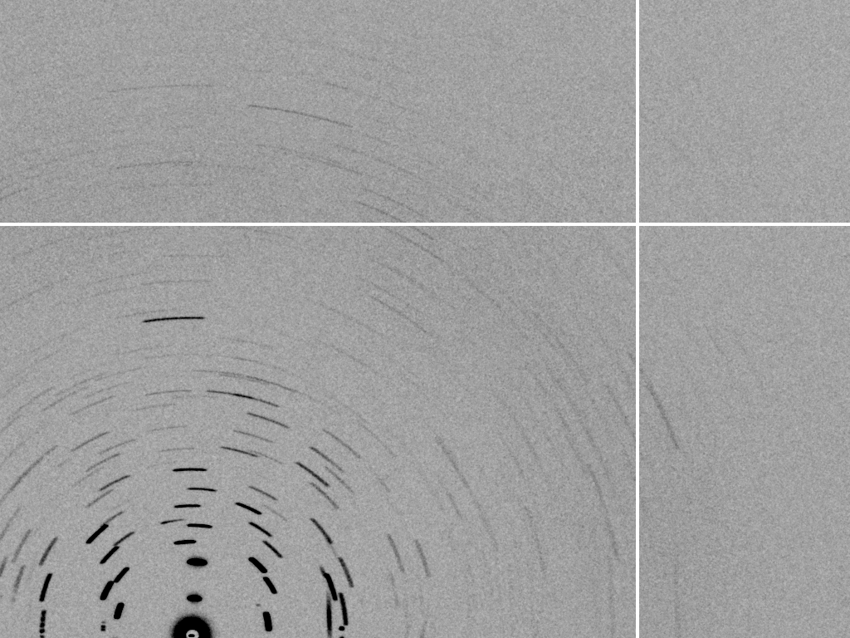
mosaic spread = 0°
mosaic spread = 0.1°
mosaic spread = 0.2°
mosaic spread = 0.4°
mosaic spread = 0.6°
mosaic spread = 0.8°
mosaic spread = 1.0°
mosaic spread = 1.5°
mosaic spread = 2.0°
mosaic spread = 2.5°
mosaic spread = 3.2°
mosaic spread = 6.4°
mosaic spread = 12.8°
Simulated diffraction images by James Holton

Slide 35
Mosaic spread
Ewald sphere
Φ circle
(h,k,l)
d*
diffracted rays
d*
spindle axis

Slide 36
Beam divergence
Angle of incident beam changes (slightly)
Ewald sphere
Φ circle
(h,k,l)
λ*
d*
spindle axis
diffracted ray
λ*

Slide 37
Beam divergence
Angle of incident beam changes (slightly)
Ewald sphere
Φ circle
(h,k,l)
d*
λ*
diffracted ray
spindle axis
λ*

Slide 38
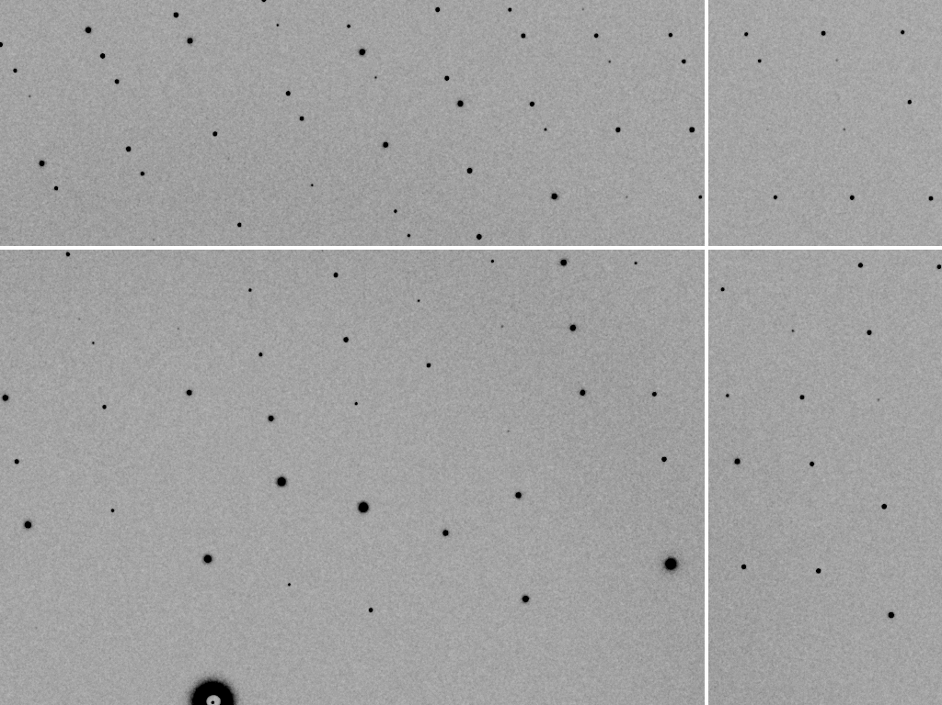
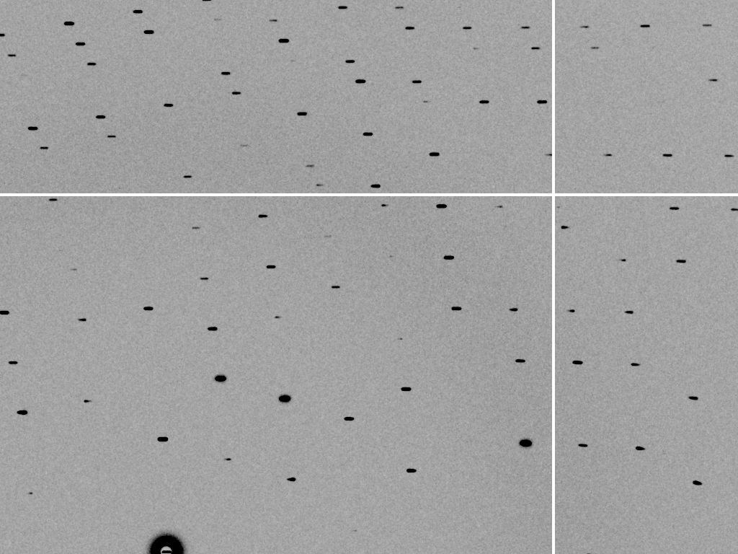
divergence = 0°
divergence = 0.3°

Slide 39
Spectral dispersion
Variation in wavelength of incident X-rays (and hence radius of Ewald sphere)
Ewald sphere
Φ circle
(h,k,l)
λ*
d*
spindle axis
diffracted ray
λ*

Slide 40
Spectral dispersion
Variation in wavelength of incident X-rays (and hence radius of Ewald sphere)
Ewald sphere
Φ circle
(h,k,l)
λ’*
d*
spindle axis
diffracted ray
λ’*

Slide 41
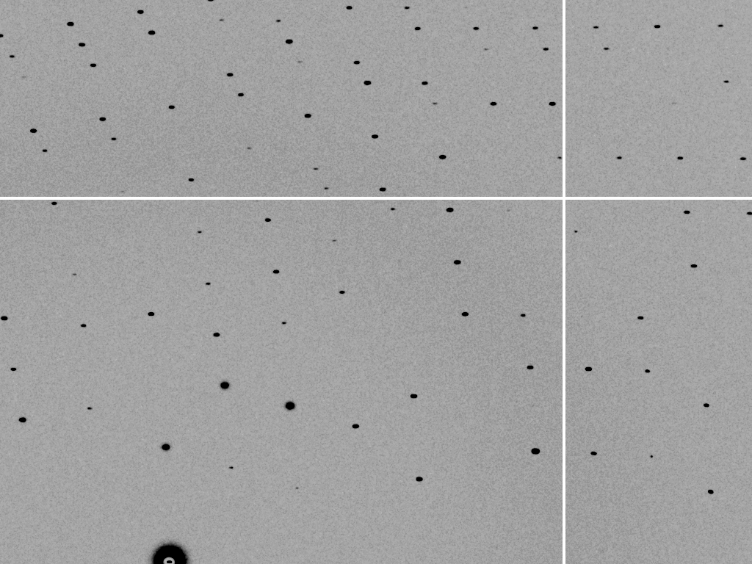

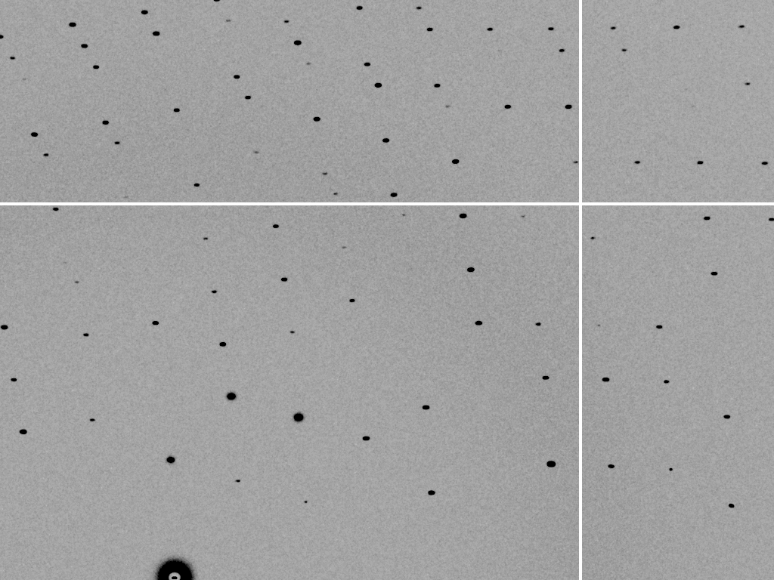
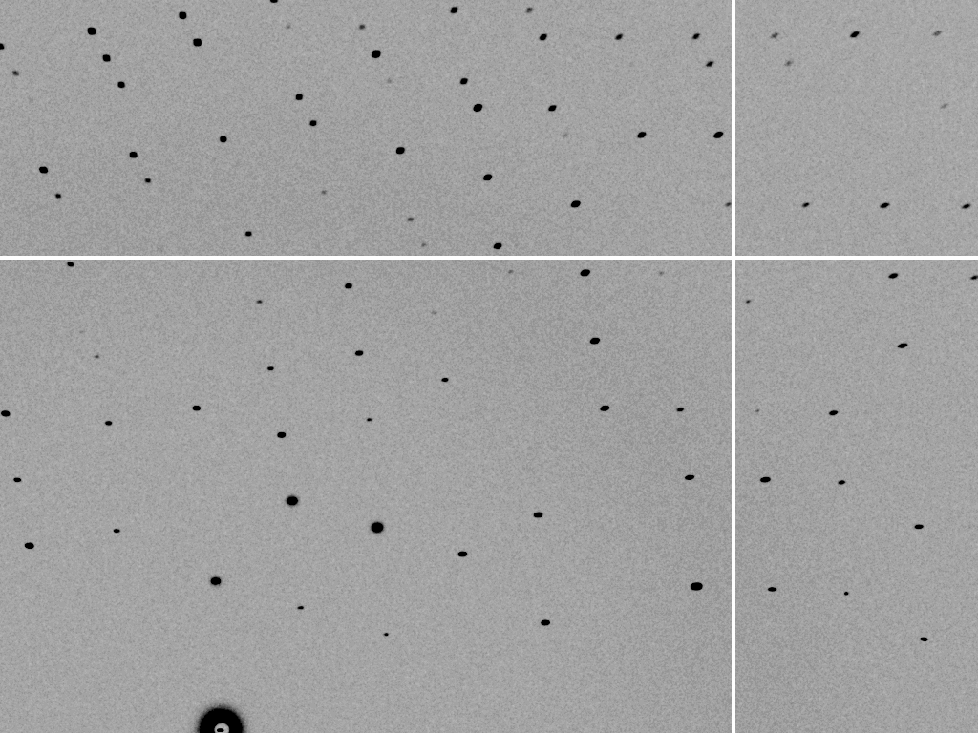



dispersion = 0.0
dispersion = 0.014% (Si 111)
dispersion = 0.25% (Cu Kα)
dispersion = 0.6%
dispersion = 1.3%
dispersion = 2.6%
dispersion = 5.1%

Slide 42
All together….
Ewald sphere
Ewald sphere
Ewald sphere
Ewald sphere
Φ circle
Φ circle
Φ circle
Φ circle
(h,k,l)
(h,k,l)
(h,k,l)
(h,k,l)
λ’*
λ*
d*
d*
d*
λ*
d*
spindle axis
spindle axis
spindle axis
diffracted rays
d*
spindle axis
diffracted ray
diffracted ray
diffracted ray
λ’*
λ*
λ*

Slide 43
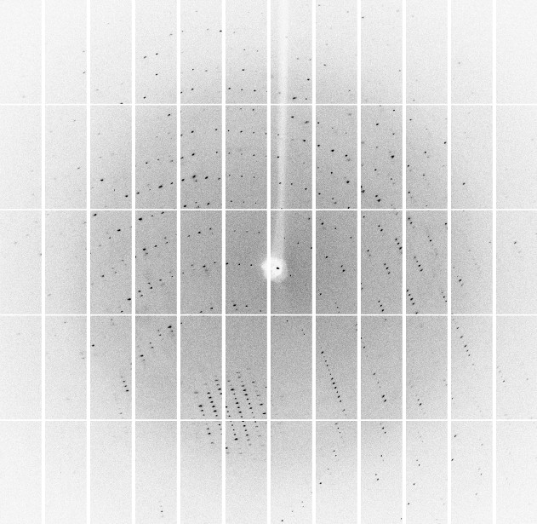
All together….

Slide 44
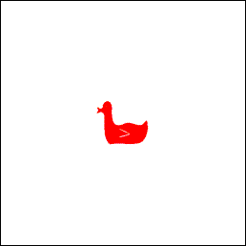
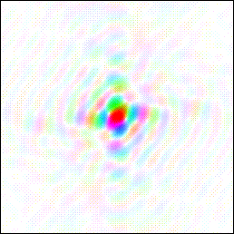
A picture of a duck and its Fourier Transform
How much data do I need?
The importance of data completeness
FT
FT
from Kevin Cowtan’s “Book of Fourier”

Slide 45
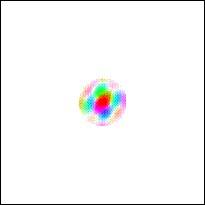



Omitting high and low resolution data
Omission of high resolution data results in a lost of detail
FT
Omission of low resolution data results in only the outline of a duck
FT

Slide 46




Omitting shells of data
FT
10% of data randomly omitted
10% of data systematically omitted
FT

Slide 47


Omitting a wedge of data
FT
If we omit a segment of the data, a perpendicular segment of the image is blurred
Calculated electron density contains artefacts therefore it is important to record all of the unique data for the map calculation

Slide 48
What is the objective of this data collection?
Mount and centre crystal
How big is my crystal and how big is the beam?
Test crystal diffraction
Determine data collection strategy
Setup data collection
Collect the data

Slide 49

How much data do I need?
Again, use the Ewald sphere construction.
In order to see which parts of reciprocal space are recorded it is easier to fix the resolution sphere and rotate the Ewald sphere.
The region of data collected is the volume swept out by the leading and trailing edges of the sphere
In a rotation of 180°
The brown and green regions are collected.
The black region is measured twice.
The blue region is not measured.
Because of Friedel’s law the dataset is complete.
Figures from
Z. Dauter. Data collection strategies (1999) Acta Cryst D55 1703-1717

Slide 50

How much data do I need?
A partial rotation of 135° fills the higher resolution shell but results in incomplete low resolution data
In a rotation of 135°
The brown and green regions are collected.
The white and blue regions are not measured.
Figures from
Z. Dauter. Data collection strategies (1999) Acta Cryst D55 1703-1717

Slide 51


How much data do I need?
Symmetry in real space is manifested as symmetry in reciprocal space.
We do not need to collect every data point in the reciprocal space sphere, but only the part containing all the unique reflections ‘the asymmetric unit of reciprocal space’.
Rotation of an orthorhombic crystal by 90° starting at an axis gives a complete dataset
A 90° rotation starting at the diagonal collects the same region twice and gives incomplete data
Starting at the optimal position is crucial!

Slide 52


The blind region
When rotating around a single axis some reflections close to the rotation axis will never pass through the Ewald sphere.
The blind region is larger at long wavelengths as 1/λ, and hence the radius of the Ewald sphere, is smaller.
Fraction of reflections in blind region
1.54 Å (green)
1.0 Å (blue)
0.71 Å (red)
At low resolution the blind region can be neglected but at high resolution and in low symmetry space groups it may be necessary to offset the rotation axis.

Slide 53

Strategy
Radiation damage limits the amount of data that can be collected from each crystal.
Strategy programs exist – use them! MOSFLM, EDNA, XPLAN, BEST
From the two test images 90° apart you should be able to obtain a lattice and its orientation. Strategy programs will tell you the start angle and the required rotation range.
Completeness as a function of start angle

Slide 54

The effect of completeness
Maps calculated with a certain percentage of data removed, at random.
(the same way the R_{free} flags would be calculated)
Animation – James Holton ALS

Slide 55

Collecting anomalous data
More data is required because Friedel’s law is no longer true
i.e. I(h,k,l) ≠ I(-h,-k,-l)
This occurs because electron resonance occurs in elements at certain wavelengths. The resonant wavelength depends on the element

Slide 56

Strategy
Programs such as BEST go further than just providing a start angle and oscillation range..
Phi = 0°
plus
Estimate of crystal lifetime
Aim of experiment (eg native or anomalous data collection)
Desired multiplicity
gives
Comprehensive strategy including phi start and end, but also suggested oscillation angle, exposure time and filter transmission.
Phi = 90°
BEST: Bourenkov and Popov
Acta Cryst. (2010). D66, 409-419

Slide 57


Strategy
At Diamond these programs are run for you after collecting two or three test images. Exploit this but check it looks right: unresolved spots or ice rings can/will cause problems…
mosflm output in visit webpage
EDNA output in visit webpage

Slide 58
Avoiding overlaps
spacing of reciprocal lattice planes
Δϕ can not be greater than the spacing of the planes at maximal resolution
i.e. Δϕ ≤ a*/d*
Δϕ ≤ d/a
In degrees: Δϕ ≤ 180d
πa
Taking the mosaicity, η, into account
(ie width of reciprocal lattice points)
this becomes
Δϕ ≤ 180d
πa
If possible set long cell axis of a crystal along rotation axis to reduce such problems
a*
d*
maximum resolution
2θ_{max}
angular rotation
Δϕ
− η
Data Collection Strategies
Dauter, Acta Cryst (1999) D55

Slide 59
What is the objective of this data collection?
Data Collection
Parameters
Omega start
Omega delta
Number of images
Detector distance
Exposure time
Filter transmission
Mount and centre crystal
How big is my crystal and how big is the beam?
Test crystal diffraction
Determine data collection strategy
Setup data collection
Collect the data

Slide 60
See other talks today
Next talk on BEST strategies by Sasha Popov
MAD/SAD experiments by Gordon Leonard
Talk on Pilatus data collection this afternoon by Neil Paterson

