Slide 1
Model Completion using ARP/wARP
Ciarán Carolan

Slide 2
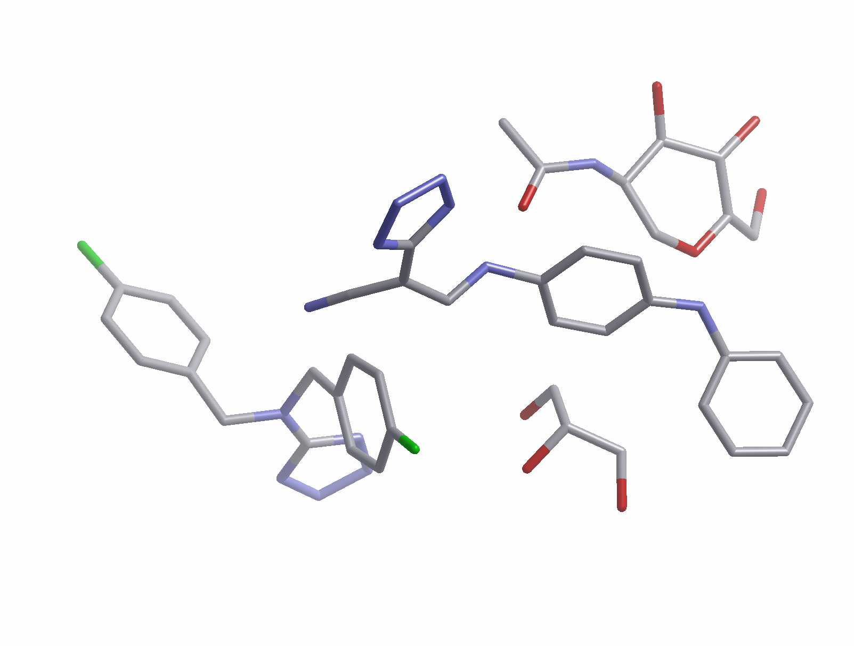
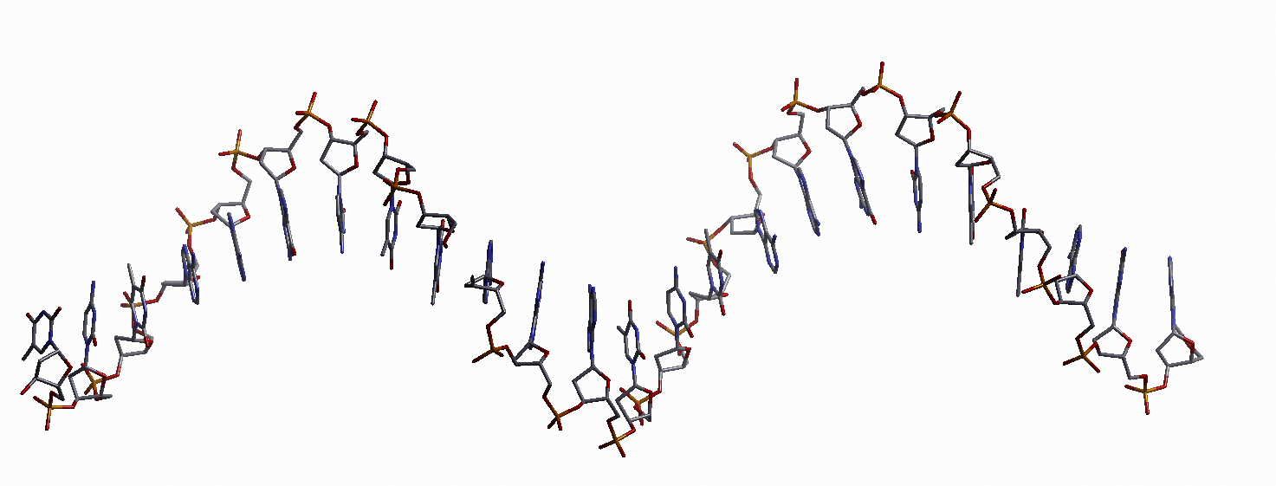
What??
Ligands
Nucleotides
Solvent

Slide 3
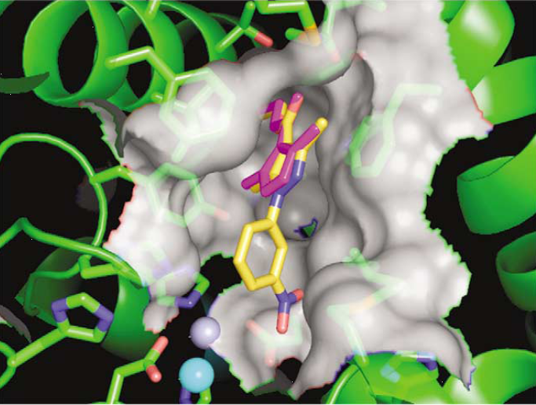
Structure based drug design
Structural work, principally involving MX and NMR, allows the elaboration of a lead to a candidate drug.
High-throughput crystallography is an up-and-coming technique in lead generation (e.g. fragment based drug design). It requires rapid and automated ligand identification and construction, however.
Elaboration of a lead to produce a drug depends on accurate knowledge of ligand binding modes, and can also be aided by automated ligand building procedures.
Purple: A lead for the inhibition of PDE4D;
Yellow: the end result from SBDD.
Card et al. (2005) Nat. Biotechnol. 23: 201-207

Slide 4
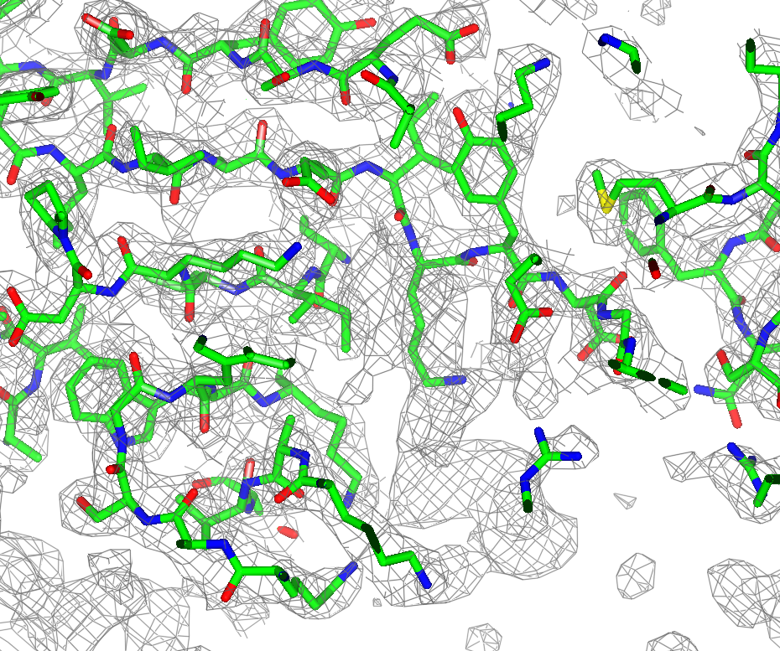
The task of ligand fitting
The data is modelled in terms of a protein ...

Slide 5
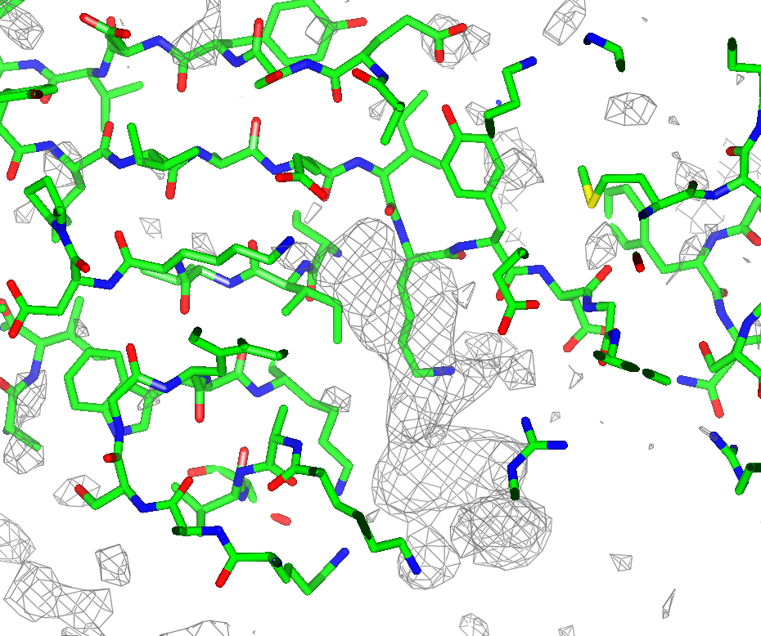
The task of ligand fitting
…but there is excess density at the end not accounted for…

Slide 6
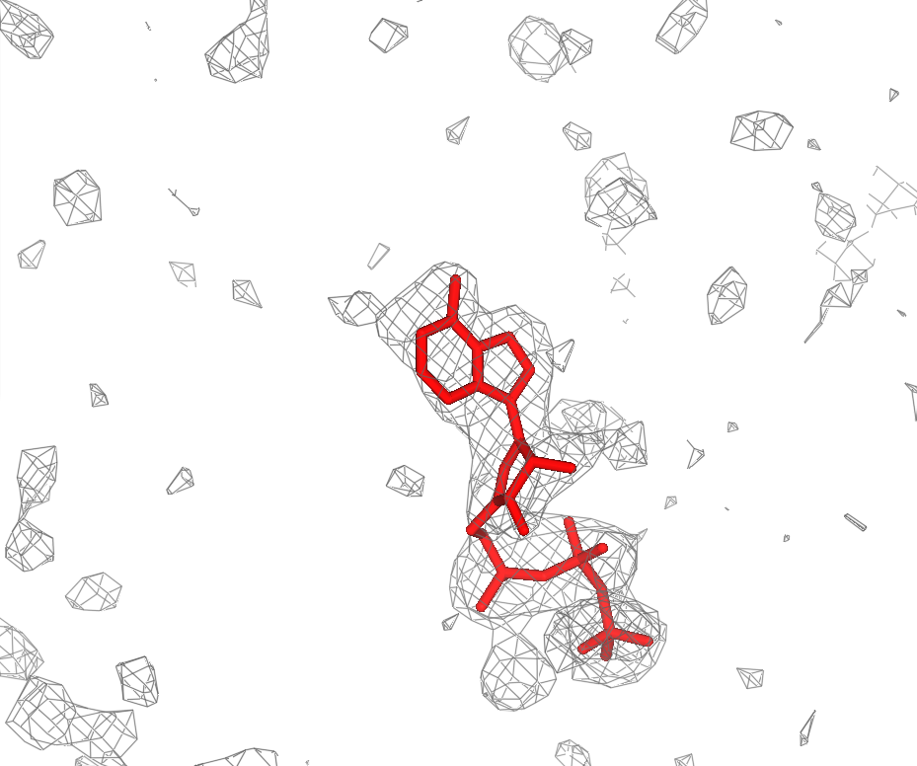
The task of ligand fitting
…which is where the ligand should go.

Slide 7
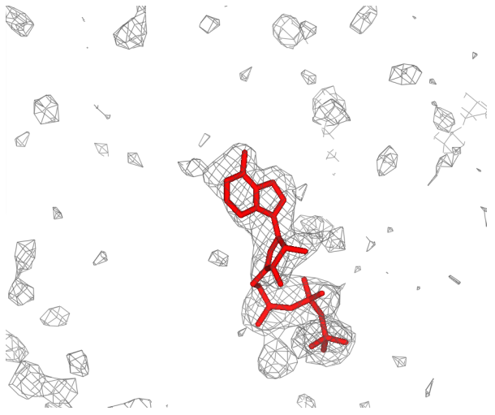
The task of ligand fitting
Challenges to be addressed...
Different resolutions and data quality
Different ligand complexity/topology
Partial disorder of a ligand
Different ligands at the same site?

Slide 8
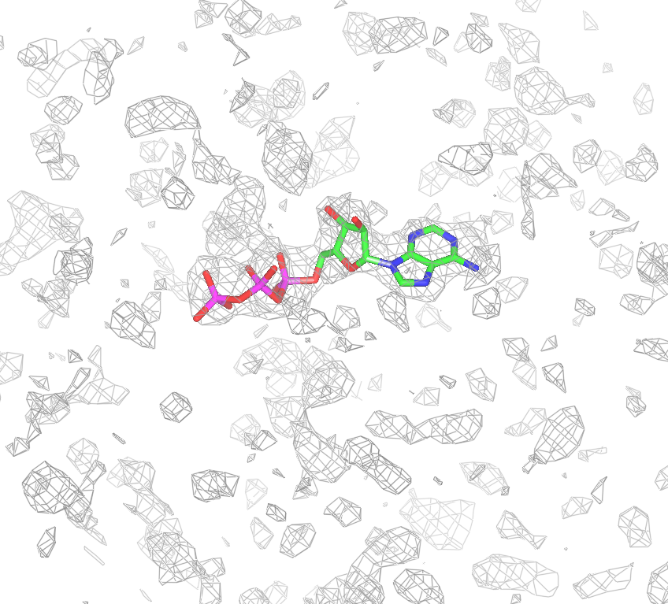
The workflow of ligand fitting in ARP/wARP
Organised as a pipeline of core modules for specific sub-tasks following an intuitive approach:
Prepare
Identify binding site and/or
ligand.
Sparse density map and
generate ligand topology.
Construct
Construct ensemble of
ligand models in
plausible conformations
to fit sparsed density.
Refine
Refine ligand coordinates to
satisfy geometric constraints
and to maximise fit to density.
Choose best model.

Slide 9
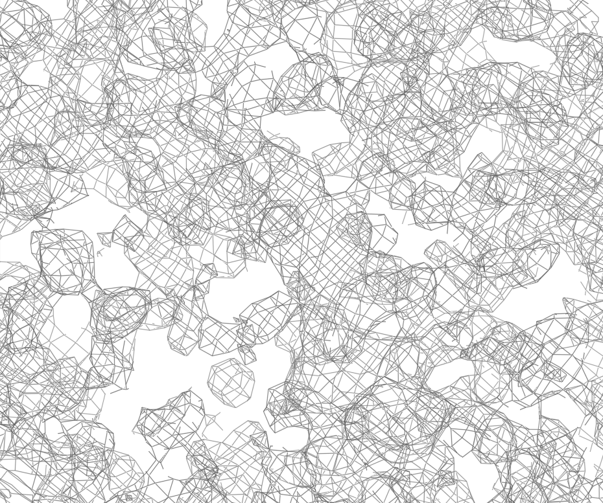
Automatic binding site identification
The difference density map at a low contour threshold.

Slide 10
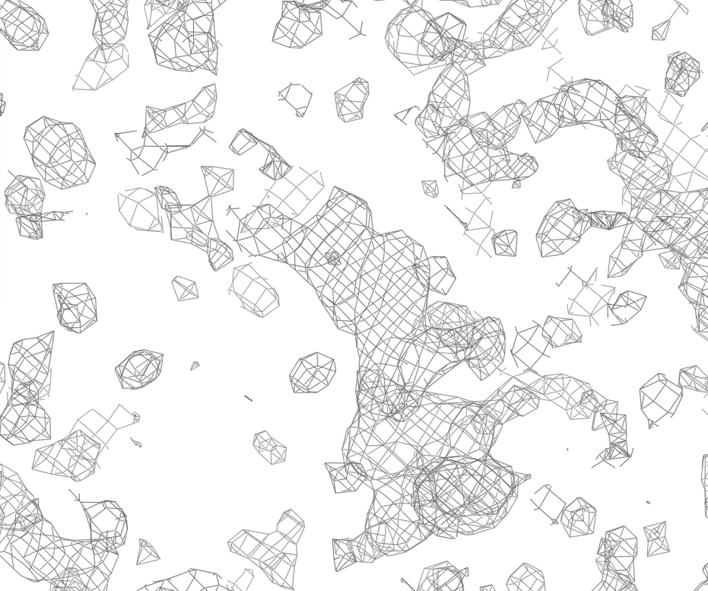
Automatic binding site identification
The difference density map at a medium contour threshold.

Slide 11
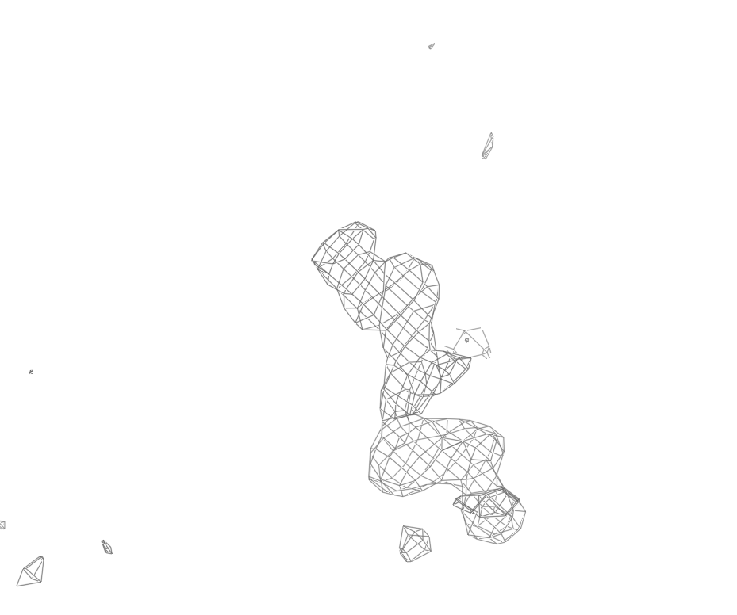
Automatic binding site identification
The difference density map at a high contour threshold.

Slide 12
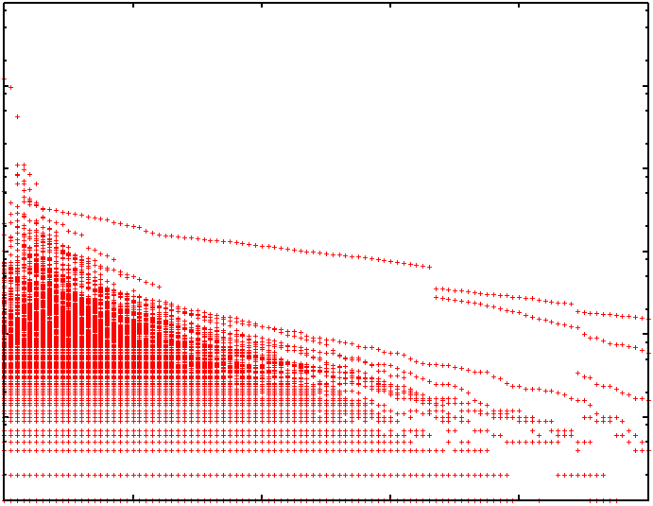
Automatic binding site identification
Capturing the dependence of the difference density map on changing the contour thresholds: Fragmentation tree.
10⁵
10⁴
10³
Cluster volume [Å³]
10²
10¹
10⁰
10⁻¹
1
2
3
4
5
6
Contour threshold [σ]

Slide 13
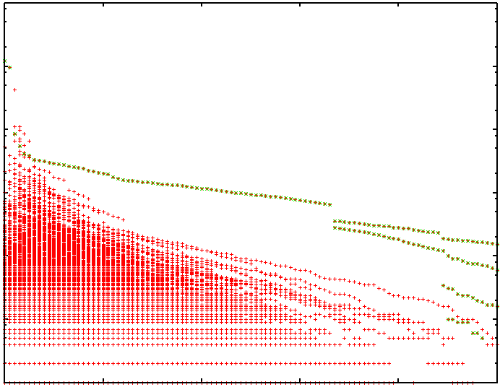
Automatic binding site identification
Capturing the dependence of the difference density map on changing the contour thresholds: Fragmentation tree.
10⁵
10⁴
Deposited
Ligand
10³
Cluster volume [Å³]
10²
10¹
10⁰
10⁻¹
1
2
3
4
5
6
Contour threshold [σ]

Slide 14

Automatic binding site identification
Capturing the dependence of the difference density map on changing the contour thresholds: Fragmentation tree.
10⁵
10⁴
Selection
10³
Cluster volume [Å³]
10²
10¹
10⁰
10⁻¹
1
2
3
4
5
6
Contour threshold [σ]

Slide 15
Constructing the ligand
To address more broadly the different ligand sizes and complexities encountered, to increase the robustness of the software...
2 separate construction methods get used:
Label swapping on the sparsed grid
Metropolis search in conformation space

Slide 16
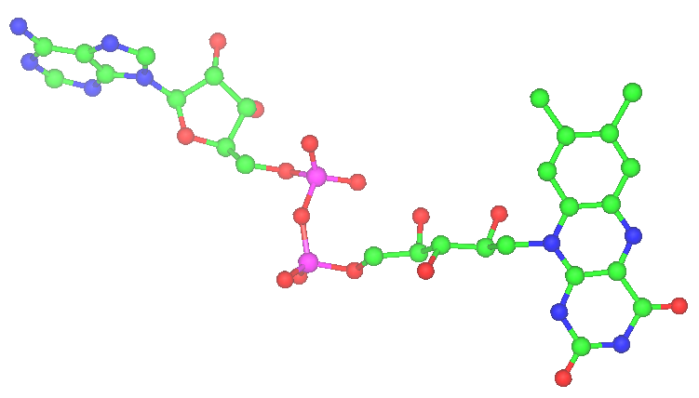
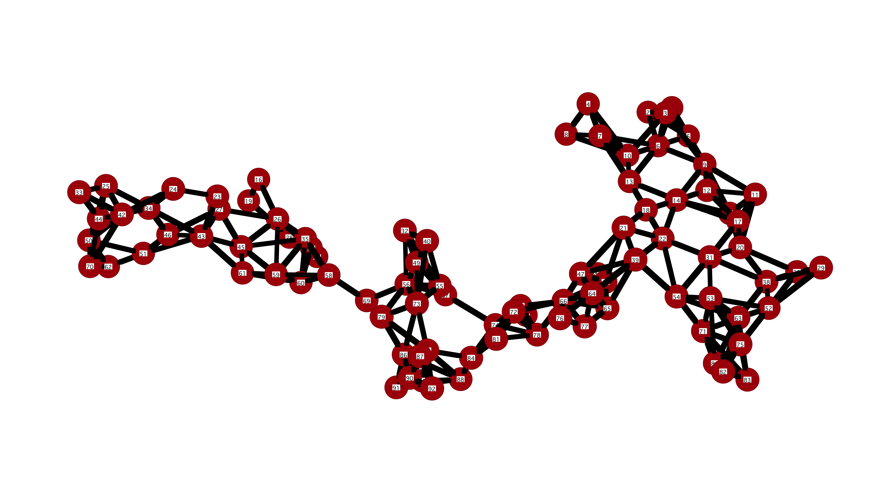
Constructing the ligand: Graph search
Uses the sparse grid representation of the electron density at the chosen binding site & topology of known ligand.
Knowledge about ligand
Knowledge about grid
Connectivity
Distances
Angles
Chirality
Connectivity
Distances
Density
NO IDENTITIES!
FAD
Grid

Slide 17
Constructing the ligand: Graph search
‘Label swapping’
The ligand is expanded on the sparse density preserving
connectivities.
Every dummy ‘atom’ of the sparse grid is tried as a start point.
An exhaustive graph search is performed.
Models are scored by their fit to density and expected
stereochemical features.
Start atom

Slide 18
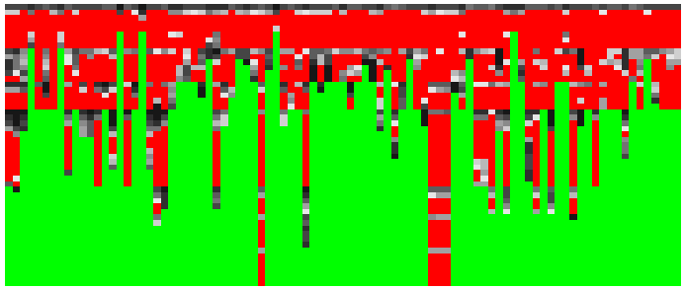
Constructing the ligand: Graph search
Index of starting grid point
No of ligand atoms placed
Dead
branches
Start atom
Surviving start points

Slide 19
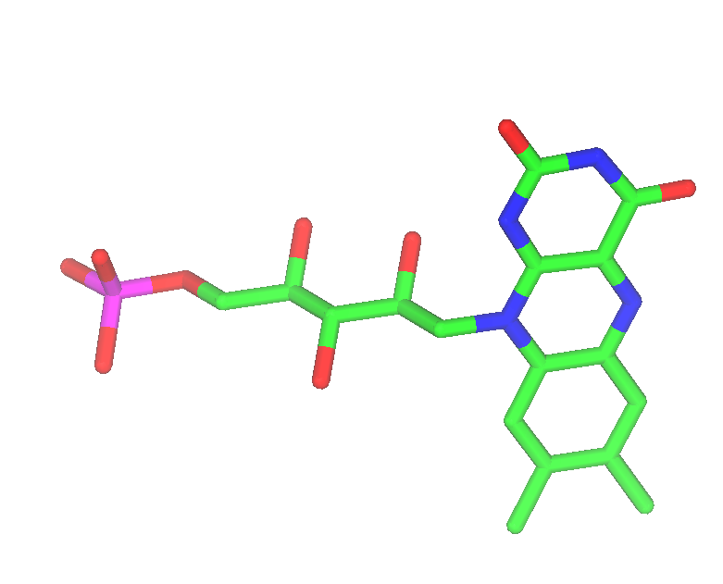
Constructing the ligand: Metropolis search
Perform a random walk in parameter space biased towards the optimum of a score function.
Parameter space: Position, Orientation and Conformation.
Score function: ‘Pseudo’ map correlation.
Advantage: Less degrees of freedom.
Rigid groups
Rotatable bonds

Slide 20
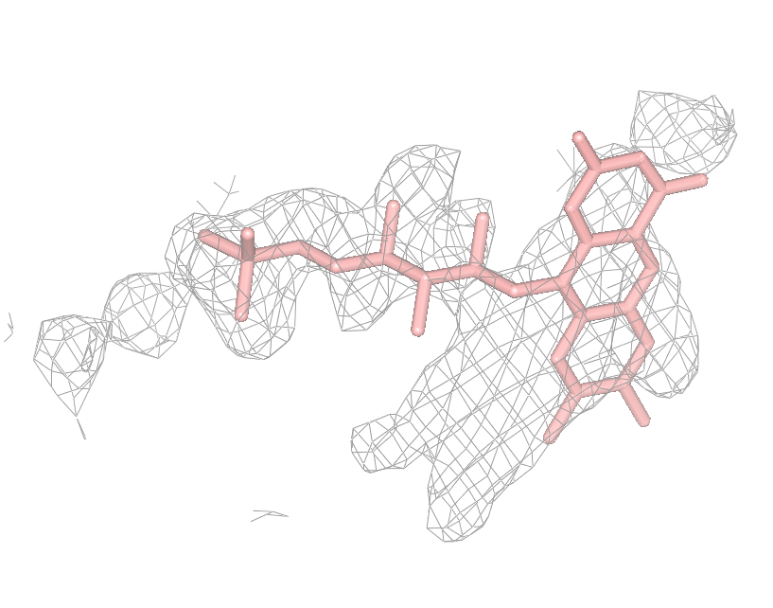
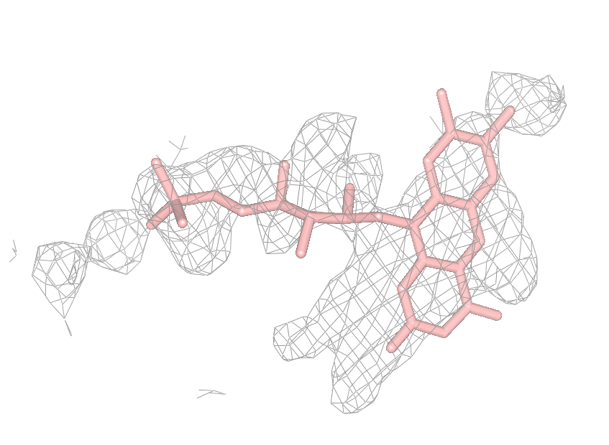
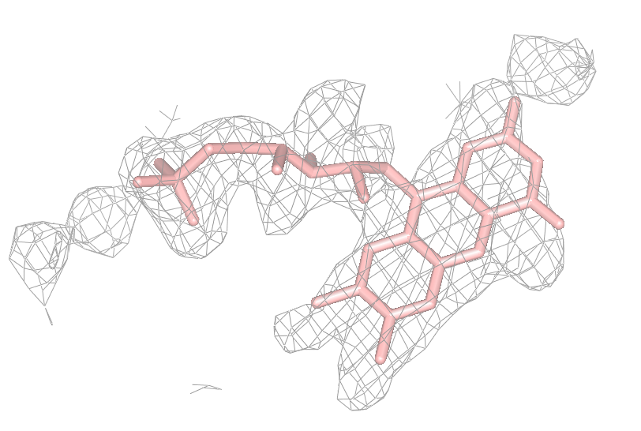
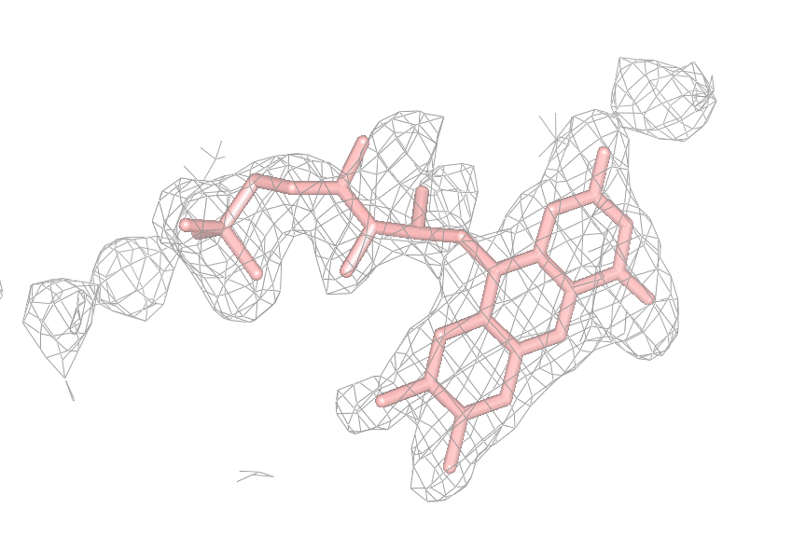
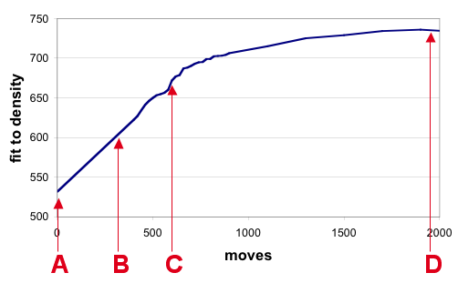
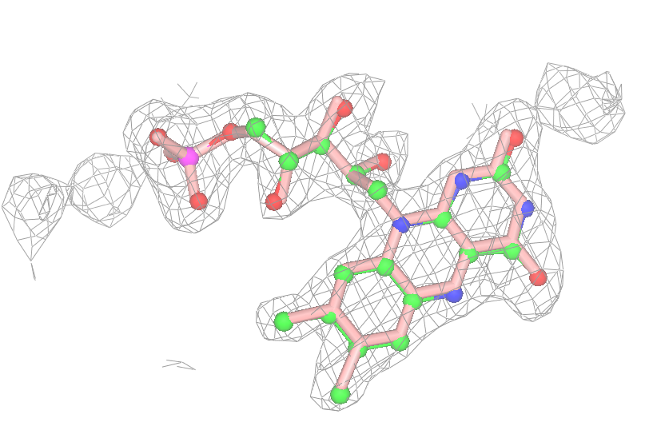
Construction with a Metropolis method
The evolution of a model during a metropolis optimisation.
A
B
C
D
FMN to 1jqv at 2.1Å: 0.23Å rmsd.
Final result: 9000 moves + refinement

Slide 21
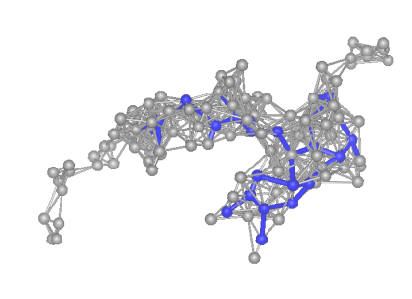
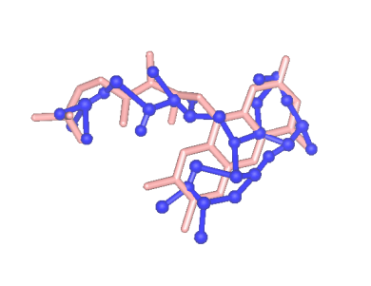
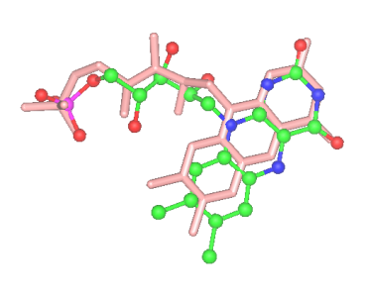
Real space refinement
Uses the full density and topology information
Employs a gradient method to optimise fit to density
and ligand geometry simultaneously

Slide 22
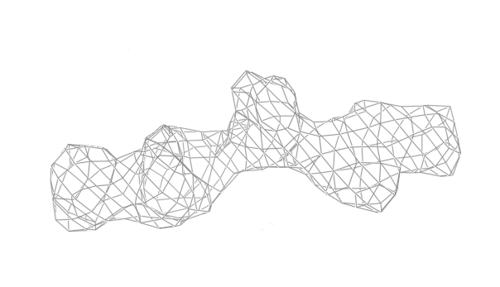
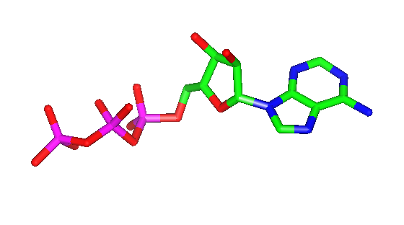
The protocol of a modeling task
Fundamental initial knowledge determines the protocol.
Binding site
1 density cluster
1 ligand
known
unknown
X
known
Ligand identity
unknown

Slide 23
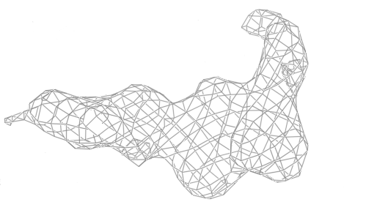
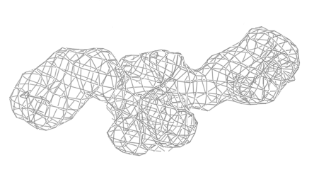
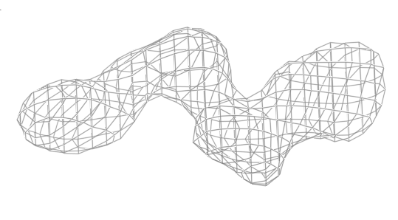
The protocol of a modeling task
Fundamental initial knowledge determines the protocol.
N density clusters
Binding site
1 ligand
known
unknown
X
known
Ligand identity
unknown

Slide 24
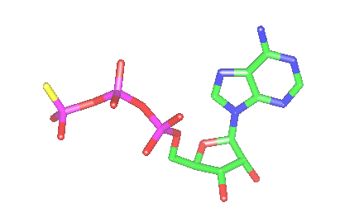
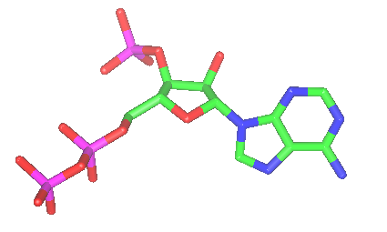
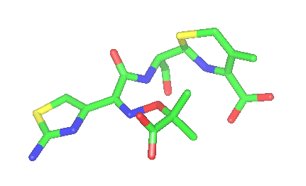
The protocol of a modeling task
Fundamental initial knowledge determines the protocol.
N ligand candidates
Binding site
1 density cluster
known
unknown
known
Ligand identity
X
unknown
…

Slide 25
The protocol of a modeling task
Fundamental initial knowledge determines the protocol.
N density clusters
N ligand candidates
Binding site
known
unknown
known
Ligand identity
X
unknown
…
…

Slide 26
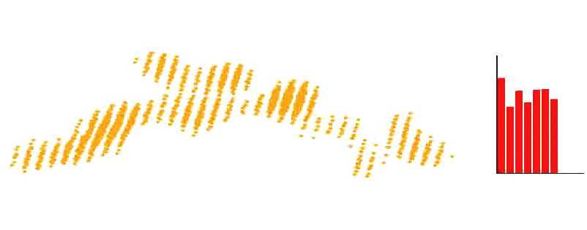
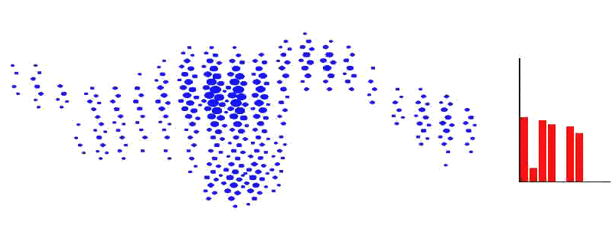
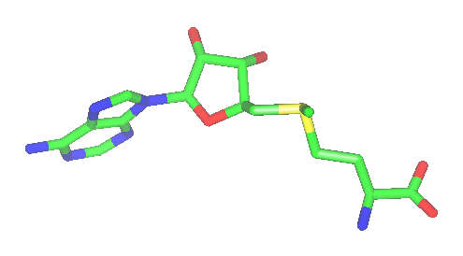
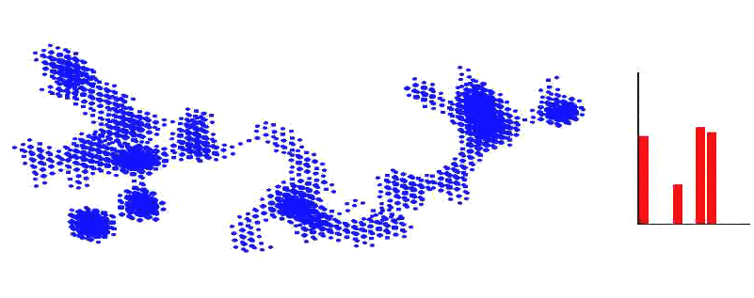
Shape features to measure similarity
To assign a likelihood to a site knowing the ligand.
Surface to volume ratio
Bounding box limits
Moments of inertia
Rotation match score
Eigenvalues
Distance histogram
Geodesic distance histogram
1 2 3 4 5 6 7
Find the matching cluster for this ligand!
1 2 3 4 5 6 7
1 2 3 4 5 6 7
Decision is based on feature vectors.

Slide 27
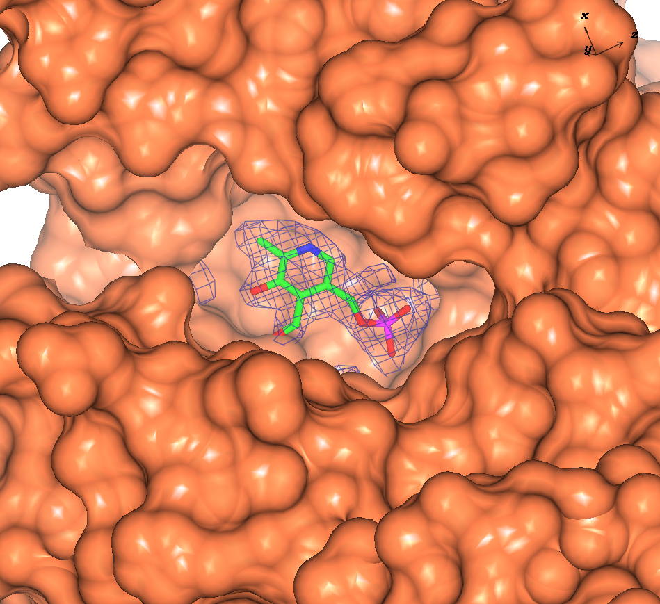
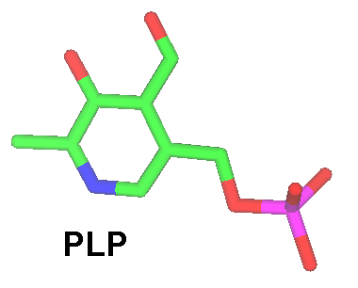
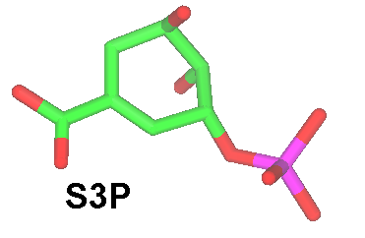
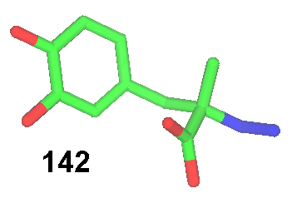
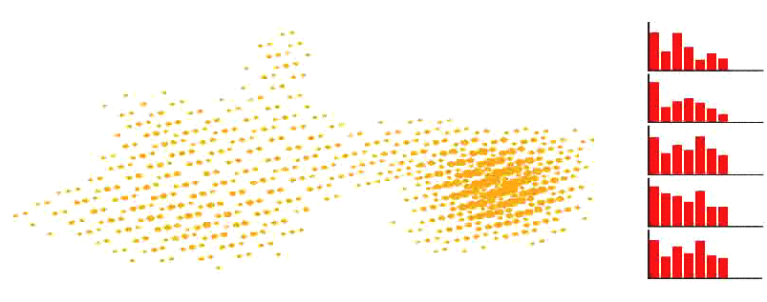
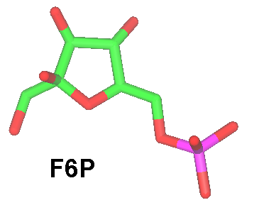
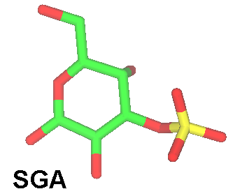
Shape features to measure similarity
To assign a likelihood to a ligand knowing the binding site.
Final ligand ranking

Slide 28
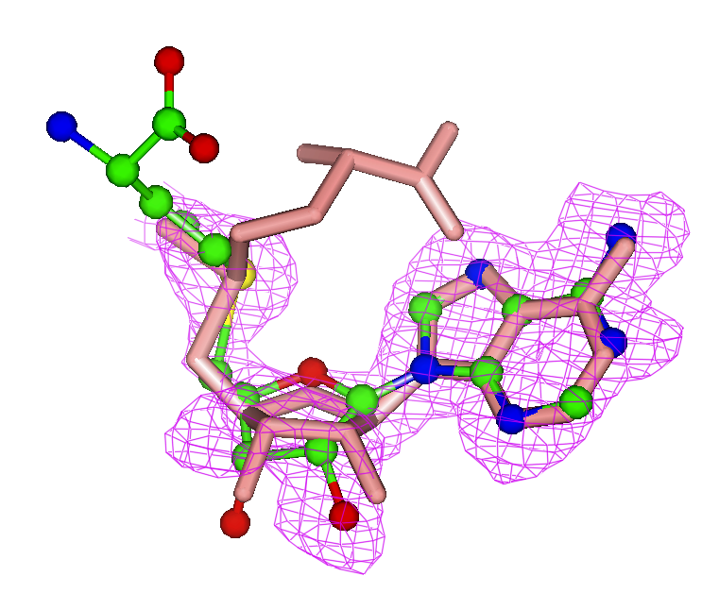
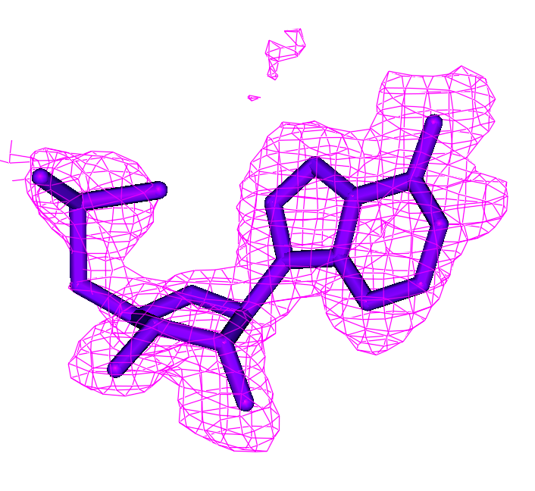
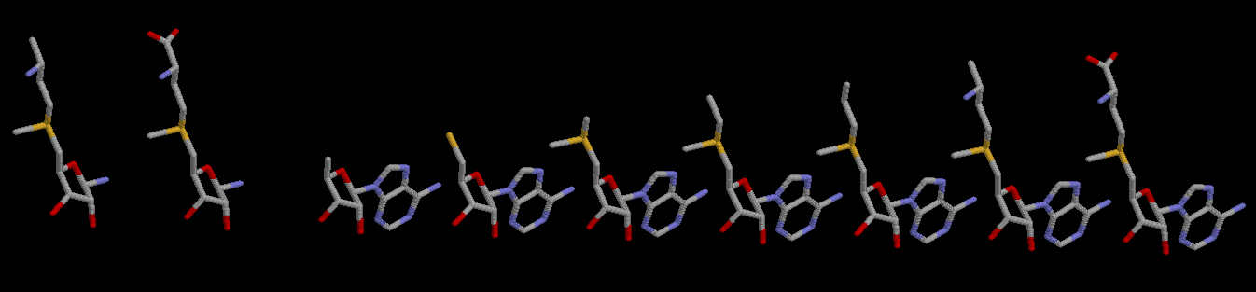
Partial disorder, partially occupied ligands
Deposited in PDB
Built automatically
with ARP/wARP when
the full ligand is given
SAM in 1v2x at 1.5Å
Compound chosen in
cocktail case
Artificial cocktail:

Slide 29
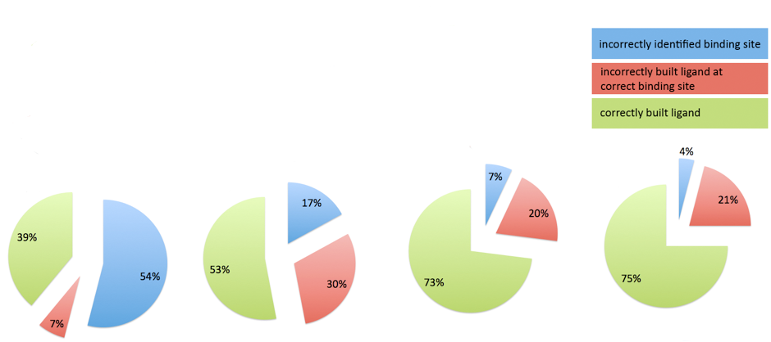
Success rates
Tested on > 20k PDB entries from EDS
X-ray resolution limits: 1.0 to 3.0Å,
Building the largest fully occupied ligand.
Correctness criterion: rmsd < 1.0Å
(Current Version 7.2)
5…6 atoms,
any map corr.
7…100 atoms,
any map corr.
10…40 atoms,
map corr. > 80%
20…40 atoms,
map corr. > 80%

Slide 30
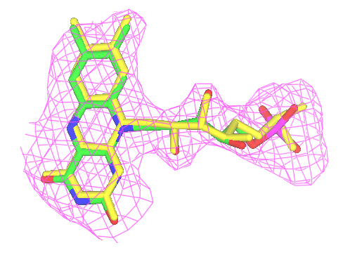



Success criterion: r.m.s.d. < 1.0Å
Correct
Correct
rmsd=0.4Å
rmsd=1.0Å
Incorrect
Incorrect
rmsd=1.5Å
rmsd=1.8Å
In yellow: the deposited ligand

Slide 31






Going forward - High throughput ligand identification
Segmentation
Projection/normalisation
Density map (or otherwise surface of protein pocket)
Calculation of shape descriptors e.g. Zernike moments
Ranking
Comparison
Ligand
Database

Slide 32


The ATOLL Database
Descriptor calculation for template and comparison with database values
User-uploaded template
Hits

Slide 33

Running a task through the CCP4 interface
The ligand building as part of ARP/wARP has its own GUI.
Protocol
Diffraction data
Protein without
ligand
Template ligand
Jobs can also be run from the command line! Series of jobs can be run this way.

Slide 34

Running a task from the command line
Series of jobs can be run this way easily.
to launch the
job with the
default scenario
only 3 files are
needed.

Slide 35

Ligand building with arpnavigator

Slide 36



Acknowledgements
Developers
EMBL Hamburg: Ciaran Carolan, Philipp Heuser, Victor Lamzin, Tim Wiegels, Saul Hazledine
NKI Amsterdam: Krista Joosten, Robbie Joosten, Tassos Perrakis
Collaborators
EMBL Hamburg: Gleb Bourenkov, Santosh Panjikar
York University: Garib Murshudov’s group
Daresbury Laboratory: CCP4 team
Funding
Former members
Gerrit Langer, Richard Morris, Peter Zwart, Francisco Fernandez, Matheos Kakaris, Olga Kirillova, Wijnand Mooij, Diederick De Vries, Marouane Ben Jelloul, Johan Hattne, Tilo Strutz, Guillaume Evrard, Serge Cohen, Venkat Parthasarathy, Babu Pothineni, Helene Doerksen

