Slide 1
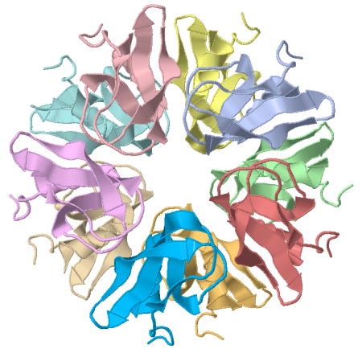
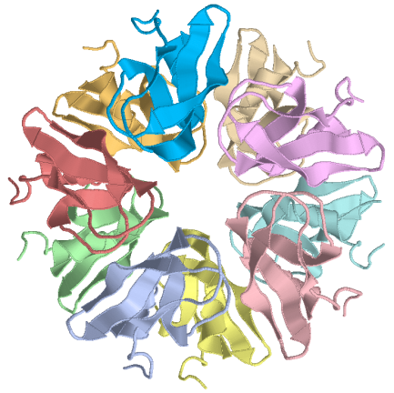
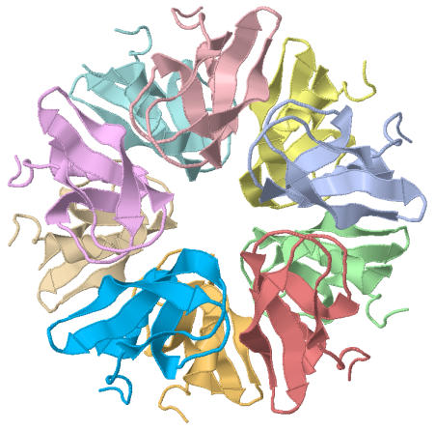
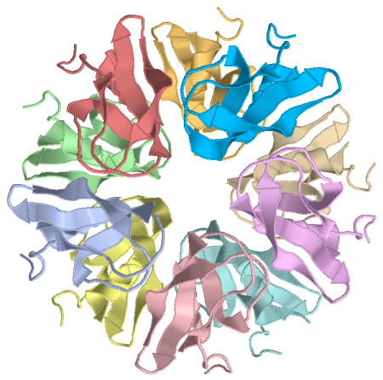
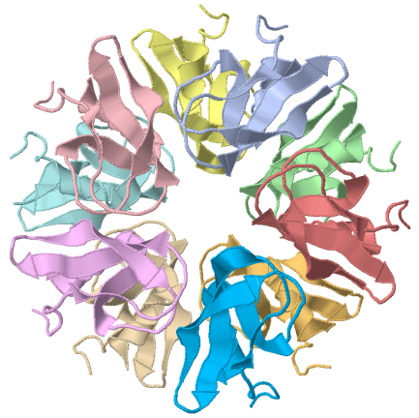
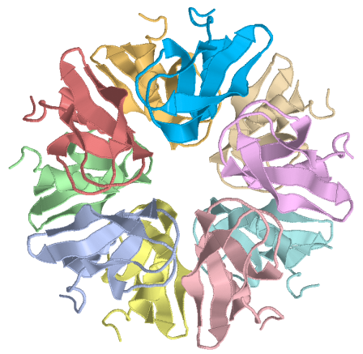
Macromolecular Complexes
in Crystals and Solutions
Eugene Krissinel
CCP4, STFC Research Complex at Harwell
Didcot, United Kingdom
krissinel@googlemail.com
E. Krissinel and K. Henrick (2007) J. Mol. Biol. 372, 774-797
E. Krissinel (2010) J. Comp. Chem. 31, 133-143
CCP4 Study Weekend, Nottingham, UK, 7-8 January 2010

Slide 2
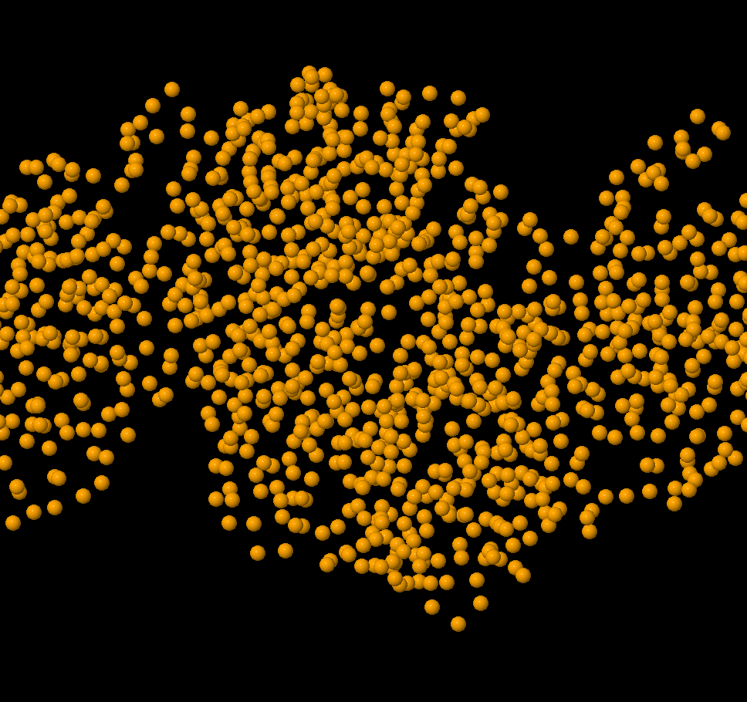

Slide 3
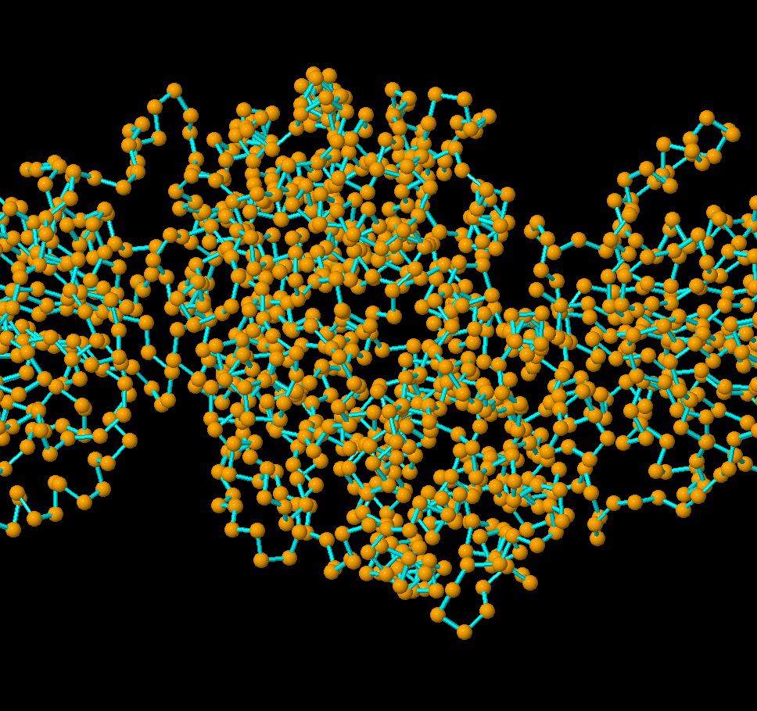

Slide 4
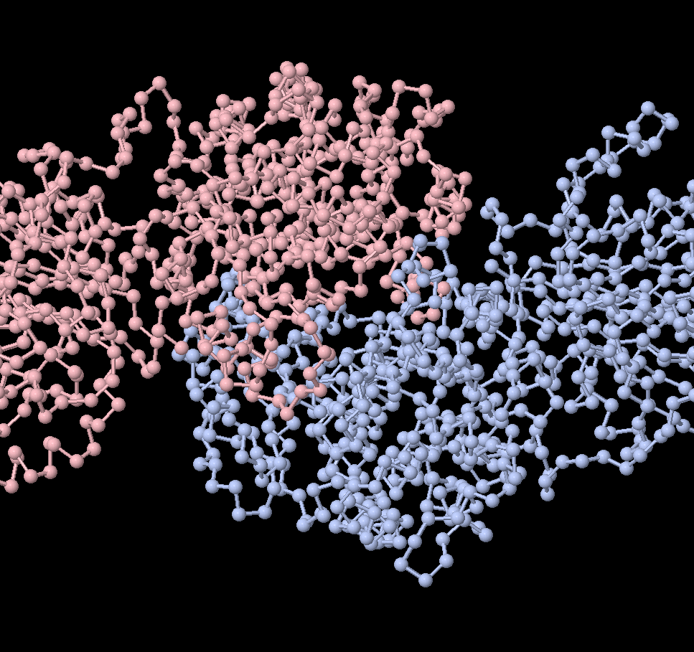

Slide 5
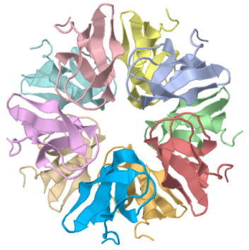
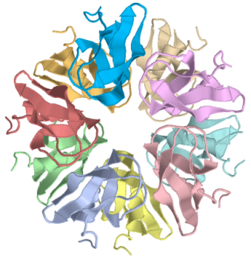
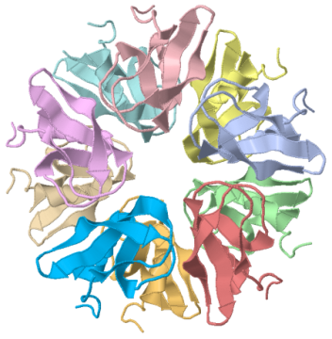
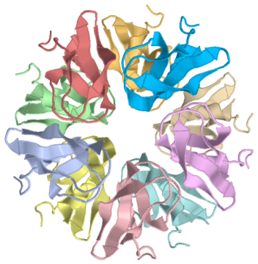
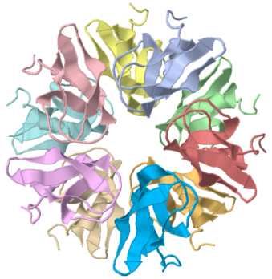
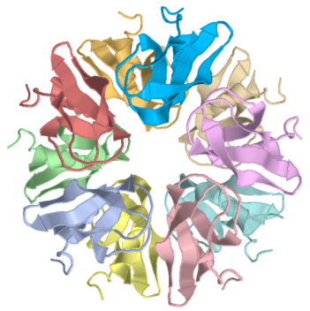
Structural Biology From Crystals
Why do we want to know structure of a macromolecule?
- for many things, but probably firstly for finding out how it interacts with other molecules
Macromolecular crystals present us with models of biological structures and their interactions
“if you want to know how A interacts with B – crystallize them together!” (crystallographer’s sweet dream)

Slide 6
Structural Biology From Crystals
Crystals present us with both real and artifactual interactions, which may be difficult to differentiate. Often used techniques:
Theoretical: Sharp Eye and Scientific Authority
Rules of thumb: e.g. manifestation in different crystal forms
Experimental: Complementing studies (EM, NMR, scattering)
Bioinformatical: Homology and interface similarity analysis
Computational: Energy estimates and modelling
PISA software infers significant interactions and macromolecular assemblies from crystals by evaluating their free Gibbs energy:
A decamer?
or a dimer?
http://www.ebi.ac.uk/msd-srv/prot_int/pistart.html

Slide 7
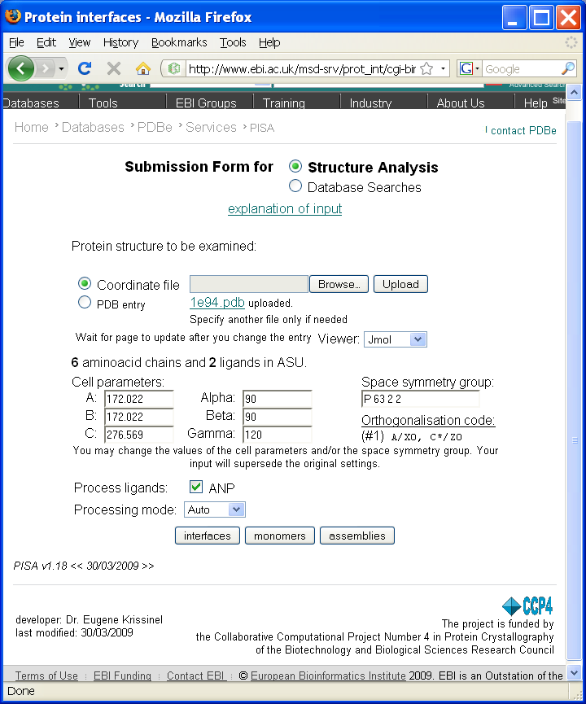
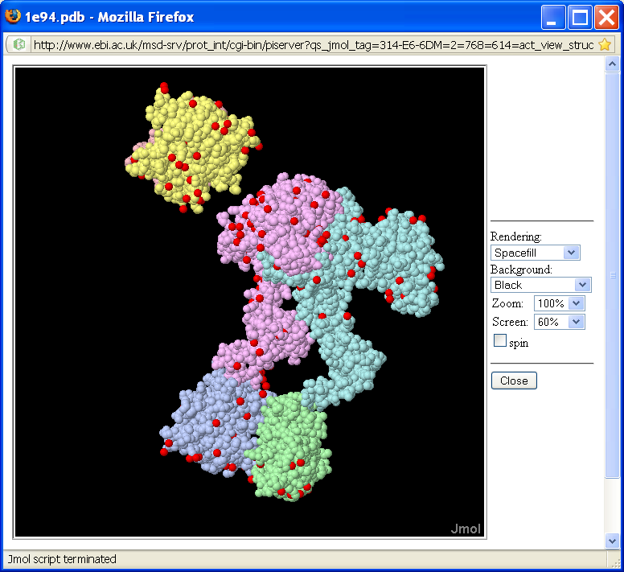

Slide 8
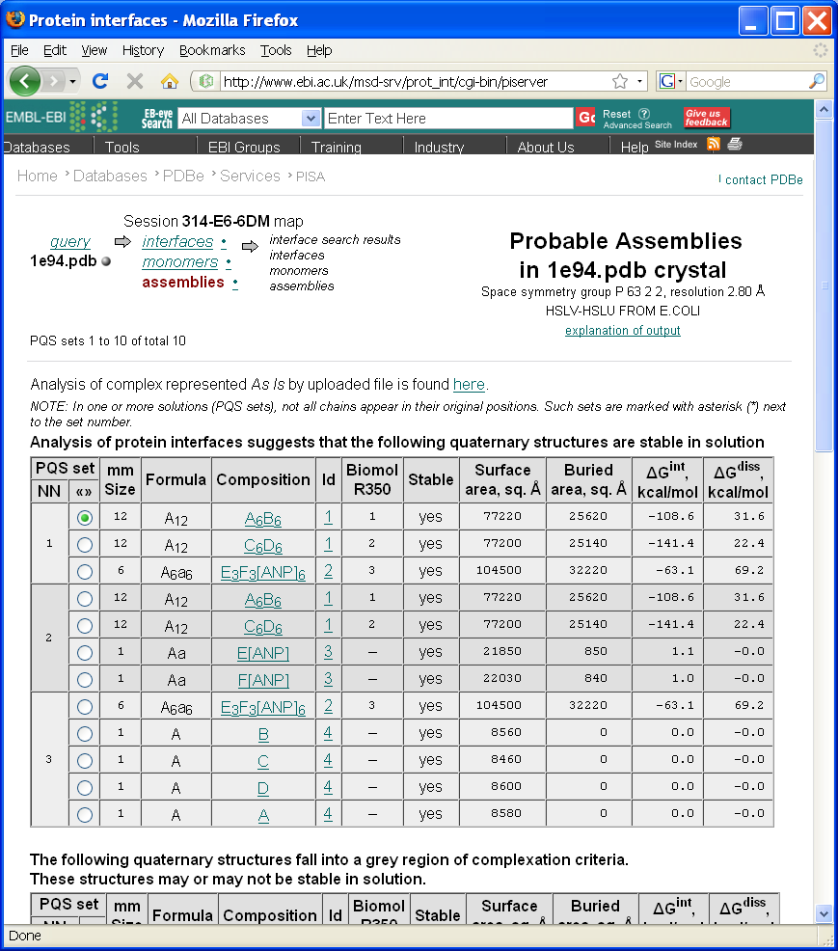
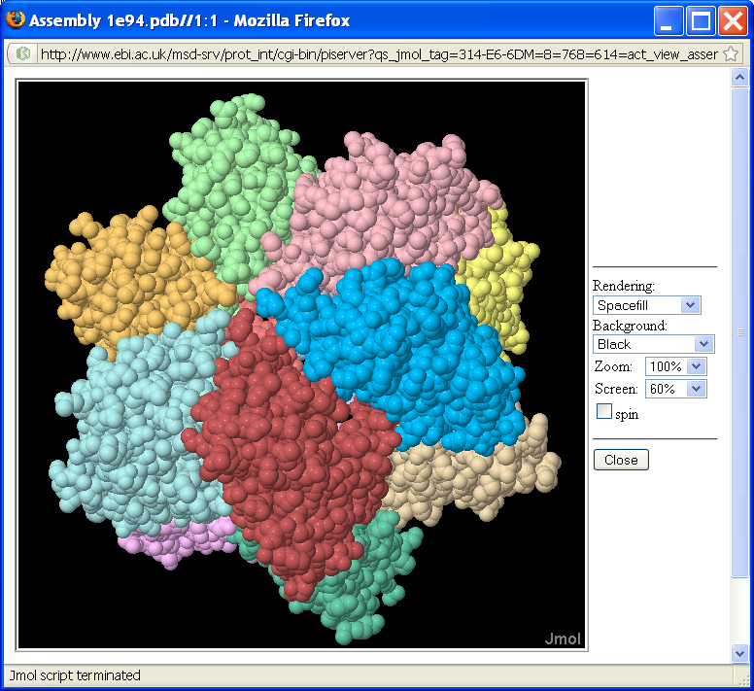
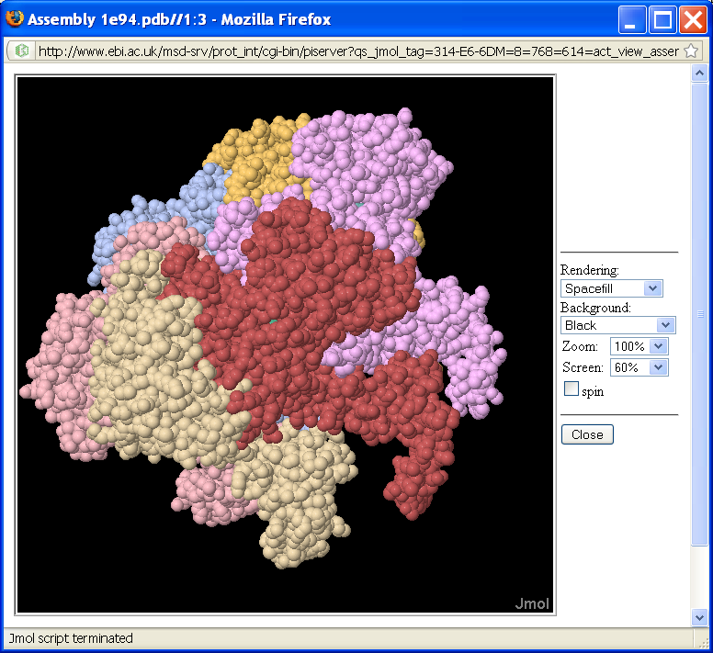

Slide 9
Detection of Biological Units in Crystals: PISA Summary
Enumerate all possible assemblies in crystal packing, subject to crystal properties: space symmetry group, geometry and composition of Asymmetric Unit
Achieved with Graph Theory techniques, by representing a crystal as an infinite periodic graph of connected macromolecules
Evaluate assemblies for chemical stability:
Leave only sets of stable assemblies in the list and range them by chances to be a biological unit :
Larger assemblies take preference
Single-assembly solutions take preference
Otherwise, assemblies with higher ΔG_{diss} take preference
E. Krissinel and K. Henrick (2007) J. Mol. Biol. 372, 774-797

Slide 10
Classification of protein assemblies
Assembly classification on the benchmark set of 218 protein structures published in
Ponstingl, H., Kabir, T. and Thornton, J. (2003) Automatic inference of protein quaternary structures from crystals. J. Appl. Cryst. 36, 1116-1122.
 | 1mer | 2mer | 3mer | 4mer | 6mer | Other | Sum | Correct
1mer | 49 | 3 | 0 | 1 | 1 | 1 | 55 | 89%
2mer | 3 | 71+11 | 0 | 2+1 | 0 | 0 | 76+12 | 93%
3mer | 1 | 0 | 22 | 0 | 1 | 0 | 24 | 92%
4mer | 2 | 2+1 | 0 | 26+6 | 0 | 1 | 31+7 | 84%
6mer | 0 | 0 | 0 | 0+1 | 10+2 | 0 | 10+3 | 92%
 |  |  |  |  |  | Total: | 196+22 | 90%
196+22 <=> 196 homomers and 22 heteromers
Classification error in : ± 5 kcal/mol

Slide 11
Classification of protein-DNA complexes
Assembly classification on the benchmark set of 212 protein – DNA complexes published in
Luscombe, N.M., Austin, S.E., Berman H.M. and Thornton, J.M. (2000) An overview of the structures of protein-DNA complexes. Genome Biol. 1, 1-37.
 | 2mer | 3mer | 4mer | 5mer | 6mer | 10mer | Other | Sum | Correct
2mer | 1 | 0 | 0 | 0 | 0 | 0 | 0 | 1 | 100%
3mer | 6 | 96 | 0 | 0 | 1 | 0 | 2 | 105 | 91%
4mer | 0 | 2 | 83 | 0 | 0 | 0 | 0 | 85 | 98%
5mer | 0 | 0 | 2 | 3 | 0 | 0 | 0 | 5 | 60%
6mer | 1 | 0 | 0 | 0 | 13 | 0 | 1 | 15 | 87%
10mer | 0 | 0 | 0 | 0 | 0 | 1 | 0 | 1 | 100%
 |  |  |  |  |  |  | Total: | 212 | 93%
Classification error in : ± 5 kcal/mol

Slide 12
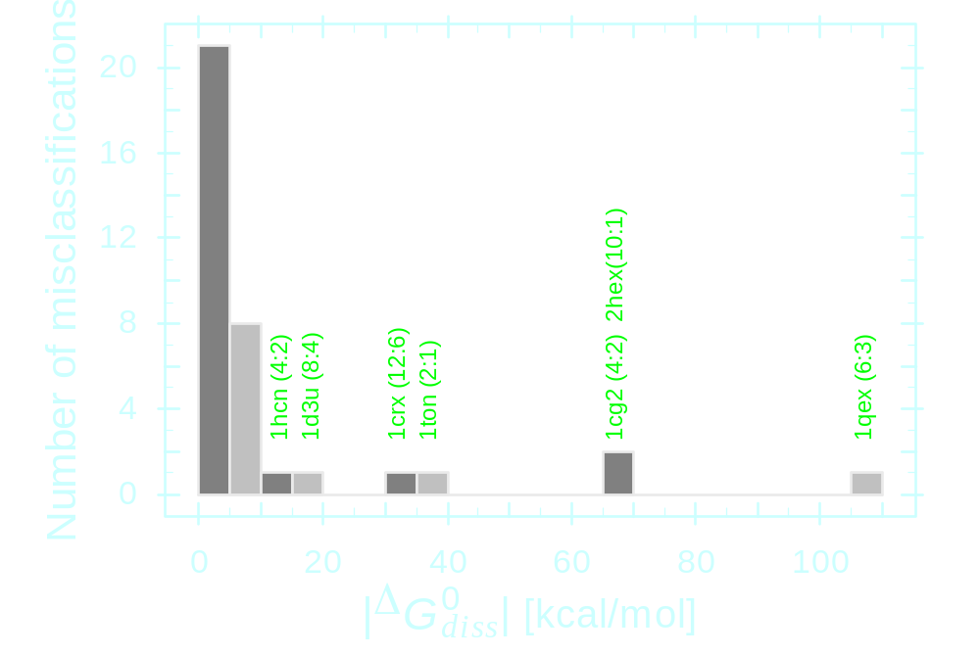
Free energy distribution of misclassifications

Slide 13
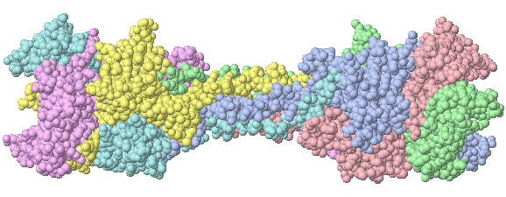
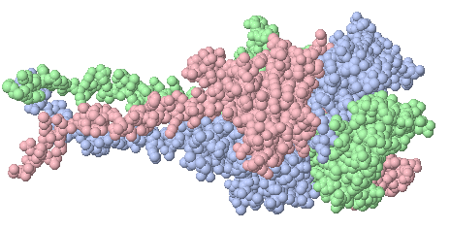
Example of misclassification: 1QEX
BACTERIOPHAGE T4 GENE PRODUCT 9 (GP9), THE TRIGGER OF TAIL CONTRACTION AND THE LONG TAIL FIBERS CONNECTOR
Predicted: homohexamer
Dissociates into 2 trimers
≈ 106 kcal/mol
Biological unit: homotrimer
Dissociates into 3 monomers
≈ 90 kcal/mol

Slide 14
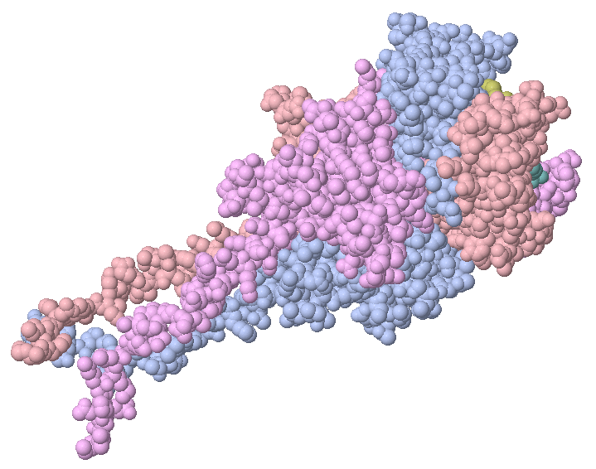
Example of misclassification: 1QEX
BACTERIOPHAGE T4 GENE PRODUCT 9 (GP9), THE TRIGGER OF TAIL CONTRACTION AND THE LONG TAIL FIBERS CONNECTOR
Rossmann M.G., Mesyanzhinov V.V., Arisaka F and Leiman P.G. (2004) The bacteriophage T4 DNA injection machine. Curr. Opinion Struct. Biol. 14:171-180.

Slide 15
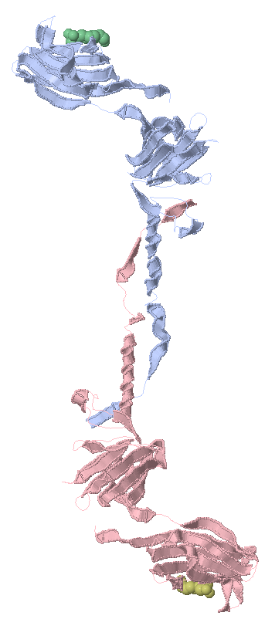
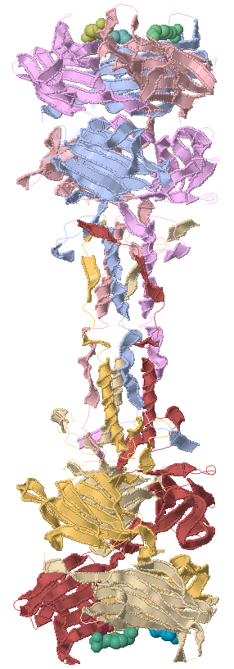
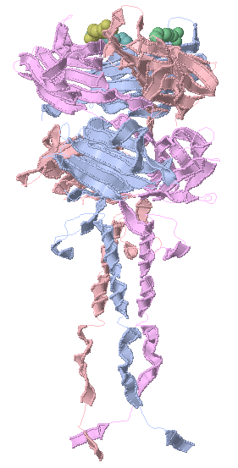
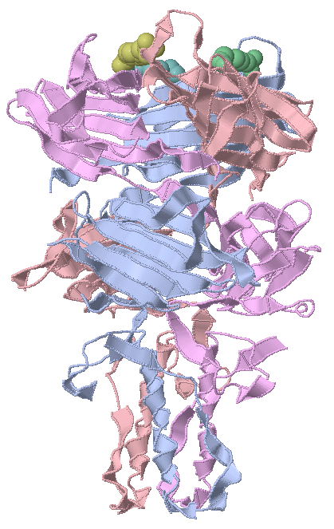
Example of misclassification: 1QEX
BACTERIOPHAGE T4 GENE PRODUCT 9 (GP9), THE TRIGGER OF TAIL CONTRACTION AND THE LONG TAIL FIBERS CONNECTOR
1S2E trimer
Correct mainchain tracing
Classed correctly
1QEX trimer
Wrong mainchain tracing!
1QEX hexamer

Slide 16
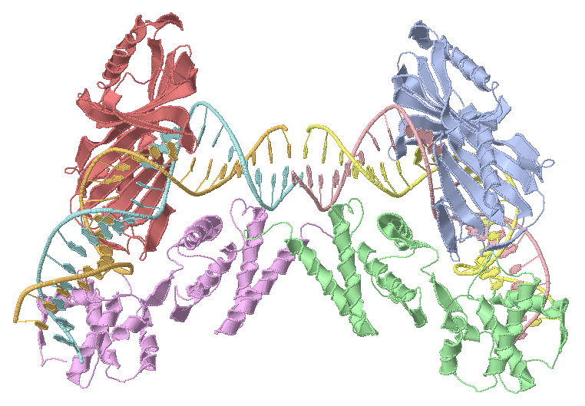
Example of misclassification: 1D3U
TATA-BINDING PROTEIN / TRANSCRIPTION FACTOR
Predicted: octamer
Dissociates into 2 tetramers
≈ 20 kcal/mol
Functional unit: tetramer

Slide 17
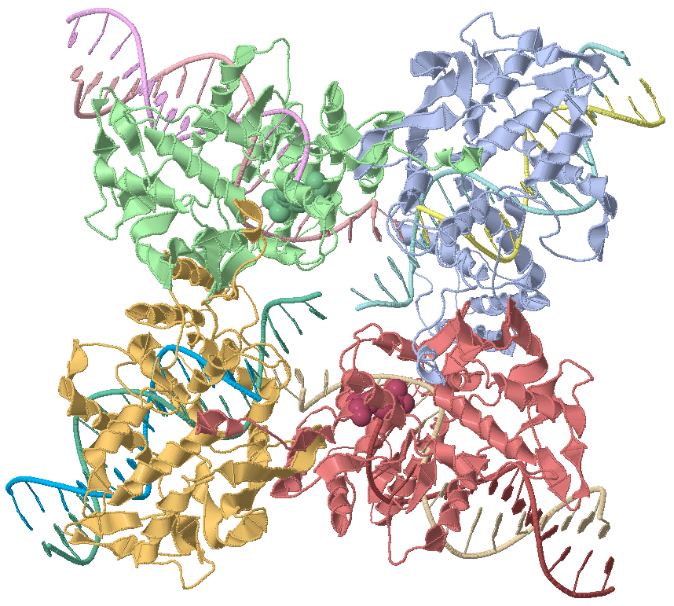
Example of misclassification: 1CRX
CRE RECOMBINASE / DNA COMPLEX REACTION INTERMEDIATE
Predicted: dodecamer
Dissociates into 2 hexamers
≈ 28 kcal/mol
Functional unit: trimer

Slide 18
Example of misclassification: 1CRX
CRE RECOMBINASE / DNA COMPLEX REACTION INTERMEDIATE
Guo F., Gopaul D.N. and van Duyne G.D. (1997)
Structure of Cre recombinase complexed with DNA in a site-specific recombination synapse.
Nature 389:40-46.

Slide 19
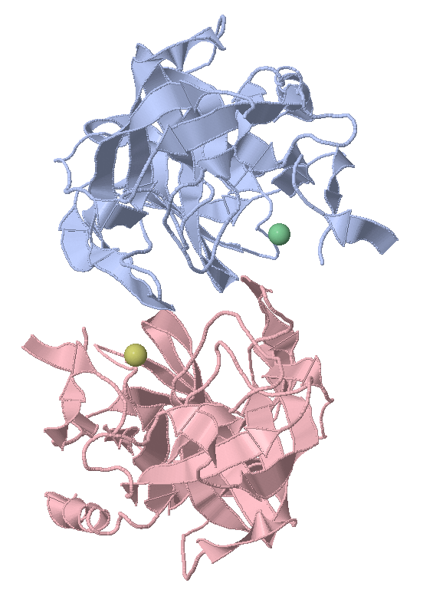
Example of misclassification: 1TON
TONIN
Predicted: dimer
Dissociates at
≈ 37 kcal/mol
Biological unit: monomer
Apparent dimerization is an artefact due to the presence of Zn⁺² ions added to the buffer to aid crystallization. Removal Zn from the file results in ≈ 3 kcal/mol
Fujinaga M., James M.N.G. (1997) Rat submaxillary gland serine protease, tonin structure solution and refinement at 1.8 Å resolution. J.Mol.Biol. 195:373-396.

Slide 20
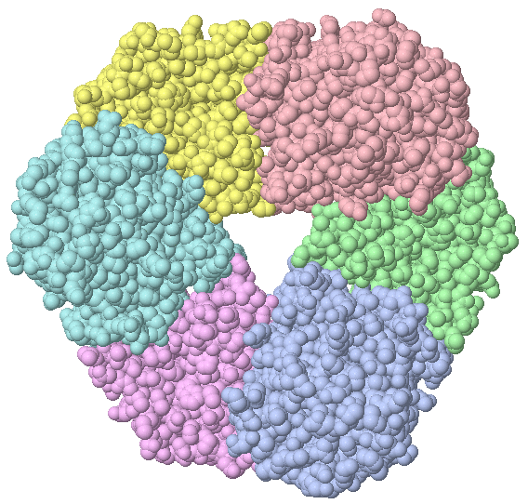
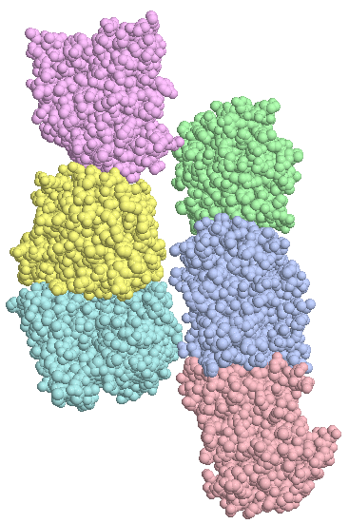
Example of misclassification: 1YWK
Structural homologue 1XRU:
RMSD ≈ 0.9 Å
Seq.Id ≈ 50% Homohexameric with ΔG_{diss}≈ 9.3 kcal/mol
Predicted: homohexameric
ΔG_{diss}≈ 4.4 kcal/mol
dissociating into 3 dimers
Believed to be:
monomeric
6 units in ASU

Slide 21


Choice of ASU

Slide 22
Example of misclassification: 1YWK
Structural homologue 1XRU:
RMSD ≈ 0.9 Å
Seq.Id ≈ 50% Homohexameric with ΔG_{diss}≈ 9.3 kcal/mol
Predicted: homohexameric
ΔG_{diss}≈ 4.4 kcal/mol
dissociating into 3 dimers
Believed to be:
monomeric
6 units in ASU

Slide 23
Why does it work?
The problem with PISA is that, apparently, it works well
90% success rate achieved on the benchmark set
Feedback from PDB and MSD curators suggests that 90%-95% of PISA classifications agree with intuitive and common-sense considerations
Mandatory processing tool at wwPDB since 2007
Average 3 citations/week
User feedback is encouraging
Two possible reasons for PISA to work well:
obviously wrong
Energy models and calculations are quite accurate
PISA relies heavily on geometry of interactions given by crystal structure. PISA does not dock structures; rather, it uses “nature’s dockings” assuming that they are correct. In essence, it exploits a combination of chemistry and crystal informatics.
probably correct

Slide 24
If this is all about crystal informatics, then ...
Apparently, PISA gives a reasonably good solution for crystal environment
But what is the relation between “natural” and crystallized structures?
Do crystals always (or most probably) give correct geometry of interactions?
Do crystals always give correct (i.e. “natural”) structures and complexes?
Can crystals misrepresent structures and interactions?
If yes, how such a case may be identified?

Slide 25
Distortion and Re-assembly
Crystal optimizes energy of the whole system, therefore it may sacrifice biologically relevant interactions to the favour of unspecific contacts
Distortion
Re-assembly
Probably, distortions are always there
There is a chance for re-assembly if interaction is weak

Slide 26
Docking experiment
Objectives:
to find out whether PISA models can give geometry of interactions
to identify conditions for complex distortion and re-assembly
Idea: attempt to reproduce crystal dimers
geometry optimized by crystal – no conformation modelling required
if there is no reassemble effects and PISA energies are good, all dimers should be found by docking
any docking failures should be due to energy errors, or crystal effects, or both
Rigid body docking
= rotation +
translation
Data set:
4065 protein dimers identified by PISA
decreased redundancy by removing structures with high structure and sequence similarity

Slide 27
Docking results
4065 protein pairs docked
2520 came back to the significant crystal interface
1545 arrived at interface not found in crystal
38% failures
E. Krissinel (2010) J. Comp. Chem. 31, 133-143

Slide 28
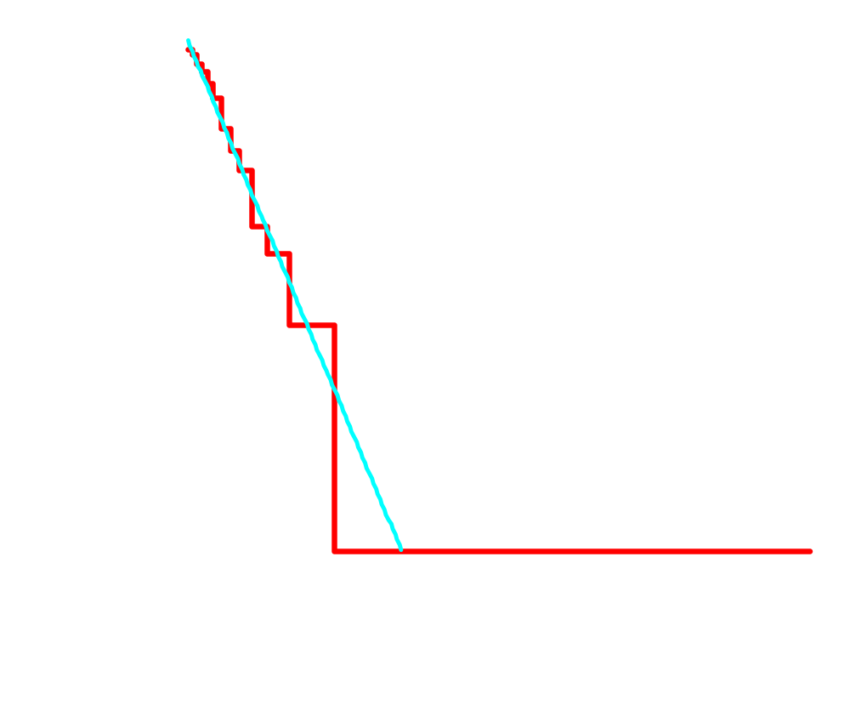
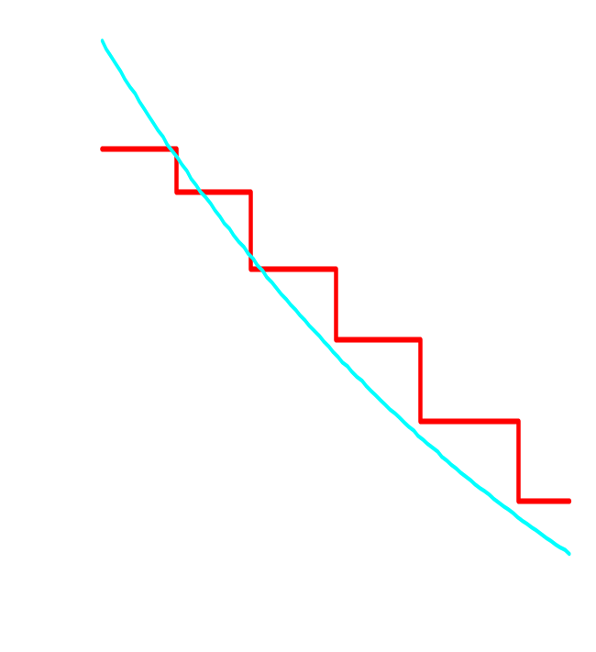
Fail rate of docking
The plot shows the probability of docking algorithm to fail as a function of free energy of dimer dissociation.
The probabilities were calculated using equipopulated bins.
Overall, 38% failures

Slide 29
Why it may fail? Thermodynamics of docking
All docking positions (dimers) are possible, however with different occurrence probabilities in both solvent and in crystal
+
E. Krissinel (2010) J. Comp. Chem. 31, 133-143

Slide 30
Crystal Misrepresentation Hypothesis
perfect docking, imperfect crystals
Docking always finds the highest–energy dimer
But crystallization may capture any dimer with probability P_{i}
Then the probability for docking to fail (that is, to disagree with the crystal) is
E. Krissinel (2010) J. Comp. Chem. 31, 133-143

Slide 31
Why it may fail? Another look
imperfect docking, perfect crystals
crystal always captures the highest-energy dimer
error function
but due to finite accuracy of calculations, another dimer may appear as best docking solution
Math is complicated
E. Krissinel (2010) J. Comp. Chem. 31, 133-143

Slide 32
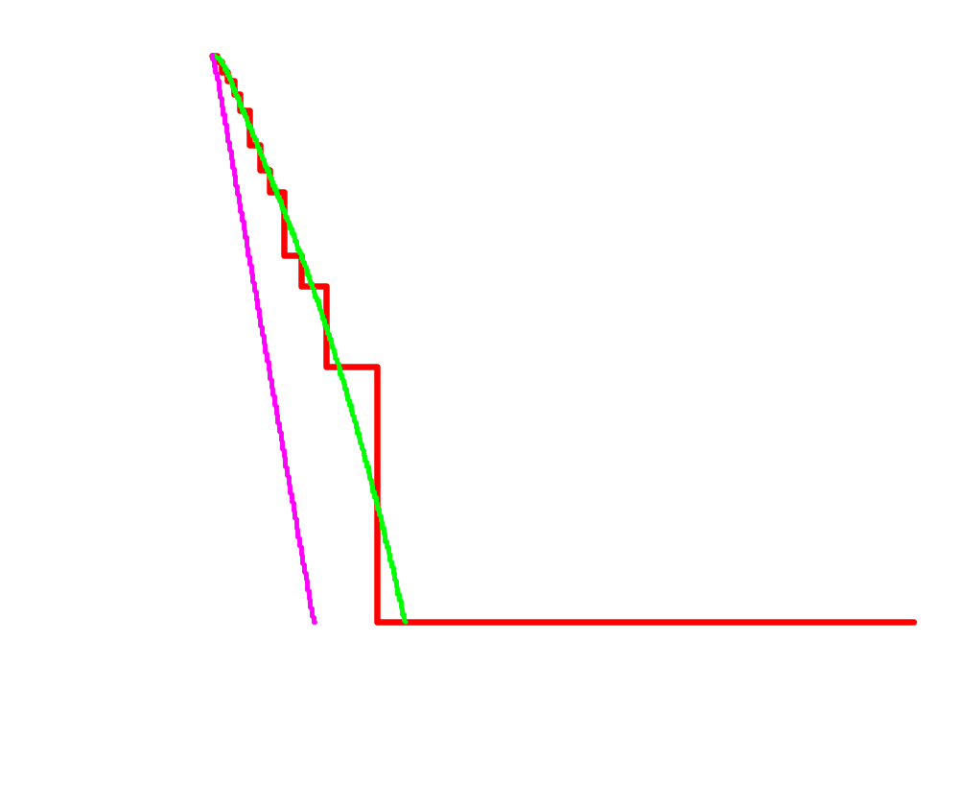
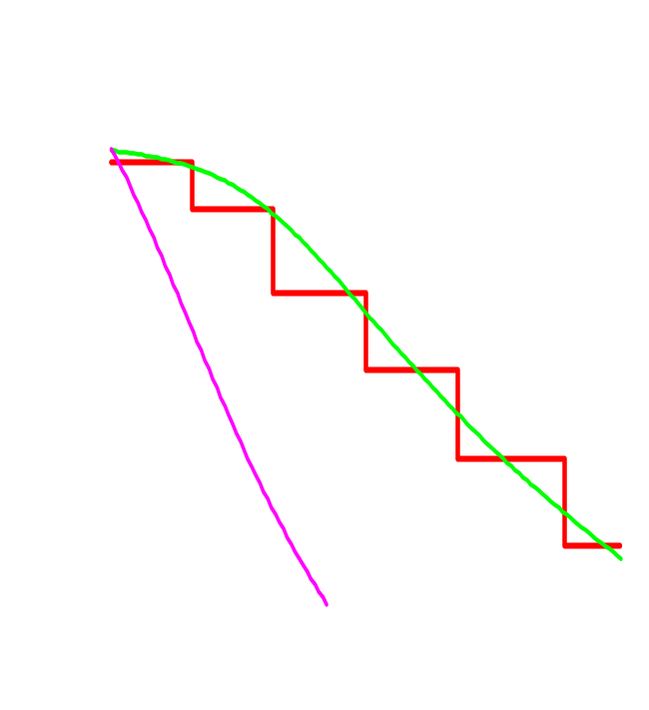
Misrepresentation effects and docking errors
docking results
Effect of both crystal misrepresentation and energy errors (2.3 kcal/mol fitted)
Pure crystal misrepresentation effect (0 kcal/mol error substituted)
E. Krissinel (2010) J. Comp. Chem. 31, 133-143

Slide 33
Conclusions
Chemical-thermodynamical models for protein complex stability allow one to recover biological units from protein crystallography data at 80-90% success rate
Considerable part of misclassifications is due to the difference of experimental and native environments and artificial interactions induced by crystal packing
Crystals are likely to misrepresent weak macromolecular complexes
Protein interface and assembly analysis software (PISA) is available, please use it

Slide 34
Acknowledgements
Kim Henrick
European Bioinformatics Institute
General introduction and PQS expertise
Mark Shenderovich
Structural Bioinformatics Inc.
Helpful discussion
Hannes Ponstingl
Sanger Centre
Sharing the expertise and benchmark data
Sergei Strelkov
University of Leuven
“Mystery” of bacteriophage T4
MSD & PDB teams
EBI & Rutgers
Everyday use of PISA, examples, verification and feedback
CCP4
Daresbury-York-Oxford-Cambridge
Encouragement and publicity
~5000 PISA users
Worldwide
Using PISA and feedback
Biotechnology and Biological Sciences Research Council
(BBSRC) UK
Research grant No. 721/B19544

